Slide 1
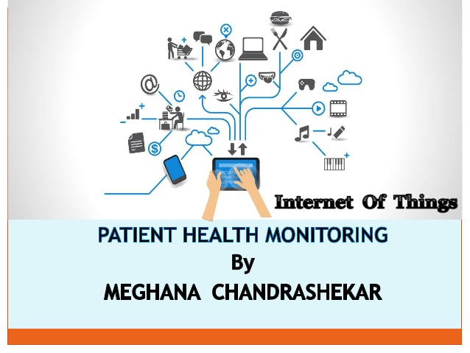
HEALTH MONITORING SYSTEM
By
SHUBHAM SANGANERIA

Slide 2
OBJECTIVE
This project is an attempt to solve a healthcare problem currently society is facing. The main objective of the project was to design a remote healthcare system.
Proper implementation of such systems can provide timely warnings to the medical staffs and doctors and their service can be activated in case of medical emergencies.
Our proposed system uses sensors to measure health parameters like heart rate, humidity and body temperature feeding it to the cloud to monitor the health of a patient even though he/she is at home.

Slide 3
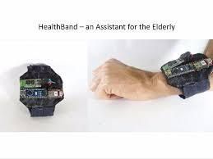
HARDWARE
Arduino Micro-Controller
WIFI Module
Temperature Sensor
Humidity Sensor
Heart Rate Sensor
LCD
I2C Module

Slide 4

SOFTWARE
Arduino Compiler
Language: C, Python
ThingSpeak Cloud

Slide 5
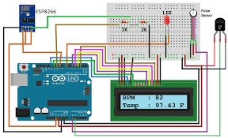
CiRCUIT DIAGRAM

Slide 6
WORKING
The system mainly has two parts:- the receiver and the transmitter.
The receiver is the sensor part of the system which is in the form of a wearable band. It collects the temperature and heart rate of the concerned patient. It even collects the humidity of the environment.
The transmitter portion of my project comprises the lcd which is embedded with the I2C module to ensure speed, accuracy and compactness. It also has the NodeMCU Wifi module which transfers the data collected the cloud server. We have used ThingSpeak for the same.
The Cloud server has the feature of graphically monitoring the data so as to ensure analysis by the experts.

Slide 7
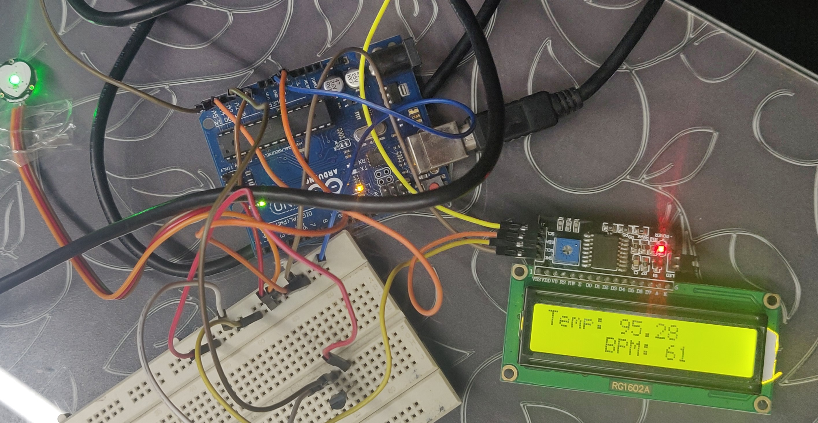
RESULTS

Slide 8
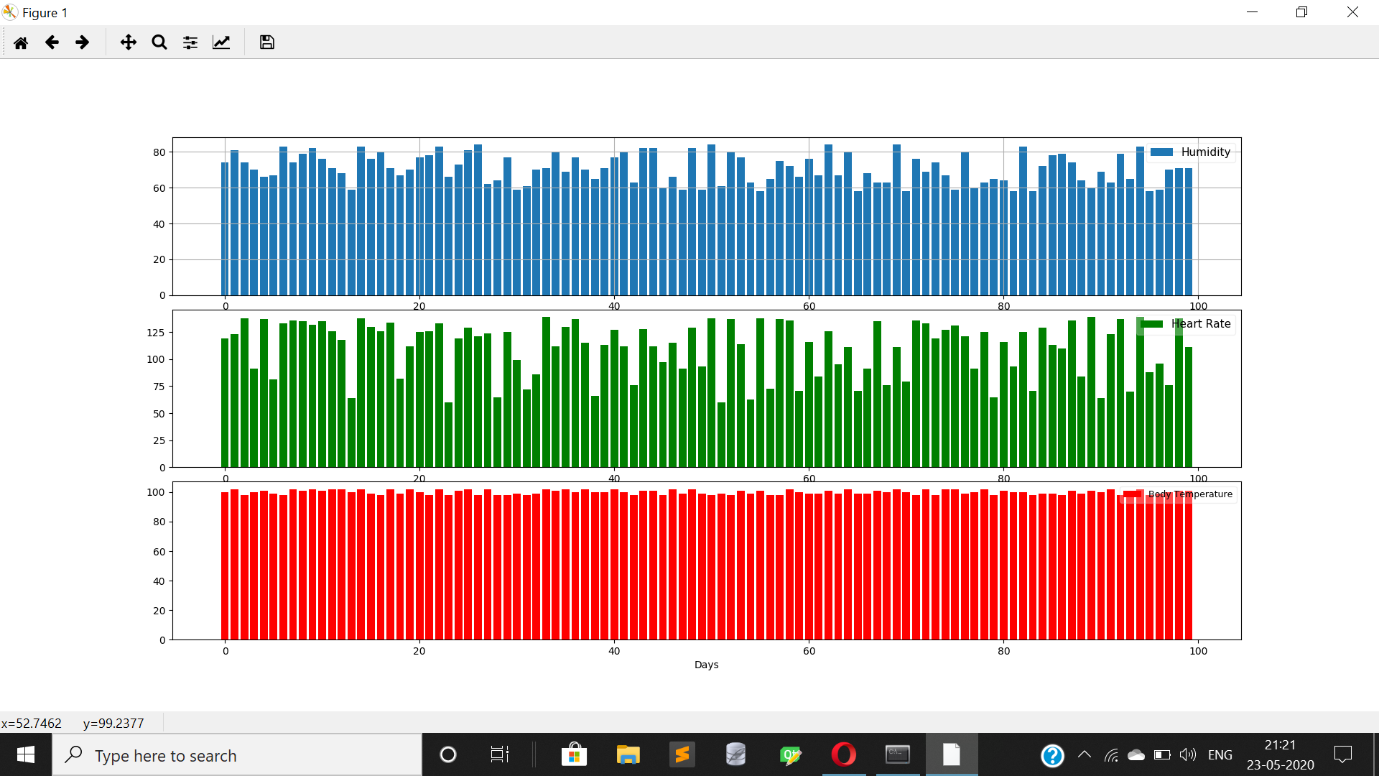
GRAPHICAL ANALYSIS

Slide 9
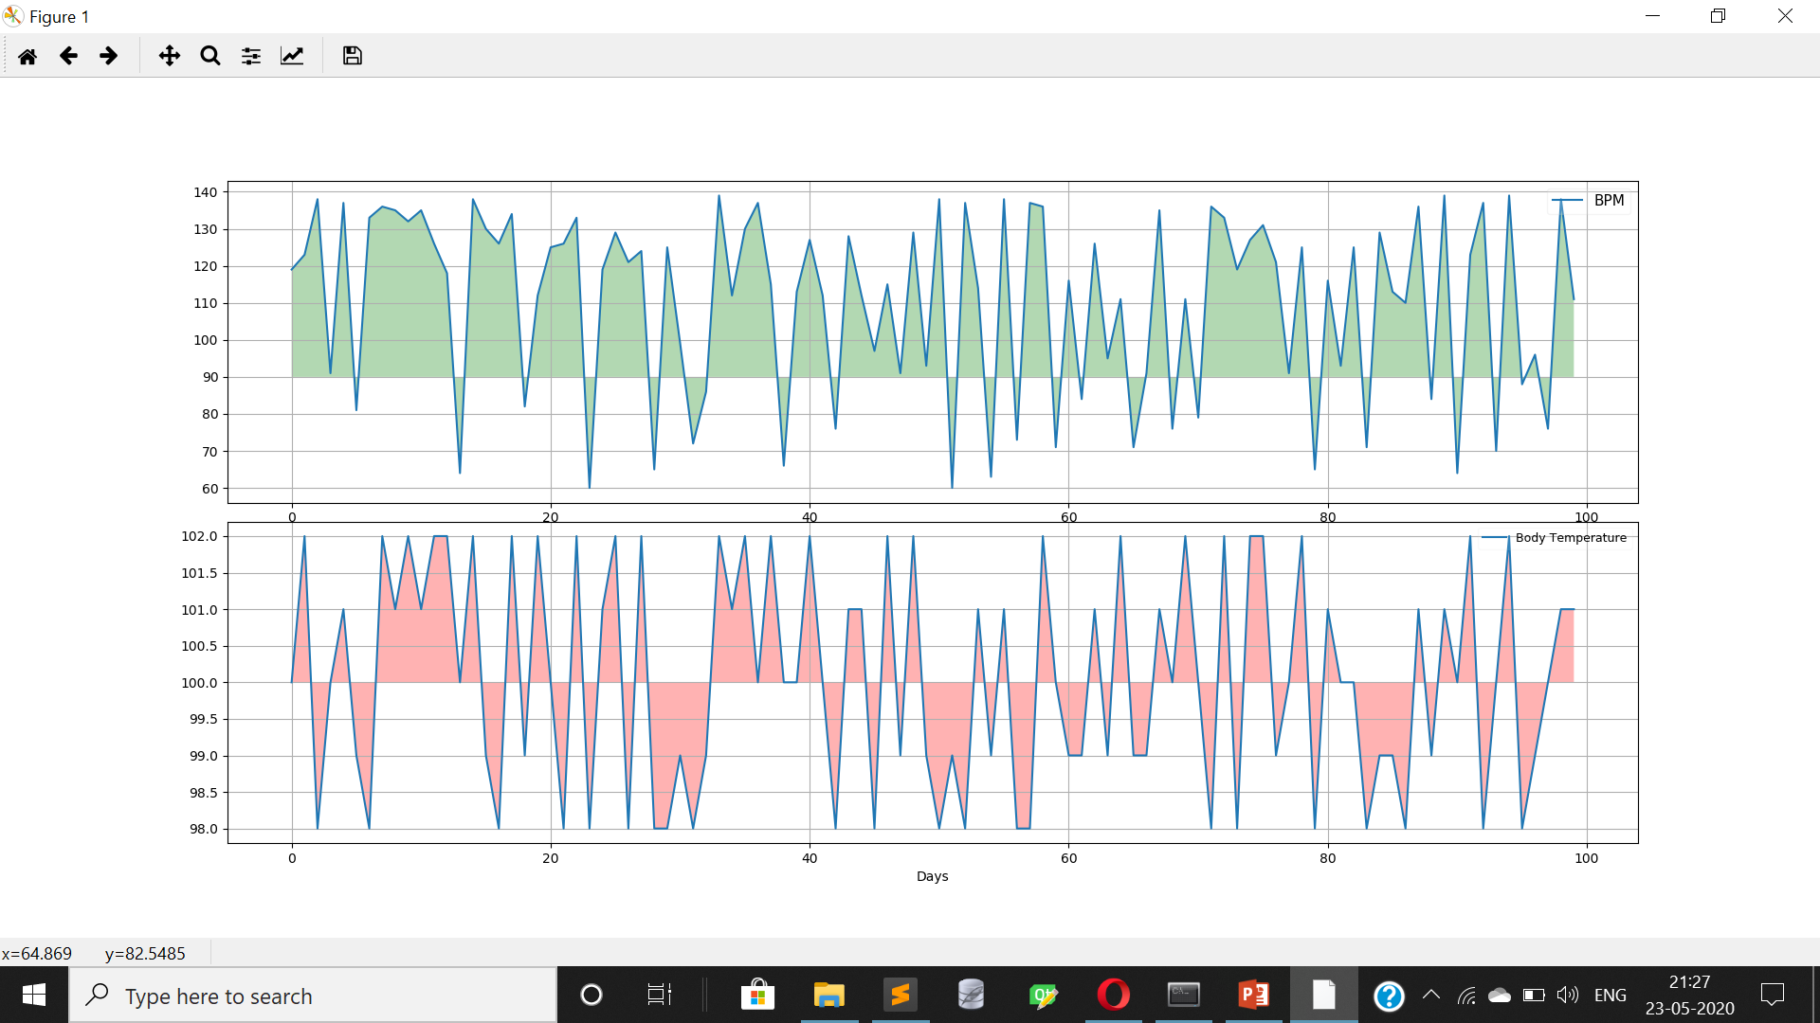
FURTHER ANALYSIS
BODY TEMERATURE VS BPM

Slide 10
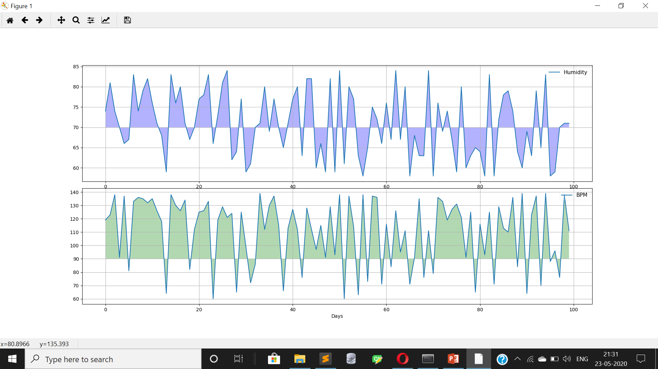
HUMIDITY VS BPM

Slide 11
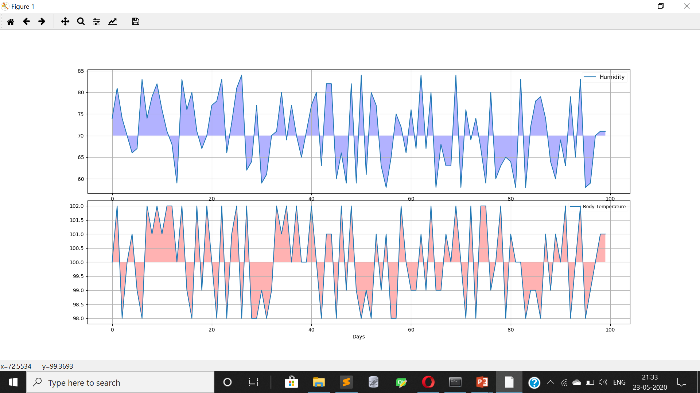
HUMIDITY VS BODY TEMPERATURE

Slide 12
CONCLUSION
From our graphical analysis we came to the conclusion that:
The Body Temperature of a person is directly proportional to his/her Heart beats per minute. Moreover from the data it was observed that if the BPM of a person crosses 100 there are high chances of that person being down with fever.
The Heat Beats per minute(BPM) of a person is also directly proportional to the humidity of the environment. Thus the health professionals suggest taking extra care of health during monsoons wherein the humidity is at its peak. It was observed that the humidity going over 80% can lead to very high BPM.
Even though one feels warm amidst high humidities there was no definite relation between the body temperature and humidity observed from our analysis.

Slide 13
ADVANTAGES OF THE SYSTEM
Bridges the gap between doctor and patient
It is a multipurpose system so that the conditions of the patient is accurately measured.
The compactness of the system ensures diverse uses and better and efficient performance.
Easy to use.

Slide 14
FUTURE SCOPE
Advanced GSM and GPRS technologies can be embedded so as to ensure real time and place evaluation of the patient.
Various other data like blood pressure, retinal size , age and weight of the patient could be collected for a better database and a important step towards proactiveness of the system.
The system could be given a proactive sense by analysing the data using Machine Learning and Artificial Intelligence and thereby predict the chances of the patient falling ill.

Slide 15
ACKNOWLEDGEMENT
I am sincerely grateful to my advisor and mentor Prof Sumita Ghosh of the ECE Dept,IEM Kolkata, for her constant support , significant insights and for generating in me a profound interest for this subject that kept me motivated during the entire duration of this project.
I would also like to express my sincere gratitude to Prof. Dr. Satyajit Chakrabarti (Director,IEM), Prof. Dr. Amlan Kusum Nayak (Principal,IEM) and Prof. Dr Malay Bondhopadhyay HOD of ECE Dept and other faculties of Institute of Engineering & Management, for their assistance and encouragement.

Slide 16
THANK YOU

