Slide 1

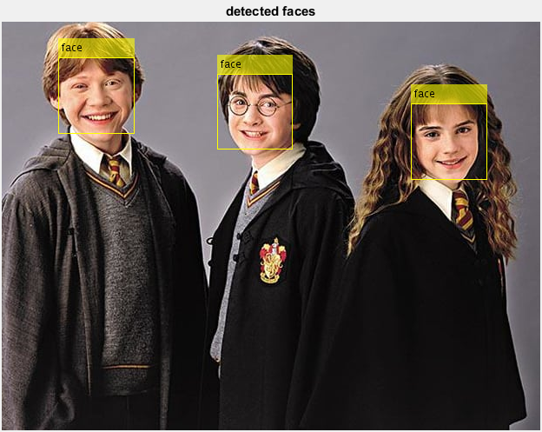
Segmenting Images for
Face Detection
Developed by:-
Shubham Saxena (1510991625)
Shubham Sapra (1510991632)
Shubham Singla (1510991635)
Shubham Thakur (1510991636)

Slide 2
TITLE
Segmenting Images For Face Detection System

Slide 3
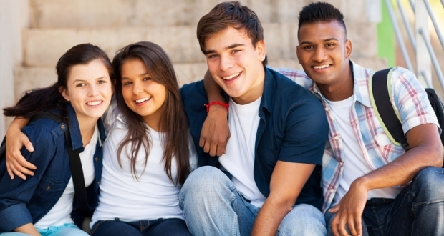
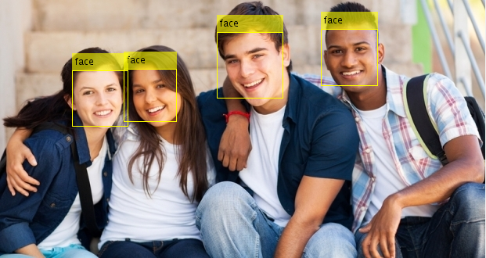
Objectives
The objective of our project is to design software that can detect human faces from an image.

Slide 4
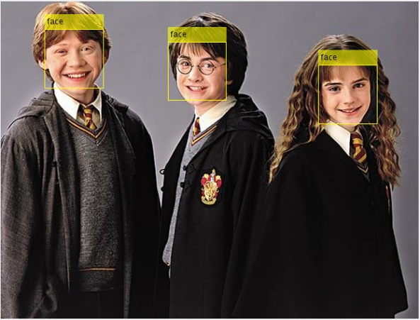
Face Detection is a computer technology being used in a variety of applications that identifies human faces in digital images. Face detection also refers to the psychological process by which humans locate and attend to faces in a visual scene.
What is Face Detection System ?

Slide 5
Applications of face detection :-
Facial recognition
Face detection is used in biometrics, often as a part of (or together with) a facial recognition system.
Photography
Some recent digital cameras use face detection for autofocus. Face detection is also useful for selecting regions of interest in photo slideshows .
Marketing
Face detection is gaining the interest of marketers. A webcam can be integrated into a television and detect any face that walks by. The system then calculates the race, gender, and age range of the face.
Criminal Investigations
Powerful 2D to 3D transformation of video or photo Facial Images. Fast, accurate and analytical comparison of multiple Facial Images for Precise Facial Recognition and Criminal Screening.

Slide 6
Software's that can be used in face detection
Notable software with face detection ability includes:
digiKam
iPhoto
OpenCv
Photoshop Elements
Picasa
MATLAB (Used In Project)

Slide 7
Viola-jones Algorithm The cascade object detector uses the viola-jones algorithm to detect people's faces, noses, eyes, mouth, or upper body. detector = vision.CascadeObjectDetector creates a system object, detector, that detects objects using the viola-jones algorithm. The Classification Model property controls the type of object to detect. By default, the detector is configured to detect faces.

Slide 8
Image segmentation is the process of dividing an image into multiple parts. This is typically used to identify objects or other relevant information in digital images. There are many different ways to perform image segmentation, including: 1. Thresholding methods such as Ostu’s method. 2. Color-based segmentation such as k-means clustering. 3. Transform methods such as watershed segmentation. 4. Texture methods such as texture filters.
What is Image Segmentation ?

Slide 9
In the study of IMAGE segmentation, a watershed is a transformation defined on a grayscale image. The watershed transformation treats the image it operates upon like a topographic map, with the brightness of each point representing its height, and finds the lines that run along the tops of ridges.
Watershed Segmentation

Slide 10
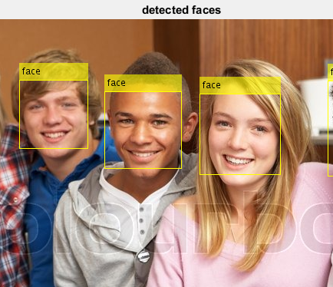
Matlab Coding
Step 1: Detect a Face
Before you begin tracking a face, you need to first detect it. Use the vision.CascadeObjectDetector to detect the location of a face in a video frame. The cascade object detector uses the Viola-Jones detection algorithm and a trained classification model for detection.
a = imread('1.jpg');
a = imresize(a,0.5);
facedetect = vision.CascadeObjectDetector();
facedetect.MergeThreshold = 7;
BBOX = step(facedetect , a );
b = insertObjectAnnotation(a , 'rectangle' , BBOX , 'face');
imshow(b) , title('detected faces');
n = size(BBOX,1);
str_n = num2str(n);
str = strcat('No. of Faces : ',str_n);

Slide 11
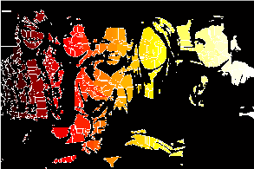
Step 2: Identify Facial Features (segmentation)
Once the face is located in the video, the next step is to identify a feature that will help you track the face. For example, you can use the shape, texture, or color. Choose a feature that is unique to the object and remains invariant even when the object moves.
In this example, you use skin tone as the feature to track. The skin tone provides a good deal of contrast between the face and the background and does not change as the face rotates or moves.
I1 = imtophat(a,strel('disk',25));
level = graythresh(I1);
I2 = im2bw(I1,level);
I3=~I2;
I4=-bwdist(I3);
I4(I3)= -Inf;
I5= watershed(I4);
I6=label2rgb(I5,'hot','w');

Slide 12
1) imtophat Very useful morphological transformation to subtract the background from the image is so called tophat. 2) ~Inf Modify this image so that the background pixels and the extended maxima pixels are forced to be the only local minima in the image
Basic Commands

Slide 13
To adjust the color of the image after processing with imtophat command.
3) imadjust
4) graythresh
To check the level to which the image should be blackened.

Slide 14
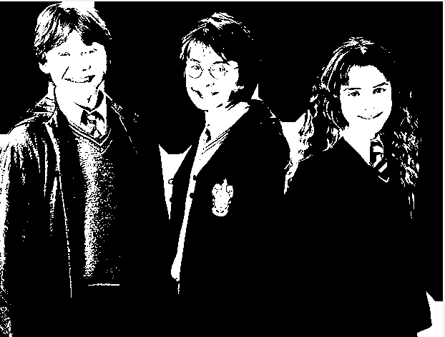
Takes the level as the parameter and converts the image to black white mode
5) im2bw

Slide 15
Reverses the color composition i.e. Sets blackened part of image to white and vice versa.
6) ~BW
7) ~bwdist
Computes the distance transform. The distance of a binary image is the distance from every pixel to nearest nonzero valued pixel.

Slide 16
Water is fallen from the minima points until two flooded regions from separate catchment merge, after this a one pixel thick dam is constructed.
8) Watershed
9) lable2rgb
Converts the image back to rgb color according to the parameter provided.

Slide 17

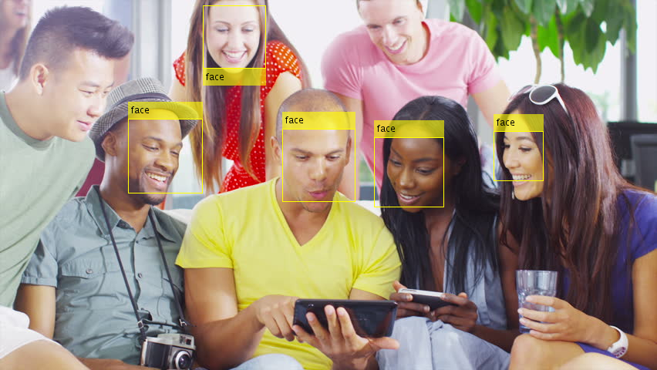
Limitations :-
It can’t detect faces without frontal view and upright orientation

Slide 18
Conclusion
We have presented a face detector with a reasonably good accuracy and running time.
However, many aspects of the design are tuned for the constrained scene conditions of the training images provided, hurting its robustness. This is not unfair given the scope and requirements of the project.
Our algorithm is sensitive to the color information in the image and will not work for a gray scale image.

Slide 19
Future Plan
Design an intelligence system that can analyse objects.
Make them enable to see and feel like us.
Remove all its limitations and eager to develop this software.
Enable them to suggest us to make the best use of objects.
Empower media and security services.

Slide 20
Thanks all

