Slide 1
Web Blogging Application
By Shubham and vivek

Slide 2
Content
Introduction to Web blogging application
Implementation
Introduction to MEAN stack
MongoDB
Express
AngularJS
NodeJS
Features of Web blogging application
Future scope
Conclusion

Slide 3
Introduction to Web blogging application
Web Application is used to manage all the blogs, comments and all other basic information about the blog.
User will be able to see the blogs posted by other users.
The user can edit their own blogs as per their requirements.
The aim is to make adding, updating and removing the posts as efficient as possible as to improve the resource management of the blogs data.

Slide 4
Implementation
This web application will be designed using HTML, CSS, JavaScript, AngularJS, mongo dB, NodeJS, and Express.
The frontend part of the project will be done by HTML, CSS, JavaScript and the backend part will be done by NodeJS.
All the data will be stored in mongoDB.

Slide 5
Introduction to MEAN stack
MEAN is a full-stack development toolkit used to develop a fast and robust web applications.
MEAN is a user-friendly stack which is the ideal solution for building dynamic websites and applications.
MEAN is comprised of four different technologies:
⦁ MongoDB
⦁ Express JS
⦁ AngularJS
⦁ Node.js

Slide 6
MongoDB
⦁ MongoDB express is a schema less NoSQL database system
There are no tables in MongoDB.
All the data is stored in JSON format i.e. key-value pairs. In JSON, we define a unique key with a value associated with it
We store anything like, string, integer, boolean, double, binary data, object, array, javascript code and many more.

Slide 7
Express
Express JS is a framework used to build web applications in Node
This framework provides a robust set of features for web and mobile applications.
With a myriad of HTTP utility methods and middleware at your disposal, creating a robust API is quick and easy.
Express provides a thin layer of fundamental web application features, without obscuring Node.js features that you know and love.
Many popular frameworks are based on Express.

Slide 8
AngularJS
⦁ AngularJS is a JavaScript framework developed by Google
Angular is a platform and framework for building single-page client applications using HTML and TypeScript.
Angular is written in TypeScript.
It implements core and optional functionality as a set of TypeScript libraries that you import into your apps.

Slide 9
NodeJS
⦁ Node.js is a server-side JavaScript execution environment
As an asynchronous event-driven JavaScript runtime.
It is designed to build scalable network applications.

Slide 10
Features of Web blogging application
Product and Component based
Creating & Changing Issues at ease
Creating user Account
Login-Logout feature for each user so they can save their work
Robust database back-end
Flexible
Accuracy in work.
Easy & speedy retrieval of information.
Well-designed blogs.
Good looking UI

Slide 11
Future scope
It can be summarized that the future scope of the project circles around maintaining information regarding:
1) Implement the backup mechanism for taking backup.
2) Automatic detection of errors like grammar.
3) Automatic notification to followers after posting blog
4) Adding AI feature to auto correct grammar mistakes

Slide 12
Conclusion
This project's only a major goal is to venture to satisfy the need to manage their project work. With the help of MEAN stack that we have used to make it possible for the user.
The objective of software is to show that the framework is capable of making the user satisfying their needs, fast and reliable.
This will prove to be a powerful web application satisfying all the requirements of the users.

Slide 13
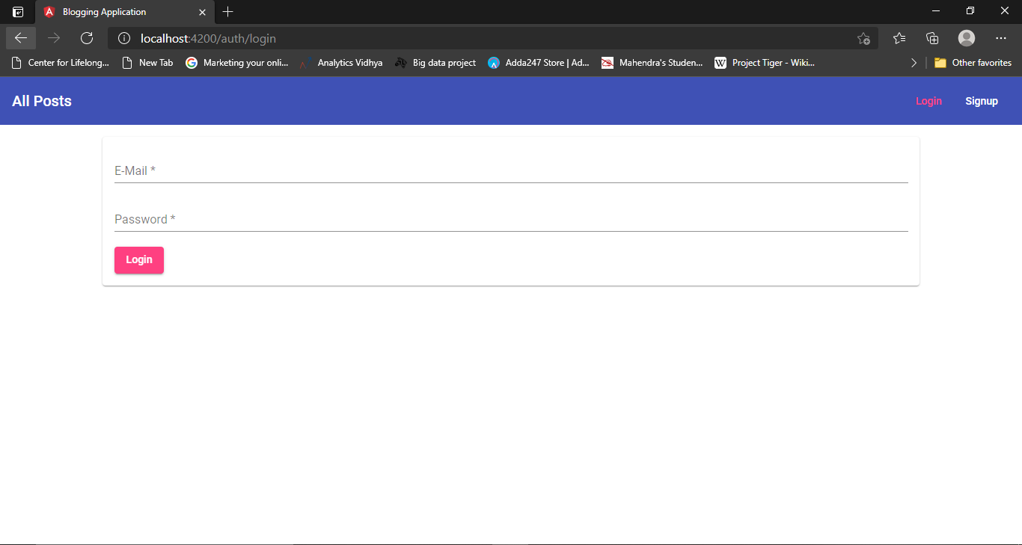
UI Screenshots

Slide 14
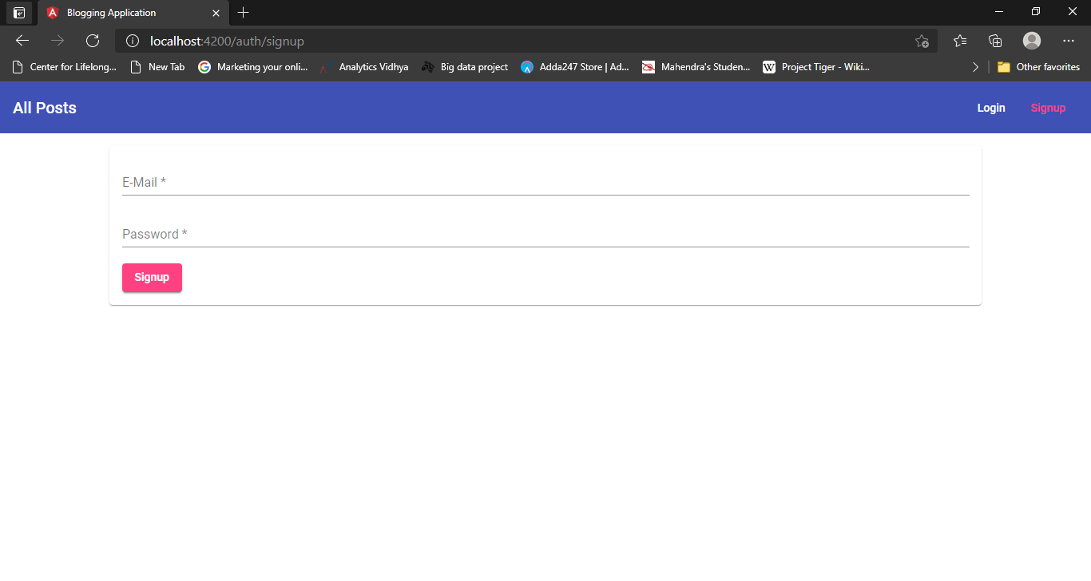

Slide 15
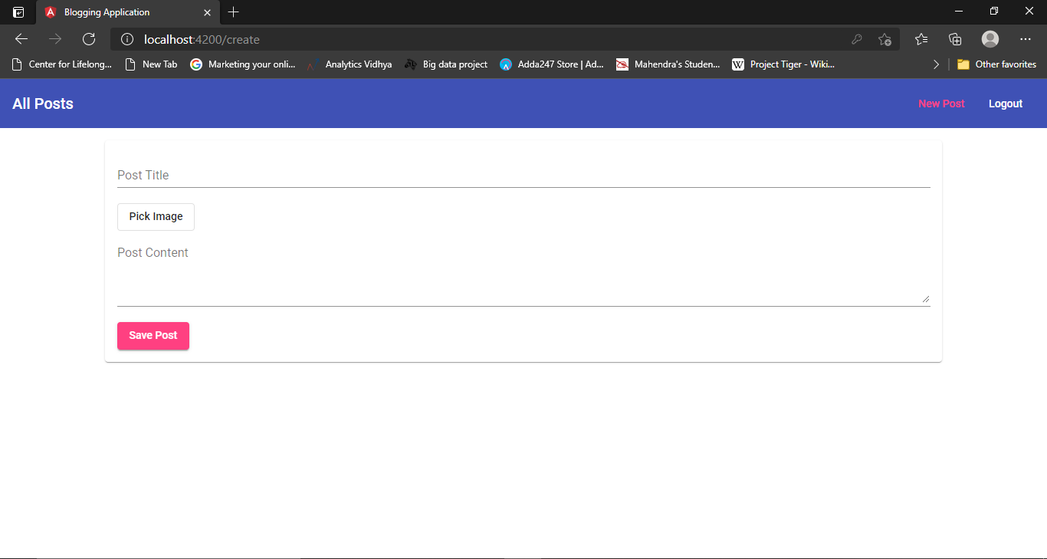

Slide 16
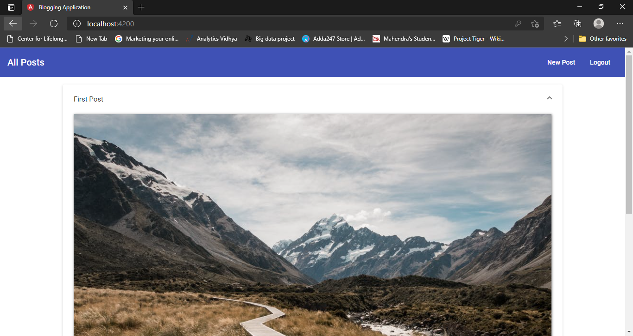

Slide 17
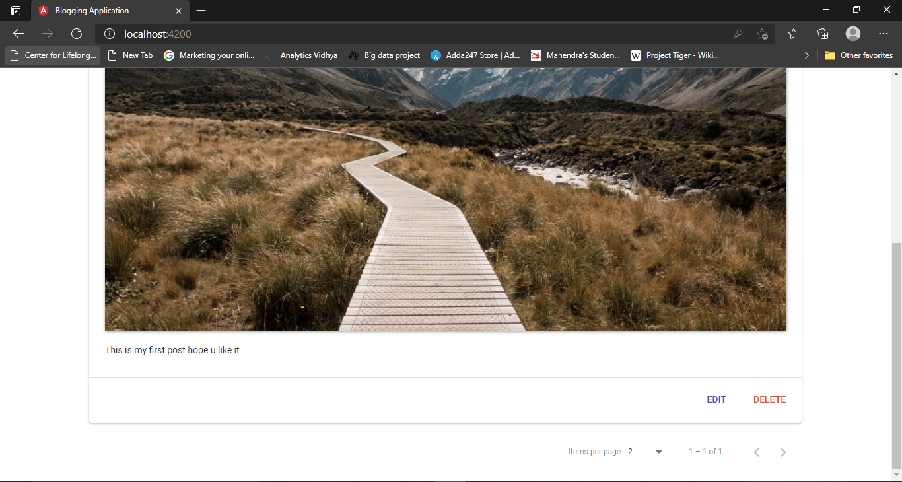

Slide 18
THANK YOU!

