Slide 1
MERN Internship Projects
These projects were built during my 3-month internship in MERN stack web development at Unified Mentor.

Slide 2
Project 1: Basic Calculator
Objective:
The project aims to develop a simple and interactive calculator using the MERN (MongoDB, Express.js, React, Node.js) stack. This calculator will perform basic arithmetic operations like addition, subtraction, multiplication, and division, providing a clean and responsive user interface.

Slide 3
Project 1: Key Features
1. **Basic Arithmetic Operations:** Perform addition, subtraction, multiplication, division, and reset calculations.
2. **Interactive User Interface:** A user-friendly calculator interface built using React with intuitive button layouts.
3. **State Management:** Efficient state handling for the inputs, current operation, and result using React hooks like useState.
4. **Database Integration:** Store a history of calculations in MongoDB for retrieval or review later.
5. **Responsive Design:** Ensures usability across devices (desktop, tablet, and mobile).

Slide 4
Project 1: Technologies Used
Frontend:
- React.js for building the UI.
Backend:
- Node.js and Express.js to handle potential API requests for history or future enhancements.
Database:
- MongoDB to store and fetch calculation history.

Slide 5
Project 1: Project Structure
Frontend:
- React components for display, input, and button handling.
Backend:
- Node.js server with optional routes for storing or retrieving data.
Database:
- MongoDB collection to store calculation history.

Slide 6
Project 1: My Learnings
1. **React:** Gained hands-on experience with component-based UI development and state management.
2. **API Integration:** Learned how to integrate frontend with backend for data exchange.
3. **Responsive Design:** Understood best practices for making interfaces user-friendly across various devices.
4. **MERN Stack Workflow:** Developed an end-to-end project using MongoDB, Express, React, and Node.js.

Slide 7
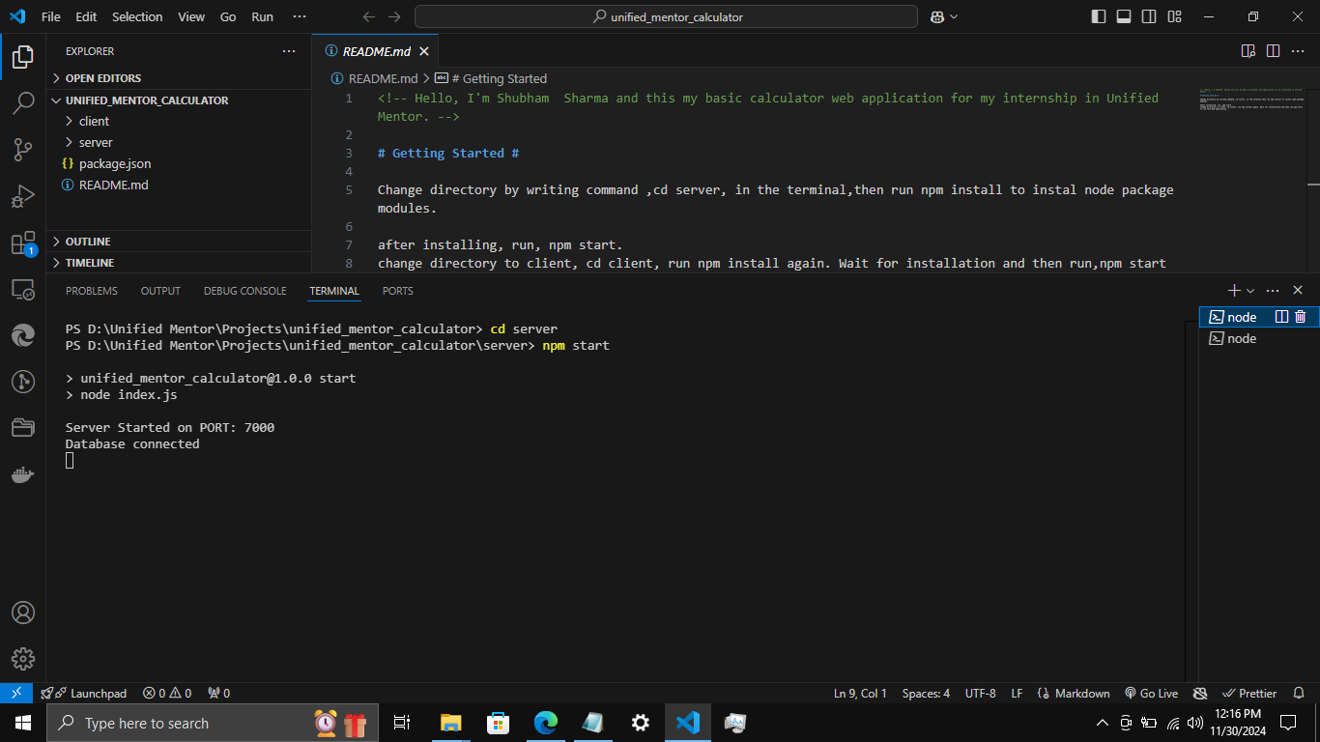
Project 1: Backend

Slide 8
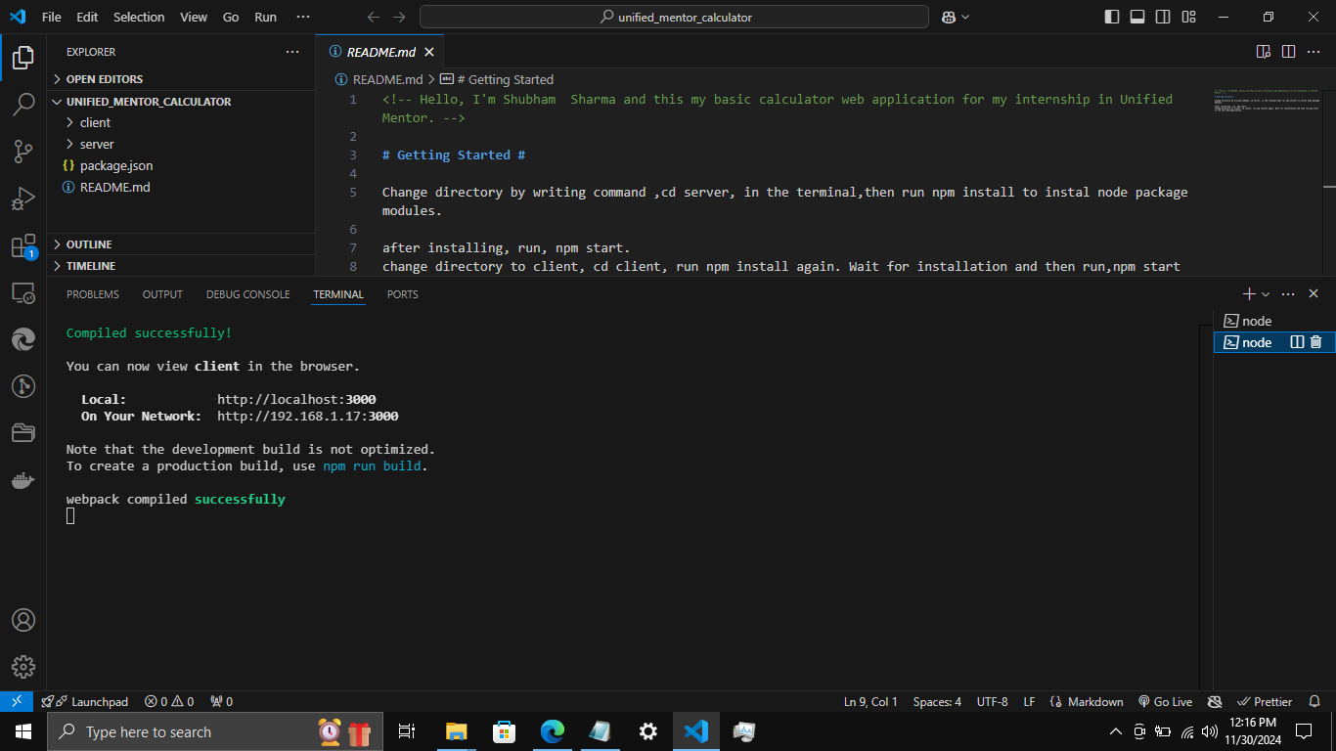
Project 1: Frontend

Slide 9
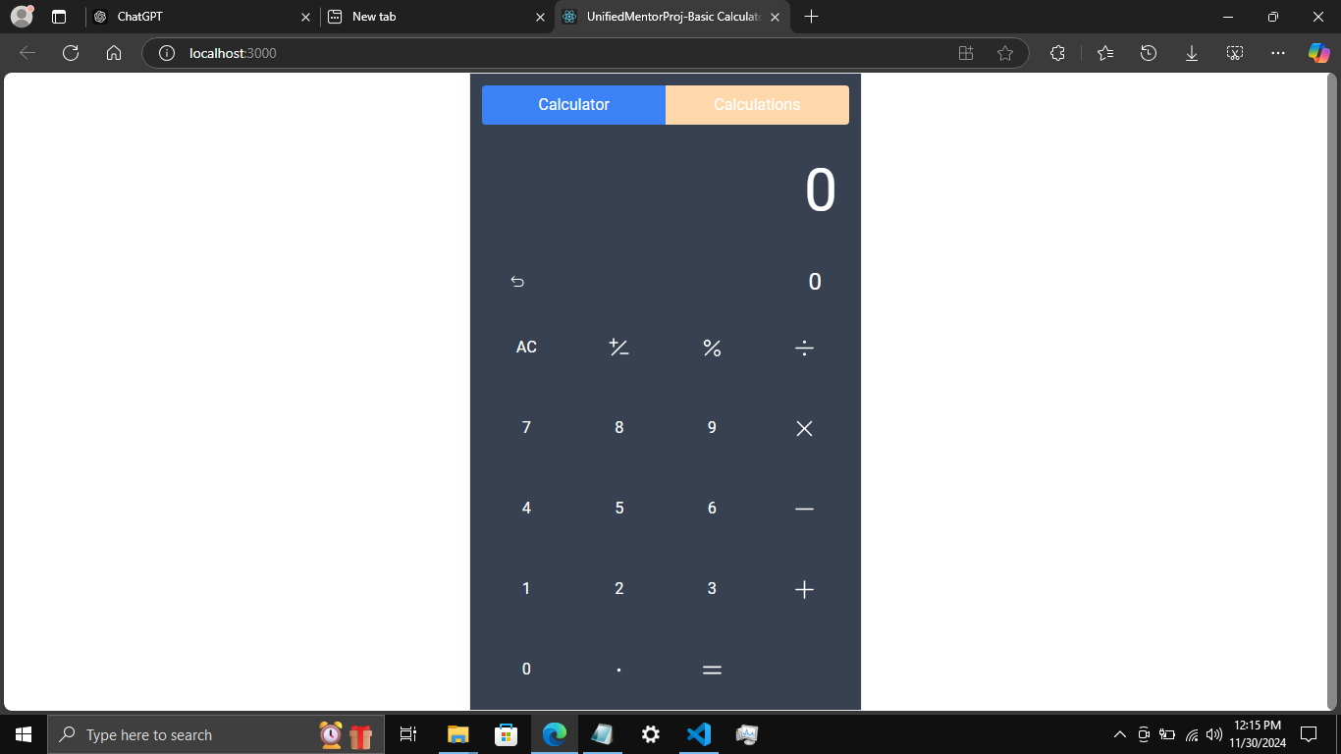
Project 1: Main Layout

Slide 10
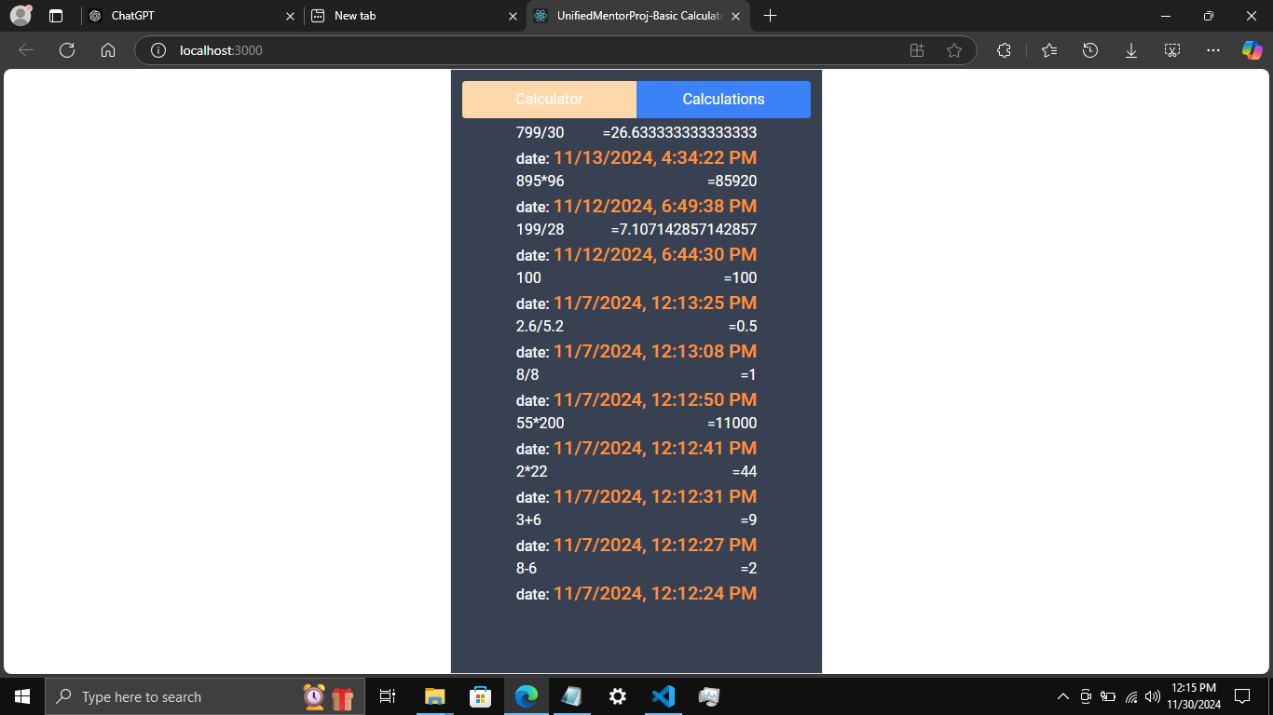
Project 1: Calculations History

Slide 11
Project 2

Slide 12
Soil Farming Agent
A MERN Stack Full-Stack Application

Slide 13
Overview
The Soil Farming Agent is a web-based platform designed to connect soil distributors and users, enabling users to shop for crops based on the type of soil available in their backyard or locality. The platform provides insights into suitable crops for various soil types, streamlining the process of crop selection and purchasing.

Slide 14
Key Features
1. Soil-Crop Mapping:
- Users can input their soil type to get a list of crops best suited for their soil.
2. Soil Distributors Marketplace:
- A directory for soil distributors where users can find and purchase soil and related products.
3. User-Friendly Shopping Experience:
- Smooth navigation and intuitive product filtering options.
4. Dynamic CRUD Operations:
- Add, update, delete, and fetch data seamlessly using APIs.
5. Responsive Design:
- Accessible on desktops, tablets, and mobile devices.
6. Data Fetching and Management:
- Axios for efficient API requests and responses.

Slide 15
Technologies Used
Frontend:
- React: To build a dynamic and responsive user interface.
- Bootstrap: For styling and layout.
Backend:
- Node.js: For server-side logic.
- Express.js: To create and manage RESTful APIs.
Database:
- MongoDB: To store soil types, crop data, user profiles, and distributor information.
API Integration:
- CRUD APIs for database interaction.
- Axios for fetching and sending data between the client and server.

Slide 16
Learning Outcomes
1. MERN Stack Development:
- Hands-on experience with the complete MERN stack to build a full-stack application.
2. Data Mapping:
- Learning to link soil types with corresponding crops dynamically.
3. API Development and Integration:
- Building and consuming APIs with CRUD functionalities using Axios.
4. Responsive Design Skills:
- Developing layouts that adapt to various devices and screen sizes.
5. Database Design:
- Structuring MongoDB collections for soil, crops, and user data effectively.

Slide 17
Potential Future Enhancements
1. Soil Testing Integration:
- Add a feature where users can upload soil reports to get recommendations.
2. AI-Based Crop Suggestions:
- Integrate AI to suggest crops based on soil quality and regional climate data.
3. Distributor Reviews and Ratings:
- Allow users to rate and review soil distributors for better transparency.
4. Add To Cart:
- This functionality enable users to add items to a cart.

Slide 18
Conclusion
This project bridges the gap between soil distributors and users, promoting efficient farming and gardening practices while offering valuable experience in full-stack web development.

Slide 19
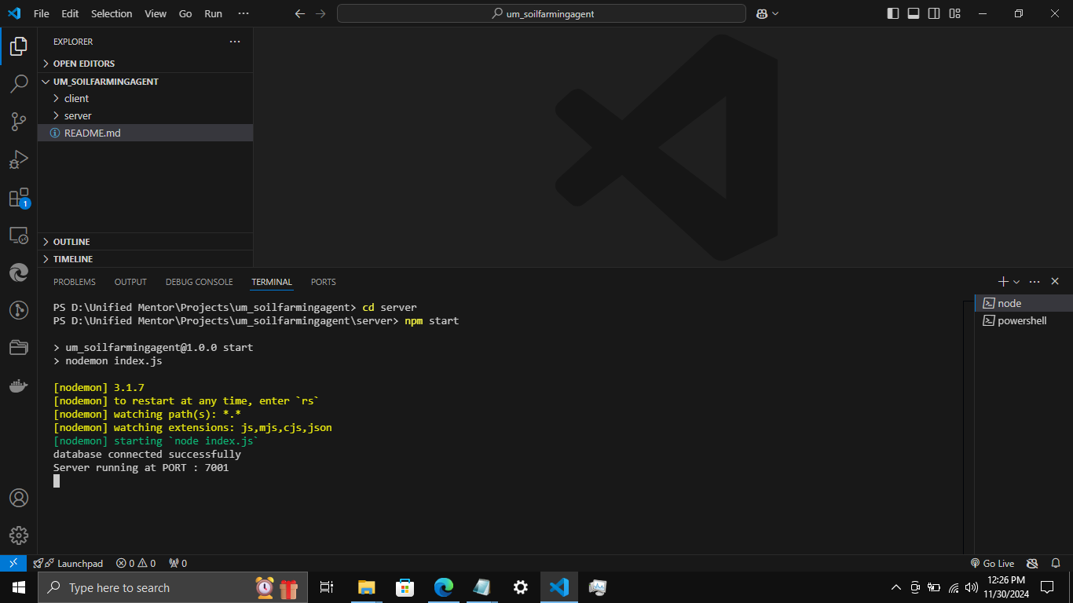
Project 2: Backend started and Database Connected

Slide 20
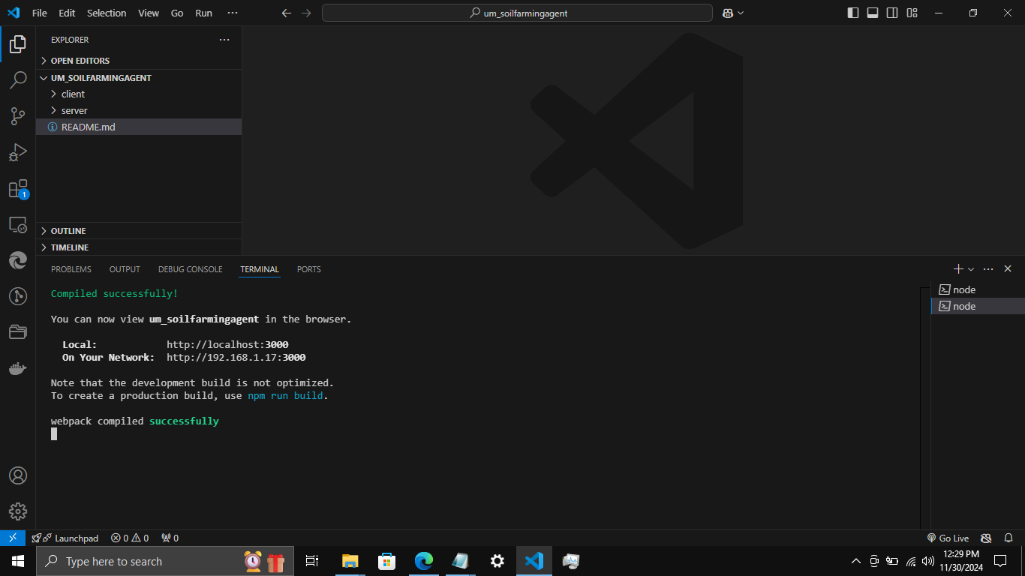
Project 2: Frontend Compiled successfully

Slide 21
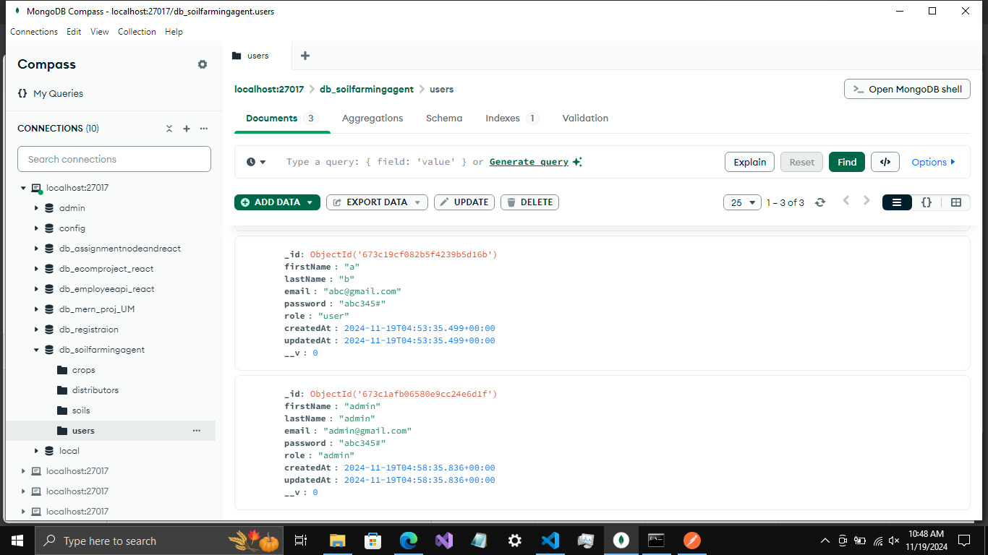
Project 2: User and Admin Created and saved successfully

Slide 22
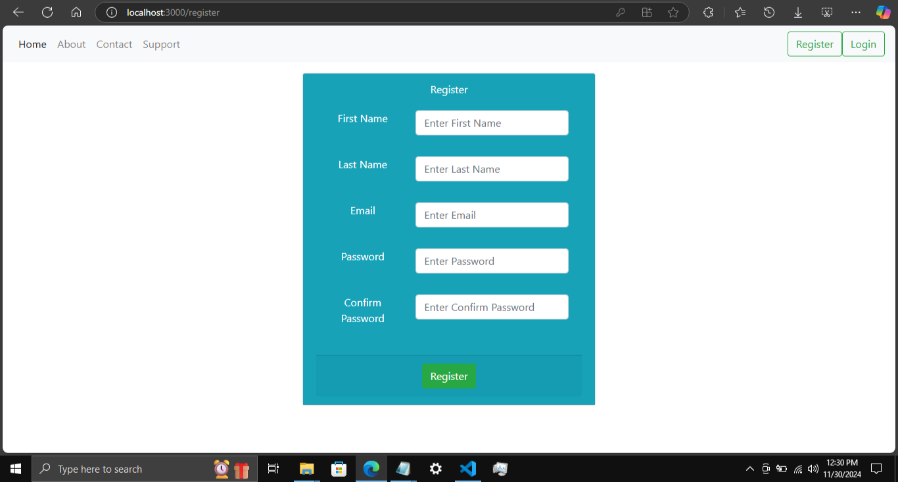
Project 2: Register Page

Slide 23
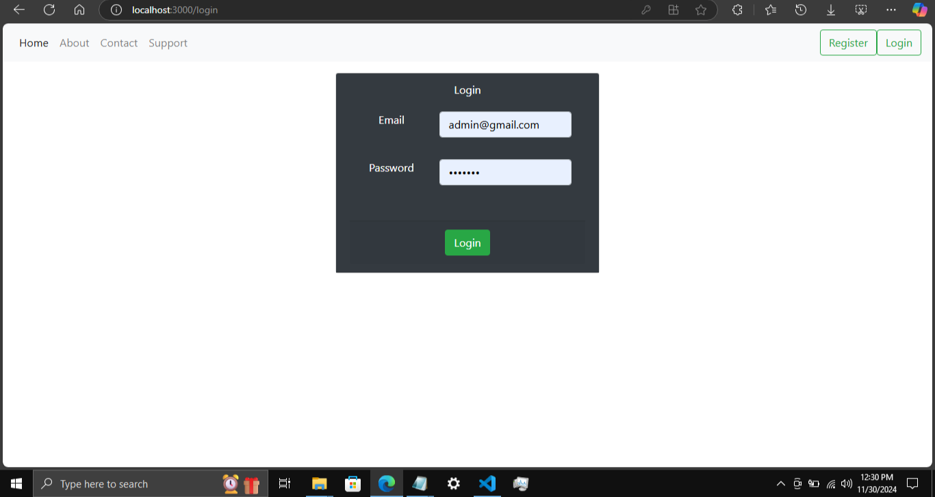
Project 2: Login Page

Slide 24
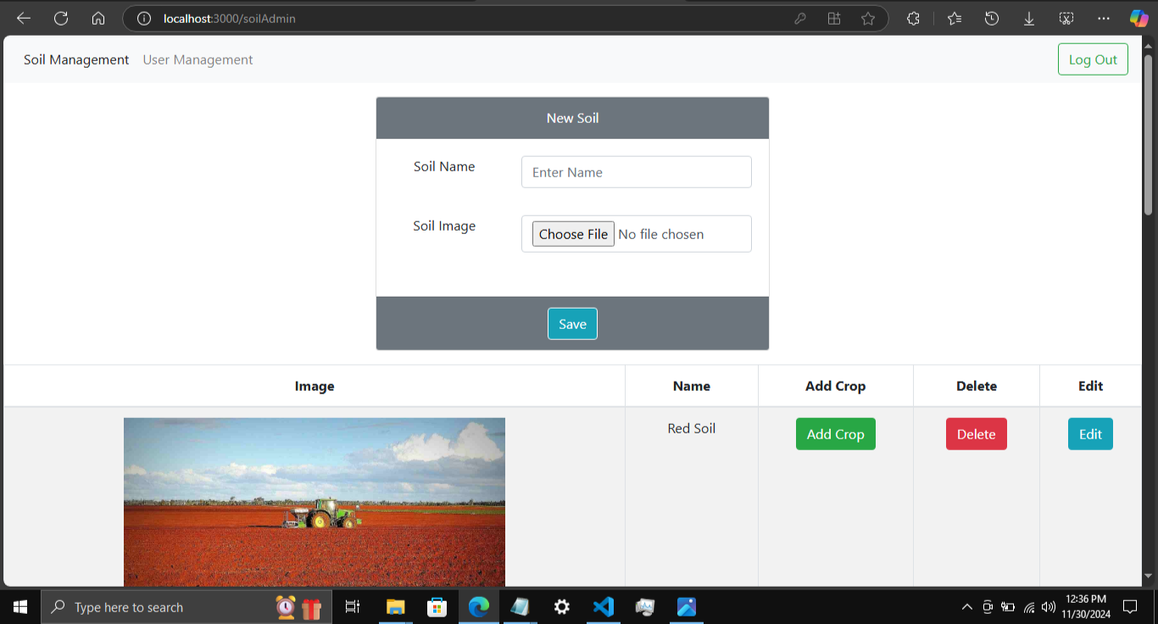
Project 2: Admin Home Page

Slide 25
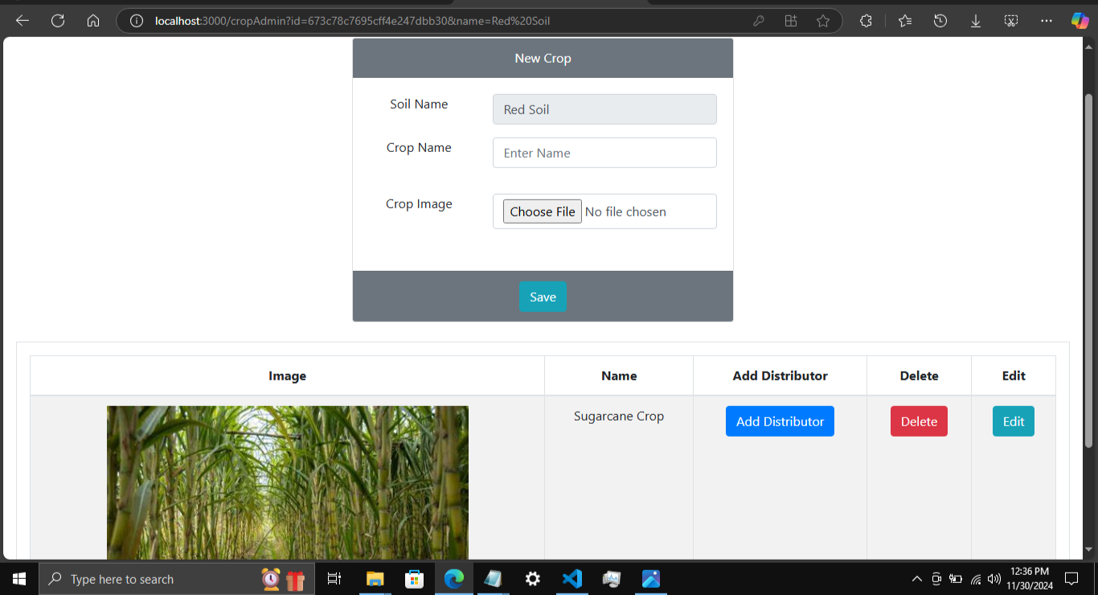
Project 2: Admin Crop

Slide 26
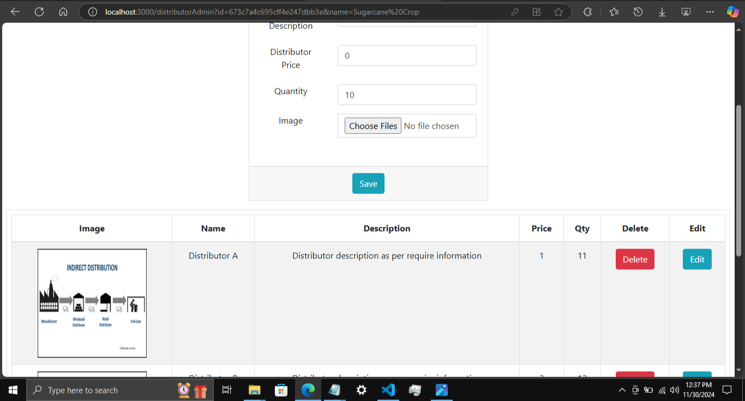
Project 2: Admin Distributor

Slide 27
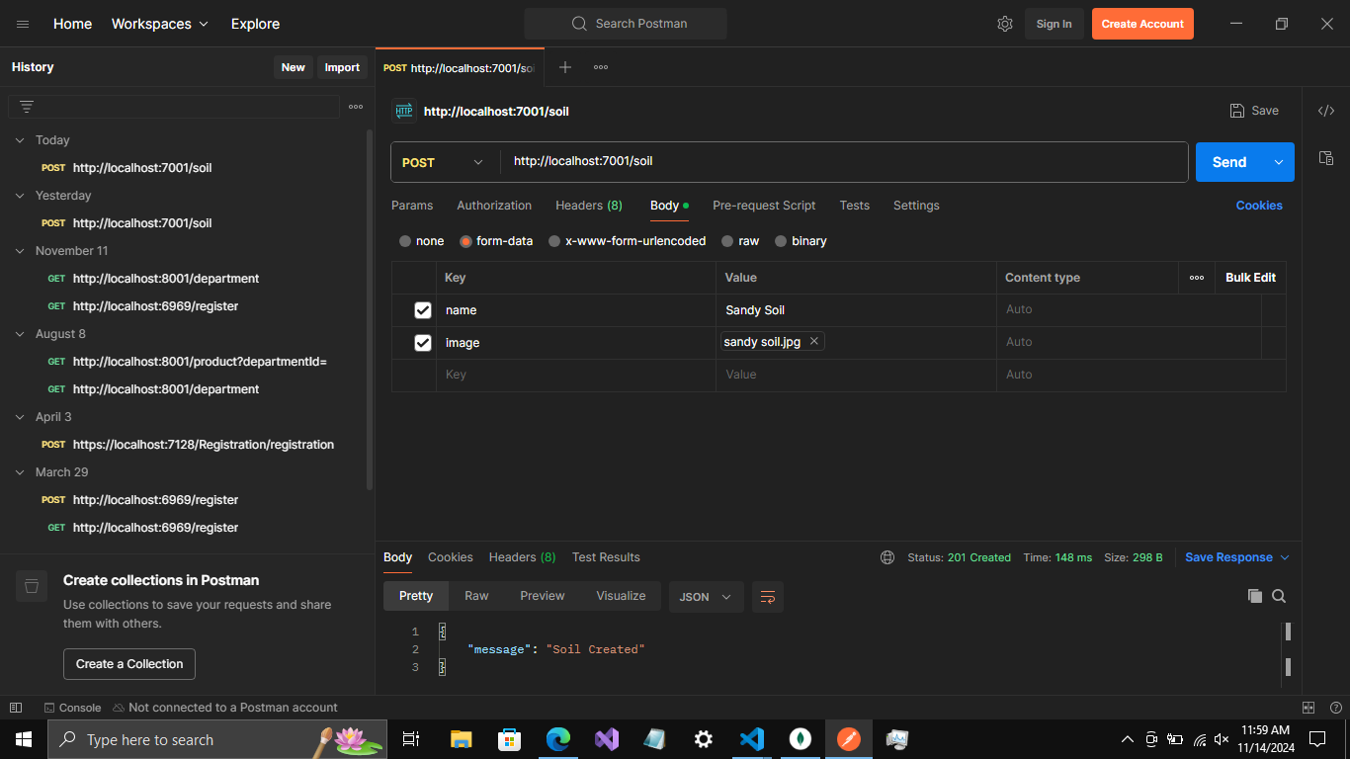
Project 2: Postman API POST

Slide 28
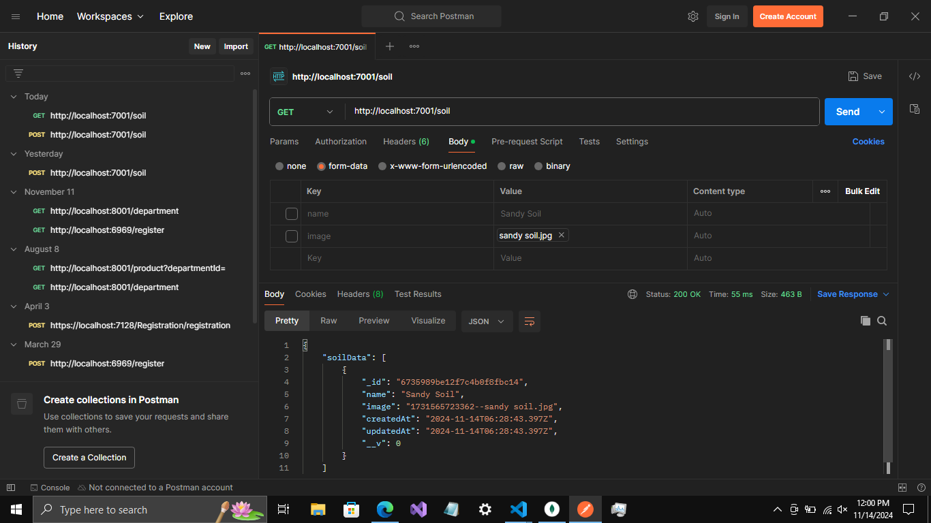
Project 2: Postman API GET request Http method

Slide 29
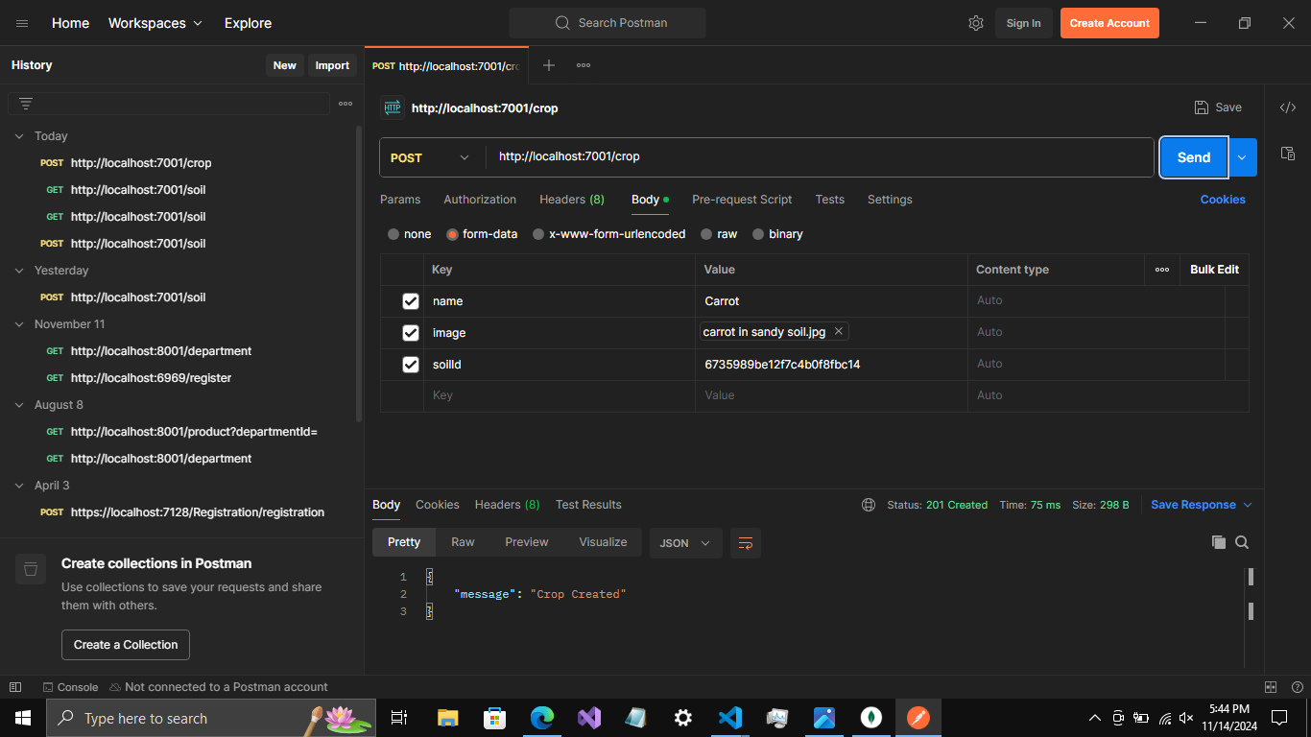
Project 2: Postman Crop Created

Slide 30
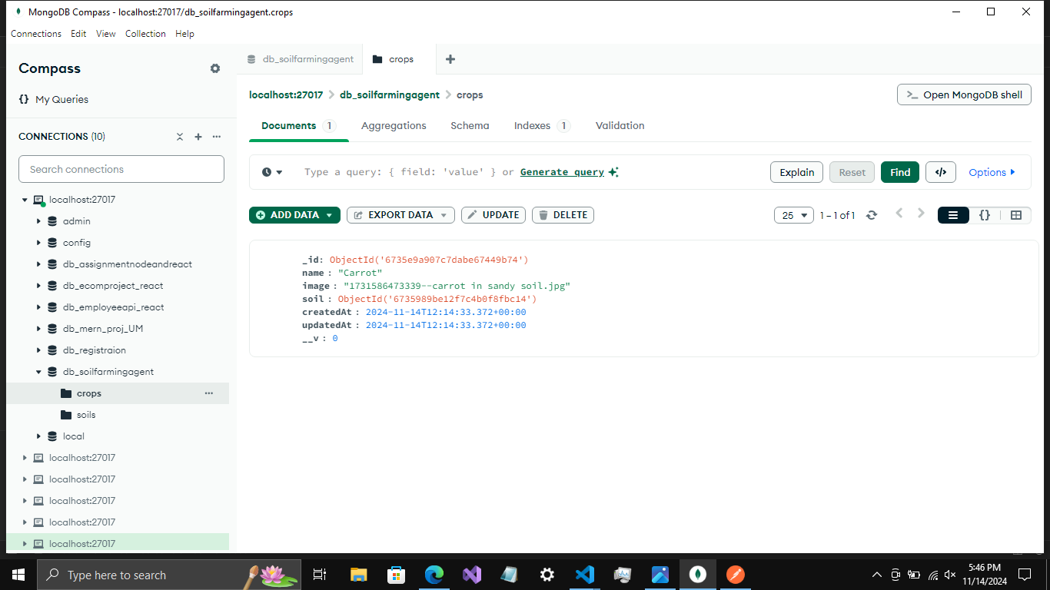
Project 2: Crop data saved successfully on MongoDB

Slide 31
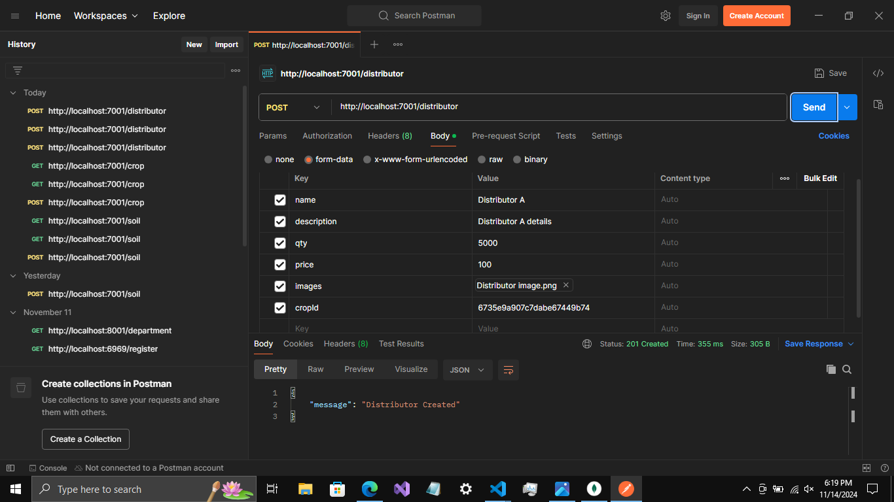
Project 2: Postman Department created through API

Slide 32
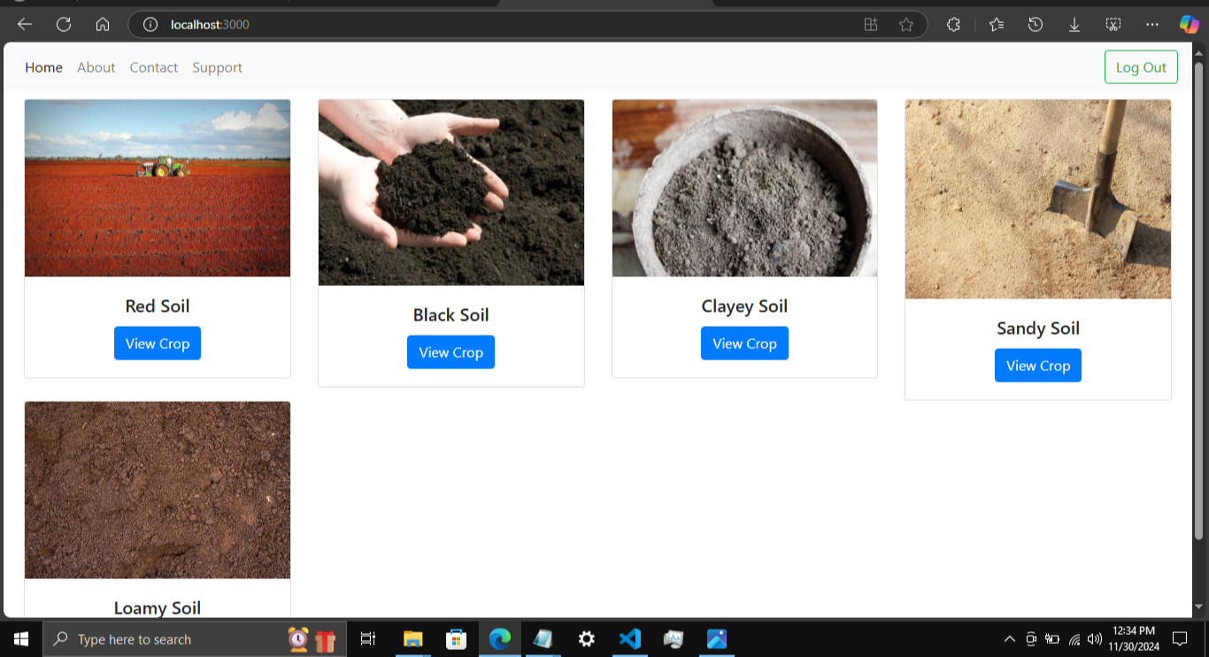
Project 2: User Home Page

Slide 33
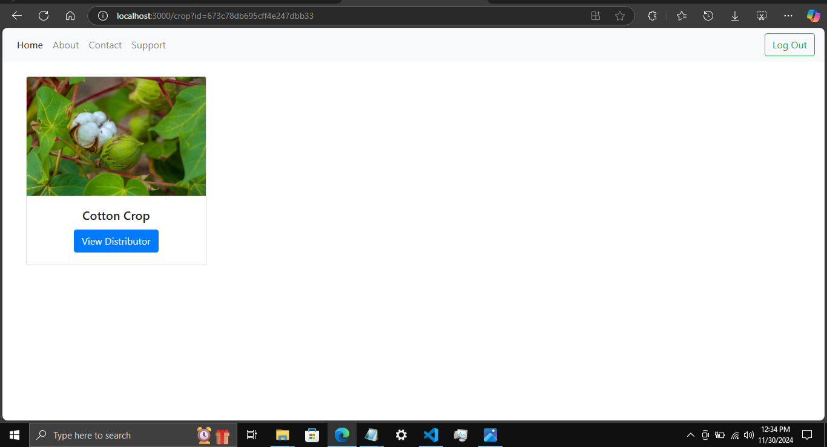
Project 2: User View Crops

Slide 34
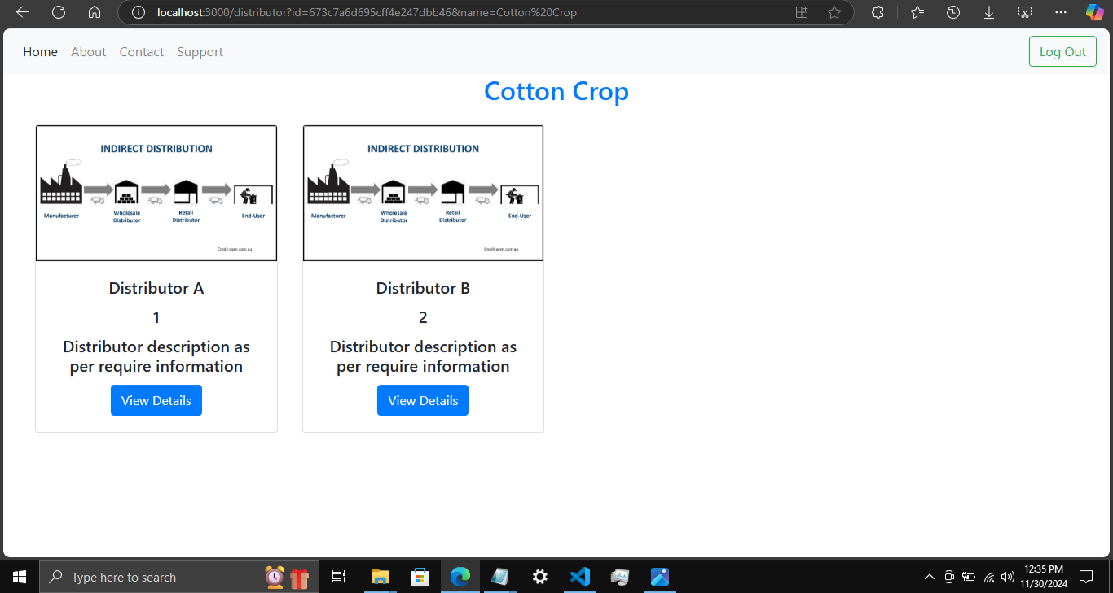
Project 2: User View Distributors

Slide 35
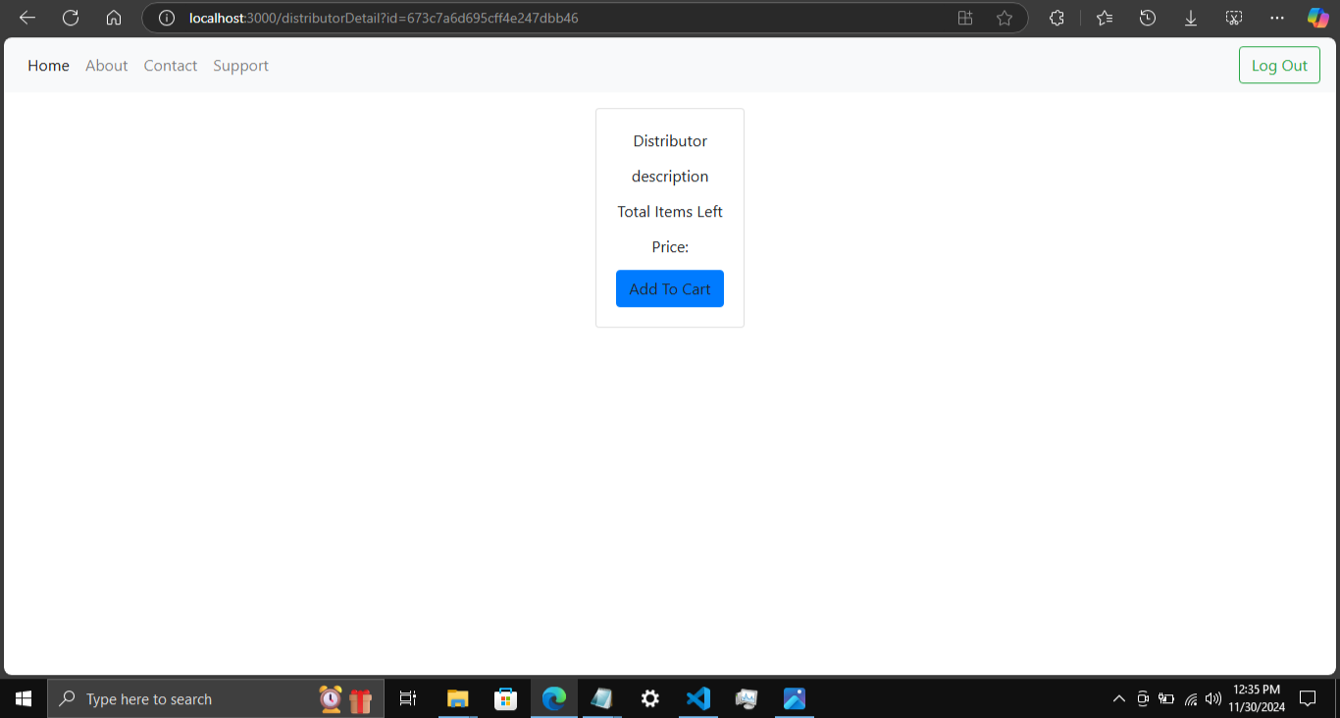
Project 2: Upcoming functionality, user View Distributor Details and Add to cart

Slide 36
Project 3

Slide 37
Teacher-Student Booking Platform
A Full-Stack Web Application for Streamlined Scheduling

Slide 38
Objective
The Teacher-Student Booking Platform is a web application designed to streamline the process of scheduling appointments between teachers and students. This platform allows both parties to register, log in, view, and manage their booking schedules efficiently. Teachers and students can send and respond to booking requests, making the process of organizing meetings seamless and transparent.

Slide 39
Key Features
1. User Authentication: Secure registration and login.
2. Booking Requests: Send, accept, or reject requests.
3. Personalized Dashboards: View upcoming bookings and appointments.
4. Dynamic Scheduling: Calendar integration.
5. Responsive Design: Accessible across devices.

Slide 40
Technologies Used
Frontend:
- React: Interactive UI
- Bootstrap & Material UI: Responsive and styled components
Backend:
- Node.js: Server-side logic
Express.js: RESTful APIs
Database:
- MongoDB: Storing user , booking, and schedule data

Slide 41
Workflow
1. Registration & Login: Secure user accounts.
2. Sending Booking Requests: Select date and time.
3. Request Management: Accept/reject requests via dashboard.
4. Appointment Tracking: View confirmed bookings.
5. Data Management: CRUD APIs with Axios.

Slide 42
Learning Outcomes
1. MERN Stack Mastery: Full-stack development.
2. User Authentication: Secure login and registration.
3. Booking System Development: Manage scheduling conflicts.
4. UI Design with Material UI: Modern interface.
5. Database Structuring: Efficient MongoDB design.

Slide 43
Potential Future Enhancements
1. Notification System: Email or in-app alerts.
2. Real-Time Chat: In-platform communication.
4. Rating & Reviews: Student feedback on teachers.

Slide 44
Conclusion
This project simplifies scheduling for educational purposes while providing valuable experience in full-stack web development. It bridges the gap between teachers and students, ensuring efficient communication and organization.

Slide 45
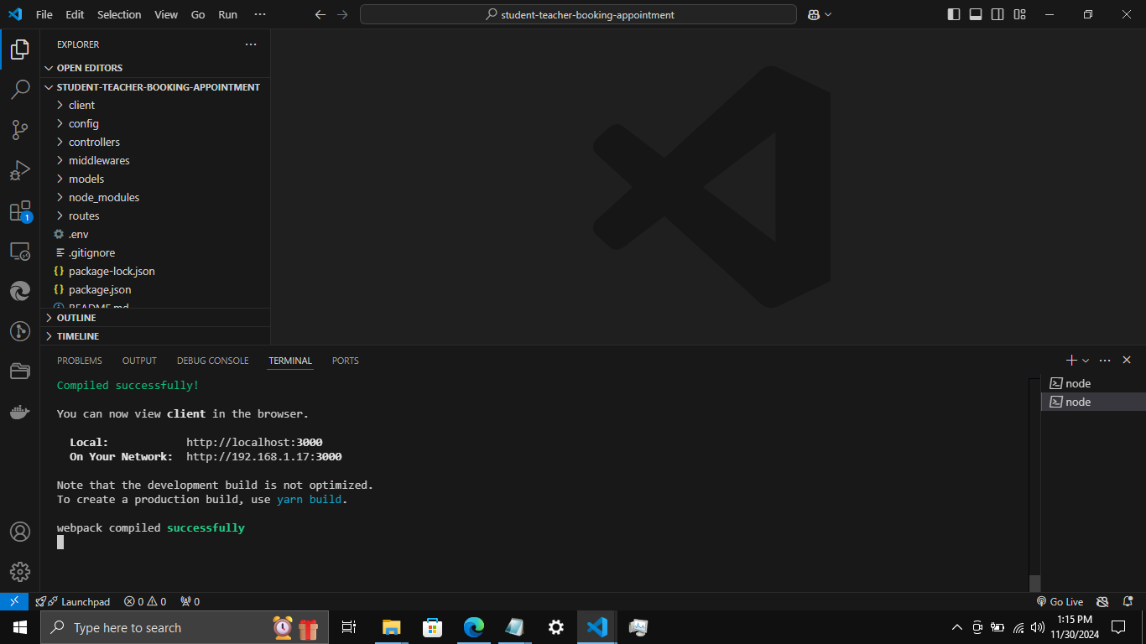
Project 3: Both backend and frontend compiled successfully

Slide 46
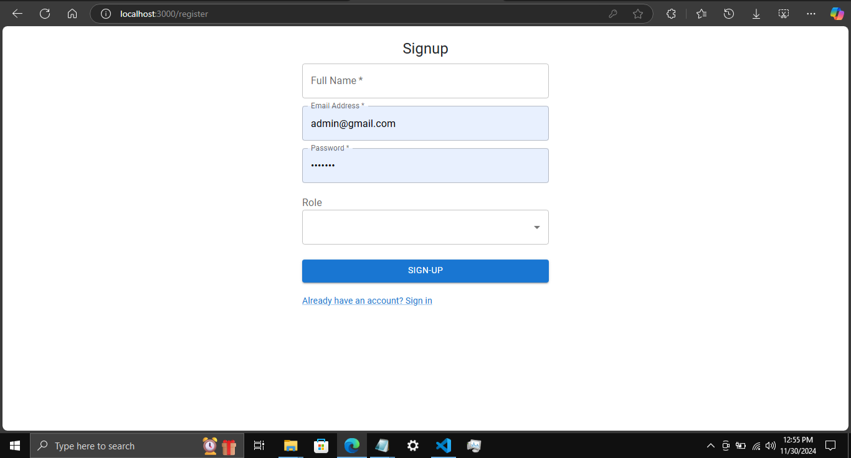
Project 3: Register Page

Slide 47
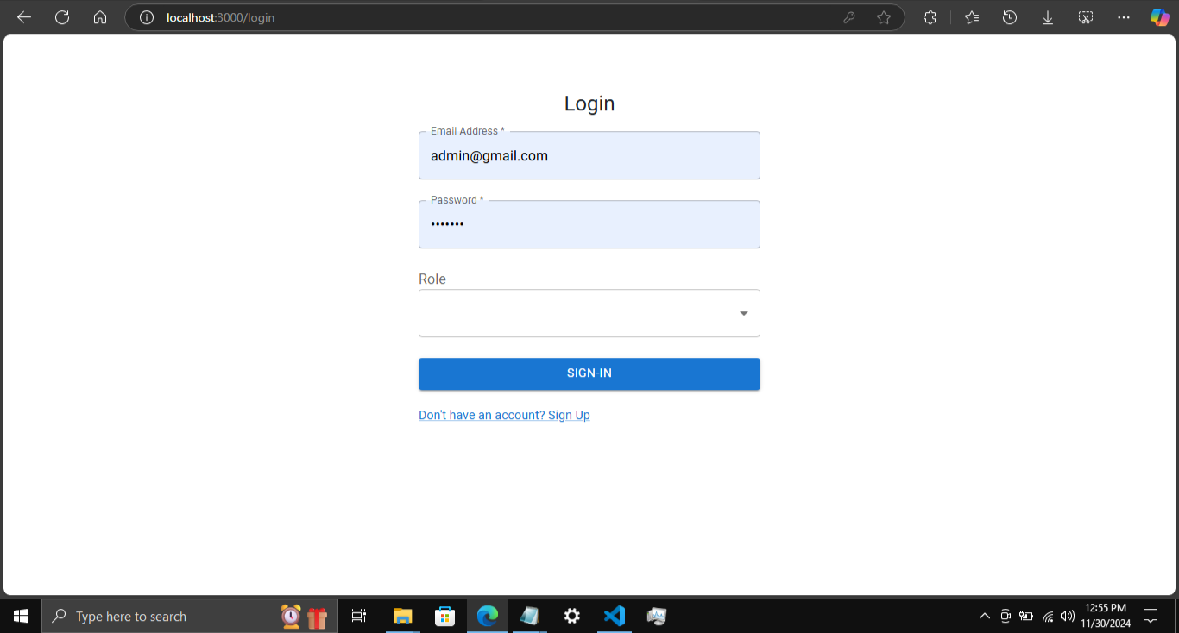
Project 3: Login Page

Slide 48
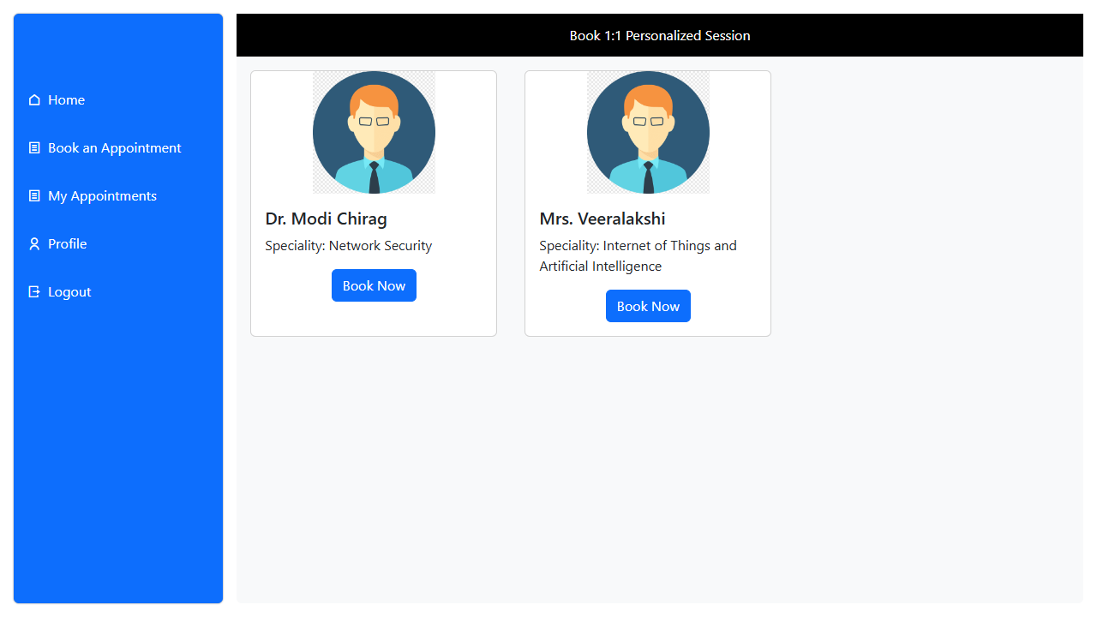
Project 3: List of Teachers

Slide 49
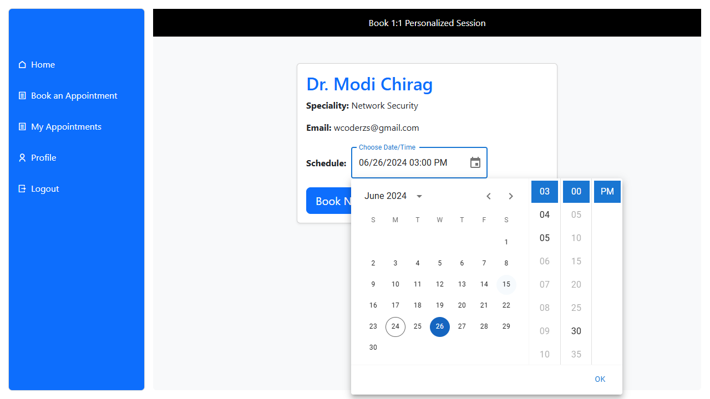
Project 3: Send Appointment Booking Request

Slide 50
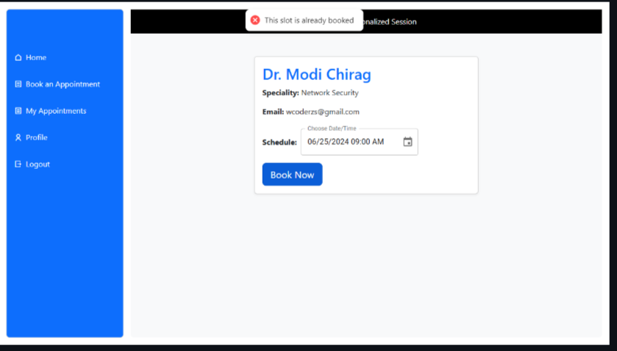
Project 3: Booking Slot Availability

Slide 51
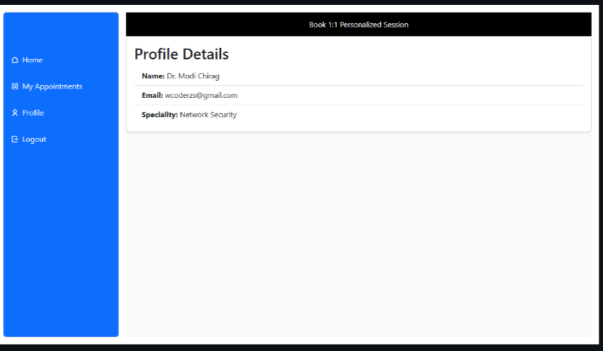
Project 3: Teacher Profile Details

Slide 52
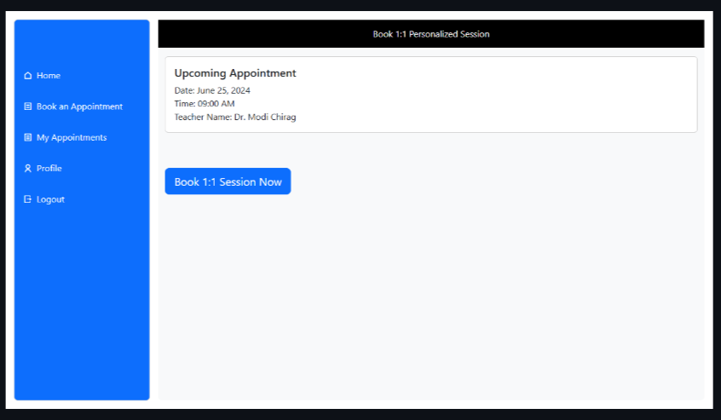
Project 3: Upcoming Appointments

Slide 53
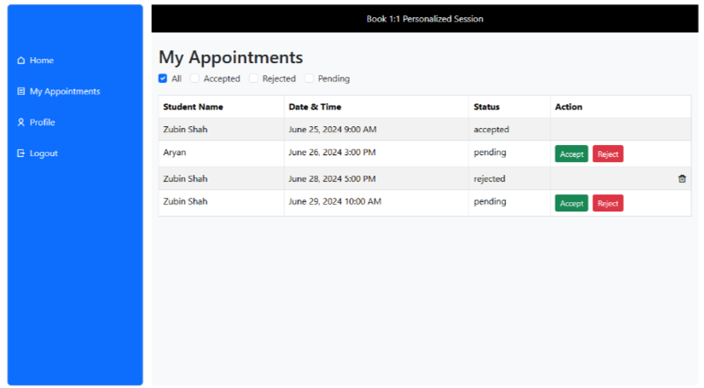
Project 3: Teacher Viewing All requests

Slide 54
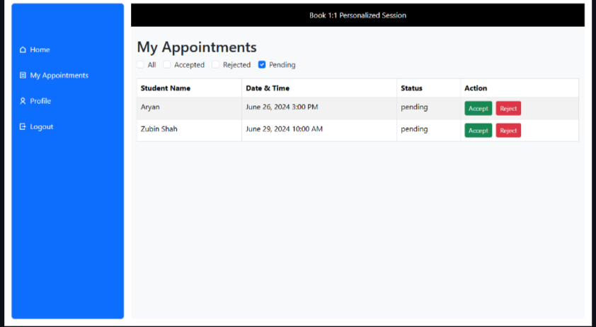
Project 3: Teacher Viewing Pending requests

Slide 55
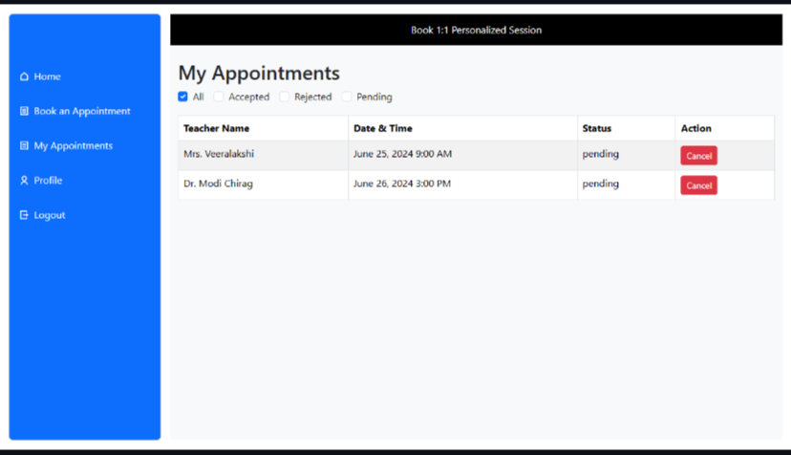
Project 3: Student Viewing All requests

Slide 56
THANKS!

