Slide 1
STEPS TO PERFOM TASK -4
1. Open firewall configuration tool.
2. Windows Firewall with Advanced Security, select Inbound Rules and Outbound Rules to see existing rules.
3. Add a rule to block inbound traffic on a specific port (e.g., port 23 for Telnet).
4. Test the rule by attempting to connect to that port using cmd with command telnet 127.0.0.1 23.
5. Test with Nmap using command nmap -p 23 127.0.0.1
6. Remove the test block rule to restore original state by deleting that rule.
8. Summarize how the firewall filters traffic:
Firewalls inspect incoming and outgoing packets based on rule.
They allow or deny traffic on defined ports or protocols.
They protect systems from unwanted or malicious access.

Slide 2
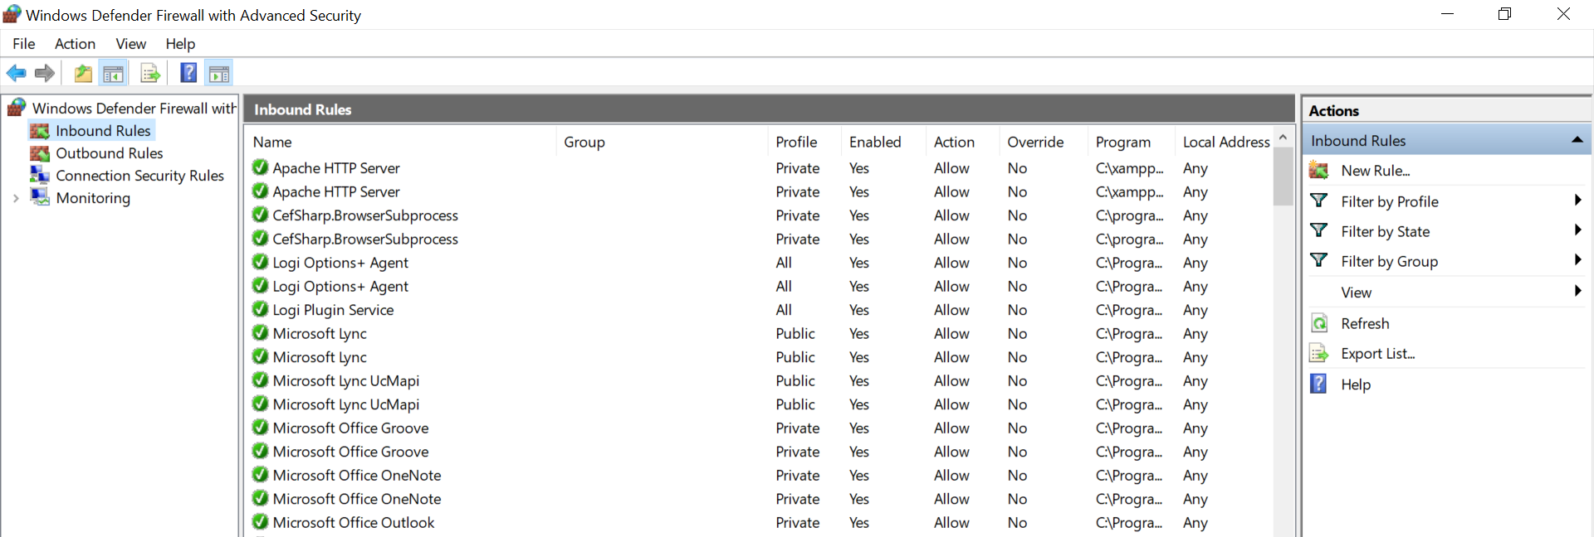


Slide 3
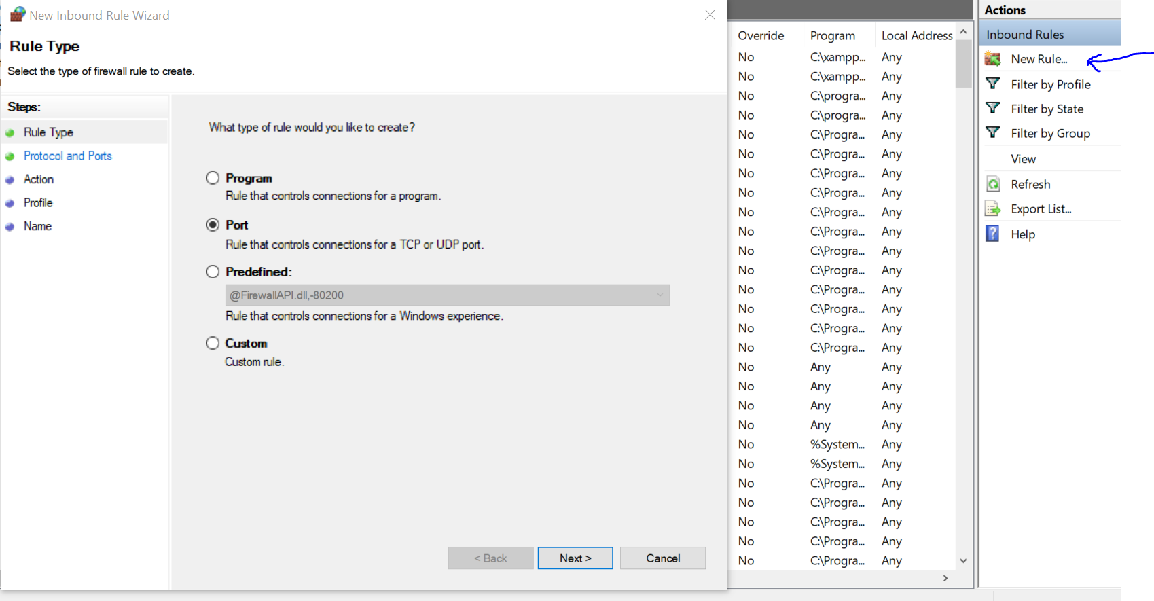

Slide 4
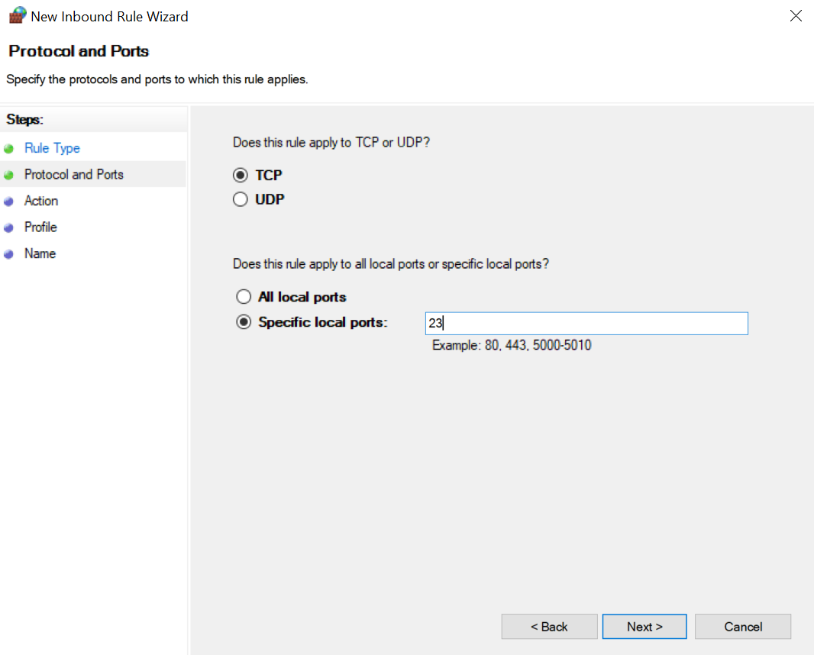

Slide 5
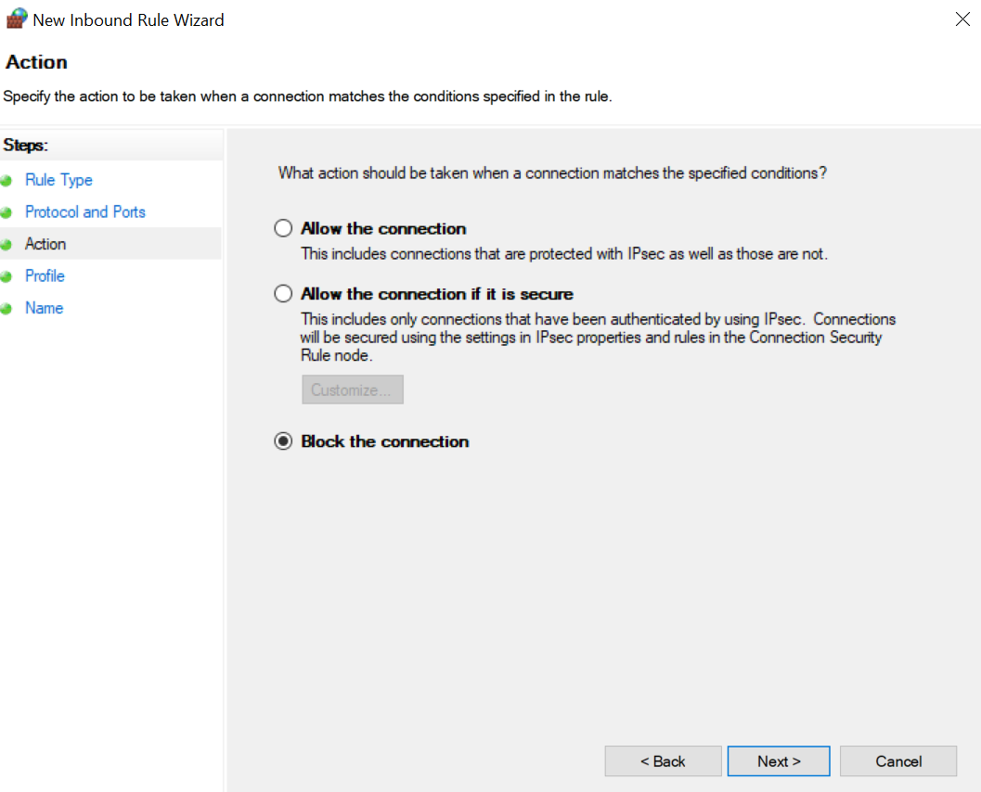

Slide 6
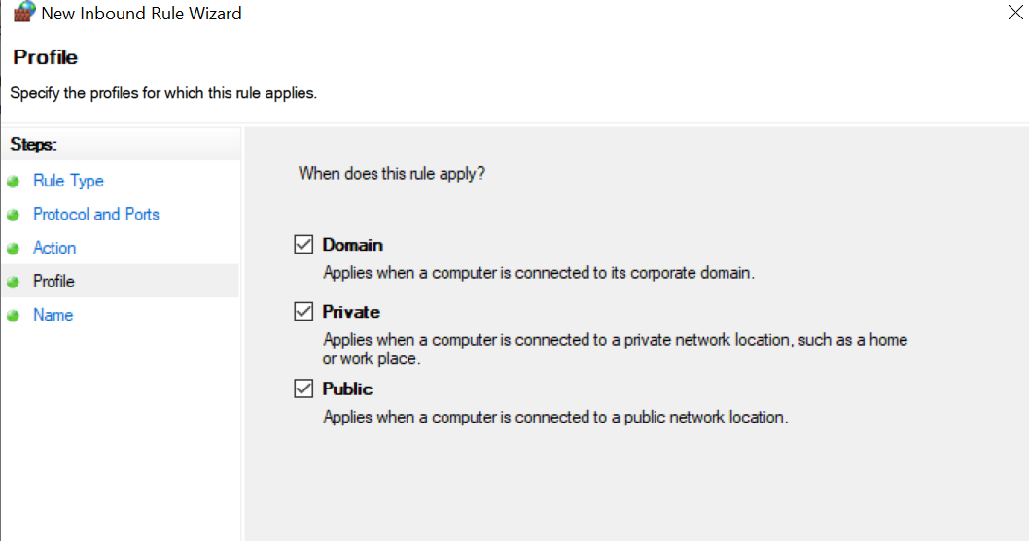

Slide 7
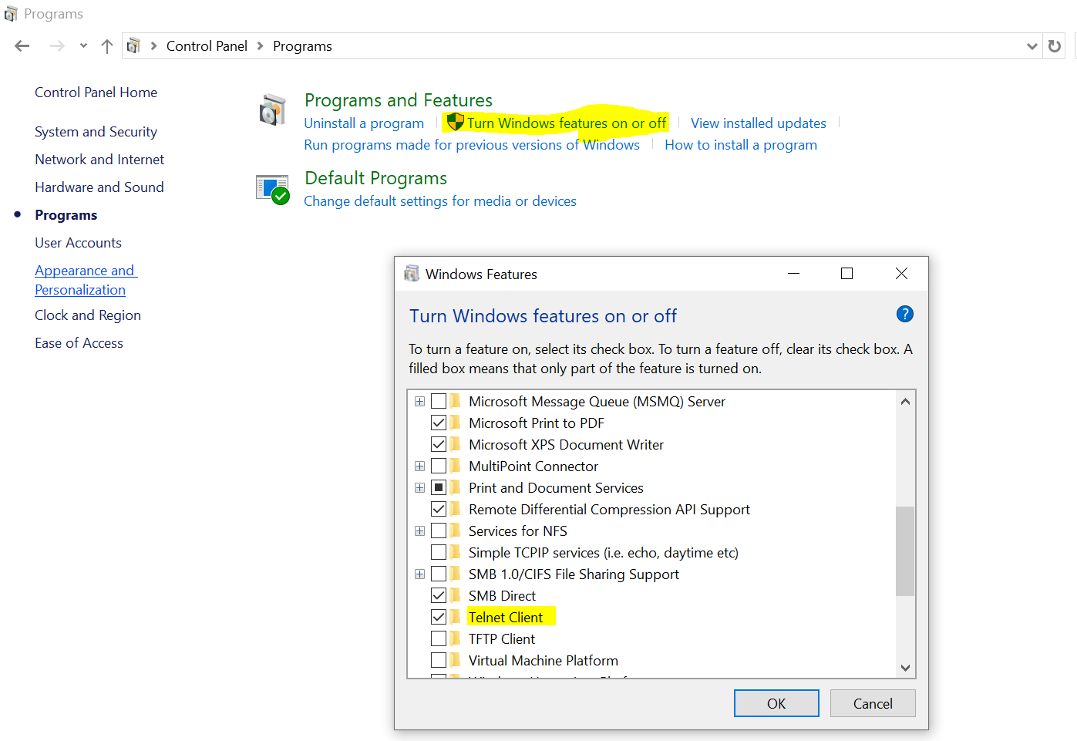

Slide 8
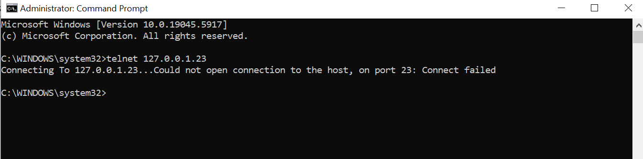

Slide 9
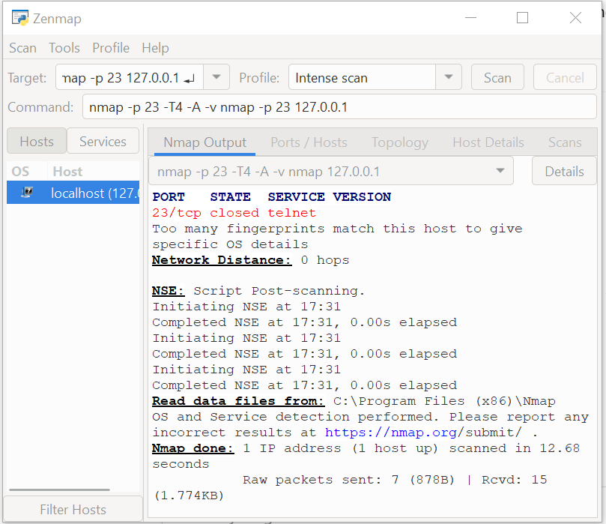

Slide 10
