Slide 1
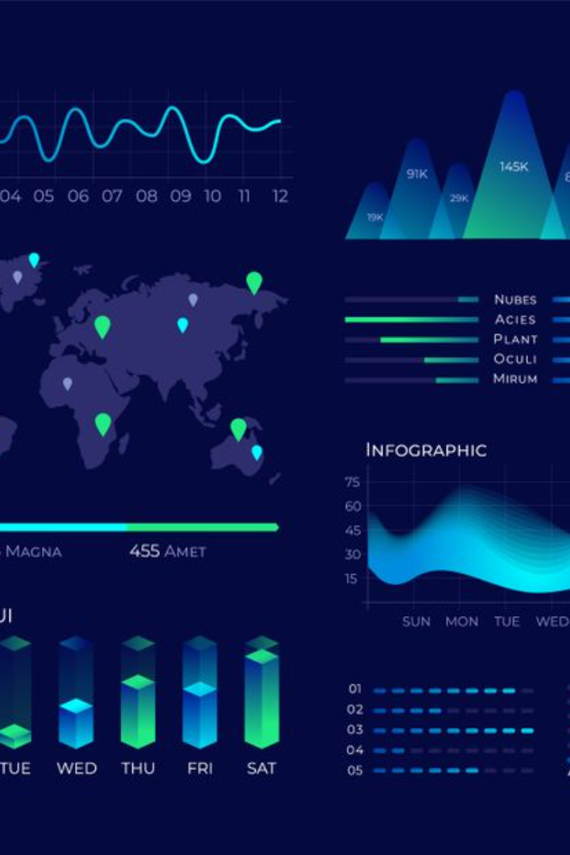
Data Visualization Using Plotly
Create stunning visualizations with Plotly, the powerful data visualization tool. In this presentation, we'll explore the benefits, features, and techniques of Plotly, with real-world examples.

Slide 2

Introduction to Plotly
1
What is Plotly?
2
Why use Plotly?
Plotly is a data visualization tool that allows you to create interactive charts, graphs and dashboards.
Plotly makes it easy to create complex visualizations and helps you communicate insights effectively.
3
How does it work?
Plotly is built on top of Python, R and JavaScript libraries, so you can create visualizations using code or the online editor.

Slide 3
Benefits of Using Plotly for Data Visualization
Interactive
Easy to Use
Flexible
Plotly's charts are interactive, allowing users to zoom in, hover, and explore the data in real-time. This feature makes it easier to communicate insights to stakeholders.
Plotly's user-friendly interface and documentation make it easy for beginners to create beautiful charts and graphs.
Plotly supports both online and offline visualization, and allows you to create visualizations in multiple programming languages, including Python, R, and JavaScript.

Slide 4
Features and Functionality of Plotly
Charts and Graphs
Line charts, bar charts, scatter plots, histograms, and pie charts are just a few of the many chart types available in Plotly.
Maps
Plotly allows you to create visually stunning maps with ease, including interactive maps, choropleth maps, and heatmaps.
Dashboards
Plotly's dashboarding capabilities allow you to create custom dashboards to monitor key metrics and trends.

Slide 5
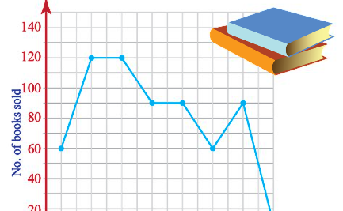
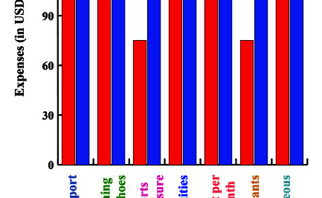
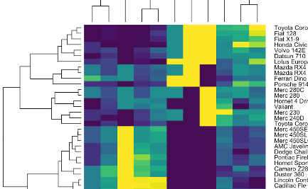
How to Create Basic Visualizations with Plotly
Line Chart
Bar Chart
Heatmap
A line chart is ideal for showing trends over time, such as stock prices or website traffic.
A bar chart is great for comparing different categories or groups, such as sales figures or survey results.
A heatmap is useful for visualizing complex data, such as customer behavior or website performance.

Slide 6

Advanced Techniques for Data Visualization Using Plotly
1
Animations
Plotly animations can help you show changes over time or add a bit of flair to your visualizations.
2
Subplots
Subplots allow you to display multiple charts or graphs on the same page, making it easier to compare different datasets.
3
Crossfiltering
Crossfiltering allows users to filter a dataset by selecting data points on a chart, making it easier to explore large datasets.

Slide 7
Case Studies and Real-World Examples of Plotly in Action
Visualizing Financial Data
Tracking COVID-19 Cases
Web Analytics
A digital marketing agency used Plotly to create custom dashboards for clients to monitor website traffic, bounce rates and other key metrics. The dashboards helped the agency increase customer retention and attract new business.
A financial services firm used Plotly to create interactive dashboards that allowed customers to monitor their investments in real-time. The dashboards helped increase customer satisfaction and retention.
Plotly was used by a healthcare organization to track COVID-19 cases and visualize the spread of the virus. The charts and graphs helped healthcare professionals make informed decisions about resource allocation.

Slide 8
Getting started with Plotly
1
Installation
pip install plotly
2
Importing Plotly in Python
import plotly.express as px
3
Basic Syntax for Creating Plots
fig = px.scatter(x=[1, 2, 3], y=[4, 1, 2], title='Scatter Plot')

Slide 9
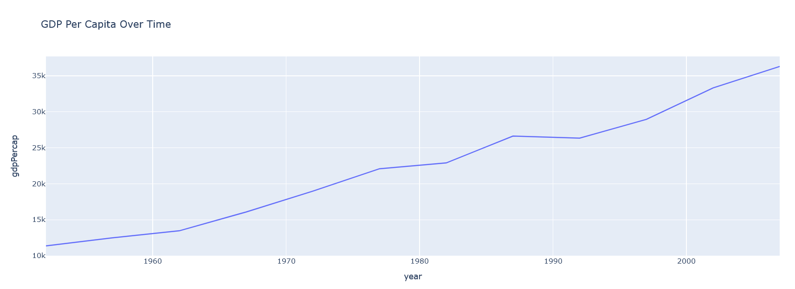
Line Chart
import plotly.express as px
df = px.data.gapminder().query("country == 'Canada'")
fig = px.line(df, x='year', y='gdpPercap', title='GDP Per Capita Over Time')
fig.show()

Slide 10
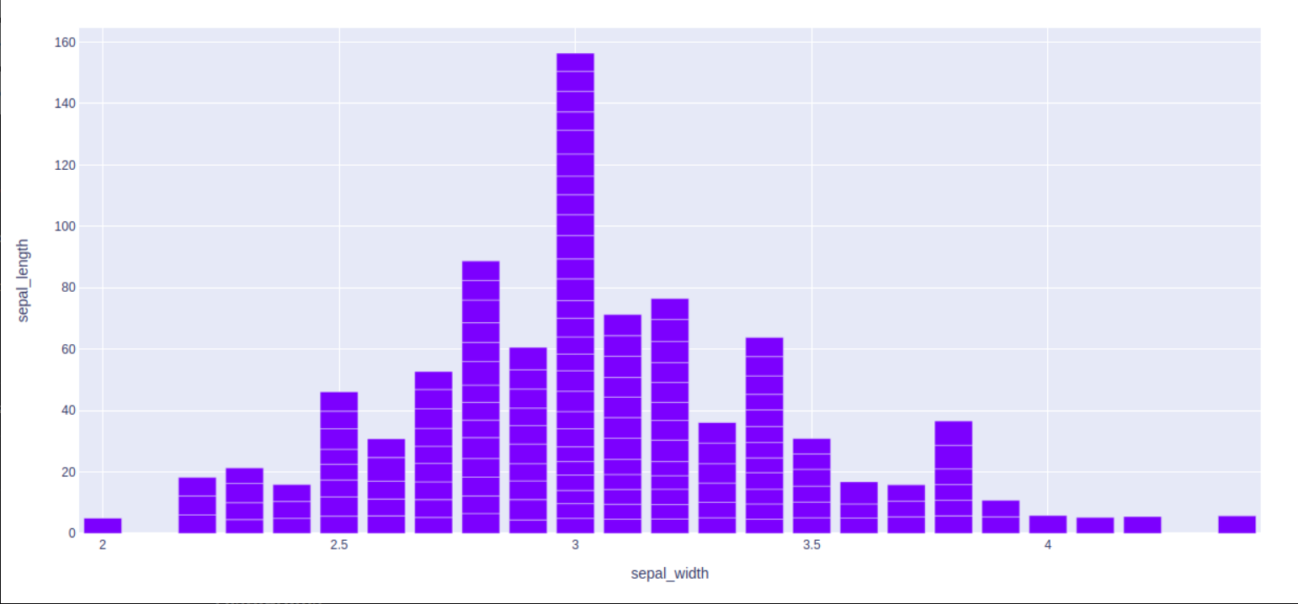
Bar Chart
import plotly.express as px
# using the iris dataset
df = px.data.iris()
# plotting the bar chart
fig = px.bar(df, x="sepal_width", y="sepal_length")
# showing the plot
fig.show()

Slide 11
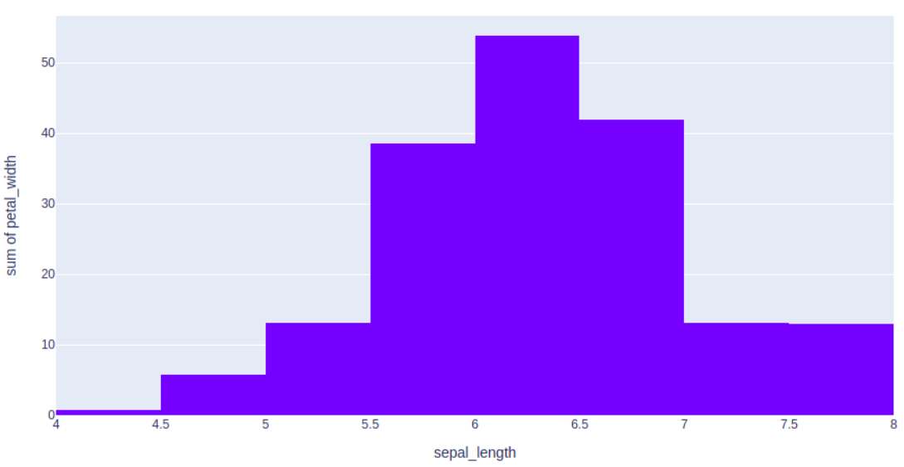
Histogram
import plotly.express as px
# using the iris dataset
df = px.data.iris()
# plotting the histogram
fig = px.histogram(df, x="sepal_length", y="petal_width")
# showing the plot
fig.show()

Slide 12
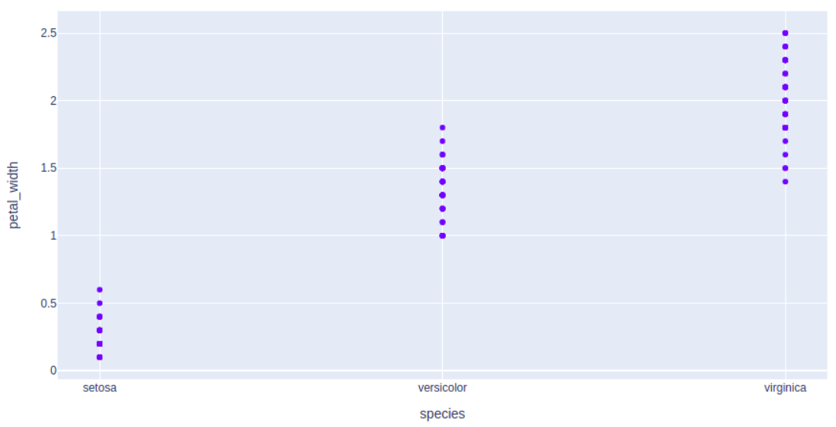
Scatter Plot
import plotly.express as px
# using the iris dataset
df = px.data.iris()
# plotting the scatter chart
fig = px.scatter(df, x="species", y="petal_width")
# showing the plot
fig.show()

Slide 13
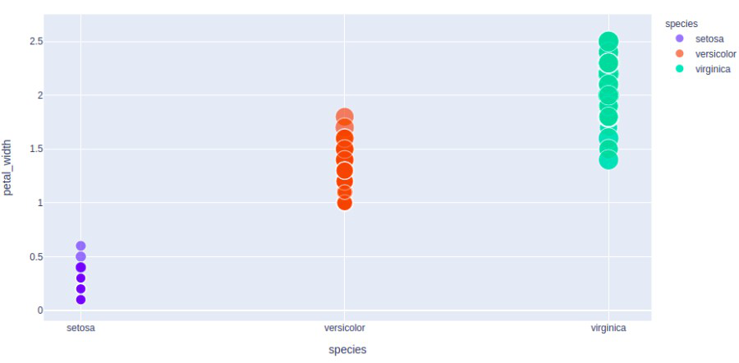
Bubble Plot
import plotly.express as px
# using the iris dataset
df = px.data.iris()
# plotting the bubble chart
fig = px.scatter(df, x="species", y="petal_width",
size="petal_length", color="species")
# showing the plot
fig.show()

Slide 14
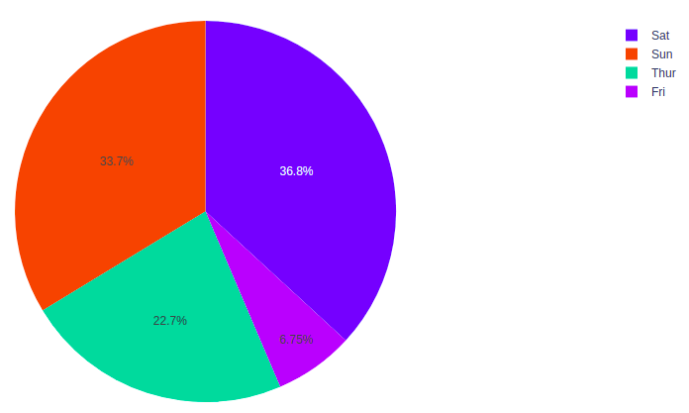
Pie Chart
import plotly.express as px
# using the tips dataset
df = px.data.tips()
# plotting the pie chart
fig = px.pie(df, values="total_bill", names="day")
# showing the plot
fig.show()

Slide 15
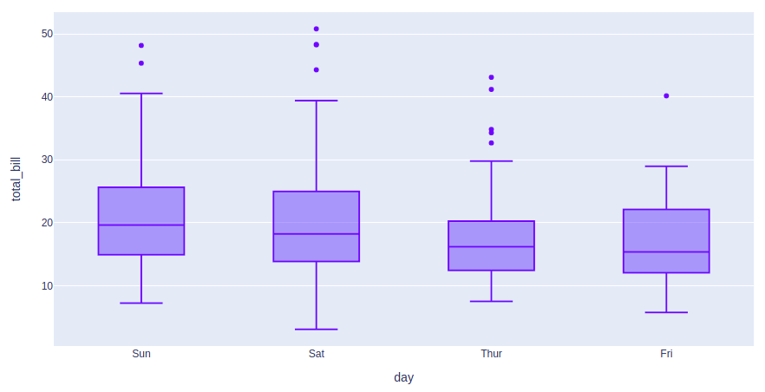
Box Plot
import plotly.express as px
# using the tips dataset
df = px.data.tips()
# plotting the box chart
fig = px.box(df, x="day", y="total_bill")
# showing the plot
fig.show()

Slide 16
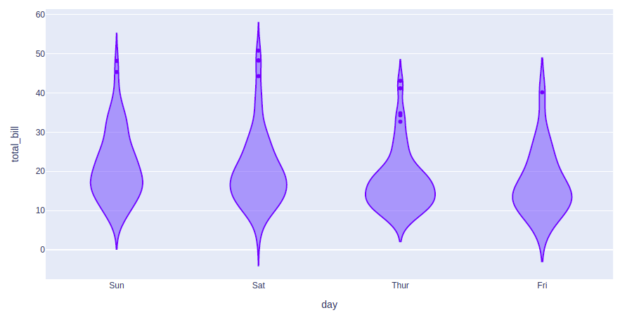
Violin Plot
import plotly.express as px
# using the tips dataset
df = px.data.tips()
# plotting the violin chart
fig = px.violin(df, x="day", y="total_bill")
# showing the plot
fig.show()

Slide 17
Gantt Charts
import plotly.figure_factory as ff
# Data to be plotted
df = [dict(Task="A", Start='2020-01-01', Finish='2009-02-02'),
dict(Task="Job B", Start='2020-03-01', Finish='2020-11-11'),
dict(Task="Job C", Start='2020-08-06', Finish='2020-09-21')]
# Creating the plot
fig = ff.create_gantt(df)
fig.show()

Slide 18
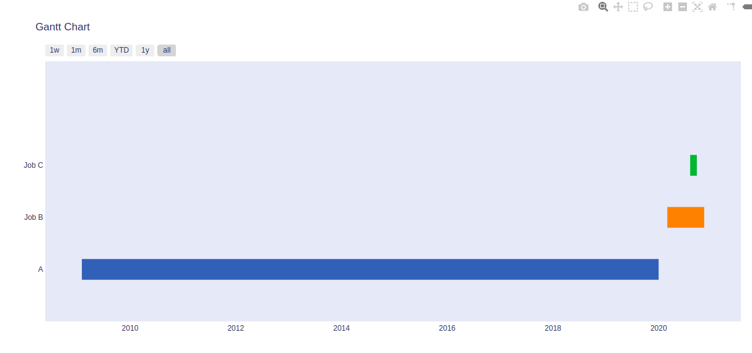
Gantt Charts

Slide 19
Contour Charts
import plotly.graph_objects as go
# Creating the X, Y value that will
# change the values of Z as a function
feature_x = np.arange(0, 50, 2)
feature_y = np.arange(0, 50, 3)
# Creating 2-D grid of features
[X, Y] = np.meshgrid(feature_x, feature_y)
Z = np.cos(X / 2) + np.sin(Y / 4)
# plotting the figure
fig = go.Figure(data =go.Contour(x = feature_x, y = feature_y, z = Z))
fig.show()

Slide 20
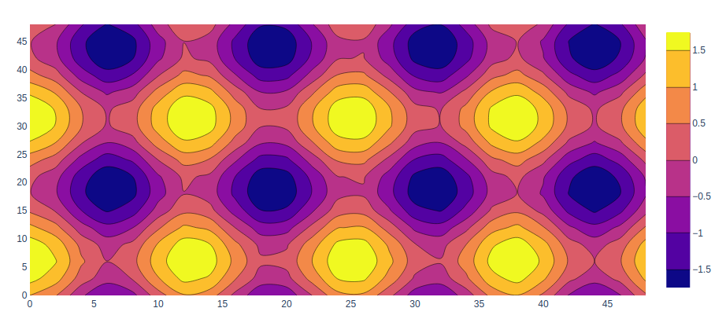
Contour Charts

Slide 21
Heatmaps
import plotly.graph_objects as go
feature_x = np.arange(0, 50, 2)
feature_y = np.arange(0, 50, 3)
# Creating 2-D grid of features
[X, Y] = np.meshgrid(feature_x, feature_y)
Z = np.cos(X / 2) + np.sin(Y / 4)
# plotting the figure
fig = go.Figure(data = go.Heatmap(x = feature_x, y = feature_y, z = Z,))
fig.show()

Slide 22
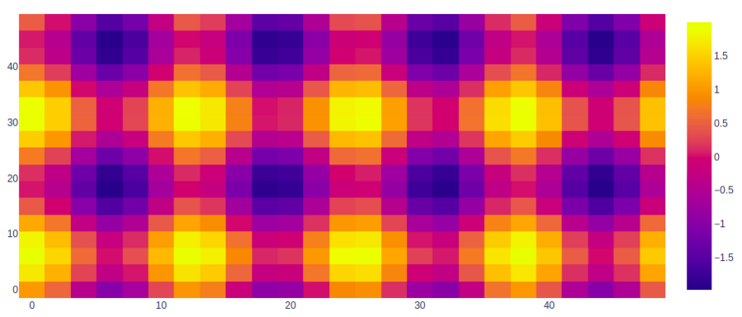
Contour Charts

Slide 23
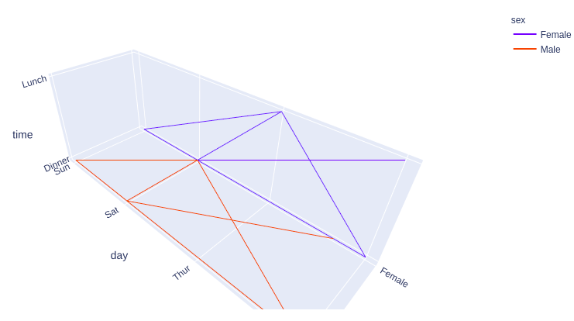
3D Line Plot
import plotly.express as px
# data to be plotted
df = px.data.tips()
# plotting the figure
fig = px.line_3d(df, x="sex", y="day", z="time", color="sex")
fig.show()

Slide 24
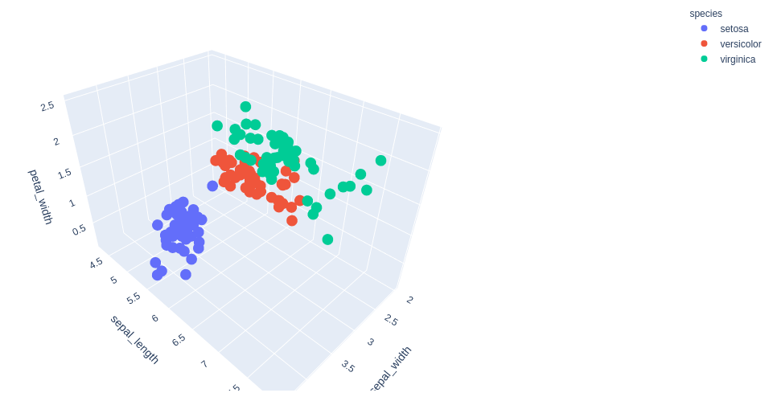
3D Scatter Plot
import plotly.express as px
# Data to be plotted
df = px.data.iris()
# Plotting the figure
fig = px.scatter_3d(df, x = 'sepal_width',
y = 'sepal_length',
z = 'petal_width', color = 'species')
fig.show()

Slide 25
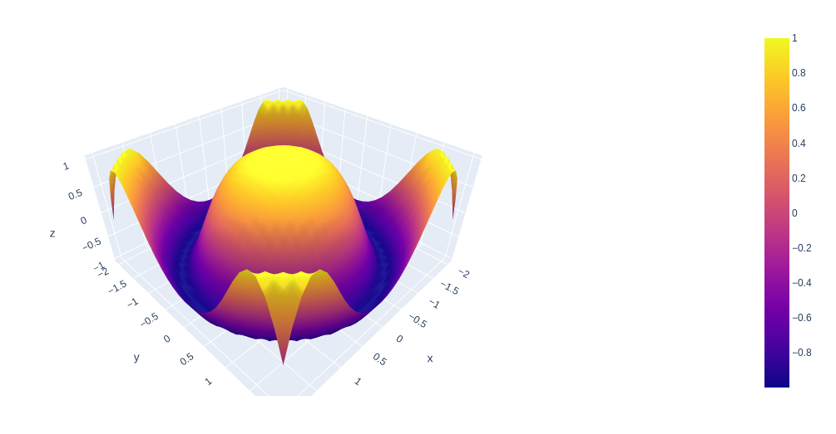
3D Surface Plot
import plotly.graph_objects as go
import numpy as np
# Data to be plotted
x = np.outer(np.linspace(-2, 2, 30), np.ones(30))
y = x.copy().T
z = np.cos(x ** 2 + y ** 2)
# plotting the figure
fig = go.Figure(data=[go.Surface(x=x, y=y, z=z)])
fig.show()

Slide 26
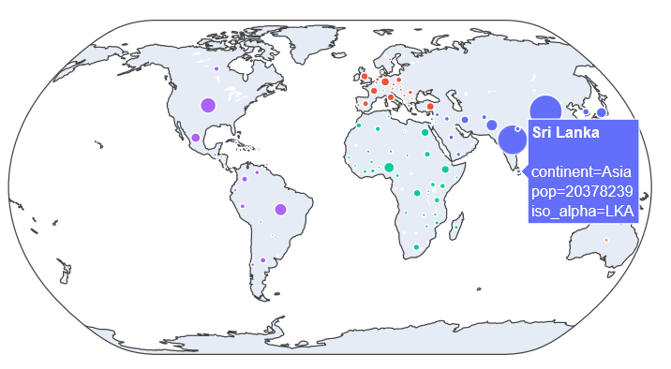
Geographic Plot
import plotly.express as px
df = px.data.gapminder()
fig = px.scatter_geo(df, locations='iso_alpha’,
color='continent', hover_name='country’,
size='pop', projection='natural earth’)
fig.show()

Slide 27
Interactive with Plots
Plotly provides various tools for interacting with the plots such as adding dropdowns, buttons,
sliders, etc.
Creating Dropdown Menu in Plotly
A drop-down menu is a part of the menu-button which is displayed on a screen all the time.
Every menu button is associated with a Menu widget that can display the choices for that menu
button when clicked on it. In plotly, there are 4 possible methods to modify the charts by using
update menu method.
restyle: modify data or data attributes
relayout: modify layout attributes
update: modify data and layout attributes
animate: start or pause an animation

Slide 28
Create a Dropdown
import plotly.graph_objects as px
import numpy as np
np.random.seed(42)
# Data to be Plotted
random_x = np.random.randint(1, 101, 100)
random_y = np.random.randint(1, 101, 100)
plot = px.Figure(data=[px.Scatter(x=random_x, y=random_y, mode='markers',)])

Slide 29
Create a Dropdown
# Add dropdown
plot.update_layout(
updatemenus=[
dict( buttons=list([
dict( args=["type", "scatter"], label="Scatter Plot", method="restyle"),
dict(args=["type", "bar"], label="Bar Chart", method="restyle")
]), direction="down", ),]
)
plot.show()

Slide 30
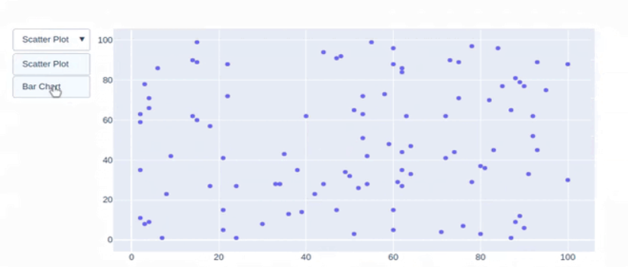
Create a Dropdown

Slide 31
Interactive with Plots
Adding Buttons to the Plot:
In plotly, actions custom Buttons are used to quickly make actions directly from a record.
Custom Buttons can be added to page layouts in CRM, Marketing, and Custom Apps. There are
also 4 possible methods that can be applied in custom buttons:
restyle: modify data or data attributes
relayout: modify layout attributes
update: modify data and layout attributes
animate: start or pause an animation

Slide 32
Add Buttons
import plotly.graph_objects as px
import pandas as pd
df = go.data.tips()
plot = px.Figure(data=[px.Scatter(
x=data['day'],
y=data['tip'],
mode='markers',)
])

Slide 33
Add Buttons
plot.update_layout(
updatemenus=[
dict( type="buttons", direction="left", buttons=list([
dict(args=["type", "scatter"], label="Scatter Plot", method="restyle"),
dict(args=["type", "bar"], label="Bar Chart", method="restyle")
]),
),
]
)
plot.show()

Slide 34
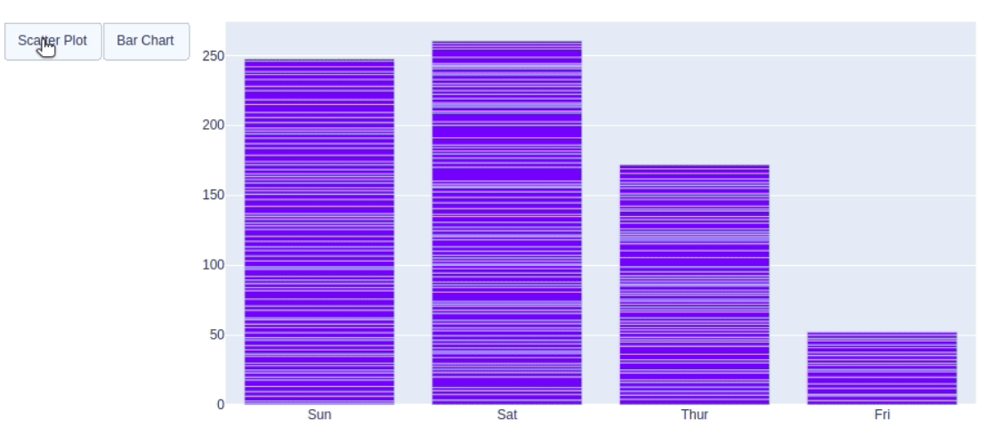
Add Buttons

