Slide 1
BLUESTOCK FINTECH · CAPSTONE PROJECT · AUGUST 2026
Bluestock Mutual Fund Analytics
End-to-End Data Engineering, Performance Analytics & Interactive Dashboard
Prepared by Shubham Sharma

Slide 2








PROJECT SCOPE
Problem & Objective
Mutual fund analysis requires combining multiple datasets — fund metadata, NAV history, AUM, SIP activity, investor transactions, and benchmark indices — into a single analytical platform. This project addresses that challenge across eight objectives.
ETL Pipeline
SQL Data Model
Automated ingestion, cleaning, and transformation
Normalized relational structure
EDA
Performance & Risk
NAV, AUM, SIP, and investor analysis
Return, Sharpe, Sortino, Alpha, Beta, and drawdown
BI Dashboard
Investor Analysis
Interactive four-page Tableau dashboard
Transaction, demographic, and geographic insights
Benchmark Comparison
Documentation
Fund versus NIFTY benchmark analysis
Report, presentation, and reproducible repository

Slide 3

DATA
Data Sources & Dataset Coverage
Primary Data Sources
Core Datasets
AMFI India & mfapi.in
NSE India & BSE India
AMFI Monthly Notes
Provided project CSV datasets
Fund Master & NAV History
AUM by Fund House & Monthly SIP Inflows
Category Inflows & Industry Folio Count
Scheme Performance & Investor Transactions
Portfolio Holdings & Benchmark Indices
Dataset Coverage
40 mutual fund schemes · 10 datasets
≈46,000 NAV records · ≈32,000 investor transactions
5,000 investors · 10 fund houses
4.5+ years NAV history · benchmark index data
Investor transaction data is synthetic. Some NAV history is simulated forward using realistic parameters. This project is for educational and analytical purposes only — not investment advice.

Slide 4

ARCHITECTURE
ETL & Analytics Architecture
Extract
Transform
Load
Analyse
The end-to-end pipeline flows from raw data extraction through transformation, loading, analysis, and visualization — each stage handled by a dedicated tool in the technology stack.
Star Schema — Analytical Data Model
Technology Stack
Dimensions: dim_fund, dim_date
Facts: fact_nav, fact_transactions, fact_performance, fact_aum, fact_sip_industry, fact_portfolio
Python — Pandas, NumPy, SciPy
SQLite / SQL — Relational data model
Jupyter — Exploratory analysis
Tableau — Interactive BI dashboard
Git / GitHub — Version control & reproducibility

Slide 5
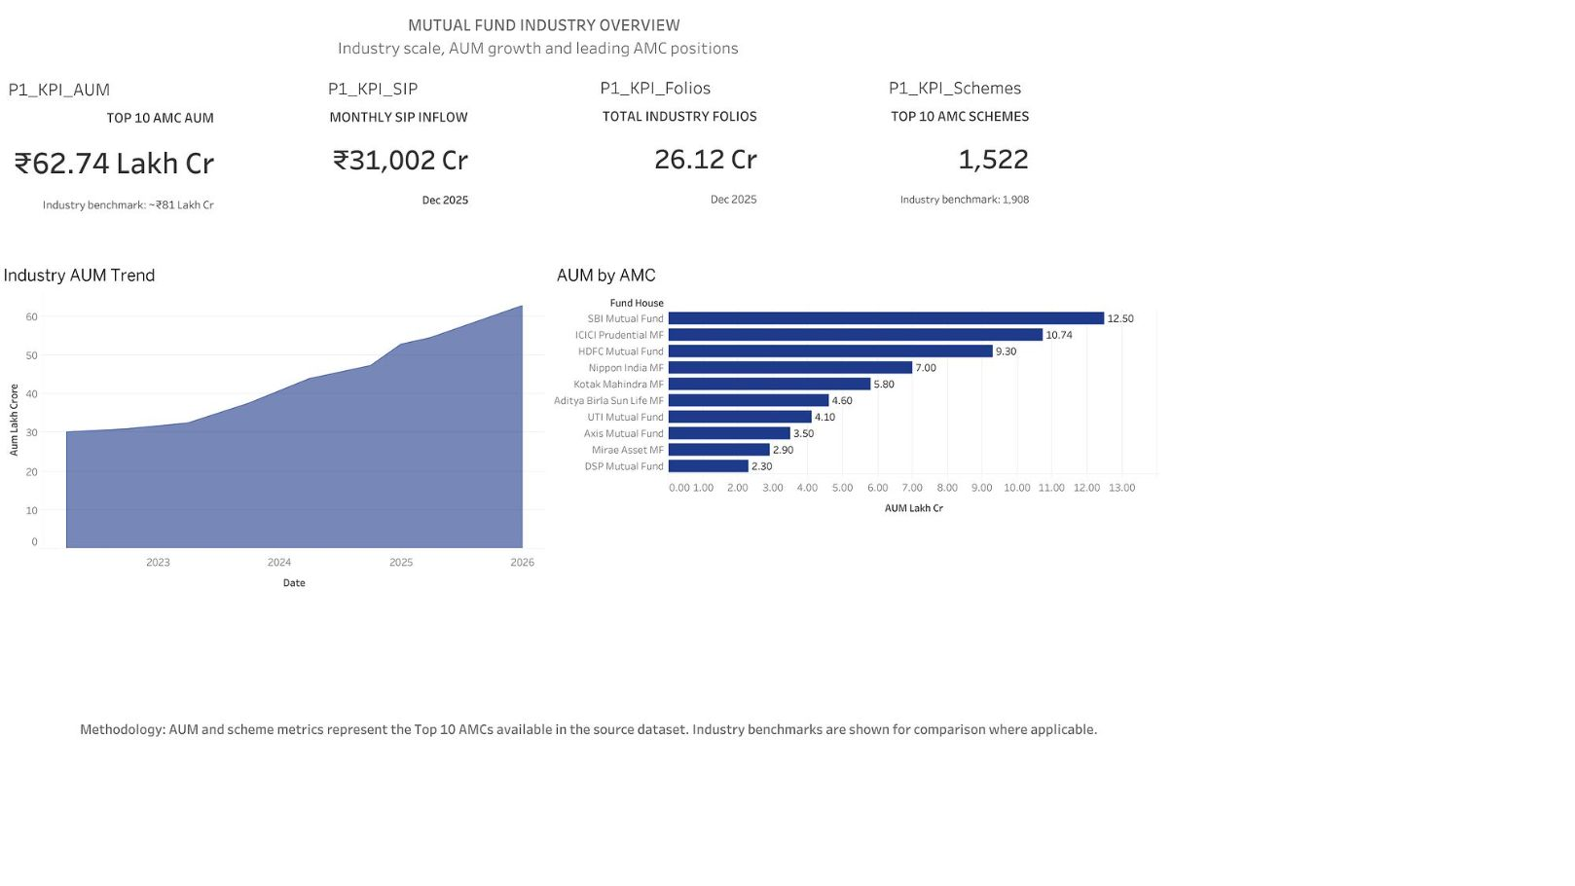

EDA
EDA Highlight: Industry Growth
Key Reference Metrics — December 2025
Industry benchmark AUM: ≈₹81 lakh crore
Top 10 AMC AUM in dashboard: ₹62.74 lakh crore
SBI Mutual Fund leads at ₹12.50 lakh crore
ICICI Prudential MF: ₹10.74 lakh crore
HDFC Mutual Fund: ₹9.30 lakh crore
Monthly SIP inflow: ₹31,002 crore
Total folios: 26.12 crore
Important distinction: ₹62.74 lakh crore represents the Top 10 AMC AUM in the dashboard dataset. The wider industry benchmark of ≈₹81 lakh crore covers all registered AMCs. These are not the same metric.

Slide 6

EDA
EDA Highlight: Investor & Category Behaviour
Investor Dataset Profile
Dashboard Analyses
≈32,000 transactions across 5,000 investors
12 Indian states · SIP, Lumpsum, and Redemption types
Fields: age group, city tier, demographics
Transaction amount by state
SIP vs Lumpsum vs Redemption breakdown
Average SIP amount by age group
Monthly transaction volume trends
Category-level net inflow comparison
FY25 Top-5 Category Net Inflows
Category
Net Inflow (₹ Cr)
Liquid
451,275
Sectoral / Thematic
103,829
Flexi Cap
63,989
Large & Mid Cap
57,752
Short Duration
55,530
Investor transaction data is synthetic and is used for analytical demonstration.

Slide 7


PERFORMANCE ANALYTICS
Performance Metrics: Return & Risk
Fund performance cannot be assessed by return alone. This project computes a comprehensive set of risk-adjusted metrics.
3-Year CAGR
Sharpe Ratio
Sortino Ratio
Measures sustained compounded return over the period
Return relative to total volatility · Risk-free rate = 6.5% · Annualized using √252
Return relative to downside volatility only
Annualized Standard Deviation
Maximum Drawdown
Worst peak-to-trough decline in fund value
Measures annualized return volatility

Slide 8
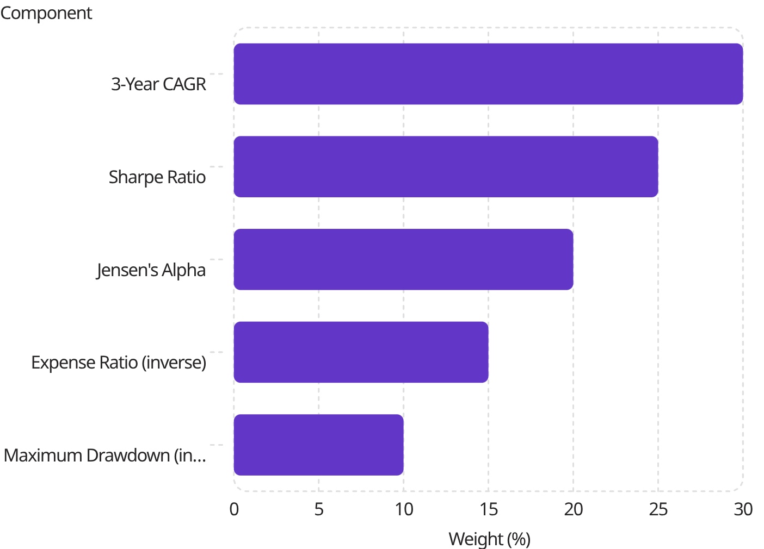
PERFORMANCE ANALYTICS
Performance Metrics: Alpha, Beta & Multi-Factor Scorecard
Market-Relative Metrics
Composite Fund Score — Weighted Formula
Jensen's Alpha: OLS regression against NIFTY 100, annualized
Beta: Fund sensitivity to benchmark movements
Tracking Error: Consistency of fund returns relative to benchmark
Advanced Analytics
Historical VaR at 95% & CVaR
Rolling 90-day Sharpe Ratio
Sector concentration using HHI
Risk-grade-based fund recommendation logic

Slide 9

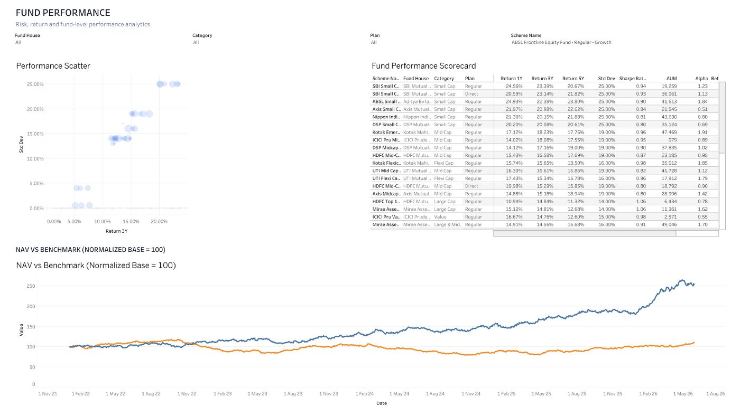
DASHBOARD
Dashboard: Industry Overview & Fund Performance
Industry Overview — AUM, SIP inflows, folios, and AMC-level comparison. Fund Performance — Risk-return positioning, composite scorecard, and normalized benchmark comparison against NIFTY 50 and NIFTY 100.

Slide 10
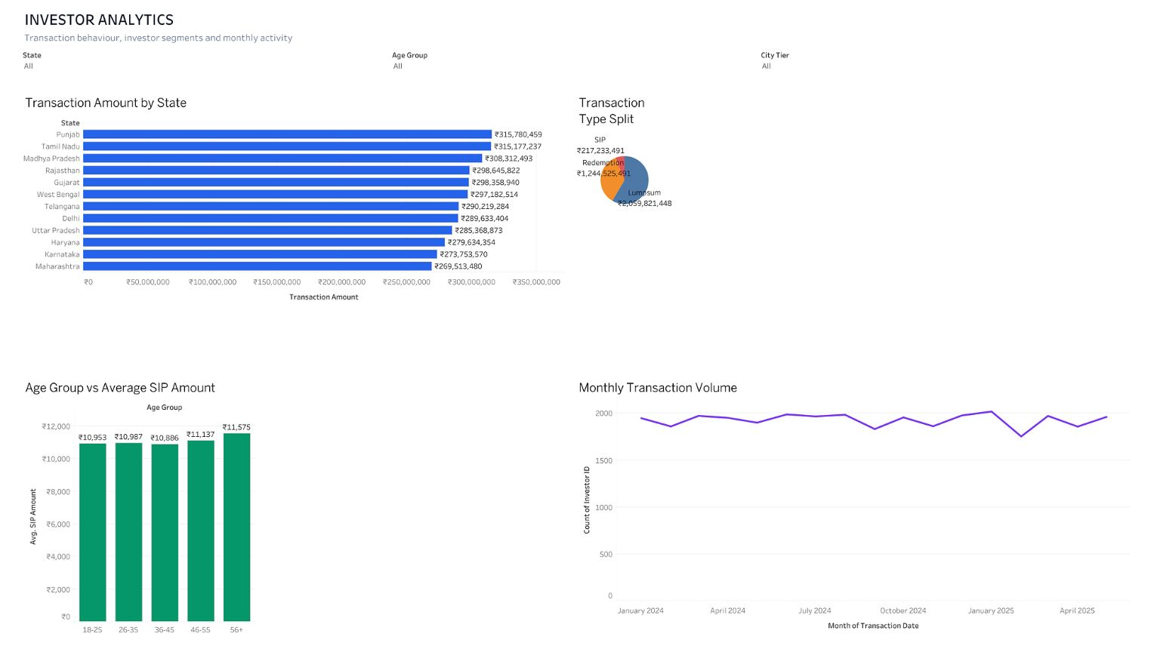
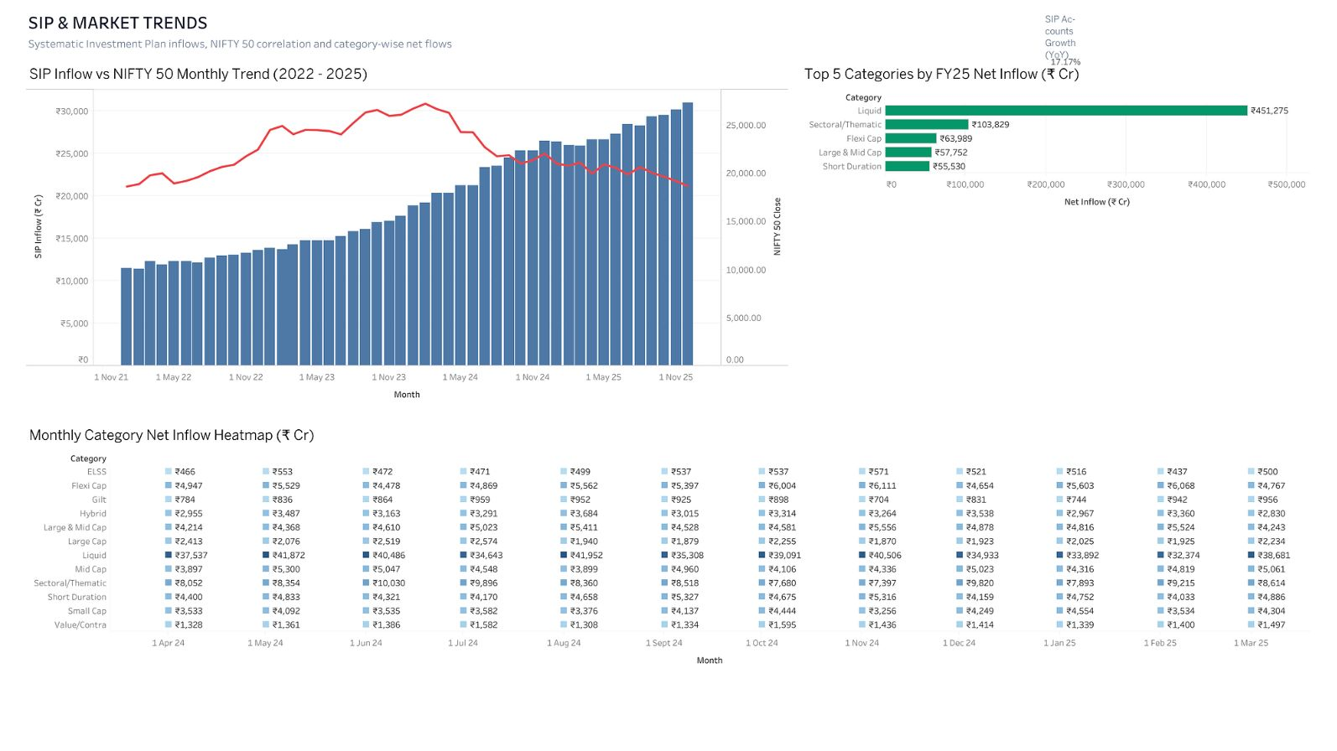
DASHBOARD
Dashboard: Investor Analytics & SIP Market Trends
Investor Analytics — State-level transactions, transaction types, age-group SIP behavior, and monthly transaction volume. SIP & Market Trends — SIP inflows, NIFTY 50 context, and category-level net inflows.

Slide 11
INSIGHTS
Key Findings & Recommendations
Industry Scale
Fund Evaluation
Benchmark Context
Production Readiness
Monthly SIP inflow: ₹31,002 crore
Total folios: 26.12 crore
Industry benchmark AUM: ≈₹81 lakh crore
Fund selection should consider risk-adjusted performance, not return alone.
Fund performance is compared against NIFTY 50 and NIFTY 100 using normalized performance and tracking error.
Replace synthetic investor transactions with governed real transaction data
Replace simulated forward NAV values with refreshed market data
Automate ETL and validation
Add scheduled data refresh and stronger data-quality monitoring
3-Year CAGR
Sharpe Ratio
Jensen's Alpha
Expense Ratio
Maximum Drawdown
NEXT STEPS — Automated ETL → Scheduled data refresh → Stronger validation → Secure dashboard deployment

Slide 12
CLOSING
Thank You
Bluestock Mutual Fund Analytics Capstone
Questions & Discussion
Shubham Sharma
Bluestock Fintech
August 2026

