Slide 1

Vishwacon 2024
7th International Conference on Recent Trends in Engineering and Technology
(Hybrid Conference)
, Pune
BRACT’S, Vishwakarma Institute of Information Technology, Pune
(An Autonomous Institute affiliated to Savitribai Phule Pune University)
(NBA and NAAC accredited, ISO 9001:2015 certified)

Slide 2
AI-DRIVEN CANDIDATE EVALUATION WITH SMART FILTERING AND ENHANCED INSIGHTS
Authors:
Shubham Adhav
Prafulla Badgujar
Bhakti Kate
Minal Naphade
Dr. Pravin Futane
BRACT’S, Vishwakarma Institute of Information Technology, Pune
(An Autonomous Institute affiliated to Savitribai Phule Pune University)
(NBA and NAAC accredited, ISO 9001:2015 certified)

Slide 3
TABLE OF CONTENTS/ AGENDA
1. Abstract
2. Introduction
3. Related work
4.Research Gaps
5. Methodology
6. Results/discussion
7. Conclusion and Future Scope
8. References
BRACT’S, Vishwakarma Institute of Information Technology, Pune
‹#›

Slide 4
1. ABSTRACT
Minimized Resume Keyword Stuffing
Customized Weightage for Required Qualification
Real-time Candidate Evaluation
Feedback System for Further Skill Improvements
Powered by NLP and AI
Potential Enhancements to Resume Evaluation
‹#›
BRACT’S, Vishwakarma Institute of Information Technology, Pune

Slide 5
2. INTRODUCTION
Diversified Skills Categorization.
Customized Weightage for Required Qualification
Detailed Required Job Posting
Seamless Integration with NLP and AI
Human-like Resume Evaluation
Appropriateness in Responses
Comprehensive Feedback Mechanism
User Account Safety and Ethical Considerations
‹#›
BRACT’S, Vishwakarma Institute of Information Technology, Pune

Slide 6
3. LITERATURE REVIEW
Paper | Objectives | Methods | Key findings
Resume Screening Using Machine Learning. 2024 | Develop a machine learning-based automated system for resume screening | Machine learning algorithms for resume parsing and candidate ranking | Improved efficiency in screening resumes, potential challenges in handling diverse resume formats.Struggles with understanding contextual skills
Resume Screening and Recommendation System using Machine Learning Approaches. 2022 | Build a system to screen and recommend resumes based on job requirement | Machine learning algorithms, recommendation systems, skill-based ranking | Effective resume recommendation system, struggles with context-based skill evaluation
Resume Screening using Machine Learning. 2023 | Enhance the recruitment process through automated resume screening | Machine learning techniques, keyword-based and pattern matching | Significant reduction in manual effort, limited handling of resumes with inconsistent formats.Lack of real-time feedback to candidates and inadequate fairness auditing
NLP Automated Resume Analysis and Skill Suggesting Website. 2024 | Develop an NLP-based system for resume analysis and personalized skill suggestions | Natural Language Processing (NLP), AI-based skill extraction and recommendation | Enhanced personalized feedback for candidates, effective at suggesting skill improvements.Bias in NLP model predictions .
‹#›
BRACT’S, Vishwakarma Institute of Information Technology, Pune

Slide 7
4. RESEARCH GAPS
Keyword Stuffing Manipulation
Lack of Soft Skills Evaluation
Challenges with Resume Format Diversity
Limited Candidate Feedback Mechanism
Entry-Level Candidate Evaluation Issues
‹#›
BRACT’S, Vishwakarma Institute of Information Technology, Punec

Slide 8
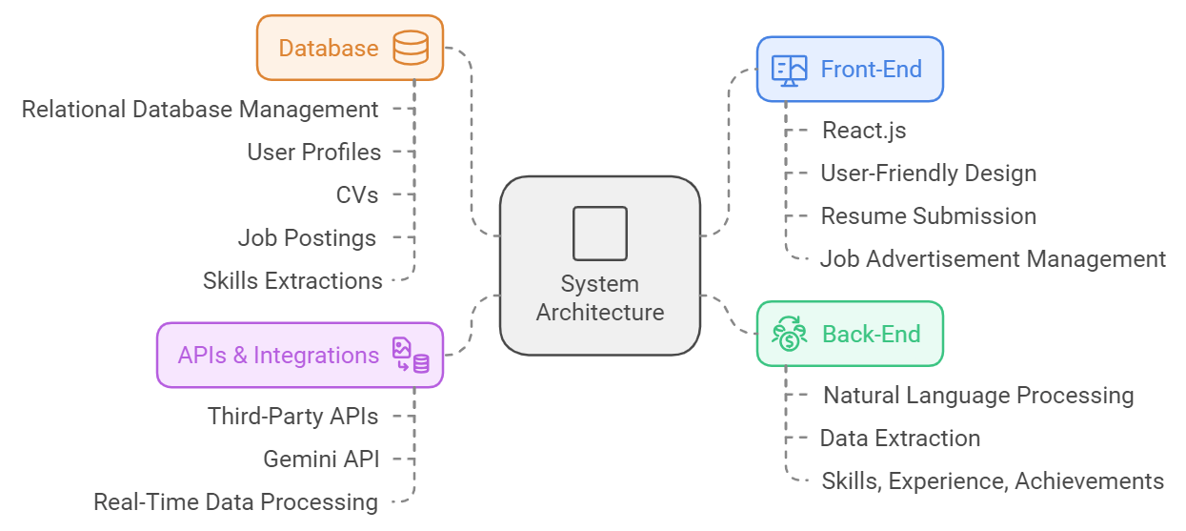
5. METHODOLOGY
‹#›
BRACT’S, Vishwakarma Institute of Information Technology, Pune

Slide 9
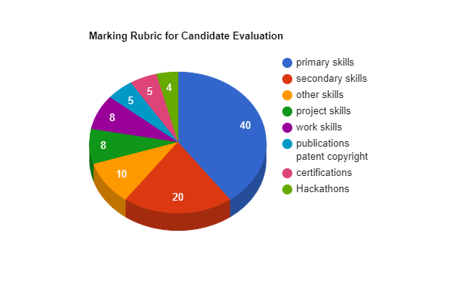
Marking Rubric
‹#›
BRACT’S, Vishwakarma Institute of Information Technology, Pune

Slide 10
6. RESULTS & DISCUSSION
Methodologies | Output Detected | Key Focus | Limitations | Additional Features
Automated Skill Matching | Matched skills and achievements of candidates | Prioritizing key skills and experience | Initial setup requires substantial data input and training | Integrates with existing HR systems
Dynamic Feedback Mechanism | Personalized feedback and improvement suggestions | Enhancing candidate applications | Potential for inaccuracies in feedback due to algorithm flaws | Customized interview preparation tips.
‹#›
BRACT’S, Vishwakarma Institute of Information Technology, Pune

Slide 11
Methodologies | Output Detected | Key Focus | Limitations | Additional Features
Data-Driven Decision Making for HR | Insights and analytics on candidate pool and screening process | Optimizing hiring decisions | Requires continuous data updates for accuracy | Detailed reports for HR professionals
Identification of Skill Gaps | Identification of missing or underdeveloped skills | Addressing candidate skill deficiencies | Dependence on the quality of input data | Suggestions for training and development programs
‹#›
BRACT’S, Vishwakarma Institute of Information Technology, Pune

Slide 12
Platforms | Highly Aligned | Moderately Aligned | Slightly Aligned | Poorly Aligned
Proposed Platform | 70.72 | 42.80 | 33.92 | 20.63
Resumeworded | 95 | 56 | 40 | 30
Panna.ai | 69 | 45 | 27 | 27
Proposed Platform: Scores Highly Aligned resumes at 70.72 by considering a wide range of factors (technical skills, soft skills, experience, education, certifications). This makes it a more comprehensive tool.
Resumeworded: Scores Highly Aligned resumes at 95, but focuses mainly on skill matching between the resume and job description.
Panna.ai: Scores Highly Aligned resumes at 69, using a range of parameters similar to the proposed platform (technical skills, soft skills, experience, certifications).
‹#›
BRACT’S, Vishwakarma Institute of Information Technology, Pune

Slide 13
7. CONCLUSION & FUTURE WORK
Increased Efficiency.
Improved Accuracy.
Bias Reduction.
Constructive Feedback.
Data-Driven Decisions.
Scalability.
Future work focuses on enhancing contextual skill understanding, improving precision in candidate-job matching, assessing soft skills implicitly, enabling self-assessment and outcome review, and developing interview preparation guidance systems with feedback mechanisms.
‹#›
BRACT’S, Vishwakarma Institute of Information Technology, Pune

Slide 14
8. REFERENCES
[1] Dr. Sandeep Tayal.; Taniya Sharma.; Shivansh Singhal.;Anurag Kumar Thakur.;Resume Screening Using Machine Learning. 2024
[2] Lokesh. S.; Mano Balaje. S.; Prathish. E and B. Bharathi.;Resume Screening and Recommendation System using Machine Learning Approaches. 2022
[3] Mehul Patel.; Savio Rodricks.;Samuel Emmatty.; Aaron Pereira.; Resume Screening using Machine Learning. 2023
[4] Nunna Prasanna Sai Venkatesh.;. K.N.L. Lavanya.; Murapaka Sivasankar.; Vegesna Somanadha Mahidhar Varma.; Mr. K. Surya Ram Prasad.; NLP Automated Resume Analysis and Skill Suggesting Website. 2024
‹#›
BRACT’S, Vishwakarma Institute of Information Technology, Pune

Slide 15
THANK YOU
BRACT’S, Vishwakarma Institute of Information Technology, Pune

