Slide 1



Call center voice clustering
Guide: Manisha Bharati
Sanket shirse
Shubham Asabe
Rohan Salvi
Vipul Ahire

Slide 2
Aim
Currently, call center agents interact with customers and try to facilitate and fulfil the customer needs. As part of the solution, we need to classify the customer conversations into different categories of calls linked with automotive industry (i.e., new vehicle purchase enquiries, test drive request, breakdown assistance, roadside assistance etc.) for necessary action by the business

Slide 3
Problem Statement
To evaluate audio clips from a contact center conversation between the customer and the contact center agent and classify the calls into different categories viz;
New vehicle purchase
Test drive requests
Breakdown
Feedback

Slide 4
Motivation
In today's world ,in call center there is a lot of waiting for thousands of people at a time ,to make this quick and efficient we are going to work on this project
This was the problem statement given by TCS in their hackathon

Slide 5
Objective
We need to evaluate audio clips from a contact center conversation between the customer and the contact center agent and classify the calls into different categories listed below:
1. New vehicle purchase enquiries ( i.e., Enquiry on latest or future or existing product features, price, availability, closest showroom to drop in for purchase or exchange, etc.)
2. Test drive requests ( i.e., Calls for booking test drives, follow up calls with customers to schedule the same, confirmation that test drive has been done as per schedule or with delayed schedule, etc.)
3. Breakdown ( i.e., Customer calling contact center to report vehicle break down and providing his location details for repair or breakdown assistance, Road assistance mechanic reaching out to customer and reaching location with preliminary input on vehicle condition )
4. Feedback ( Feedback collected post sales /service on vehicle delivery on customer sales/ service experience)
5. Vehicle Quality ( Complaints of the vehicle parts not functioning properly, repetitive complaints, etc. - except breakdowns and failures

Slide 6
Literature survey
Sr no.​ | Paper Title​ | Idea/Algorithm description​ | Problem found​
​1 | Multiclass Digital Audio Segmentation with MFCC​ Features using Naive Bayes and SVM Classifiers(2019)(ASYU)​ | ​Detects Silence, Speech and Music | Detects only audio segments​
2 | Analysis of Detected Silent Segments in Call​ Center Recordings(2019)(IDAP)​ | Adaptive amplitude Threshold, Entropy and variance, RNN​ | Solution for audio processing​
3​ | Feature Selection for Anomaly Detection in Call Center Data(2019) (ELECO)​ | O-SVM, IF and a MG​ | Did not cluster the data
4​ | Text clustering algorithm based on deep​ representation learning(2018 )(The Journal of Engineering)​ | K-means, VSM (TF-TDF),CNN)​ | Did not deal with audio data set​
5​ | Artificial Neural Networks in Customer Segmentation(2019)(SIU)​ | MLP​​ | More into visualization, Don’t deal with audio data​​

Slide 7
Literature survey
Sr no.​ | Paper Title​ | Idea/Algorithm description​ | Problem found​
​6 | Mobile Phone Clustering From Speech Recordings Using Deep Representation and Spectral Clustering(2018) | MFCC,SVM
7 | A Hybrid Approach for Mobile Phone Clustering With Speech Recordings(2019) | MFCCs, MPC | Speech recording over mobile phones
8 | Machine Learning-based Silence Detection in Call Center Telephone Conversations(2019) | Naive Bayes, MFCC, K means
9 | Classification Techniques for Automatic Speech Recognition (ASR) Algorithms used with Real Time Speech Translation(2017) | DTW,MFCC,HMM | Works on small dataset
10 | A Review on Emotion Recognition using Speech(2017) | MFCC,RNN,KNN,LPCC | Rises problem with Different size of audio
Notes:
Probabilistic yin

Slide 8
source of data
http://www.cs.toronto.edu/~complingweb/data/karaOne/karaOne.html
http://www.cs.toronto.edu/~complingweb/data/TORGO/torgo.html
http://kahlan.eps.surrey.ac.uk/savee/

Slide 9
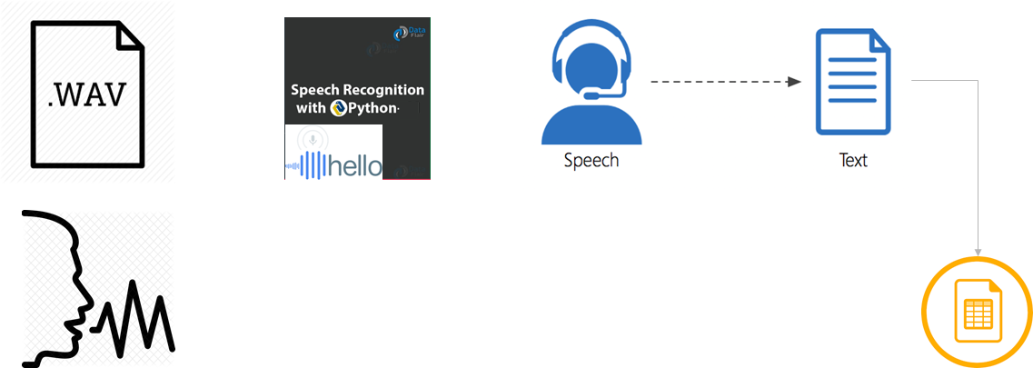
Pre-Processing Approach
The audio is converted into text via python code.
The Text is sent into a txt file.
Further the text file Is sent for processing as final input.

Slide 10
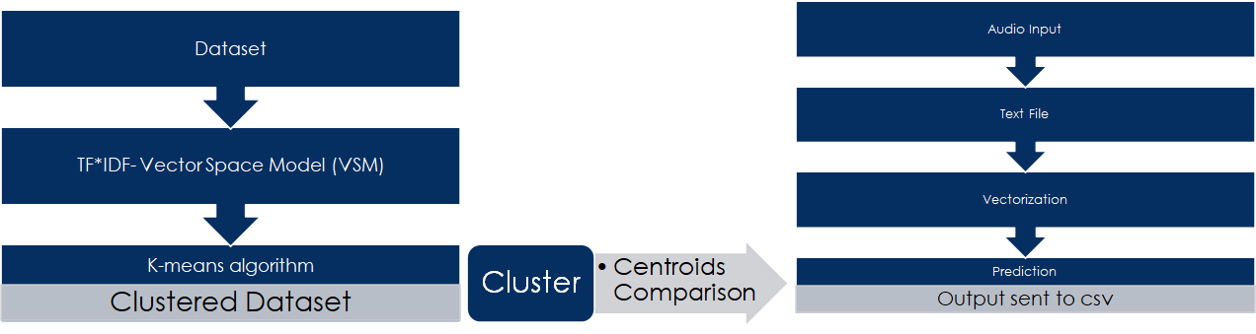
Solution architecture

Slide 11
Software/Hardware requirements
Python 3 or +
Any IDE/Jupyter/Google Colab Notebook
Any pc Config >= i3
Python Libraries (Pandas, Scikit)

Slide 12
Algorithm
TF*IDF algorithm is used for weighing a keyword in any content and assign the importance to that keyword based on the number of times it appears in the document.
•The value of K defines the Number of clusters that is the 5 categories we are choosing.
•More number of clusters = more numbers of divisions
Advantages of K-Means:
•Widely used method for cluster analysis
•Easy to understand

Slide 13
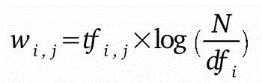
TF-IDF
Term frequency-inverse document frequency also called tf-idf, is a well-known method to evaluate how important is a word in a document. tf-idf are also a very interesting way to convert the textual representation of information into a Vector Space Model (VSM).
TF*IDF is an information retrieval technique that weighs a term’s frequency (TF) and its inverse document frequency (IDF). Each word or term has its respective TF and IDF score. The product of the TF and IDF scores of a term is called the TF*IDF weight of that term. We have to create vectorizer using Tfidf Vectorizer class to fit and transform the document which we have created.

Slide 14
Thank You

