Slide 1



Call center voice clustering
Rohan Salvi
Shubham Asabe
Sanket Shirse
Vipul Ahire

Slide 2
Aim
Currently, call center agents interact with customers and try to facilitate and fulfil the customer needs. As part of the solution, we need to classify the customer conversations into different categories of calls linked with automotive industry (i.e., new vehicle purchase enquiries, test drive request, breakdown assistance, roadside assistance etc.) for necessary action by the business

Slide 3
Motivation
In today's world ,in call center there is a lot of waiting for thousands of people at a time ,to make this quick and efficient we are going to work on this project
This was the problem statement given by TCS in their hackathon

Slide 4
Objective
We need to evaluate audio clips from a contact center conversation between the customer and the contact center agent and classify the calls into different categories listed below:
1. New vehicle purchase enquiries ( i.e., Enquiry on latest or future or existing product features, price, availability, closest showroom to drop in for purchase or exchange, etc.)
2. Test drive requests ( i.e., Calls for booking test drives, follow up calls with customers to schedule the same, confirmation that test drive has been done as per schedule or with delayed schedule, etc.)
3. Breakdown ( i.e., Customer calling contact center to report vehicle break down and providing his location details for repair or breakdown assistance, Road assistance mechanic reaching out to customer and reaching location with preliminary input on vehicle condition )
4. Feedback ( Feedback collected post sales /service on vehicle delivery on customer sales/ service experience)
5. Vehicle Quality ( Complaints of the vehicle parts not functioning properly, repetitive complaints, etc. - except breakdowns and failures

Slide 5
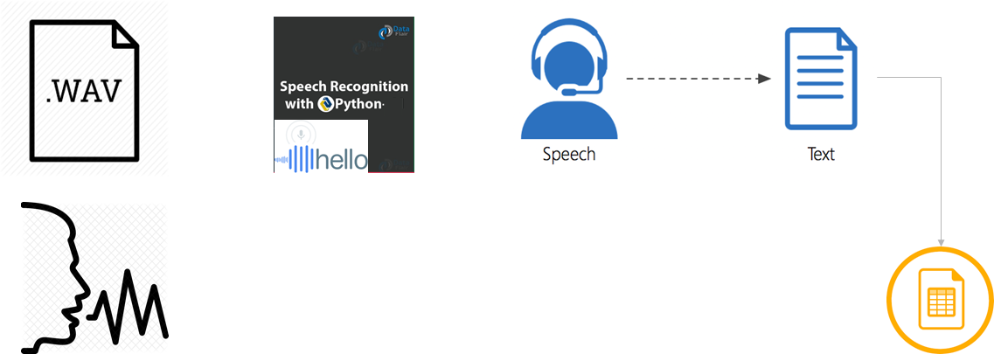
Pre-Processing Approach
The audio is converted into text via python code.
The Text is sent into a txt file.
Further the text file Is sent for processing as final input.

Slide 6
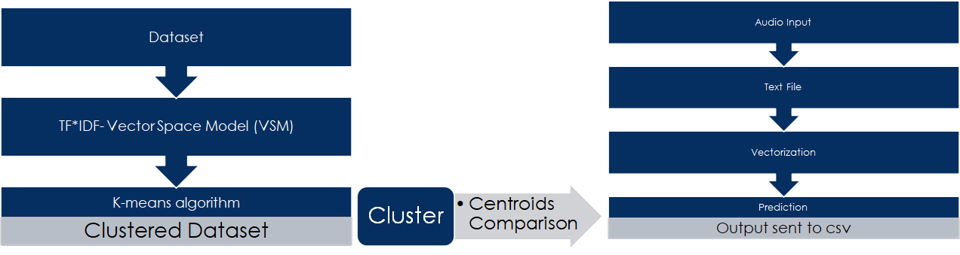
Solution architecture

Slide 7
Algorithm
TF*IDF algorithm is used for weighing a keyword in any content and assign the importance to that keyword based on the number of times it appears in the document.
•The value of K defines the Number of clusters that is the 5 categories we are choosing.
•More number of clusters = more numbers of divisions
Advantages of K-Means:
•Widely used method for cluster analysis
•Easy to understand

Slide 8
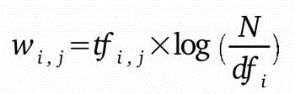
TF-IDF
Term frequency-inverse document frequency also called tf-idf, is a well-known method to evaluate how important is a word in a document. tf-idf are also a very interesting way to convert the textual representation of information into a Vector Space Model (VSM).
TF*IDF is an information retrieval technique that weighs a term’s frequency (TF) and its inverse document frequency (IDF). Each word or term has its respective TF and IDF score. The product of the TF and IDF scores of a term is called the TF*IDF weight of that term. We have to create vectorizer using Tfidf Vectorizer class to fit and transform the document which we have created.

Slide 9
Sr no. | Paper Title | Idea/Algorithm description | Problem found
1 | Feature Selection for Anomaly Detection in Call Center Data(2019) (ELECO) | O-SVM, IF and A MG | Did not cluster the data
2 | Text clustering algorithm based on deep representation learning(2018 )(The Journal of Engineering) | RNN, CNN, LSTM,TF IDF | Did not deal with Audio data
3 | Multiclass Digital Audio Segmentation with MFCC Features using Naive Bayes and SVM Classifiers(2019)(ASYU) | Detects Silence, Speech, and Music | Detects only audio segments
4 | Analysis of Detected Silent Segments in Call Center Recordings(2019)(IDAP) | Adaptive amplitude Threshold, Entropy and variance, RNN | Solution for audio processing
5 | Artificial Neural Networks in Customer Segmentation(2019)(SIU) | MLP | More into visualization, Don’t deal with audio data
Notes:
International Conference on Electrical and Electronics Engineering, ELECO
The Journal of Engineering Open source run by Research4Life
Innovations in Intelligent Systems and Applications Conference
Mel Frequency Cepstral Coefficients (MFCC)
Support Vector Machines(svm)
2019 International Artificial Intelligence and Data Processing Symposium (IDAP)
Signal Processing and Communications Applications Conference (SIU)
multi layer perceptron(MLP)

Slide 10
Software/Hardware requirements
Python 3.0+
Any IDE/Jupyter/Google Colab Notebook
Any pc Config >= i3
Python Libraries (Pandas, Scikit, Numpy)

Slide 11
Thank You

