Slide 1

Call Center Voice Clustering​
Guide: Prof. Manisha Bharati
Rohan Salvi 24140​
Sanket Shirse 24239​
Vipul Ahire 24245
Shubham Asabe 24250 ​

Slide 2
Agenda
Introduction
Motivation
Objectives
Literature Survey
Authentications Used
Hardware & Software Requirements
Block Diagram
System Architecture
System Flow
System Diagram
Use Case Diagram
Future Scope
Conclusion
References
Question-Answer

Slide 3
Aim
Nowadays, Call Center agents interact with customers and try to facilitate and fulfill the customer needs. As part of the solution, we need to classify the customer Request in Text Format To Service Call Center into different categories of Request linked with automotive industry (i.e., new vehicle purchase enquiries, test drive request, breakdown assistance, roadside assistance, Insurance, Servicing etc.) for necessary action by the business.​
We need to Customer Request in Text Format To Service Call Center for classify the Request into different categories listed below:​
New vehicle purchase enquiries ( i.e., Enquiry on latest or future or existing product features, price, availability, closest showroom to drop in for purchase or exchange, etc.)​
Test drive requests ( i.e., Request for booking test drives, follow up Request with customers to schedule the same, confirmation that test drive has been done as per schedule or with delayed schedule, etc.)​
Breakdown ( i.e., Customer Send Request TO contact center to report vehicle break down and providing his location details for repair or breakdown assistance, Road assistance mechanic reaching out to customer and reaching location with preliminary input on vehicle condition )​
Feedback ( Feedback collected post sales /service on vehicle delivery on customer sales/ service experience)​

Slide 4
Motivation
In today's world , many customer send request to call center there is a lot of waiting for thousands of people at a time ,to make this quick and efficient we are going to work on this project​.
All call centers use manual or IVR based routing so our project can help to do automation.
This was the problem statement given by TCS in their hackathon.

Slide 5
Objective
To provide better services and better customer relationship.
Automate the call routing from department to department.
To learn about clustering concepts.

Slide 6
Literature Survey
Sr no.​​ | Paper Title​​ | Idea/Algorithm description​​ | Problem found​​
​1​ | Multiclass Digital Audio Segmentation with MFCC​​ Features using Naive Bayes and SVM Classifiers(2019)(ASYU)​​ | ​Detects Silence, Speech and Music​ | Detects only audio segments​​
2​ | Analysis of Detected Silent Segments in Call​​ Center Recordings(2019)(IDAP)​​ | Adaptive amplitude Threshold, Entropy and variance, RNN​​ | Solution for audio processing​​
3​​ | Feature Selection for Anomaly Detection in Call Center Data(2019) (ELECO)​​ | O-SVM, IF and a MG​​ | Did not cluster the data​
4​​ | Text clustering algorithm based on deep​​ representation learning(2018 )(The Journal of Engineering)​​ | K-means, VSM (TF-TDF),CNN)​​ | Did not deal with audio data set​​
5​​ | Artificial Neural Networks in Customer Segmentation(2019)(SIU)​​ | MLP​​​ | More into visualization, Don’t deal with audio data​​​
Notes:
Support Vector Machine/​
Mel Frequency Cepstral Coefficients feature extraction​
Isolation forests Multivariate Gaussian​
multilayer perceptron​
Probabilistic yin​
Support Vector Machine/​
Mel Frequency Cepstral Coefficients feature extraction​
Isolation forests Multivariate Gaussian​
multilayer perceptron​

Slide 7
Hardware & Software Requirements
OPERATING SYSTEM​ | WINDOWS XP/7/10​
Development Framework​ | Java Framework 1.8 JDK​
Programming Language​ | Java 8.1​
Database​ | MySQL 5.5​
IDE​ | Eclipse ​

Slide 8
DFD Flow
Request speech to text or type request
Stop words elimination
Customer
Classify request types
Final output
Send request to department

Slide 9
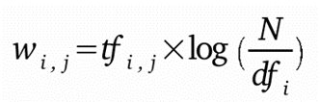
Algorithm TF-IDF
Term frequency-inverse document frequency also called tf-idf, is a well-known method to evaluate how important is a word in a document. tf-idf are also a very interesting way to convert the textual representation of information into a Vector Space Model (VSM).​
TF*IDF is an information retrieval technique that weighs a term’s frequency (TF) and its inverse document frequency (IDF). Each word or term has its respective TF and IDF score. The product of the TF and IDF scores of a term is called the TF*IDF weight of that term. We have to create vectorizer using Tf-idf Vectorizer class to fit and transform the document which we have created.
Notes:
Term frequency-inverse document frequency is used to evaluate how important word is in the document
This is done by multiplying two metrics:​
- Easy to compute​ - You have some basic metric to extract the most descriptive terms in a document​ - You can easily compute the similarity between 2 documents using it​.
O(nL log nL)

Slide 10
K-MEANS
K-Means algorithm is an iterative algorithm that tries to partition the dataset into K pre-defined distinct non
overlapping subgroups (clusters) where each data point belongs to only one group. It tries to make the intra
cluster data points as similar as possible while also keeping the clusters as different (far) as possible. It assigns data
points to a cluster such that the sum of the squared distance between the data points and the cluster’s centroid
(arithmetic mean of all the data points that belong to that cluster) is at the minimum. The less variation we have
within clusters, the more homogeneous (similar) the data points are within the same cluster.
The value of K defines the Number of clusters that is the 5 categories we are choosing. More number of clusters = more numbers of divisions
Advantages of K-Means:
Widely used method for cluster analysis
Easy to understand
Notes:
K-means clustering is one of the simplest and popular unsupervised machine learning algorithms.
Every data point is allocated to each of the clusters through reducing the in-cluster sum of squares.

Slide 11
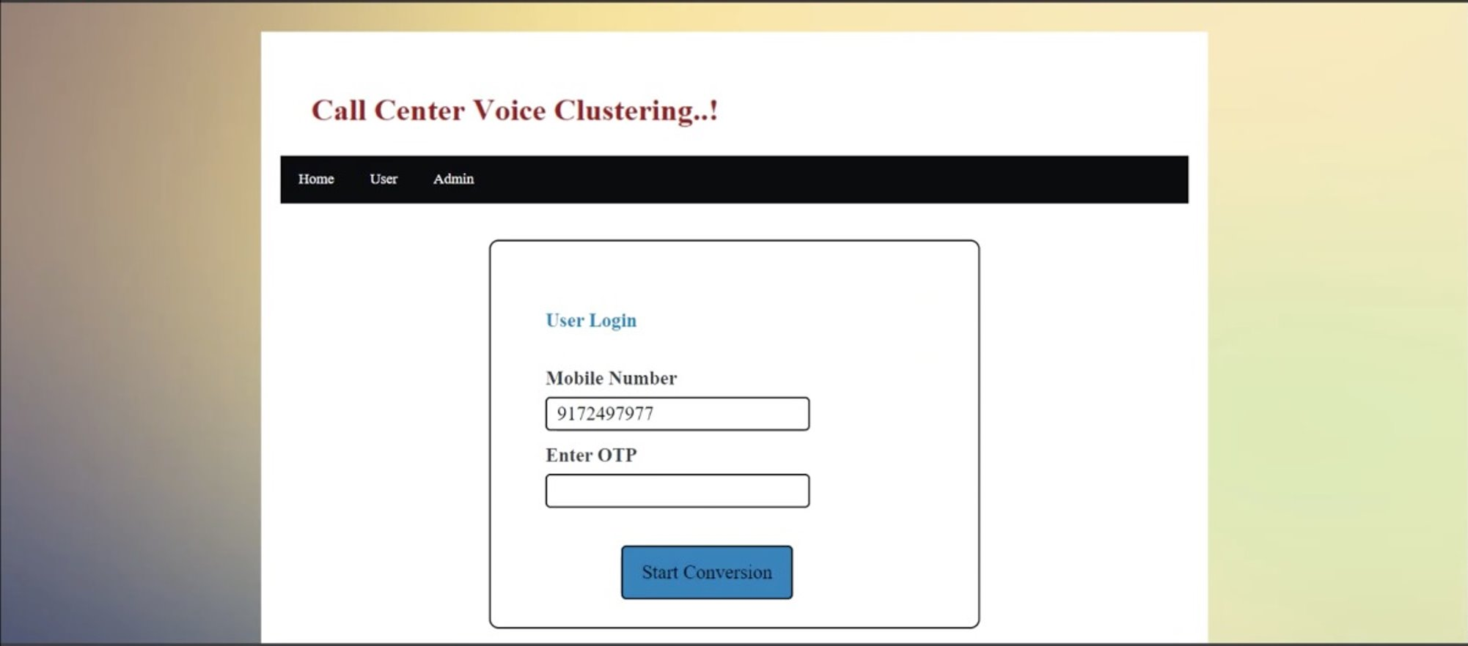
Outputs

Slide 12
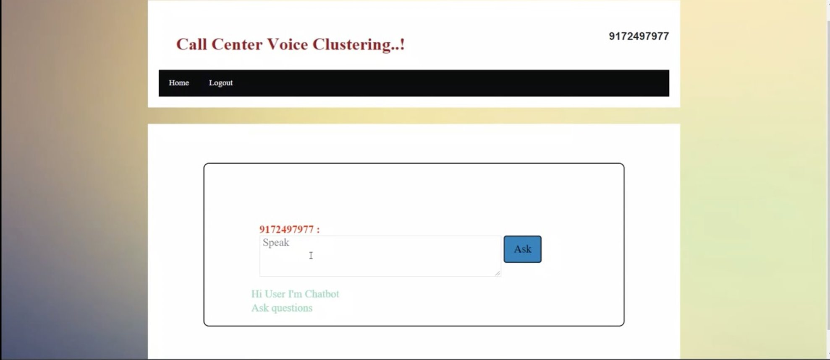
Output

Slide 13
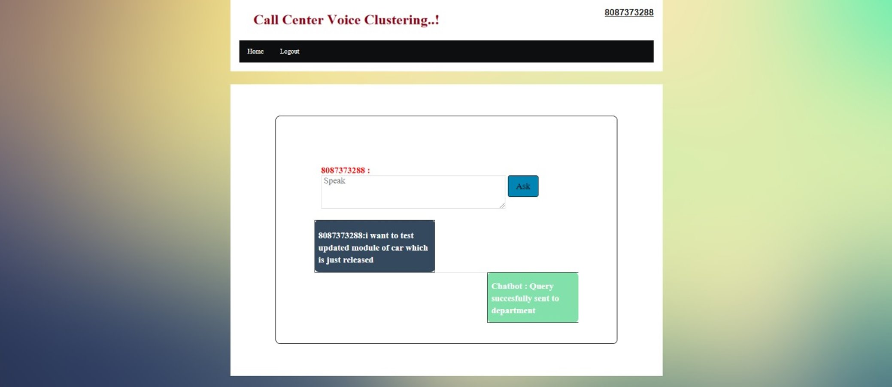
Output

Slide 14
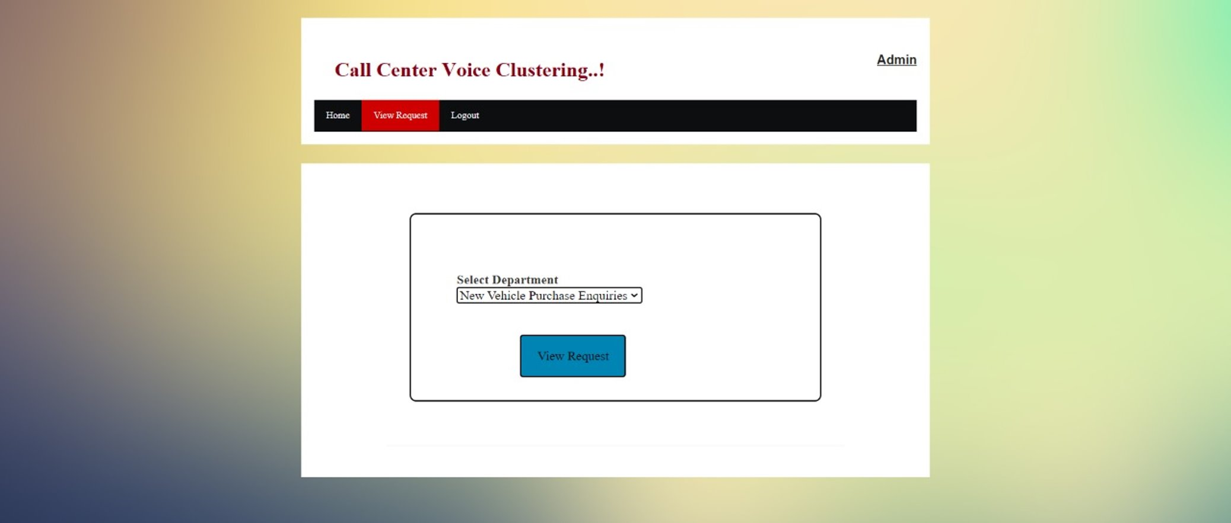
Output

Slide 15

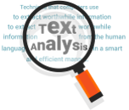
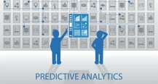
Future Applications
Call Center Speech Analytics
Speech Analytics is a fairly new and relatively rare field, but one that many early adopters are finding significant success with.
2. Call Center Text Analytics
Text analytics can review and monitor not only the messages sent to customers, but also the message they are sending to the company. This is vital in seeing any potential issues through the customer lens.
3. Predictive Analytics
The modern predictive analysis engine is an invaluable tool in the call center environment.

Slide 16
Conclusion
Although promising results have been achieved in this work, there are some issues that can be further investigated by the call center experts. But we can conclude that now is possible to implement an automatic classification system to online monitor the service quality. Finally, it can be concluded that the obtained text mining results can be used in the industry to: Understand the needs of customers while accessing preferred customers.

Slide 17
Reference
1. Multiclass Digital Audio Segmentation with MFCC Features using Naive Bayes and SVM Classifiers(2019)(ASYU)
2. Analysis of Detected Silent Segments in Call Center Recordings(2019)(IDAP)
3. Feature Selection for Anomaly Detection in Call Center Data(2019) (ELECO)
4. Text clustering algorithm based on deep representation learning(2018 )(The Journal of Engineering)
5. Artificial Neural Networks in Customer Segmentation(2019)(SIU)
6. Mobile Phone Clustering From Speech Recordings Using Deep Representation and Spectral Clustering(2018)
7. A Hybrid Approach for Mobile Phone Clustering With Speech Recordings(2019)
8. Machine Learning-based Silence Detection in Call Center Telephone Conversations(2019)
9. Classification Techniques for Automatic Speech Recognition (ASR) Algorithms used with Real Time Speech Translation (2017)
10. A Review on Emotion Recognition using Speech(2017)

Slide 18
THANK YOU
Notes:
O(nL log nL)
where n is total number of sequences in a dataset, and L the average length of sequences in a dataset.

