Slide 1

AutoML Using Gen AI Akanksha Barge
Abhishek Dongre
Shubham Gadhave
Jawahar Education Society’s
A. C.Patil College of Engineering, Kharghar
Department of Artificial Intelligence & Data Science
Under the Guidance of
Prof. Suresh Pingale
Date:-30/8/2024

Slide 2
Outline
Introduction
Objective
Motivation
Literature Survey
Problem Statement
Proposed System
Working
Conclusion
References

Slide 3
Introduction
The aim of this project is to automate the machine learning model selection process, streamline data insights, and provide feature engineering suggestions using Gemini AI integration. This web-based platform allows users to upload their CSV datasets, identifies whether the task is classification or regression, and automatically applies a variety of machine learning algorithms. The system generates detailed performance reports and provides insights to improve models and optimize feature engineering

Slide 4
Objectives
1. Automated Model Selection: The system will automatically select appropriate machine learning models (classification or regression) based on the dataset.
2. Data Insights with Gemini API: By integrating Gemini AI, the system will provide data summaries, feature suggestions, and insights into how to improve model performance and feature engineering.
3. Model Evaluation: Evaluate various machine learning models and present detailed performance metrics, including accuracy, root mean square error (RMSE), precision, recall, and more.
4. Report Generation: Provide users with a detailed report on the performance of different models, highlighting the best-performing models for their use case.
5. Ease of Use: Create a user-friendly platform where users can upload datasets, view results, and download reports without requiring advanced machine learning expertise.

Slide 5
Motivation
This project addresses the growing complexity in machine learning by automating model selection, data insights, and feature engineering. By integrating Gemini AI, our web-based platform allows users to upload datasets, automatically identify task types (classification or regression), and apply suitable ML algorithms. The system generates detailed performance reports and provides actionable insights to optimize models. This streamlines the ML process, making it more accessible and efficient, enabling businesses and developers to focus on strategic decisions and accelerate innovation.

Slide 6
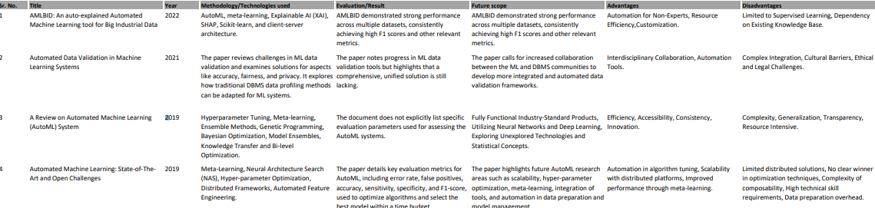
Literature Survey

Slide 7
Problem Statement
The problem this project addresses is the difficulty and inefficiency in navigating the machine learning process, especially for non-experts. As businesses increasingly rely on data-driven decisions, they face challenges in selecting the right models, tuning them effectively, and optimizing feature engineering. These tasks often require specialized knowledge and significant time investment, leading to delays and suboptimal outcomes. Without streamlined processes and automated tools, organizations struggle to fully leverage their data, limiting their ability to innovate and stay competitive.

Slide 8
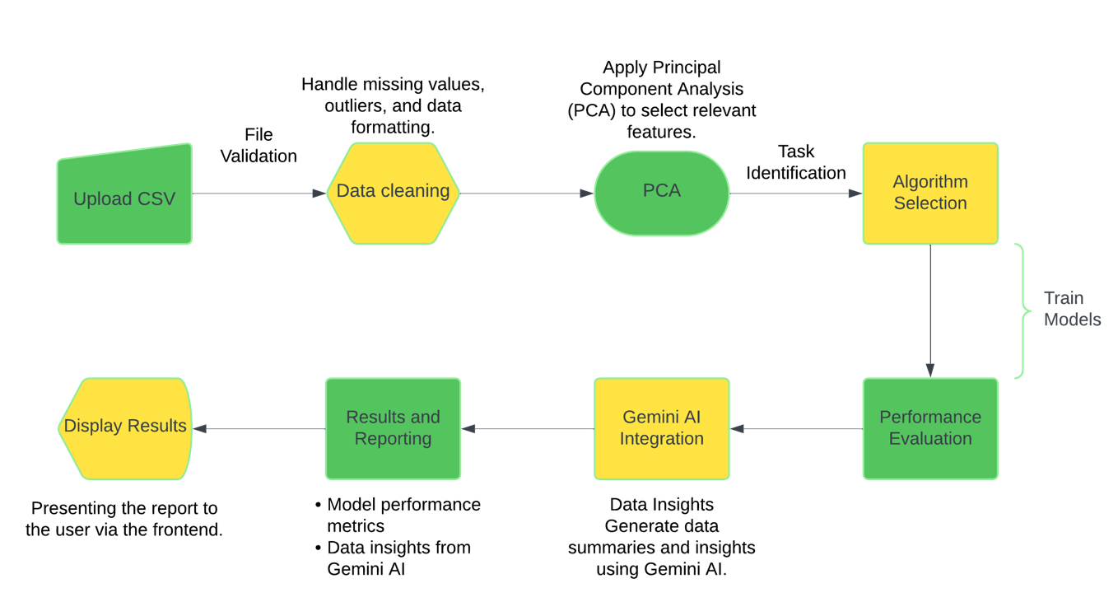
Proposed System

Slide 9
Working
1. Data Upload and Preprocessing: User uploads CSV dataset via the web interface.System checks for missing values, irrelevant columns, and data type mismatches.
Preprocess data:
- Encode categorical variables.
- Handle missing data.
- Scale features using PCA.
2. Model Selection and Training : Detect task type (classification or regression) based on the target column.Train multiple machine learning models. Apply cross-validation to evaluate model performance.
3. Ensemble Learning (Optional) : Implement ensemble techniques (e.g., bagging with Random Forest, boosting with XGBoost). Combine models to improve accuracy and reduce overfitting.
4. Model Evaluation and Reporting: Evaluate models using:
- Classification: Accuracy, Precision, Recall, F1 Score, ROC-AUC.
- Regression: RMSE, MAE, R².
- Generate a comparative performance report.
- Allow user to download the report.
5. Insights and Recommendations from Gemini AI : Provide actionable insights to enhance model performance.Offer feedback on feature importance for further feature engineering or reduction.

Slide 10
Conclusion
This project offers a powerful solution to the challenges faced in the machine learning process by automating model selection, data insights, and feature engineering. Through the integration of Gemini AI, it empowers users to efficiently utilize their data, regardless of their expertise level, and accelerates the deployment of high-performing models. By streamlining these complex tasks, the platform not only enhances productivity but also drives better decision-making and innovation, helping businesses maintain a competitive edge in an increasingly data-driven world.

Slide 11
References
[1] Karim Ahmed and Lorenzo Torresani. Maskconnect: Connectivity learning by gradient descent. Lecture Notes in Computer Science, page 362ˆaA¸S378, 2018. ˘ [2] Peter J Angeline, Gregory M Saunders, and Jordan B Pollack. An evolutionary algorithm that constructs recurrent neural networks. IEEE transactions on Neural Networks, 5(1):54–65, 1994.
[3] Peter Bailis, Edward Gan, Samuel Madden, Deepak Narayanan, Kexin Rong, and Sahaana Suri. Macrobase: Prioritizing attention in fast data. In Proceedings of the 2017 ACM International Conference on Management of Data, SIGMOD ’17, pages 541–556, New York, NY, USA, 2017. ACM.
[4] Bowen Baker, Otkrist Gupta, Nikhil Naik, and Ramesh Raskar. Designing neural network architectures using reinforcement learning. arXiv preprint arXiv:1611.02167, 2016.
[5] R´emi Bardenet, M´aty´as Brendel, Bal´azs K´egl, and Michele Sebag. Collaborative hyperparameter tuning. In International conference on machine learning, pages 199–207, 2013.

Slide 12
Thank You

