Slide 1


DATA DRIVEN POWER CONSUMPTION
- Te a m B y t e b o t s .
• To achieve the goal of sustainability, our aim is to reduce the overall power consumption at office premises.
• Design the solution such as to provide the power consumption prediction and suggest the optimize way of power utilization
PROBLEM STATEMENT

Slide 2
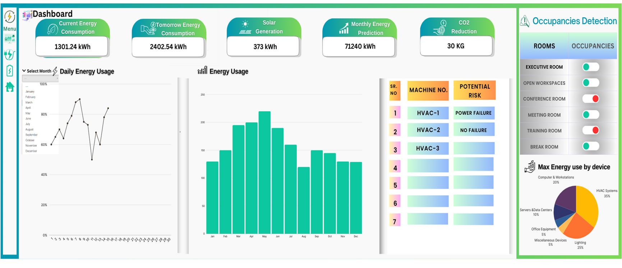
PROPOSED SYSTEM
DAILY CONSUMPTION PREDICTION
MONTHLY CONSUMPTION PREDICTION
SOLAR ENERGY PREDICTION
PREDICTIVE MAINTENANCE
OCCUPANCY DETECTION
01.
MONTHLY
CONSUMPTION
PREDICTION
03.
04.
HVAC
OPTIMIZATION
05.
SOLAR ENERGY PREDICTION
06.

Slide 3

FUTURE SCOPE
1. Cloud Integration: Move data processing and storage to the cloud for better scalability and reliability.
2. User Roles and Permissions: Add features to manage multiple users with different access levels for larger organizations.
3. Localization and Language Support: Adapt the dashboard for different regions with local languages and units ofmeasurement
4. Data Security Enhancements: Strengthen security protocols to protect sensitive energy and operational data as the user base grows.

