Slide 1
SMART GARDENING
NEED OF NATURE

Slide 2
CONTENT
Abstract
Introduction
NODEMCU
Components
Sensors
WORKING
Product Validation-NEED,CONS ,PROS
Product Design & Development
Implementation
Conclusion
Citation
Credits

Slide 3
ABSTRACT
SMART GARDENING SYSTEM using IoT is a system that uses computers or mobile devices to control basic plant needs through internet from anywhere around the world.
The system will automatically update and display on the basis of live sensors’ data.
This system is designed to be expandable allowing a variety of devices to be controlled.

Slide 4
INTRODUCTION
When you spend 9 hours in a office and 2 hours in traffic it is obvious that your favorite rose or lily plant may get neglected but now for this problem we are here with a perfect solution
This project of smart gardening is important in order to encourage people to garden which is very important for reducing the carbon dioxide content in the environment.
This project presents a possible solution whereby the user controls devices/ sensors and lights.

Slide 5
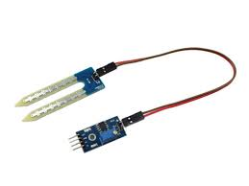
SENSORS
Sr.no. | SENSORS | USE1
1. | DHT11 | Temperature & humidity sensor
2. | SOIL MOISTURE | Detect moisture of the soil

Slide 6
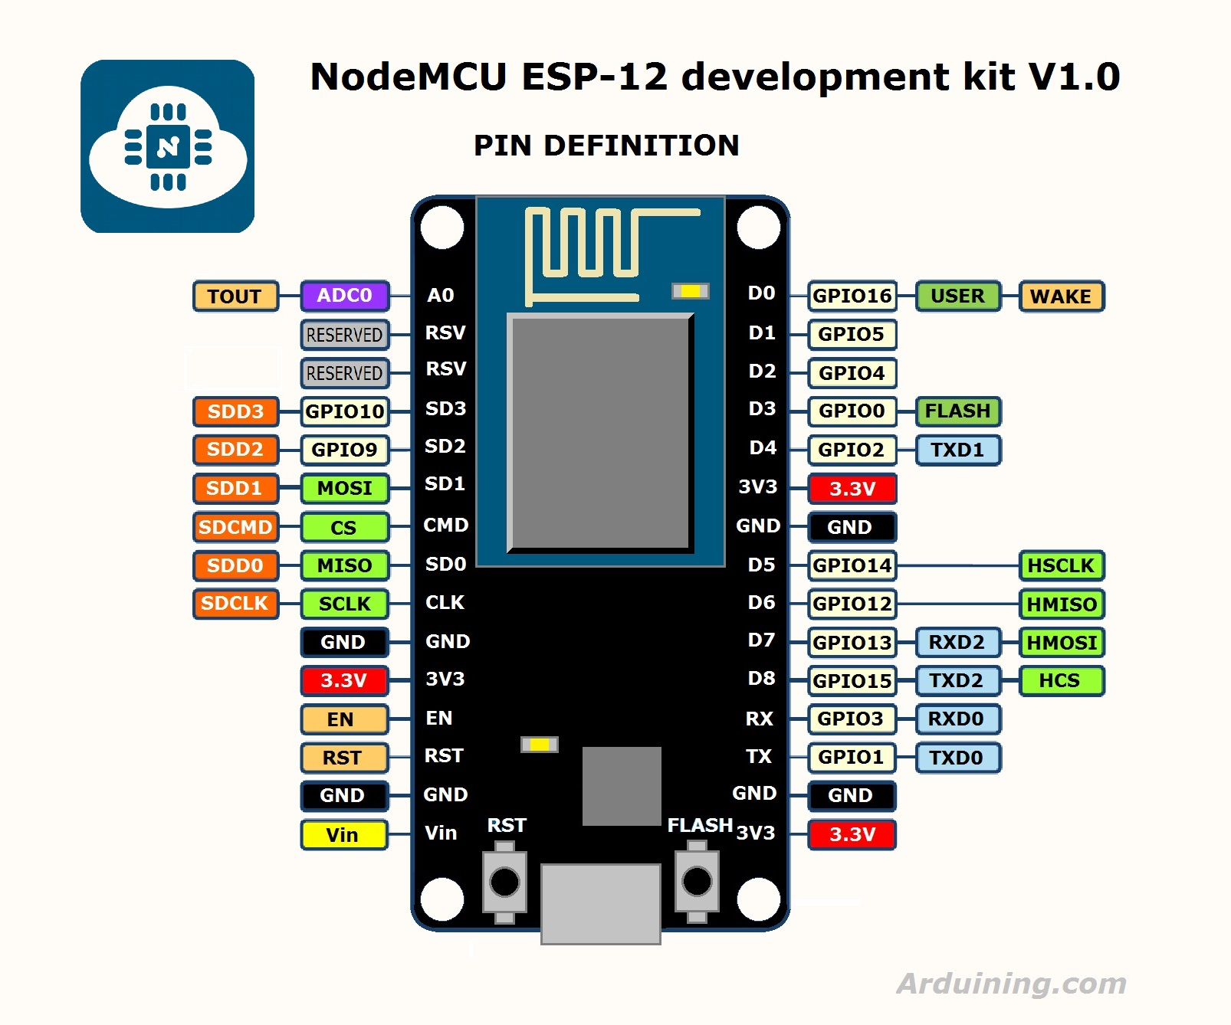
NODEMCU
Developer-ESP8266 open source Community
Type-Single board microcontroller
Operating System-XTOS
CPU-ESP8266(LX106)
Memory-128Kb
Storage-4Mb
Power-USB

Slide 7
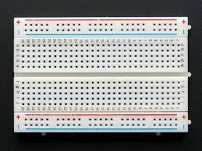
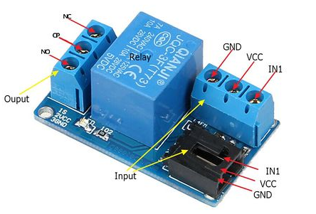
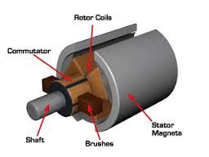
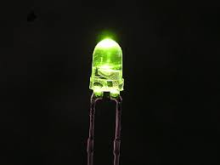
Components
Sr no. | Component | Use
1. | Breadboard | Interconnect circuit design
2. | Jump wires | For connecting components without soldering
3. | Motors | For motion of Sprinklers
4. | Relay | As a switch
5. | LED | As a Indicator

Slide 8
WORKING
Web app
Wi-Fi or Network
Cloud
Wi-Fi
Smart garden HUB
System and sensors
Web app
Wi-Fi or Network
Cloud
Wi-Fi
Smart garden HUB
System and sensors

Slide 9
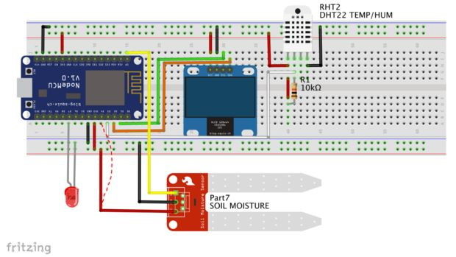
ON BOARD CONNECTIONS

Slide 10
Concept Validation
The idea of this project is old one but it has been developed and presented with more accuracy, efficiency and utility.
Ease of access of your garden will truly encourage you to love your plants as they will be less demanding.
And the most important part you don’t need to be a scientist to understand the common aspects like humidity, temperature etc.
In nut-shell the project is for common public. Who want to pay attention and maintain their plants but cant do because of various reasons.

Slide 11
PROS &CONS
PROS
the smart garden is easy to maintain.
You may set it to your requirement .
The smart garden is easy set of sensor so one can take care from miles away.
you may link this smart garden to Alexa or google assistant as per your requirement.
It can set alerts for you to shape your plant and to add fertilizers in it.
CONS
Complexity-it can cause due to software Bug.
Privacy-you may lost your privacy as you have to give all data to system.
Safety- There is a chance that the software can be hacked and your personal information may misused

Slide 12
Development & Design
The idea is to have an soil moisture sensor , Temperature sensor on the ESP8266 node mcu, take the decision to whether to provide water or not and for how long.
In order to control, it is necessary to monitor the variable continuously.
Smart sprinkler and irrigation controllers can simplify home lawn and garden care, reduce water consumption, and help owner to utilize resources optimally.
Instead of fixed timers, these systems draw on data from sensors, plant care databases to determine watering needs and deliver just enough moisture at just the right time.

Slide 13
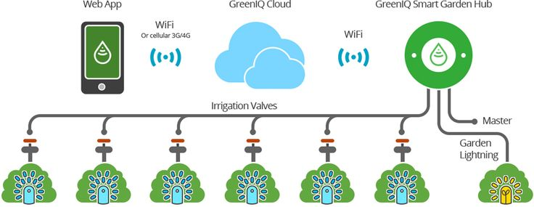
IMPLEMENTATION
Automated System
Monitior soilvital through moisture sensors
Determine best time to water plant from probing temperature & lights

Slide 14
CONCLUSION
Smart Gardening is the product which you can handle from miles away just with one TAP.
One easy step can make this earth green and balance the nature and the ecosystem.
We can call it as “click and grow”.

Slide 15
REFERENCES Nitaigour P. Mahalik ,‖ Mechatronics-Principles, Concepts and Applications‖, Tata McGraw Hill, Eleventh reprint 2011. DevdasShetty and Richard A.Kolk, ―Mechatronics System Design‖, Thomson India Edition 2007.

Slide 16
CREDITS
Shubham Bhandari(Group Leader)
Shraddha Bhagure
Purva Mutha
Trupti Chavan
Rohan Baichwal
Alonna Debbarna

