Slide 1

INFO6105 Data Science Engineering Methods and Tools Lending Club - Interest Rate Analysis and Prediction
Group Number – 11
Rishabh Singh (002743830)
Shubham Singh (002762502)

Slide 2
INTRODUCTION
Background:
Lending Club offers loans of various grades they assign that correspond to specific interest rates for investors.
Lending Club is a peer-to-peer lending company, the largest of its kind in the world. It aims to operate a platform at low cost to offer interest rates to our borrower members lower than the rates they could obtain through credit cards or traditional banks.
On the basis of the borrower’s credit score, credit history, desired loan amount and the borrower’s debt-to-income ratio, Lending Club determines whether the borrower is credit worthy and assigns to its approved loans a credit grade that determines payable interest rate and fees

Slide 3

Pros:
Repayment terms of the loan can be stretched up to three years and five years.
Lending Club credit score has a minimum acceptance of 600.
No hard credit inquiry is needed to check rates which comes handy for the customers.
Cons:
Lending Club money requires a seven-day period to become available whereas there are other places that provide money around in a day.
Lending Club will provide an interest rate, but part of that is an origination fee, which will cut into your loan.

Slide 4
Motivation
With the rising popularity of peer-to-peer lending platforms in recent years, investors now have easy access to this alternative investment asset class by lending money to individual borrowers through platforms such as Lending Club, Prosper Marketplace, and Upstart, or to small businesses through Funding Circle
Hence, it is desirable for investors to be able to independently evaluate the credit risk of a large number of listed loans quickly, and invest in those with lower perceived risks
This motivates us to build machine-learned classification and regression models that can quantify the credit risk with a Lending Club historical loan dataset

Slide 5
DATASET OVERVIEW
DATA SOURCE
https://www.kaggle.com/datasets/wordsforthewise/lending-club
These files contain the latest payment information and all the necessary and appropriate loan data for all the loans issued through 2007-2018 which also includes current loan status (Current, Fully Paid, Late, etc.)
For this project, we have used the “accepted_2007_to_2018.csv” file which has details of all Accepted Loans between 2007 and 2018. The file is a matrix that includes a total of 105 variables(Columns) and about 2260701 observations

Slide 6
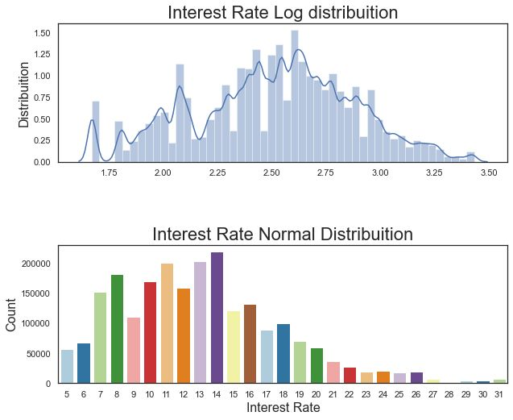
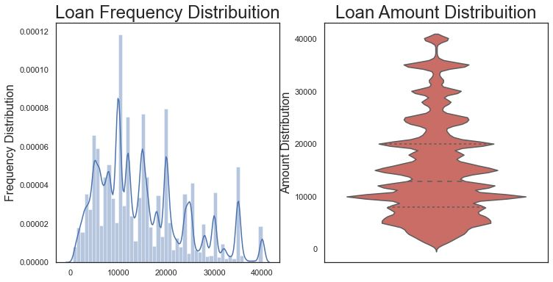
Data Analysis

Slide 7
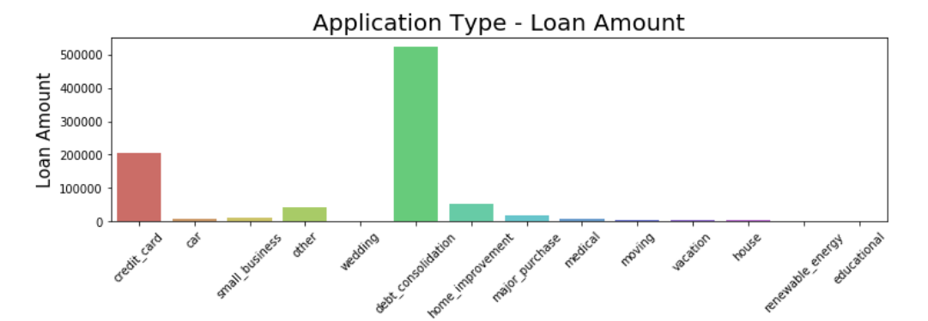
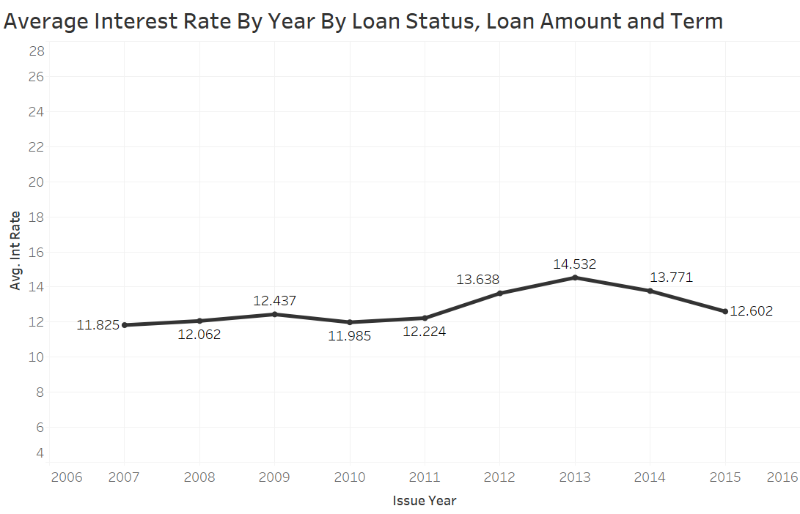
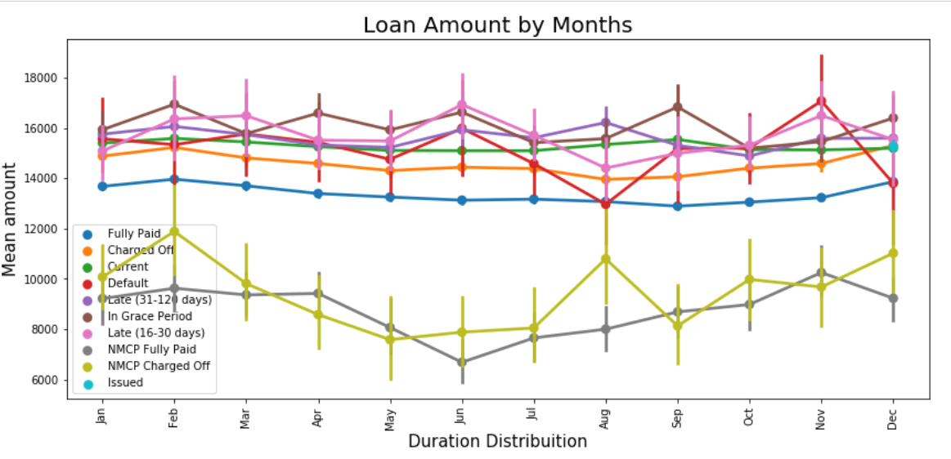

Slide 8
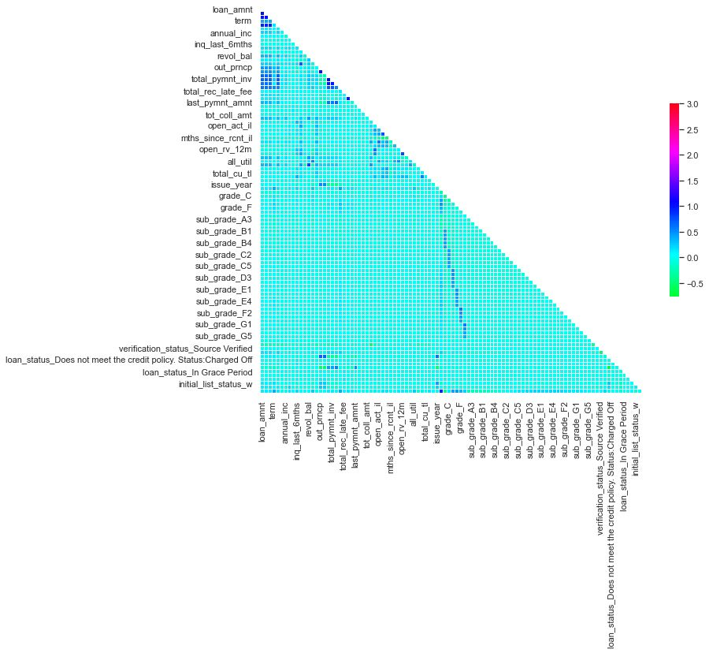
Correlation Analysis

Slide 9
Methodology
Data Collection
Cleaning and Pre-Processing
Importing the Data and removing unnecessary columns
Implementing Simple Imputer to fill missing values
Data Normalization
Feature Selection using LassoCV
Models and Algorithm Used
Linear Regression
Support Vector Regression
Random Forest

Slide 10
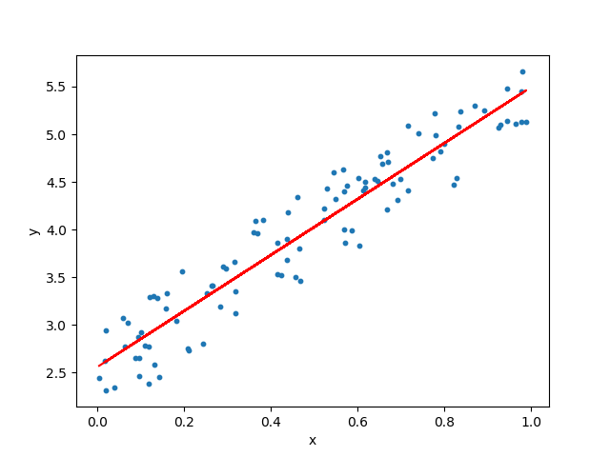
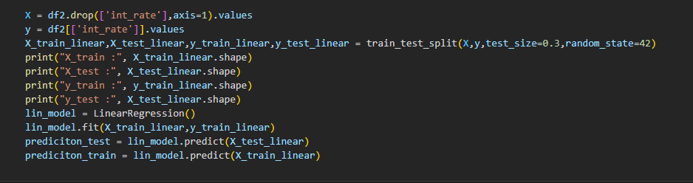
Linear Regression
Linear Regression is a machine learning algorithm based on supervised learning. It performs a regression task. Regression models a target prediction value based on independent variables
We have Performed Linear Regression with a sample test size of 30% and keeping the random state as 42.

Slide 11
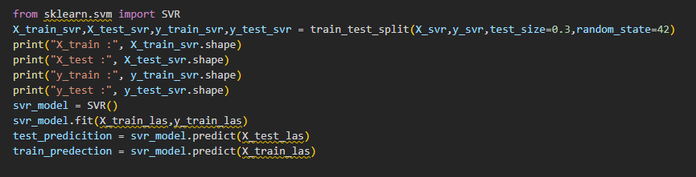
Support Vector Regression
Secondly, we have used Support Vector Regression Algorithm to train our Model.
It uses the same idea of SVM but here it tries to predict the real values. This algorithm uses hyperplanes to segregate the data.
We have Performed Support Vector Regression with a sample test size of 30% and keeping the random state as 42.

Slide 12
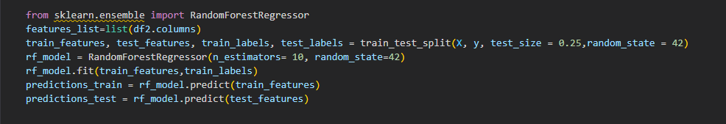
Random Forest
A Random Forest is an ensemble technique capable of performing both regression and classification tasks with the use of multiple decision trees.
The random forest algorithm combines multiple algorithms of the same type i.e. multiple decision trees, resulting in a forest of trees, hence the name "Random Forest".
We have Performed Random Forest with a sample test size of 25% and keeping the random state as 42.

Slide 13
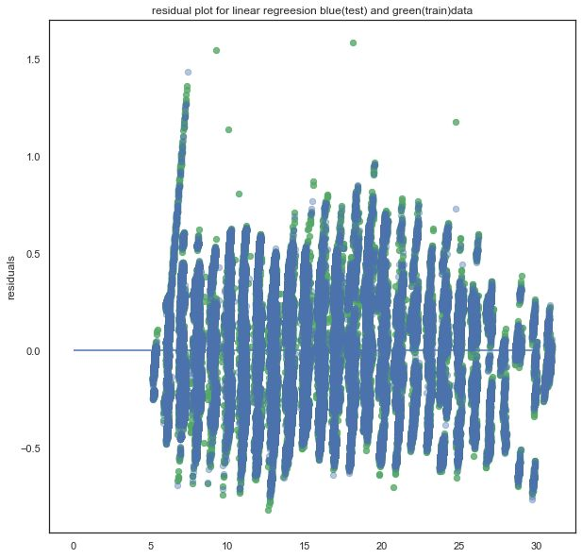
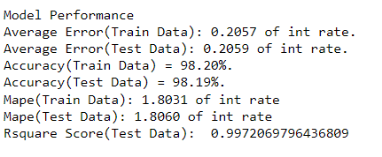
Result and Analysis
Linear Regression

Slide 14
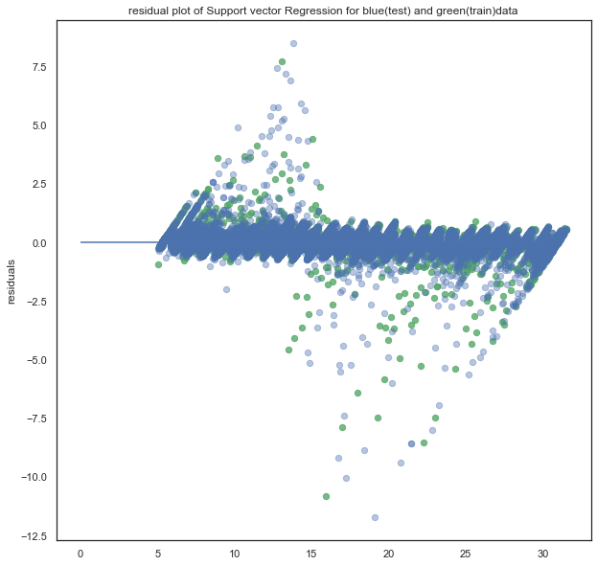
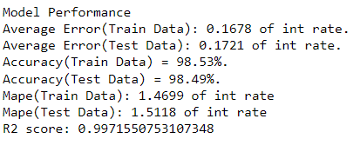
Support Vector Regression

Slide 15
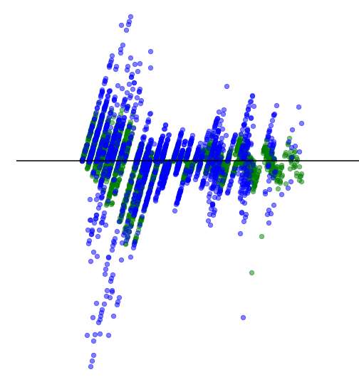
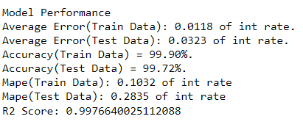
Random Forests

Slide 16
Conclusion
After Running the Dataset on all three above mentioned Algorithm’s, the MAPE for each Model were as follows:
Linear Regression: 1.8
Support Vector Regression: 1.5
Random Forest: 0.3
Amongst all the three models we can see that Random Forest gives us the best predictions. Given, any data from the Dataset, the predicted values can be seen satisfactory as compared to the actual data of interest rates provided by the lending club. So, if we test, our model, against any scenario, be risk averse, risk taking or any other scenario, our model will give a satisfactory predicted estimate of the interest rate. Also, it tells us about the most optimized ML Model that is Random Forest with a MAPE of 0.3 and an Accuracy of 99.72%

Slide 17
References
https://www.lendingclub.com/public/how-peer-lending-works.action
http://cs229.stanford.edu/proj2015/199_report.pdf
https://www.debt.org/credit/loans/personal/lending-club-review/
https://en.wikipedia.org/wiki/LendingClub
http://cs229.stanford.edu/proj2018/report/69.pdf
https://docplayer.net/39484619-3-algorithms-and-results-where-s.html
https://www.analyticsvidhya.com/blog/2021/05/5-regression-algorithms-you-should-know-introductory-guide/
https://en.wikipedia.org/wiki/Random_forest
https://en.wikipedia.org/wiki/Artificial_neural_network
https://www.geeksforgeeks.org/ml-linear-regression/
https://en.wikipedia.org/wiki/LendingClub

Slide 18

Thank You!!

