Slide 1

CITY BIKE Management System
Group 10
Sejal Chandak (002789139)
Krupa Patel (002789566)
Shubham Singh (002762502)
Rishabh Singh (002743830)
Abhishek Sand (002752069)

Slide 2






Overview
Serves in Boston
Metropolitan Area
Fleet of 393 Bike Stations & 3800 Bikes
Easily available &
affordable pricing
Higher usage → higher inefficiency in ride booking & payments
Proposing a better & efficient RDBMS

Slide 3




Problem Statement
Persistent payment issues & slow loading of the application
Fare calculation w.r.t time duration, membership & discount coupons
Providing membership options: Weekly pass, Monthly pass, Yearly pass , etc
Data encryption using Symmetric key for privacy of coupon code.

Slide 4

Proposed Solution
1.Created an Entity Relationship Diagram with tables and entities to explain relationship between tables
2.Created Database , Tables and data inside the tables using insert statements
3. Applied table level constraints , data encryption and computed columns
4.Functions : Created functions for table level constraints and computed columns
5.Views : Created views for reporting purpose
6.Triggers : Created trigger on updation

Slide 5
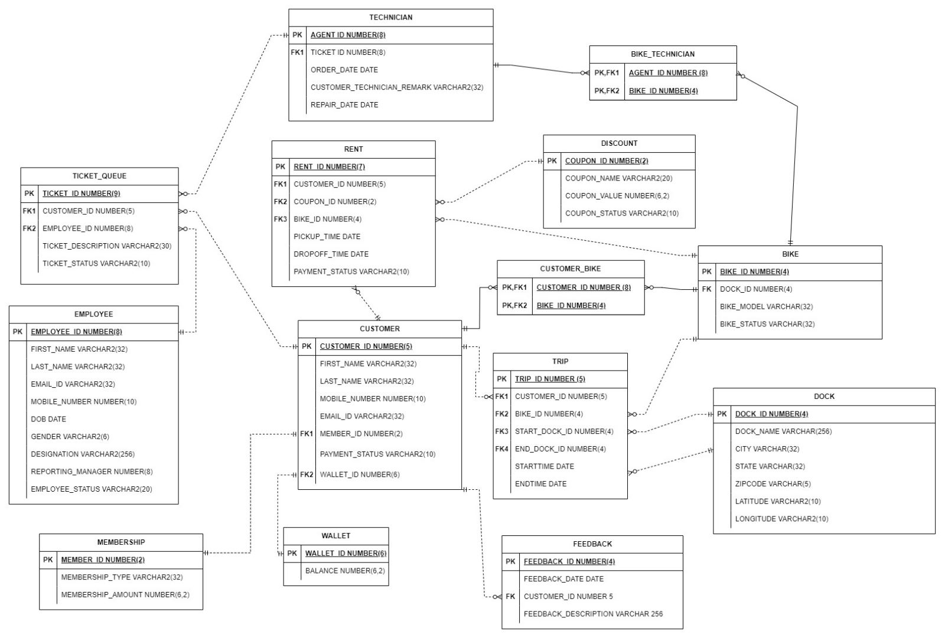
ERD

Slide 6
Technical Aspects Covered
Stored Procedures
Functions
Sequences
Triggers
Views
Table-Level Check Constraint
Computed Columns
Data Encryption for Security

Slide 7
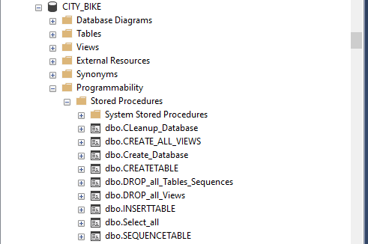
Stored Procedure

Slide 8
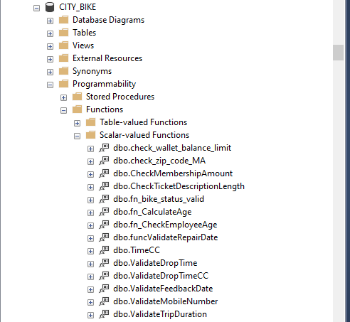
Functions

Slide 9
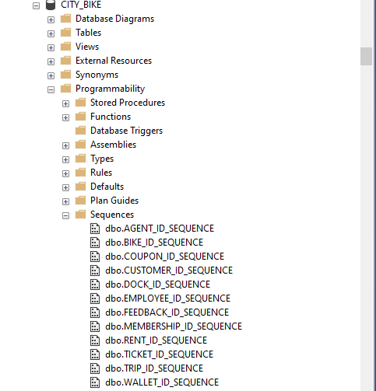
Sequences

Slide 10
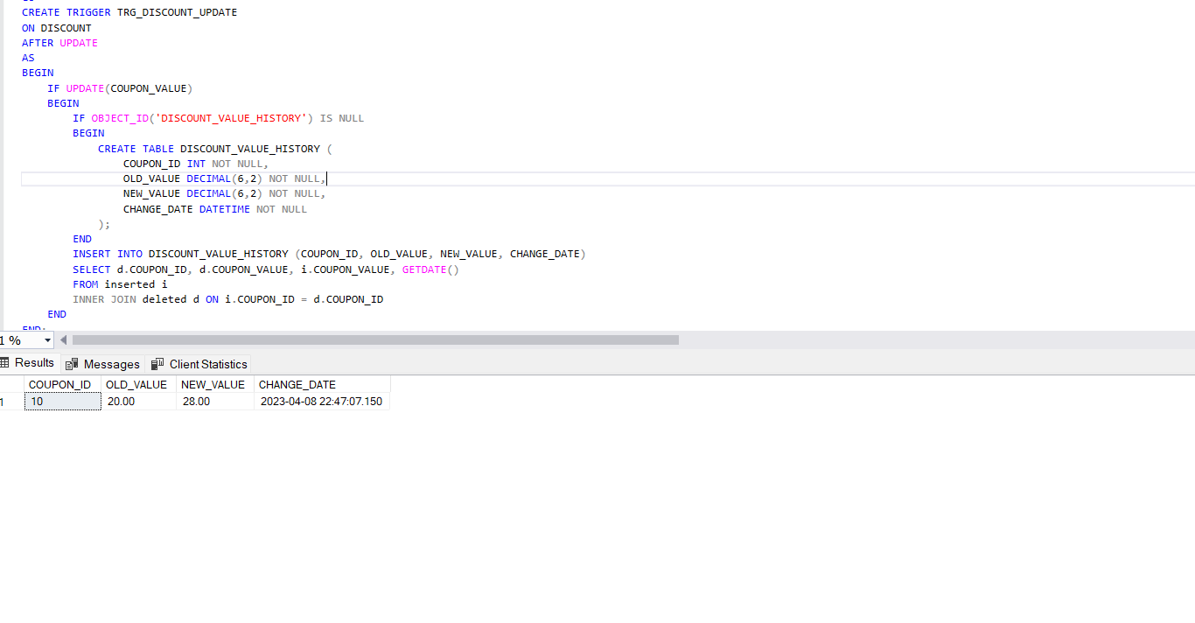
Trigger: Coupon Value Update

Slide 11
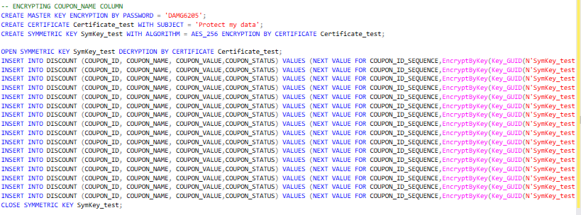
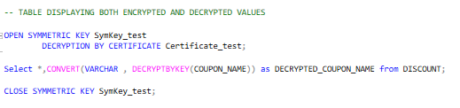
Data Encryption

Slide 12
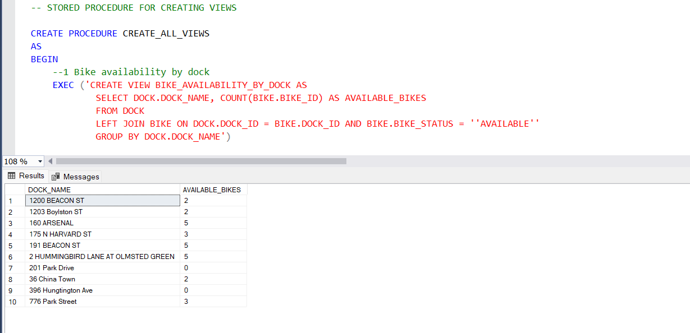
Report 1– Bike available at dock

Slide 13
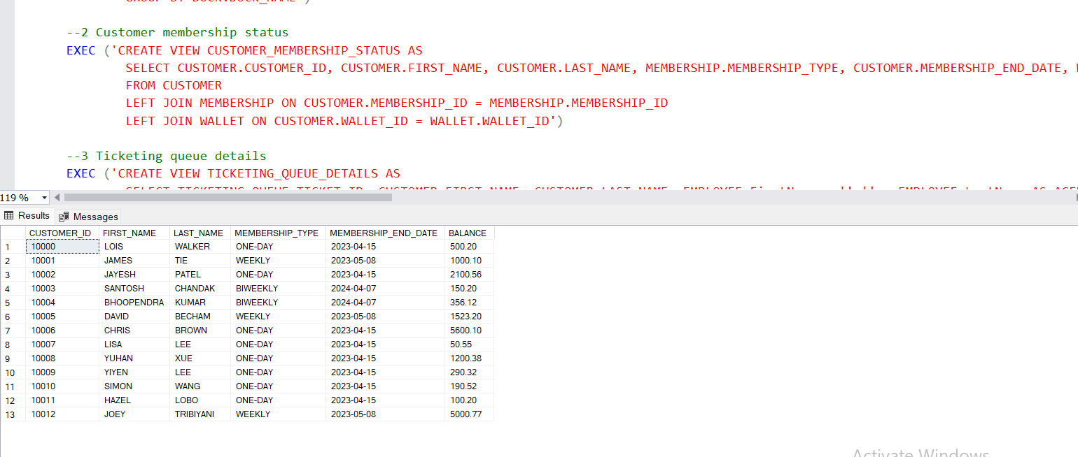
Report 2– Customer Membership Status

Slide 14
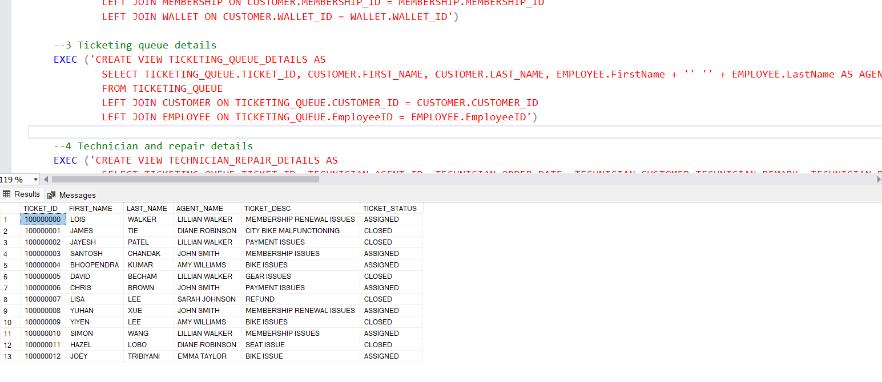
Report 3– Ticketing Queue Details

Slide 15
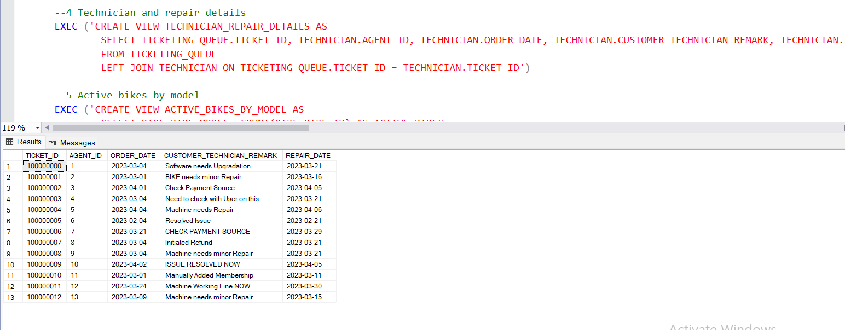
Report 4– Technician and Repair Details

Slide 16
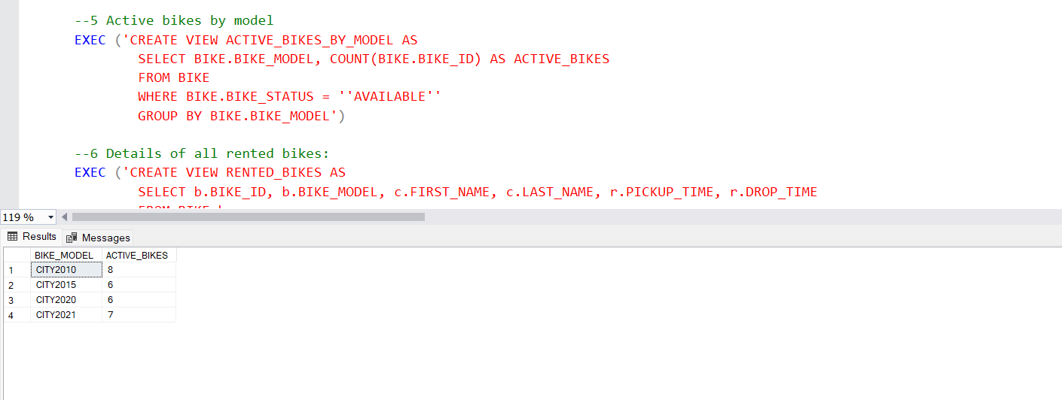
Report 5– Active Bikes by Model

Slide 17
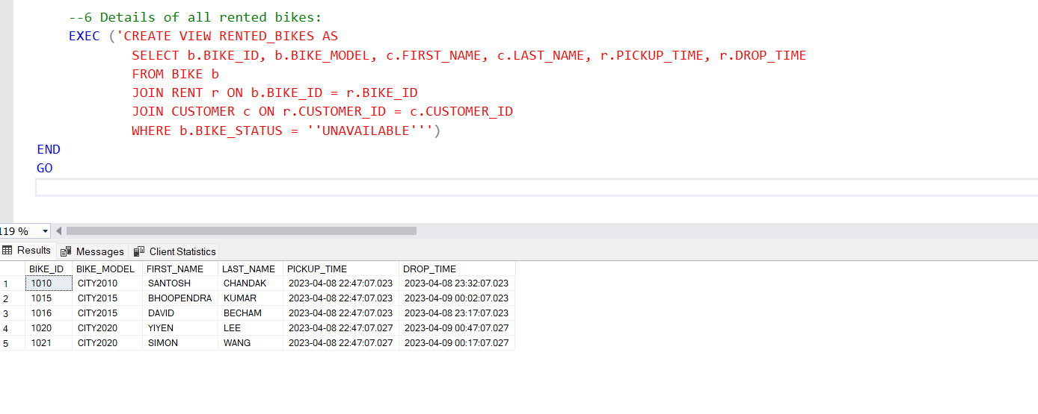
Report 6– Details of Rented Bikes

Slide 18

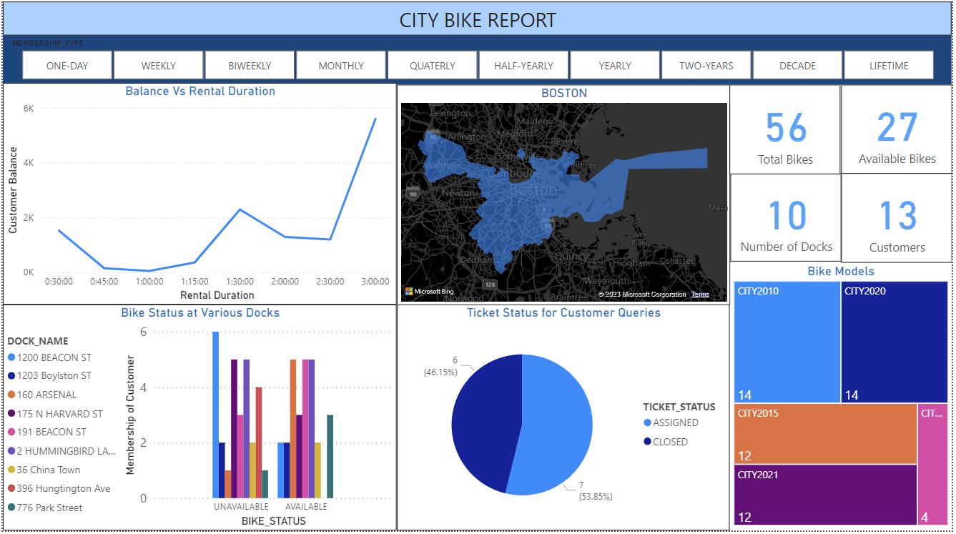
Power Bi Dashboard

Slide 19
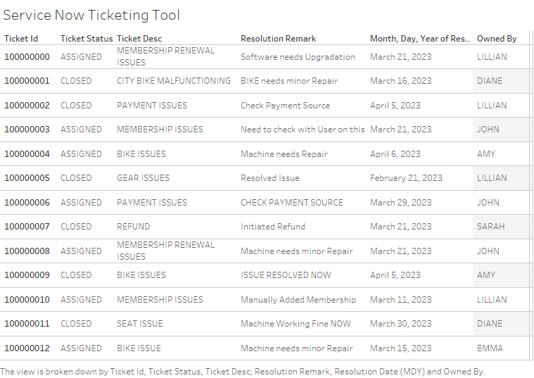
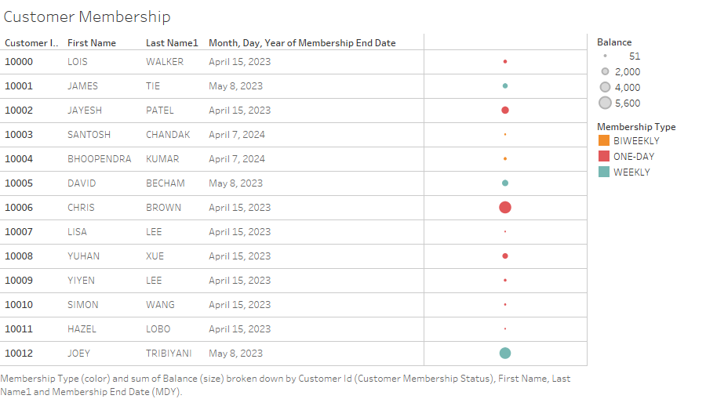
Tableau Dashboard

Slide 20
DEMO

Slide 21

Thank You

