Slide 1





Medical Insurance Price Prediction Model USING
aws sagemaker

Slide 2






Summary of Project
In this project, I used AWS SageMaker to build, train, and deploy a machine learning model to predict medical insurance prices.
1. Environment Setup: Set up the environment for SageMaker to access AWS resources, including S3 for storage and IAM roles for permissions.
2. Data Preparation: I uploaded the training and test data to Amazon S3 in a format compatible with SageMaker's algorithm
3.Model Training: I used SageMaker’s Linear Learner algorithm, configured hyperparameters like epochs, batch size, and ran the training on an EC2 instance.
4.Model Deployment: After training, I deployed the model to a real-time endpoint in SageMaker to serve predictions.
5 .Model Testing: I tested the deployed model using CSV input, and handled serialization and deserialization to get predictions.
These steps covered training, building, and deploying the model. Further details are in the project’s Jupyter notebook.

Slide 3



Welcome to the
Project
MEDICAL INSURANCE PRICE PREDICTION MODEL USING
AWS SAGEMAKER

Slide 4
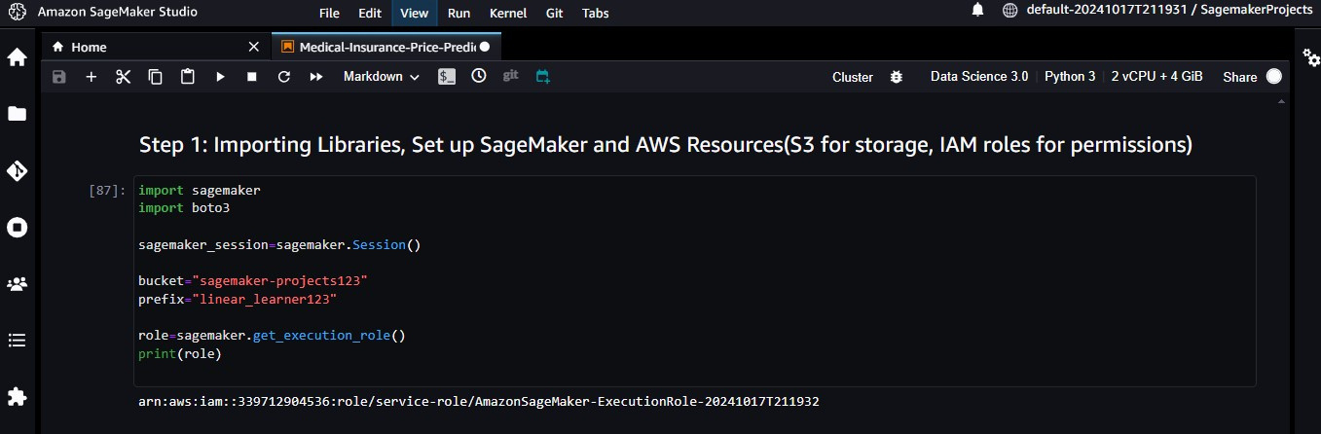
MEDICAL INSURANCE PRICE PREDICTION MODEL USING AWS SAGEMAKER
Step-1
Model Building, Training and Deployment by AWS SageMaker
Welcome to the
Project

Slide 5
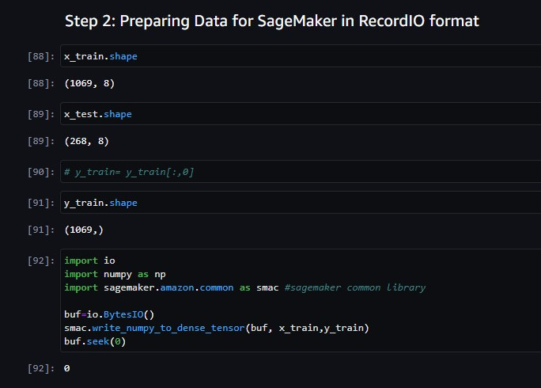
MEDICAL INSURANCE PRICE PREDICTION MODEL USING AWS SAGEMAKER
Step-2
Welcome to the
Project

Slide 6
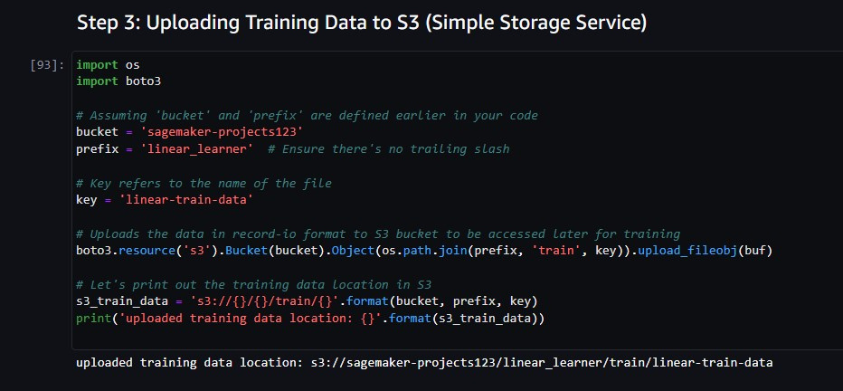
MEDICAL INSURANCE PRICE PREDICTION MODEL USING AWS SAGEMAKER
Step-3
Welcome to the
Project

Slide 7
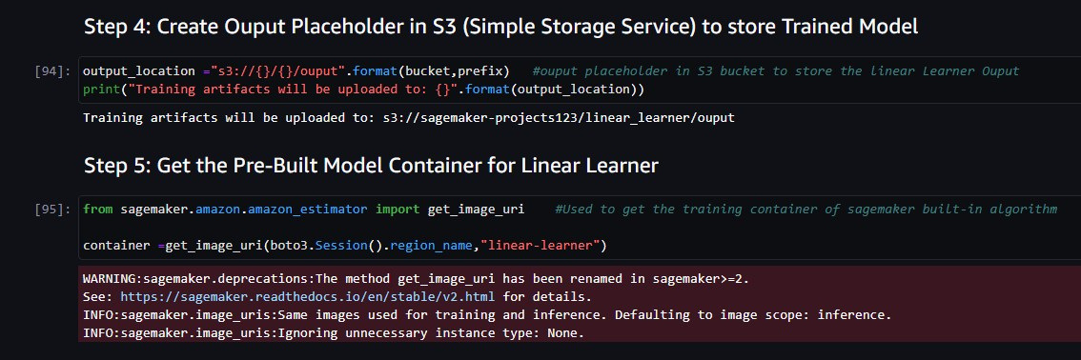
MEDICAL INSURANCE PRICE PREDICTION MODEL USING AWS SAGEMAKER
Step-4 & Step-5

Slide 8
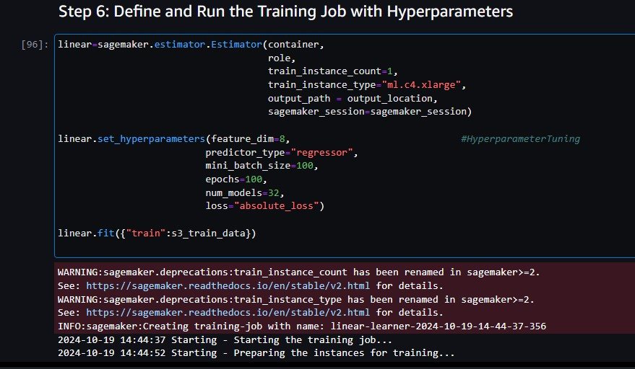
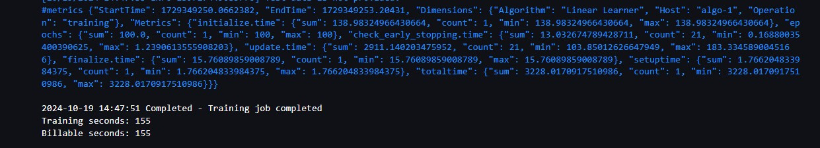
MEDICAL INSURANCE PRICE PREDICTION MODEL USING AWS SAGEMAKER
Step-6
Welcome to the
Project

Slide 9
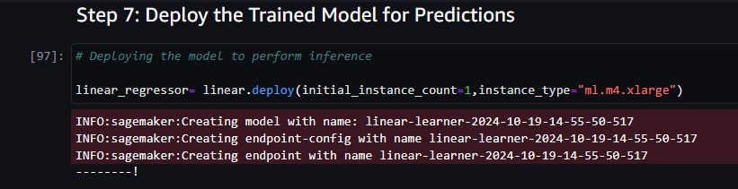
MEDICAL INSURANCE PRICE PREDICTION MODEL USING AWS SAGEMAKER
Step-7
Welcome to the
Project

Slide 10
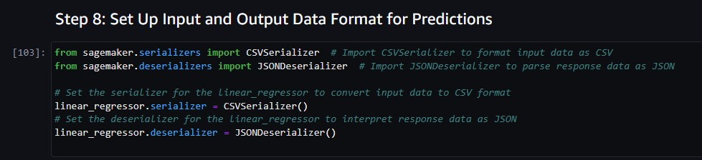
MEDICAL INSURANCE PRICE PREDICTION MODEL USING AWS SAGEMAKER
Step-8
Welcome to the
Project

Slide 11
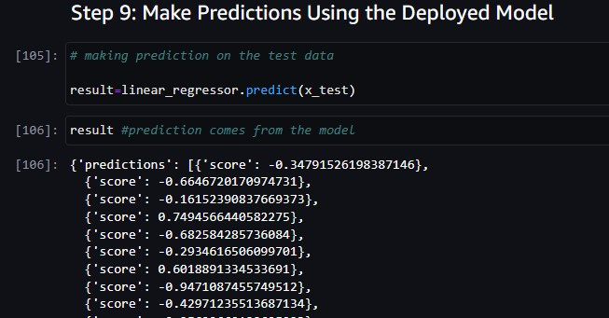
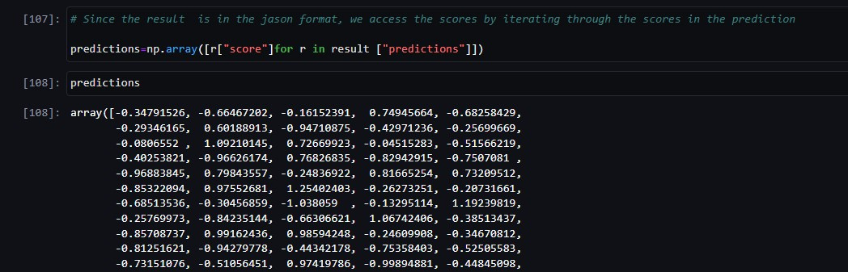
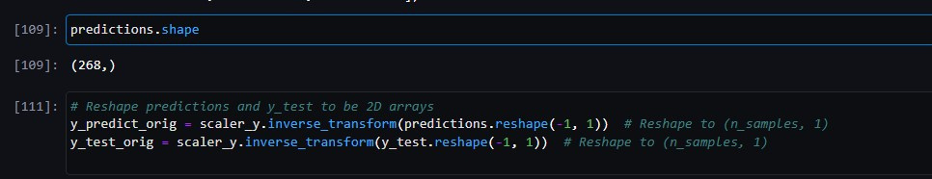
MEDICAL INSURANCE PRICE PREDICTION MODEL USING AWS SAGEMAKER
Step-9
Welcome to the
Project

Slide 12
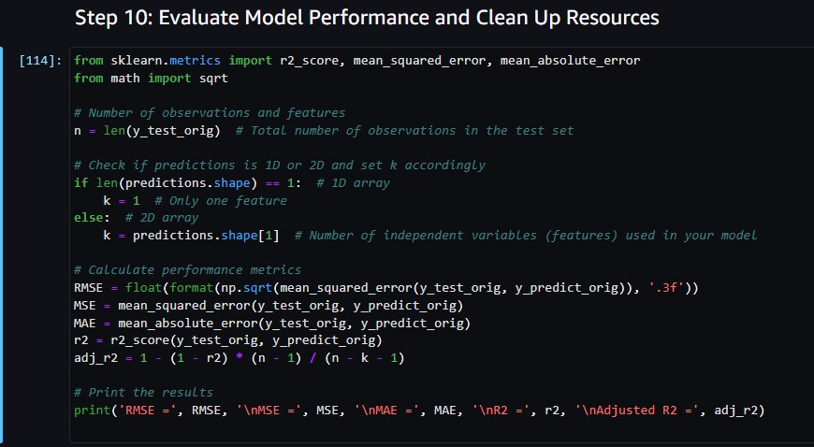
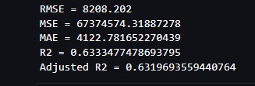
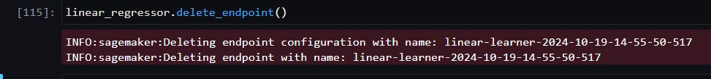
MEDICAL INSURANCE PRICE PREDICTION MODEL USING AWS SAGEMAKER
Step-10
Welcome to the
Project

Slide 13
Model Performance or Accuracy of Model is Low Due to:
1. Non Linear Data: The features (age, BMI, etc.) exhibit non linear relationships with the target (insurance price), making it challenging for the linear model to capture all patterns.
2. Sensitivity to Outliers: Linear regression is sensitive to outliers, and the dataset includes critical outliers that significantly impact prices. Removing them would reduce the model’s ability to predict real world cases.

Slide 14









MEDICAL INSURANCE PRICE PREDICTION MODEL USING AWS SAGEMAKER
Thank you for watching my project! I appreciate your time and feedback.
Shubham Kumar
Dubey9245@gmail.com
www.linkedin.com/in/shubham-kumar-556a81303
https://github.com/Shubhamd1234

