Slide 1
Customer Booking
Prediction Model
Predicting Holiday Purchases with Machine Learning
Dataset: 50,000 records | Algorithm: Random Forest | Task: British Airways Data Science

Slide 2
Dataset Overview
50,000
16
14.96%
Total Records
Features
Booking Rate
Customer bookings
After engineering
Class imbalance
Key Features
New Engineered Features
Feature | Type
booking_origin | Categorical (encoded)
route | Categorical (encoded)
purchase_lead | Integer (days)
length_of_stay | Integer (nights)
flight_duration | Float (hours)
total_extras | Engineered (sum)
total_extras — sum of all add-on preferences
wants_any_extra — binary flag for any add-on
is_weekend_flight — weekend departure indicator
is_roundtrip — trip type flag
is_internet — sales channel flag
booking_urgency — bucketed purchase lead time

Slide 3
Model Performance — 5-Fold Cross-Validation
Random Forest | 200 Trees | Max Depth 10 | Balanced Class Weights
0.767
71.3%
69.1%
0.419
ROC-AUC
Accuracy
Recall
F1 Score
±0.004
±0.4%
±0.9%
±0.003
Interpretation
ROC-AUC of 0.767 indicates the model has meaningful discriminative power — well above random (0.5)
High Recall (69%) means we correctly identify ~7 in 10 customers who will book — crucial for proactive outreach
Lower Precision reflects class imbalance (85/15 split); balanced class weights were applied to compensate
5-fold CV confirms results are stable and not a result of overfitting (low standard deviation across folds)

Slide 4
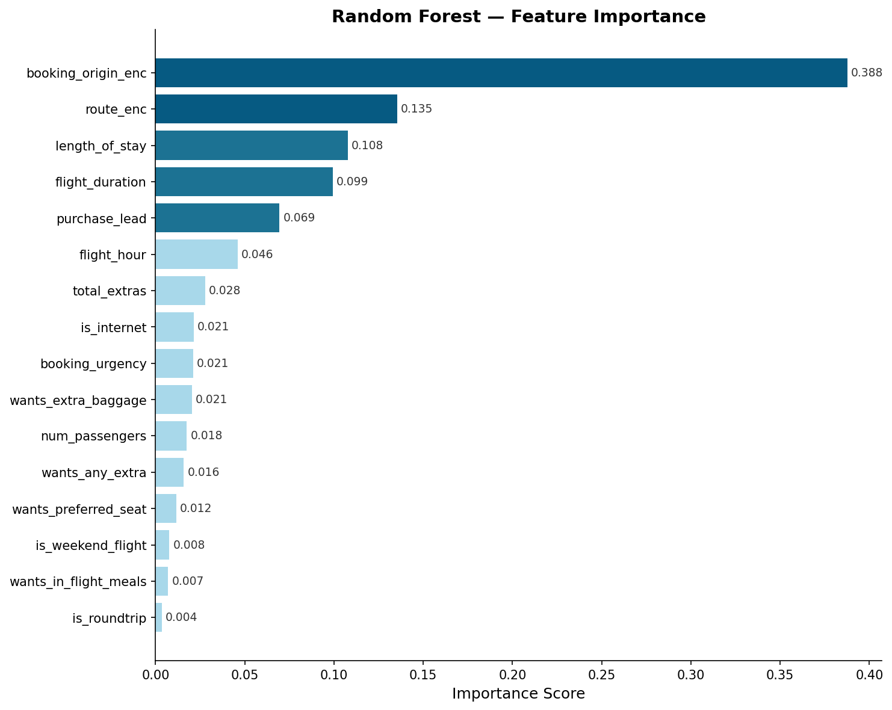
Feature Importance — What Drives Booking?
Top 5 Drivers
Booking Origin
38.8%
Strongest driver — market matters most
Route
13.5%
Specific routes highly predictive
Length of Stay
10.8%
Longer stays → more likely to complete
Flight Duration
9.9%
Longer haul trips show distinct patterns
Purchase Lead
6.9%
Timing from search to buy is key

Slide 5
Conclusions & Recommendations
Key Findings
Recommendations
Booking Origin is the single strongest predictor (38.8%) — targeted campaigns by country of origin can dramatically improve conversion
Route and flight duration together account for ~24% of importance — long-haul international routes should be prioritised for proactive outreach
Purchase lead time and stay length are behavioural signals that can be captured early in the browsing journey
Add-on preferences (baggage, seat, meals) have moderate impact but indicate high-intent customers worth targeting
Deploy model in real-time to score web visitors and trigger personalised offers before customers leave
Prioritise email/push campaigns for customers from high-converting booking origins
Create targeted landing pages by route segment based on model-predicted propensity
Monitor model drift quarterly and retrain as seasonal travel patterns shift
Model: Random Forest | CV ROC-AUC: 0.767 | CV Accuracy: 71.3% | Dataset: 50,000 records

