Slide 1

CSC - 522 FINAL PROJECT
(Automated Learning & Data Analysis)
Group P38
ROAD TRAFFIC PREDICTION & ANALYSIS
Rakesh Muppala
(rmuppal)
Shubham Bansal
(sbansal6)
Rishabh Agarwal
(ragarwa9)
Shubham Dua
(sdua2)

Slide 2
Motivation
On average, an American commuter wastes 54 extra hours a year because of traffic delays
The use of navigation apps (to find the fastest route, for example) has become very popular
More than 75% of smartphone users use some sort of navigation apps
Building a navigation system to predict (or analyze) traffic trends can go a long way to help avoid delays due to traffic

Slide 3
Project Task
We have two main project tasks
The first task is to predict if a road is a National Highway or not (given the latitude & longitude, and the hourly traffic volume)
We split the data three different ways, and used four classification models to evaluate and compare the results - KNN, SVM, Naive Bayes, Decision Trees (Task 1 - Classification)
For the second task, we used LSTM(Long Short-Term Memory) to calculate the hourly traffic count for a given latitude and longitude coordinates and for any given date (Task 2 - Regression)
We used the metric “accuracy” for the classification tasks, and “root mean square error” for the regression task.

Slide 4
Data Description
We used the dataset “US Traffic, 2015” available on Kaggle.
After preprocessing the data, we have 6904 data entries
For Task 1, we split the dataset three ways.
First split - 80% training & 20% test data
Second split - 70% training, 15% validation, 15% test data
Third split - Used K-fold cross validation
For Task 2, we used latitude and longitude coordinates, direction of travel, and date as the input features. The hourly traffic was an input as the time series data.

Slide 5
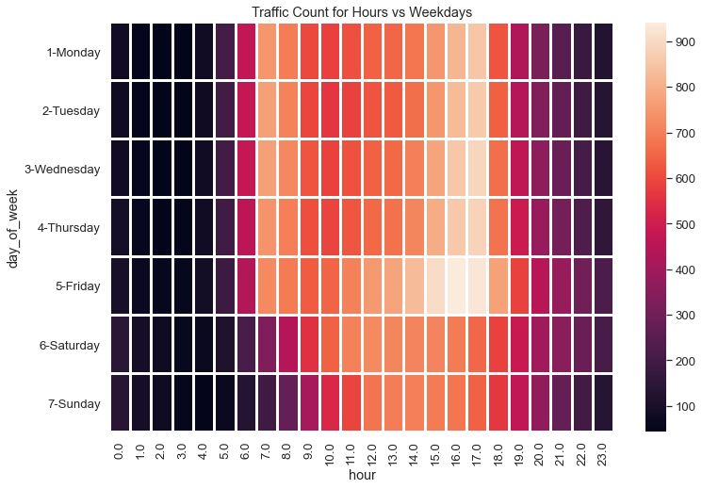
Dataset heatmap

Slide 6
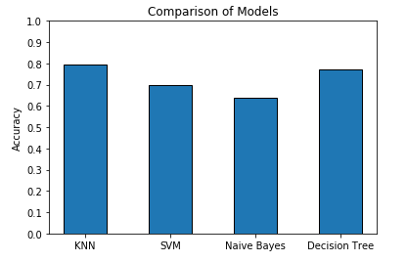
SPLIT 1 (80% training, 20% test)
Task 1
KNN model has a best accuracy of 0.7936 (with K=10)
SVM model has a best accuracy of 0.6966
Naive Bayes has a best accuracy of 0.6371
Decision Tree has a best accuracy of 0.7733 (with criterion ‘Entropy’)

Slide 7
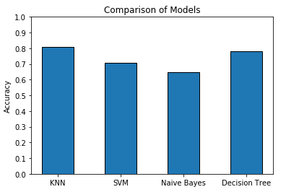
SPLIT 2 (70% training, 15% validation, 15% test)
KNN model has a best accuracy of 0.8089 (with K=10)
SVM model has a best accuracy of 0.6699
Naive Bayes has a best accuracy of 0.6486
Decision Tree has a best accuracy of 0.7828 (with criterion ‘Entropy’)

Slide 8
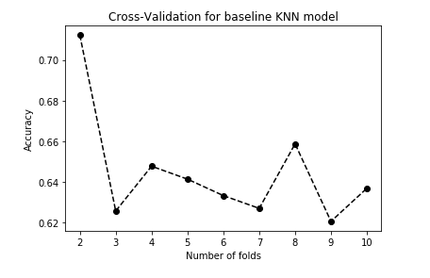
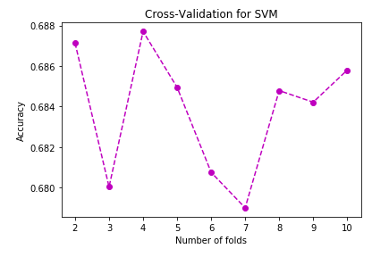
SPLIT 3 (K-Fold Cross Validation)
1) KNN
2) SVM
The baseline KNN model (with K=10) has a best accuracy of 0.7122 with 2 folds
The SVM model has a best accuracy of 0.6877 with 4 folds

Slide 9
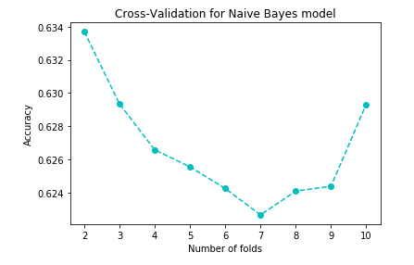
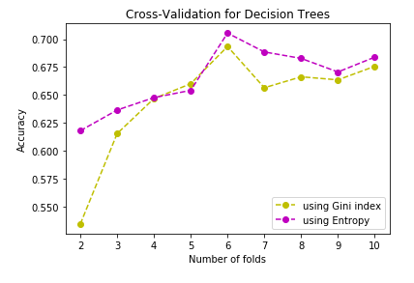
3) Naive Bayes
4) Decision Trees
The Decision Tree (with criterion ‘Entropy’) has a best accuracy of 0.7055 with 6 folds
The Naive Bayes model has a best accuracy of 0.6337 with 2 folds

Slide 10
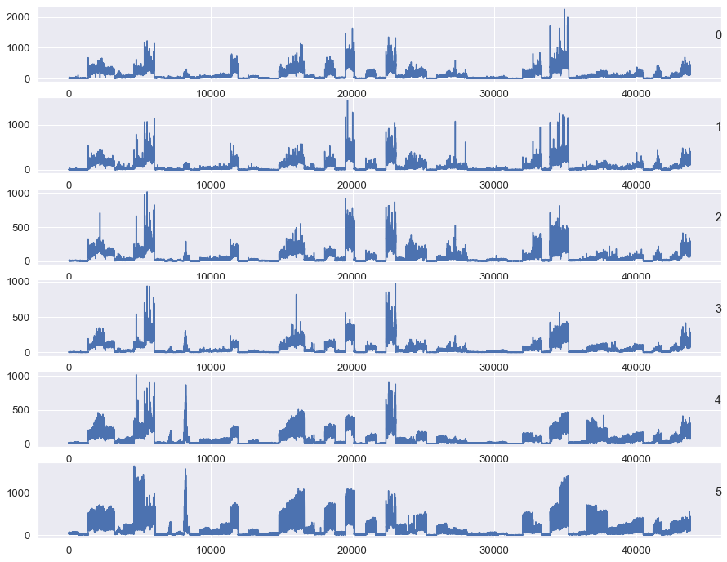
Patterns in data (why we use LSTM)

Slide 11
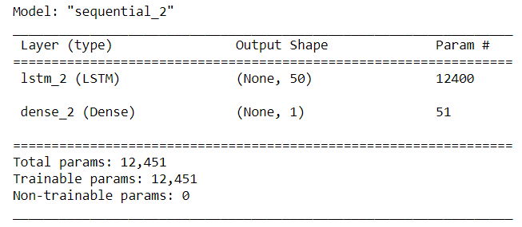
LSTM Layers
The LSTM model has an LSTM layer and a Dense layer(output layer).
LSTM layer has 50 neurons
The model uses 12,451 parameters

Slide 12
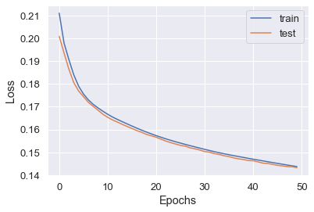
Performance of LSTM model
Test RMSE = 0.226

Slide 13
CONCLUSION
We predicted whether a given road is a National highway or not using four models - KNN, SVM, Naive Bayes and Decision Trees
We split the data three different ways; an 80-20 train-test split, a 70-15-15 train-validation-test split, and K-fold cross validation. All three splits give their best accuracy for KNN model (with 10 neighbors).
An LSTM was used to predict the hourly traffic volume and the model had a Test RMSE of 0.226.
These encouraging results for such a basic LSTM model mean that if we are able to tune the model further, we might get even better results.
With a low RMSE value, this model can be used in navigation systems or any application that predict (or analyzes) traffic trends by the hour.

Slide 14
REFERENCES
Pan, B., Demiryurek, U. and Shahabi, C., 2012, December. Utilizing real-world transportation data for accurate traffic prediction. In 2012 IEEE 12th International Conference on 132 Data Mining (pp. 595-604). IEEE.
Min, W. and Wynter, L., 2011. Real-time road traffic prediction with spatio-temporal correlations. Transportation Research Part C: Emerging Technologies, 19(4), pp.606-616. 135
Ishak, S. and Al-Deek, H., 2002. Performance evaluation of short-term time-series traffic 136 prediction model. Journal of transportation engineering, 128(6), pp.490-498
US Traffic, 2015 “https://www.kaggle.com/jboysen/us-traffic-2015”

Slide 15


