Slide 1
DESIGN & ANALYSIS OF ALGORITHM
PCC-CS501

Slide 2
Asymptotic notation Analysis of algorithm
Asymptotic analysis refers to computing the running time of any operation in mathematical units of computation. Example: T_{A}(N)=O(logn)/
Types
Big oh or upper bound
Big theta or tight bound
Big omega or lower bound

Slide 3
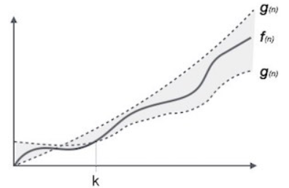
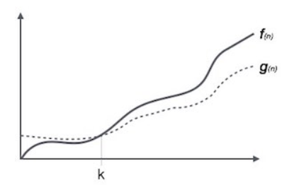
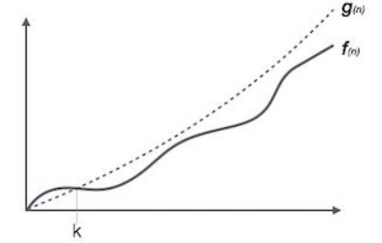
Asymptotic notation
f(n)=O(g(n)) . f(n)= Ω(g(n)) f(n)= Ɵ(g(n))

Slide 4
Complexity calculation using Asymptotic notation
Find the all possible complexities of f(n)=4n³+3n+5
<=f(n) ,n₀= f(n)<= , n₀=
<=f(n)<= , n₀=

Slide 5
Complexity calculation using Asymptotic notation
Find the all possible complexities of f(n)=4n³logn+2n+5
?<=f(n) ,n₀= ? f(n)<= ? , n₀=?
? <=f(n)<= ? , n₀= ?

Slide 6
Complexity calculation using Asymptotic notation
Find the all possible complexities of f(n)=4n³logn+2n+5
n³logn <=f(n) ,n₀= 1 || f(n)<= 11n³logn , n₀=1
n³logn <=f(n)<= 11n³logn , n₀= 1
Ω(n³logn) Ɵ(n³logn) O(n³logn)

Slide 7
Complexity calculation using Asymptotic notation
Find the all possible complexities of f(n)=n!
f(n)=n.(n-1).(n-2)………3.2.1
1.1.1….1 <= f(n)<=n.n.n….. n , n₀=1
Ω( ?) Ɵ(?) O(n^n)

Slide 8
Complexity calculation using Asymptotic notation
Find the all possible complexities of f(n)=log(n!)
f(n)=log(n.(n-1).(n-2)………3.2.1)
log()<= f(n)<=log() , n₀=
Ω( ?) Ɵ(?) O(?)

Slide 9
Properties of Asymptotic notation
If f(n) is O(g(n)) Then af(n)=O(g(n))
f(n) =n f(n)=O(n)
15f(n) f(n)=?

Slide 10
Properties of Asymptotic notation
Reflexive -
If f(n) is given Then f(n)=O(f(n))
Example- f(n)=n f(n)=O(n)

Slide 11
Properties of Asymptotic notation
Transitive-
If f(n) is O(g(n)) and g(n)=O(h(n)) Then f(n)=O(h(n))
Example- f(n)=5n g(n)=n^2 h(n)=n^3
n is O(n^2) n^2 is O(n^3)
n is O(n^3)
N.B- True for all other notation

Slide 12
Properties of Asymptotic notation
Symmetric- (only true for Ɵ notation)
If f(n) is Ɵ(g(n)) then g(n)= Ɵ(f(n)).
Example- f(n)=n^2 g(n)=n^2
f(n)= Ɵ(n^2)
g(n)= Ɵ(n^2)

Slide 13
Properties of Asymptotic notation
Transpose Symmetric- (only true for O & Ω notation)
If f(n) is O(g(n)) then g(n)= Ω(f(n)).
Example- f(n)=5n g(n)=n^2 Then
n is O(n^2) and n^2 is Ω(n)

Slide 14
Properties of Asymptotic notation
If f(n) = O(g(n)) and d(n)=O(e(n)) then
f(n)+d(n)=?

Slide 15
Properties of Asymptotic notation
If f(n) = O(g(n)) and d(n)=O(e(n)) then
f(n)+d(n)=?
Example- f(n)=5n d(n)=n^2 Then
f(n)+d(n)=O(n) +O(n^2)= O(n^2)

Slide 16
Properties of Asymptotic notation
If f(n) = O(g(n)) and d(n)=O(e(n)) then
f(n)+d(n)=O(max(g(n),d(n))
Example- f(n)=5n d(n)=n^2 Then
f(n)+d(n)=O(n) +O(n^2)= O(n^2)

Slide 17
Properties of Asymptotic notation
If f(n) = O(g(n)) and d(n)=O(e(n)) then
f(n)*d(n)=?

Slide 18
Properties of Asymptotic notation
If f(n) = O(g(n)) and d(n)=O(e(n)) then
f(n)*d(n)=?
Example- f(n)=5n d(n)=n^2 Then
f(n)*d(n)=5 n^3

Slide 19
Properties of Asymptotic notation
If f(n) = O(g(n)) and d(n)=O(e(n)) then
f(n)*d(n)=O(g(n)*d(n))
Example- f(n)=5n d(n)=n^2 Then
f(n)*d(n)=O(n^3)

Slide 20
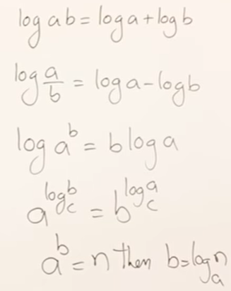
Comparison of function
F(n) =n^3 G(n)= n
1) directly compare the values
2) Apply log

Slide 21
Comparison of function
F(n) =n^3(log n) G(n)= n (log n)^5

Slide 22
Comparison of function
F(n) = 3 n^ (√n) G(n)= 2^(√n log n)

Slide 23
Comparison of function
1. f(n)= log n+ log logn
2 f(n)=logn +√n
3. f(n)= n^logn + 2^ √n
4. f(n)= 2^logn+ n ^ √n
5. f(n) = (n^2)(logn) + n(logn)^9
6. f(n)=2^n + 2^(2n)

Slide 24
f(n)= n^logn + 2^ √n
1. log( n^logn ) log( 2^ √n)
2. log n logn √n log2
3. log^2(n) √n
4. 2log log n ½ log n
So n^logn < 2^ √n

Slide 25
Comparison of function
1. f(n)= log n+ log logn (i)
2 f(n)=logn +√n (ii)
3. f(n)= n^logn + 2^ √n (ii)
4. f(n)= 2^logn+ n ^ √n (ii)
5. f(n) = (n^2)(logn) + n(logn)^9 (i)

Slide 26
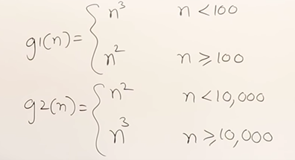
Comparison of function
?

Slide 27
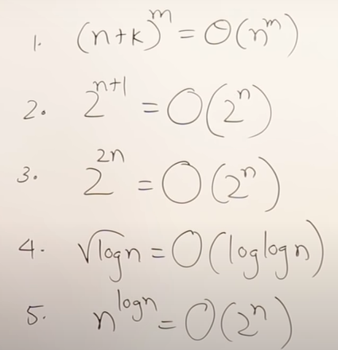
Validity checking

Slide 28
Next class
SOLVING RECURRENCE RELATION

