Slide 1
Quicksort

Slide 2
Introduction
Fastest known sorting algorithm in practice
Best case: O(N log N)
Average case: O(N log N)
Worst case: O(N²)
  But, the worst case seldom happens.
Another divide-and-conquer recursive algorithm, like mergesort

Slide 3
Quicksort
S
Divide step:
  Pick any element (pivot) v in S
  Partition S – {v} into two disjoint groups
  S1 = {x ∈ S – {v} | x <= v}
  S2 = {x ∈ S – {v} | x ≥ v}
Conquer step: recursively sort S1 and S2
Combine step: the sorted S1 (by the time returned from recursion), followed by v, followed by the sorted S2 (i.e., nothing extra needs to be done)
v
v
S1
S2
To simplify, we may assume that we don’t have repetitive elements,
So to ignore the ‘equality’ case!

Slide 4
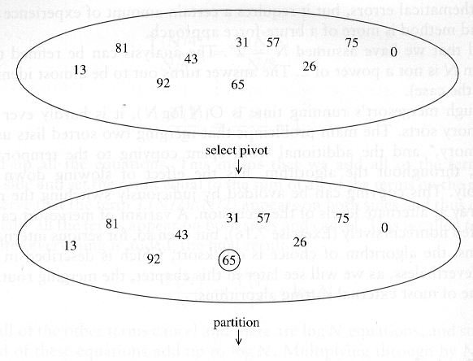
Example

Slide 5
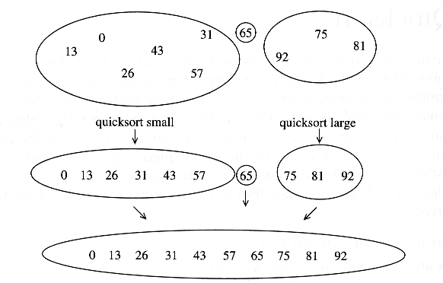

Slide 6
Pseudo-code
Input: an array a[left, right]
QuickSort (a, left, right) {
if (left < right) {
pivot = Partition (a, left, right)
Quicksort (a, left, pivot-1)
Quicksort (a, pivot+1, right)
}
}

Slide 7
Two key steps
How to pick a pivot?
How to partition?

Slide 8
Pick a pivot
Use the first element as pivot
  if the input is random, ok
  if the input is presorted (or in reverse order)
    all the elements go into S2 (or S1)
    this happens consistently throughout the recursive calls
    Results in O(n²) behavior (Analyze this case later)
Choose the pivot randomly
  generally safe
  random number generation can be expensive

Slide 9
In-place Partition
  If use additional array (not in-place) like MergeSort
    Straightforward to code like MergeSort (write it down!)
    Inefficient!
  Many ways to implement
  Even the slightest deviations may cause surprisingly bad results.
    Not stable as it does not preserve the ordering of the identical keys.
    Hard to write correctly ☹

Slide 10
Small arrays
For very small arrays, quicksort does not perform as well as insertion sort
  how small depends on many factors, such as the time spent making a recursive call, the compiler, etc
Do not use quicksort recursively for small arrays
  Instead, use a sorting algorithm that is efficient for small arrays, such as insertion sort

Slide 11
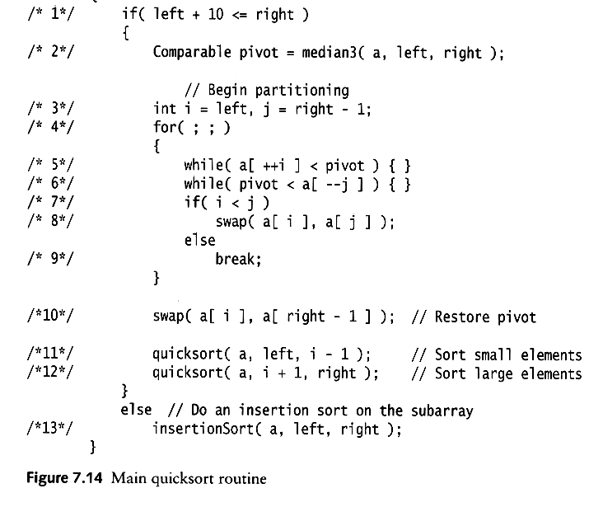
A practical implementation
Choose pivot
Partitioning
Recursion
For small arrays

Slide 12
Quicksort Analysis
Assumptions:
  A random pivot (no median-of-three partitioning)
  No cutoff for small arrays
Running time
  pivot selection: constant time, i.e. O(1)
  partitioning: linear time, i.e. O(N)
  running time of the two recursive calls
T(N)=T(i)+T(N-i-1)+cN where c is a constant
  i: number of elements in S1

Slide 13
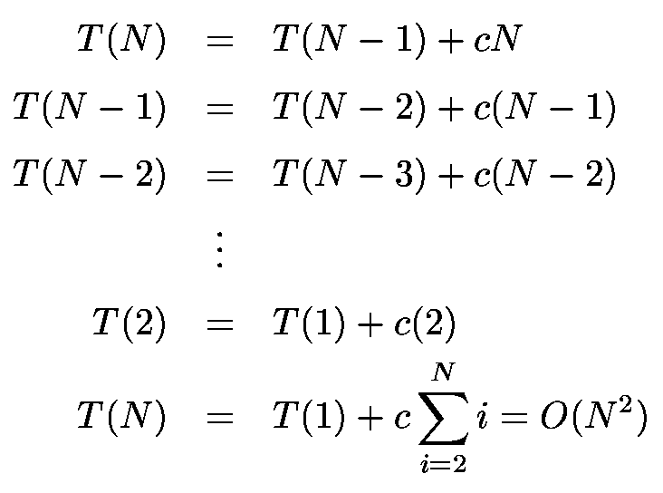
Worst-Case Analysis
What will be the worst case?
  The pivot is the smallest element, all the time
  Partition is always unbalanced

Slide 14
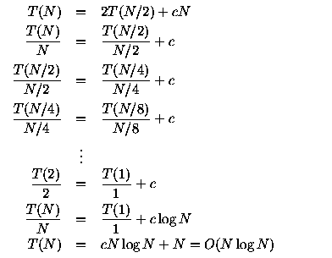
Best-case Analysis
What will be the best case?
  Partition is perfectly balanced.
  Pivot is always in the middle (median of the array)

Slide 15
Average-Case Analysis
Assume
  Each of the sizes for S1 is equally likely
On average, the running time is O(N log N)

Slide 16
Quicksort is ‘faster’ than Mergesort
Both quicksort and mergesort take O(N log N) in the average case.
Why is quicksort faster than mergesort?
  The inner loop consists of an increment/decrement (by 1, which is fast), a test and a jump.
  There is no extra juggling as in mergesort.
inner loop

Slide 17
Randomizing Quicksort
Randomly permute the elements of the input array before sorting
OR ... modify the PARTITION procedure
  At each step of the algorithm we exchange element A[p] with an element chosen at random from A[p…r]
  The pivot element x = A[p] is equally likely to be any one of the r – p + 1 elements of the subarray

Slide 18
Randomized PARTITION
Alg.: RANDOMIZED-PARTITION(A, p, r)
i ← RANDOM(p, r)
exchange A[p] ↔ A[i]
return PARTITION(A, p, r)

Slide 19
Randomized Quicksort
Alg. : RANDOMIZED-QUICKSORT(A, p, r)
if p < r
then q ← RANDOMIZED-PARTITION(A, p, r)
RANDOMIZED-QUICKSORT(A, p, q)
RANDOMIZED-QUICKSORT(A, q + 1, r)

