Slide 1
SQL JOIN
PRESENTER: SRESTHA SADHU

Slide 2
What are JOINS?
Joins help retrieving data from two or more database tables.
The tables are mutually related using primary and foreign keys.
Types of joins
EQUI JOIN
INNER JOIN
NATURAL JOIN
CROSS JOIN
OUTER JOIN
LEFT JOIN
RIGHT JOIN

Slide 3
Equi join
SQL EQUI JOIN performs a JOIN against equality or matching column(s) values of the associated tables. An equal sign (=) is used as comparison operator in the where clause to refer equality.
SYNTAX:
SELECT column_list FROM table1, table2.... WHERE table1.column_name = table2.column_name;
OR
SELECT * FROM table1 JOIN table2 [ON (join_condition)]

Slide 4
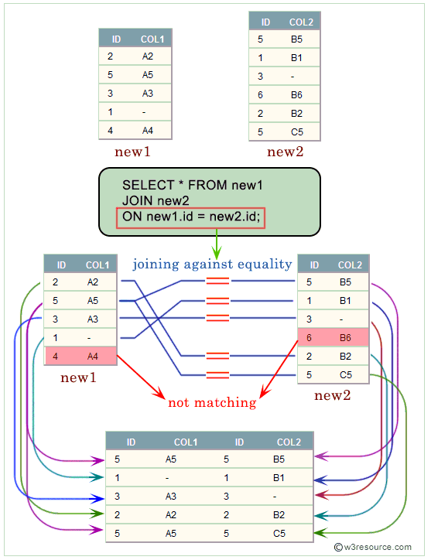
EXAMPLE

Slide 5
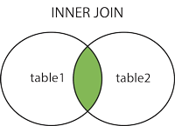
INNER JOIN
The inner JOIN is used to return rows from both tables that satisfy the given condition.

Slide 6
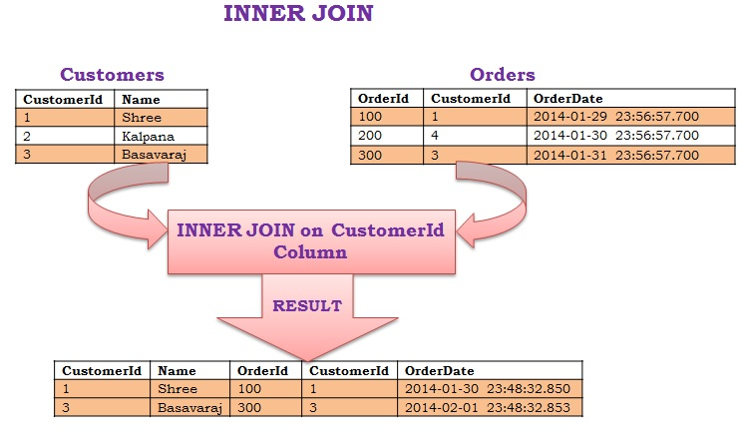
INNER JOIN(SYNTAX)
SELECT column_name(s) FROM table1 INNER JOIN table2 ON table1.column_name = table2.column_name;

Slide 7
DIFFERENCE BETWEEN INNER JOIN AND EQUI JOIN
Inner join can have equality (=) and other operators (like <,>,<>) in the join condition.
Equi join only have equality (=) operator in the join condition.
Equi join can be an Inner join, Left Outer join, Right Outer join

Slide 8
NATURAL JOIN
We have already learned that an EQUI JOIN performs a JOIN against equality or matching column(s) values of the associated tables and an equal sign (=) is used as comparison operator in the where clause to refer equality.
The SQL NATURAL JOIN is a type of EQUI JOIN and is structured in such a way that, columns with the same name of associated tables will appear once only.
Natural Join: Guidelines
- The columns must be the same data type. - Don’t use ON clause in a natural join.
Syntax:
SELECT * FROM table1 NATURAL JOIN table2;

Slide 9
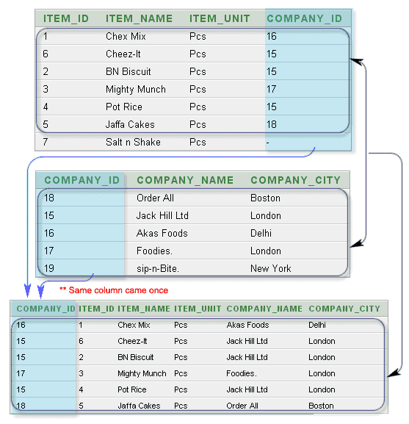
EXAMPLE

Slide 10
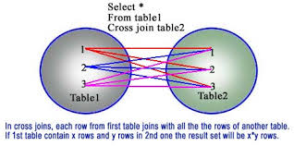
Cross JOIN
Cross JOIN is a simplest form of JOINs which matches each row from one database table to all rows of another.
In other words it gives us combinations of each row of first table with all records in second table.

Slide 11
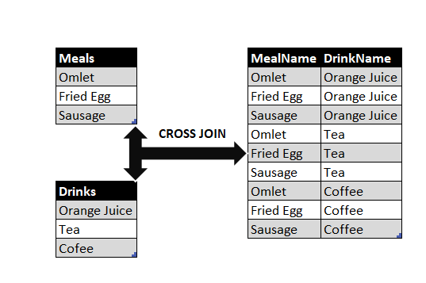
EXAMPLE AND SYNTAX
SELECT * FROM table1 CROSS JOIN table2;

Slide 12
Outer JOINs
Outer JOINs return all records matching from both tables .
It can detect records having no match in joined table. It returns NULL values for records of joined table if no match is found.
Types of Outer Join
Left Outer Join
Right Outer Join
Full Outer Join

Slide 13
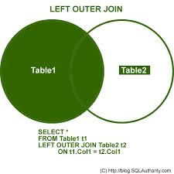
LEFT OUTER JOIN
The LEFT JOIN returns all the rows from the table on the left even if no matching rows have been found in the table on the right.
Where no matches have been found in the table on the right, NULL is returned.

Slide 14
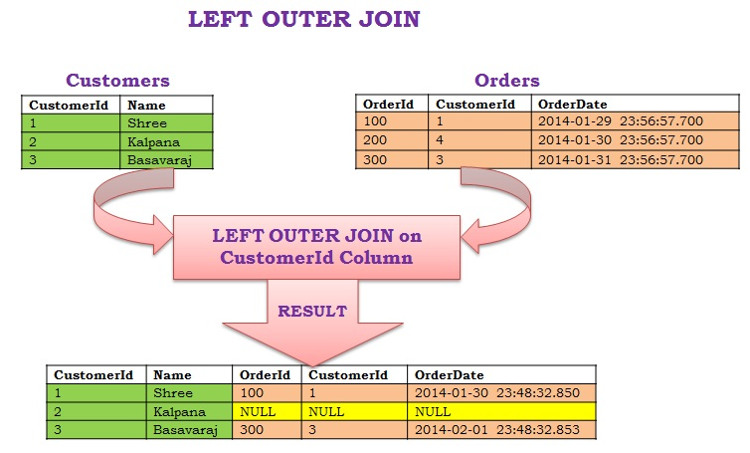
EXAMPLE AND SYNTAX
SELECT column_name(s) FROM table1 LEFT JOIN table2 ON table1.column_name = table2.column_name;

Slide 15
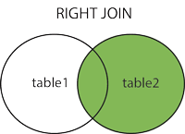
RIGHT OUTER JOIN
RIGHT JOIN is obviously the opposite of LEFT JOIN. The RIGHT JOIN returns all the columns from the table on the right even if no matching rows have been found in the table on the left.
Where no matches have been found in the table on the left, NULL is returned.

Slide 16
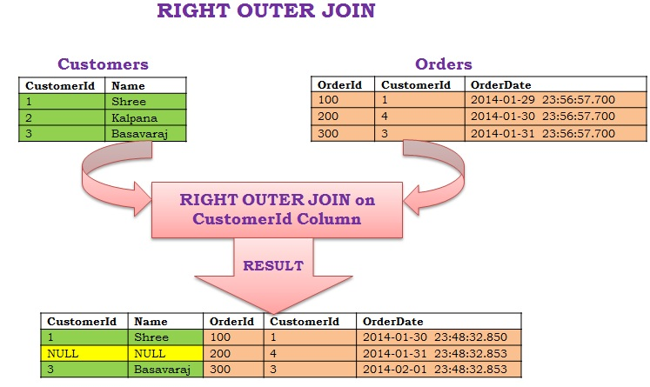
EXAMPLE AND SYNTAX
SELECT column_name(s) FROM table1 RIGHT JOIN table2 ON table1.column_name = table2.column_name;

Slide 17
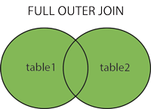
FULL OUTER JOIN
The FULL OUTER JOIN keyword returns all records when there is a match in left (table1) or right (table2) table records.

Slide 18
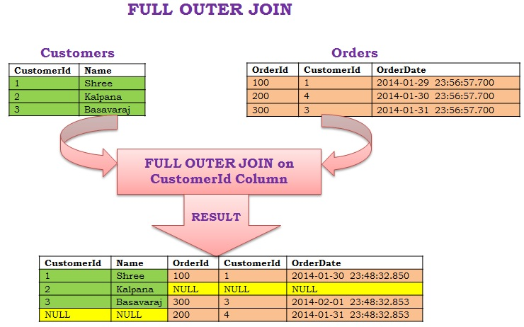
EXAMPLE AND SYNTAX
SELECT column_name(s) FROM table1 FULL OUTER JOIN table2 ON table1.column_name = table2.column_name WHERE condition;

Slide 19
SET OPERATION
1.UNION 2.UNION ALL 3.INTERSECT 4.MINUS
UNION
It is used to combine the results of two or more SELECT statements. It will eliminate duplicate rows from its result set. In case of union, number of columns and data type must be same in both the tables, on which UNION operation is being applied.
ID | NAME
1 | abhi
2 | adam
3 | Chester
ID | Name
1 | abhi
2 | adam
ID | Name
2 | adam
3 | Chester
SELECT * FROM First UNION SELECT * FROM Second;

Slide 20
UNION ALL
This operation is similar to Union. But it also shows the duplicate rows.
SELECT * FROM First UNION ALL SELECT * FROM Second;
INTERSECT
SELECT * FROM First INTERSECT SELECT * FROM Second;
MINUS
The Minus operation combines results of two SELECT statements and return only those in the final result, which belongs to the first set of the result.
SELECT * FROM First MINUS SELECT * FROM Second;
ID | Name
1 | abhi
2 | adam
ID | Name
2 | adam
3 | Chester
ID | Name
1 | abhi

Slide 21
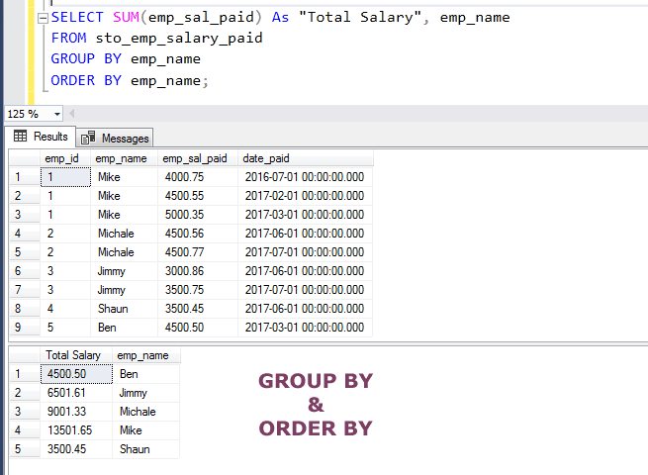
SQL GROUP BY Statement
The GROUP BY statement groups rows that have the same values into summary rows, like "find the number of customers in each country".
The GROUP BY statement is often used with aggregate functions (COUNT(), MAX(), MIN(), SUM(), AVG()) to group the result-set by one or more columns.

Slide 22
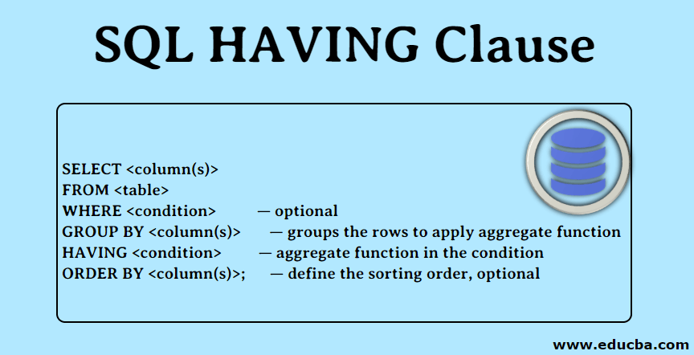
SQL HAVING Clause
The HAVING clause was added to SQL because the WHERE keyword cannot be used with aggregate functions.

Slide 23
