Slide 1
Object Oriented Programming using JAVA
Presented By Sudeshna Kundu (Mondal)

Slide 2
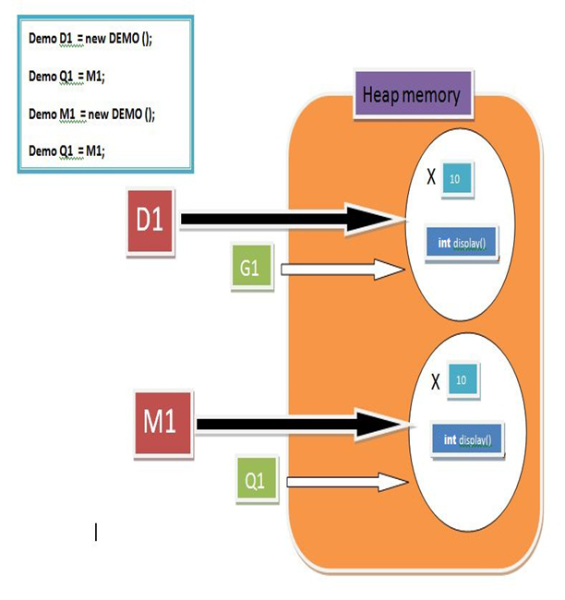
Pointing to same instance memory
Demo D1 = new Demo();
// point to same reference
Demo G1 = D1;

Slide 3
Java Copy Constructor
Why copy constructor is required?
Sometimes, we face a problem where we required to create an exact copy of an existing object of the class. There is also a condition, if we have made any changes in the copy it should not reflect in the original one and vice-versa. For such cases, Java provides the concept of a copy constructor.
Copy Constructor
In Java, a copy constructor is a special type of constructor that creates an object using another object of the same Java class. It returns a duplicate copy of an existing object of the class.

Slide 4
public class Fruit
{
private double fprice;
private String fname;
//constructor to initialize roll number
and name of the student
Fruit(double fPrice, String fName)
{
fprice = fPrice;
fname = fName;
}
//creating a method that returns the price of the fruit
double showPrice()
{
return fprice;
}
//creating a method that returns the name of the fruit
String showName()
{
return fname;
}

Slide 5
//creating a copy constructor
Fruit(Fruit fruit)
{
System.out.println("\nAfter invoking the Copy Constructor:\n");
fprice = fruit.fprice;
fname = fruit.fname;
}
//class to create student object and print roll number and name of the student
public static void main(String args[])
{
Fruit f1 = new Fruit(399, "Ruby Roman Grapes");
System.out.println("Name of the first fruit: "+ f1.showName());
System.out.println("Price of the first fruit: "+ f1.showPrice());
//passing the parameters to the copy constructor
Fruit f2 = new Fruit(f1);
System.out.println("Name of the second fruit: "+ f2.showName());
System.out.println("Price of the second fruit: "+ f2.showPrice());
}
}

Slide 6
Inheritance
Inheritance is a fundamental Object Oriented concept
A class can be defined as a "subclass" of another class.
The subclass inherits all data attributes of its superclass
The subclass inherits all methods of its superclass
The subclass can:
Add new functionality
Use inherited functionality
Override inherited functionality
superclass:
Person
- name: String
subclass:
Employee
- employeeID: int
- salary: int

Slide 7
The idea behind inheritance in Java is that you can create new classes that are built upon existing classes. When you inherit from an existing class, you can reuse methods and fields of the parent class. Moreover, you can add new methods and fields in your current class also.
Inheritance represents the IS-A relationship which is also known as a parent-child relationship.
Why use inheritance in java
For Method Overriding (so runtime polymorphism can be achieved).
For Code Reusability.

Slide 8
What really happens?
In this example, we can say that an Employee "is a kind of" Person.
An Employee object inherits all of the attributes, methods and associations of Person
Person
name = "John Smith"
Person
- name: String
Employee
name = "Sally Halls"
employeeID = 37518
salary = 65000
is a kind of
Employee
- employeeID: int
- salary: int

Slide 9
Inheritance in Java
Inheritance is declared using the "extends" keyword
class Person
{
String name;
[...]
Person
- name: String
class Employee extends Person
{
int employeID;
int salary;
[...]
Employee
- employeeID: int
- salary: int
Employee anEmployee = new Employee();

Slide 10
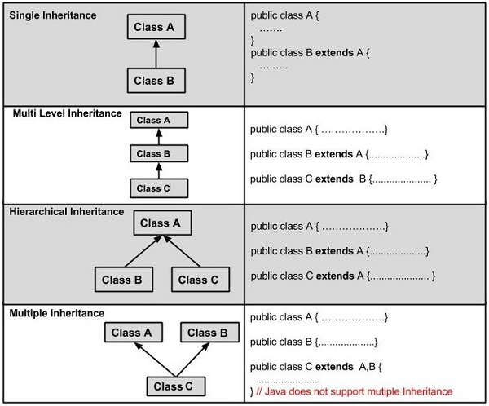
Types of Inheritance in Java

Slide 11
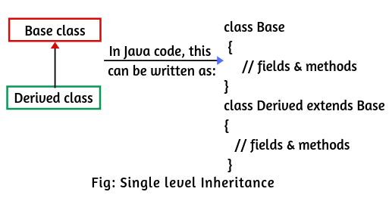
Single level Inheritance
class Employee{
float salary=40000;
}
class Programmer extends Employee{
int bonus=10000;
void display()
{
System.out.println("Programmer salary is:"+salary);
System.out.println("Bonus of Programmer is:"+bonus);
}
}
class EmployeeMain{
public static void main(String args[]){
Programmer p=new Programmer();
p.display();
}
}

Slide 12
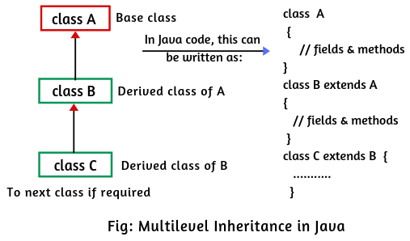
Multi-level Inheritance
class Animal{
void eat(){System.out.println("eating...");}
}
class Dog extends Animal{
void bark(){System.out.println("barking...");}
}
class BabyDog extends Dog{
void weep(){System.out.println("weeping...");}
}
class TestInheritance2{
public static void main(String args[]){
BabyDog d=new BabyDog();
d.weep();
d.bark();
d.eat();
}}

Slide 13
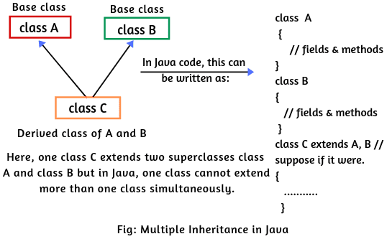
Multiple Inheritance
class A{
void msg(){System.out.println("Hello");}
}
class B{
void msg(){System.out.println("Welcome");}
}
class C extends A,B
{
int c=10;
}
class TestInheritance3
{
public static void main(String args[]){
C obj=new C();
obj.msg();//Now which msg() method
would be invoked?
}
}

Slide 14
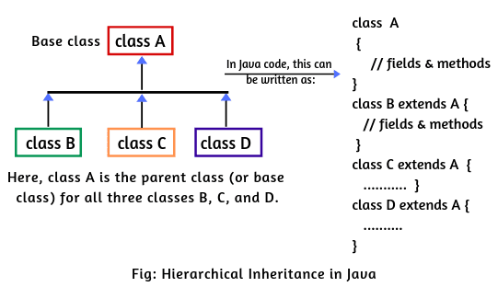
Hierarchical Inheritance
A class which is inherited by many subclasses is known as hierarchical inheritance. In other words, when one class is extended by many subclasses, it is known as hierarchical inheritance. In this kind of inheritance, one class can be a parent of many other classes. Hierarchical inheritance is as shown in the below diagram.

Slide 15
Hierarchical Inheritance
public class MyClass
{
public static void main(String[] args)
{
// Create the object of class B, class C, and class D.
B obj1 = new B();
C obj2 = new C();
D obj3 = new D();
// Calling inherited function from the base class.
obj1.msgA();
obj2.msgA();
obj3.msgA();
}
}
public class A
{
public void msgA()
{
System.out.println("Method of class A");
}
}
public class B extends A
{
// Empty class B, inherits msgA of parent class A.
}
public class C extends A
{
// Empty class C, inherits msgA of parent class A.
}
public class D extends A
{
// Empty class D, inherits msgA of parent class A.
}

Slide 16
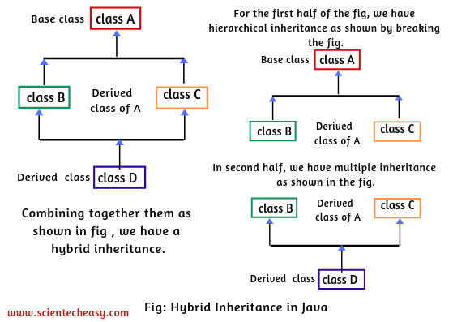
Hybrid Inheritance
A hybrid inheritance in Java is a combination of single and multiple inheritance. A typical flow diagram is shown in the below image. A hybrid inheritance can be achieved in the same way as multiple inheritance using interfaces in Java.
By using interfaces, we can achieve multiple as well as a hybrid inheritance in Java. It is not allowed in Java.

Slide 17
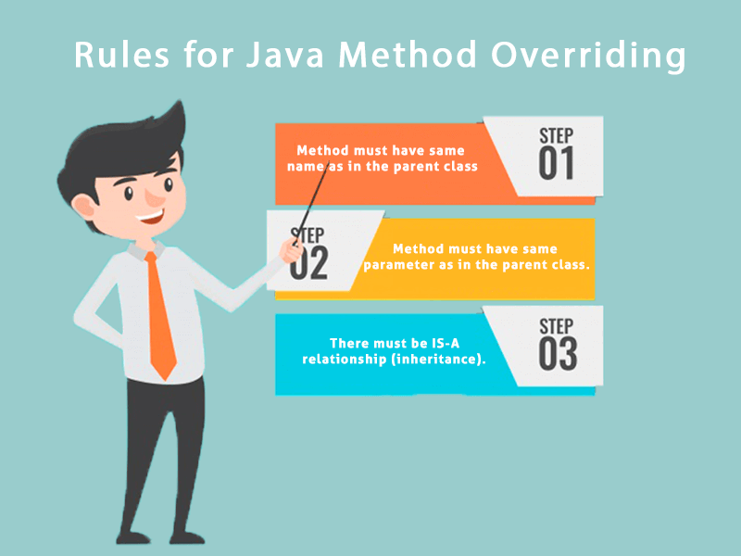
Method Overriding
If subclass (child class) has the same method as declared in the parent class, it is known as method overriding in Java.
In other words, If a subclass provides the specific implementation of the method that has been declared by one of its parent class, it is known as method overriding.
Usage of Java Method Overriding
Method overriding is used to provide the specific implementation of a method which is already provided by its superclass.
Method overriding is used for runtime polymorphism
Rules for Java Method Overriding
The method must have the same name as in the parent class
The method must have the same parameter as in the parent class.
There must be an IS-A relationship (inheritance).

Slide 18
Method Overriding
If subclass (child class) has the same method as declared in the parent class, it is known as method overriding in Java.
In other words, If a subclass provides the specific implementation of the method that has been declared by one of its parent class, it is known as method overriding.
class Vehicle{
//defining a method
void run(){System.out.println("Vehicle is running");}
}
//Creating a child class
class Bike2 extends Vehicle{
//defining the same method as in the parent class
void run(){System.out.println("Bike is running safely");}
}
class OverrideMain
public static void main(String args[]){
Bike2 obj = new Bike2();//creating object
obj.run();//calling method
}
}

