Slide 1
Object Oriented Programming using JAVA
Presented By Sudeshna Kundu (Mondal)

Slide 2
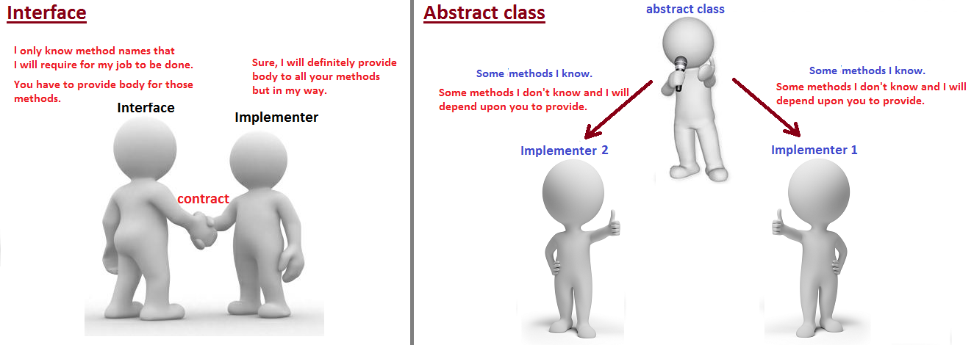
abstract void run();
abstract void run();
void changeGear(){System.out.println("gear changed");}
Interface provides total abstraction; means all the methods in an interface are declared with the empty body,

Slide 3
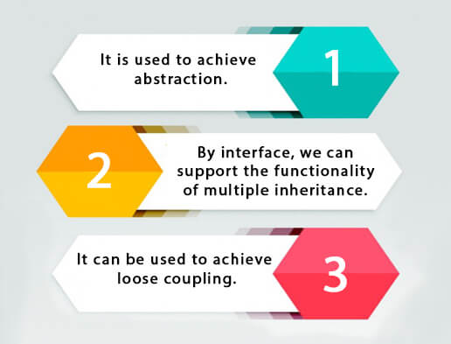
Interface in Java
An interface in Java is a blueprint of a class. It has static constants and abstract methods.
The interface in Java is a mechanism to achieve abstraction. There can be only abstract methods in the Java interface, not method body. It is used to achieve abstraction and multiple inheritance in Java.
Why use Java interface?
There are mainly three reasons to use interface. They are given below.
It is used to achieve abstraction.
By interface, we can support the functionality of multiple inheritance.
It can be used to achieve loose coupling.
In simple words, loose coupling means they are mostly independent. If the only knowledge that class A has about class B, is what class B has exposed through its interface, then class A and class B are said to be loosely coupled.

Slide 4
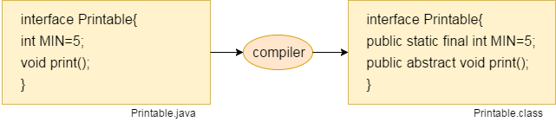
Interface in Java
How to declare an interface?
An interface is declared by using the interface keyword. It provides total abstraction; means all the methods in an interface are declared with the empty body, and all the fields are public, static and final by default. A class that implements an interface must implement all the methods declared in the interface.
Syntax:
interface <interface_name>{
// declare constant fields
// declare methods that abstract
// by default.
}
Internal addition by the compiler
The Java compiler adds public and abstract keywords before the interface method. Moreover, it adds public, static and final keywords before data members.
In other words, Interface fields are public, static and final by default, and the methods are public and abstract.

Slide 5
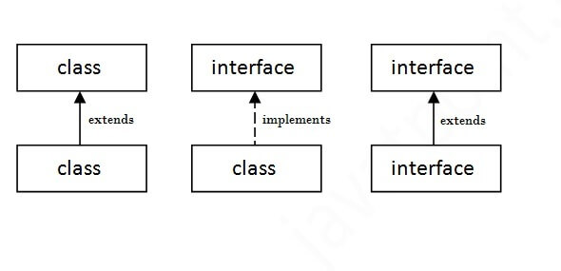
Interface in Java
interface Bank{
float rateOfInterest();
}
class SBI implements Bank{
public float rateOfInterest(){return 9.15f;}
}
class PNB implements Bank{
public float rateOfInterest(){return 9.7f;}
}
class TestInterface2{
public static void main(String[] args){
SBI b=new SBI();
System.out.println("ROI: "+b.rateOfInterest());
}}
Output:
ROI: 9.15
The relationship between classes and interfaces
As shown in the figure given below, a class extends another class, an interface extends another interface, but a class implements an interface.

Slide 6

Does Java support Multiple inheritance?
When one class extends more than one classes then this is called multiple inheritance. For example: Class C extends class A and B then this type of inheritance is known as multiple inheritance. Java doesn’t allow multiple inheritance.
Why Java doesn’t support multiple inheritance?
C++ , Common lisp and few other languages supports multiple inheritance while java doesn’t support it. Java doesn’t allow multiple inheritance to avoid the ambiguity caused by it. One of the example of such problem is the diamond problem that occurs in multiple inheritance.
void show()
{
S.o.p (“In A”);
}
void show()
{
S.o.p (“In B”);
}
C ob = new C();
ob.show();

Slide 7

Does Java support Multiple inheritance?
What is diamond problem?
We will discuss this problem with the help of the diagram below: which shows multiple inheritance as Class D extends both classes B & C. Now lets assume we have a method in class A and class B & C overrides that method in their own way. Wait!! here the problem comes – Because D is extending both B & C so if D wants to use the same method which method would be called (the overridden method of B or the overridden method of C). Ambiguity. That’s the main reason why Java doesn’t support multiple inheritance.

Slide 8
interface X
{
public void myMethod();
}
interface Y
{
public void myMethod();
}
class JavaExample implements X, Y
{
public void myMethod()
{
System.out.println("Implementing more than one interfaces");
}
public static void main(String args[]){
JavaExample obj = new JavaExample();
obj.myMethod();
}
}
Output:
Implementing more than one interfaces
Can we implement more than one interfaces in a class?
Yes, we can implement more than one interfaces in our program because that doesn’t cause any ambiguity(see the explanation below).
As you can see that the class implemented two interfaces. A class can implement any number of interfaces. In this case there is no ambiguity even though both the interfaces are having same method. Why? Because methods in an interface are always abstract by default, which doesn’t let them give their implementation (or method definition ) in interface itself.

Slide 9
Difference between abstract class and interface
Abstract class | Interface
1) Abstract class can have abstract and non-abstract methods. | Interface can have only abstract methods.
2) Abstract class doesn't support multiple inheritance. | Interface supports multiple inheritance.
3) Abstract class can have final, non-final, static and non-static variables. | Interface has only static and final variables.
4) Abstract class can provide the implementation of interface. | Interface can't provide the implementation of abstract class.
5) The abstract keyword is used to declare abstract class. | The interface keyword is used to declare interface.
6) An abstract class can extend another Java class and implement multiple Java interfaces. | An interface can extend another Java interface only.
7) An abstract class can be extended using keyword "extends". | An interface can be implemented using keyword "implements".
8) A Java abstract class can have class members like private, protected, etc. | Members of a Java interface are public by default.
9)Example: public abstract class Shape{ public abstract void draw(); } | Example: public interface Drawable{ void draw(); }

Slide 10
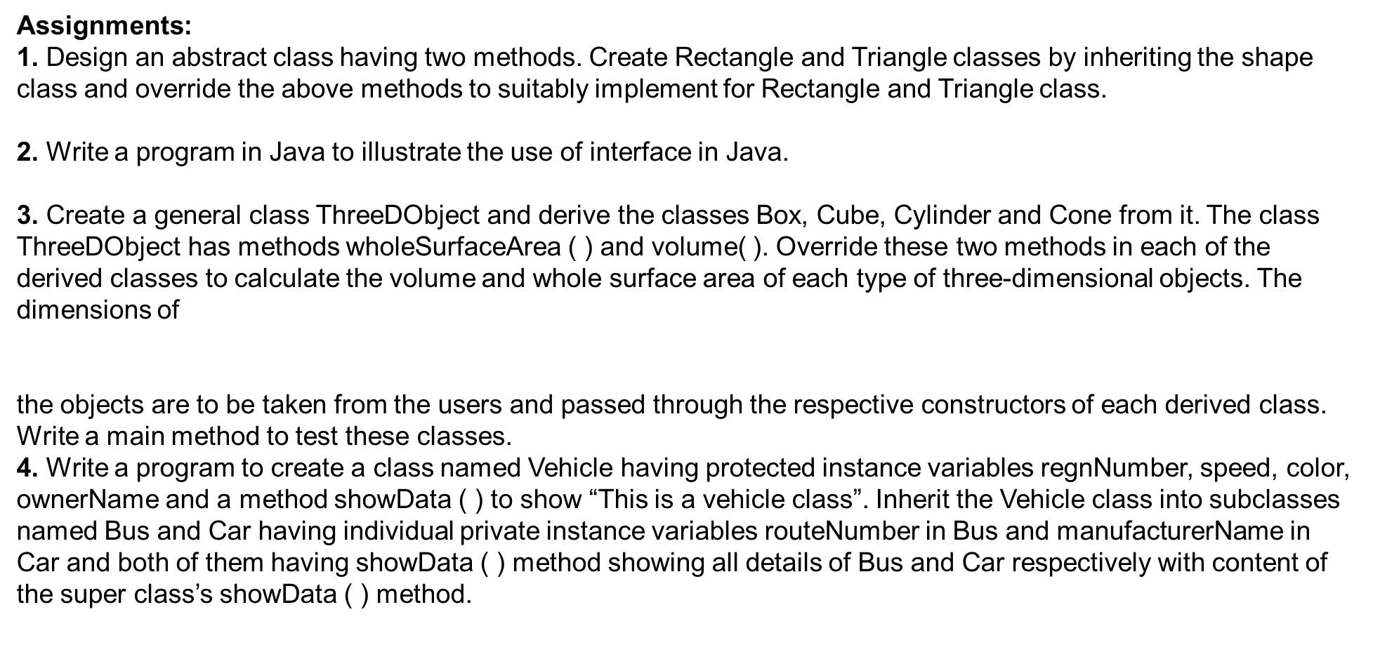

Slide 11
5. Create three interfaces, each with two methods. Inherit a new interface from the three, adding a new method. Create a class by implementing the new interface and also inheriting from a concrete class. Now write four methods, each of which takes one of the four interfaces as an argument. In main ( ), create an object of your class and pass it to each of the methods.
6. Create an interface Department containing attributes deptName and deptHead. It also has abstract methods for printing the attributes. Create a class hostel containing hostelName, hostelLocation and numberofRooms. The class contains methods for getting and printing the attributes. Then write Student class extending the Hostel class and implementing the Department interface. This class contains attributes studentName, regdNo, electiveSubject and avgMarks. Write suitable getData and printData methods for this class. Also implement the abstract methods of the Department interface. Write a driver class to test the Student class. The program should be menu driven containing the options:
i) Admit new student
ii) Migrate a student
iii) Display details of a student
For the third option a search is to be made on the basis of the entered registration number.
7. Create an interface called Player. The interface has an abstract method called play()
that displays a message describing the meaning of “play” to the class. Create classes
called Child, Musician, and Actor that all implement Player. Create an application
that demonstrates the use of the classes(UsePlayer.java )

Slide 12
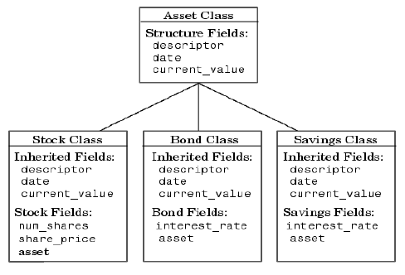
9. Create an abstract class MotorVehicle with the following details:
Data Members:
(a) modelName (b)modelNumber (c) modelPrice
Methods:
(a) display() to show all the details
Create a subclass of this class Carthat inherits the class MotorVehicle and add the following details:
Data Members:
(b) discountRate
Methods:
(a) display() method to display the Car name, model number, price and the discount rate.
(b) discount() method to compute the discount.
10. Implement the below Diagram.
Here, Asset class is an abstract class containing an abstract method displayDetails() method. Stock, bond and Savings class inherit the Asset class and displayDetails() method is defined in every class.

Slide 13
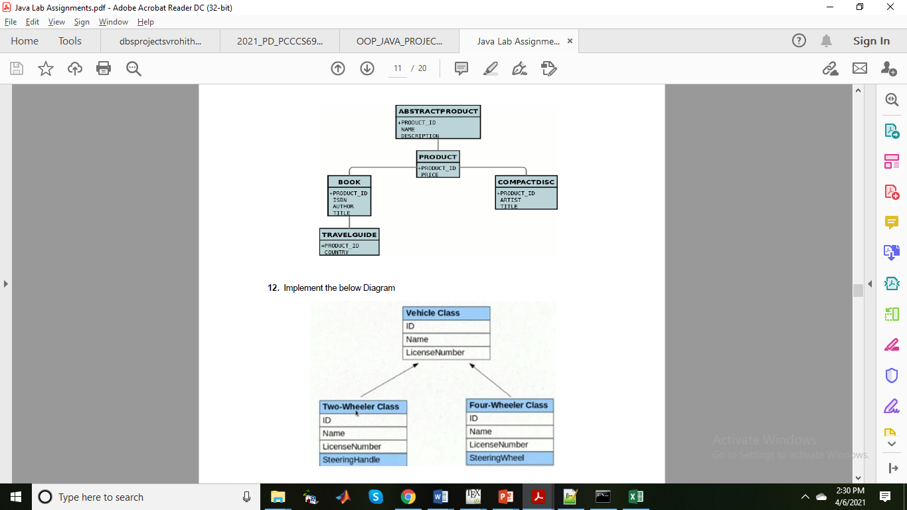
11. Implement the below Diagram. Here AbstractProduct is only abstract class.

Slide 14
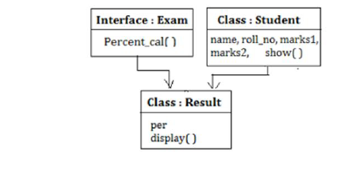
13. Write a program to implement the Multiple Inheritance (Bank Interface, Customer & Account classes).
14. Write a program to implement the Multiple Inheritance (Gross Interface, Employee & Salary classes).
15. Program to create a interface 'Mango' and implement it in classes 'Winter' and 'Summer'.
16. Program to implement the Multiple Inheritance (Exam Interface, Student & Result classes).
17. Program to demonstrate use of hierarchical inheritance using interface.
18. Java program to Perform Payroll Using Interface (Multiple Inheritance).
19. Implement the following diagram.

