Slide 1
Java Applets

Slide 2
Applet in Java
Applet is a special type of program that is embedded in the webpage to generate the dynamic content. It runs inside the browser and works at client side.
Any applet in Java is a class that extends the java.applet.Applet class.
An Applet class does not have any main() method.

Slide 3
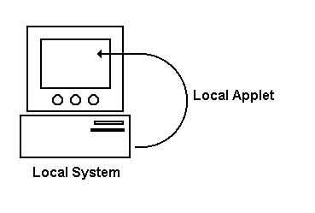
Local Applets
Local applets are applet types that are developed and stored in local system. The web page will search the local system directories, find the local applet and execute it. Execution of local applet does not require internet connection.

Slide 4
Specifying a Local Applet
<applet codebase="path" code="NewApplet.class"
width=120
height=120 >
</apple>

Slide 5
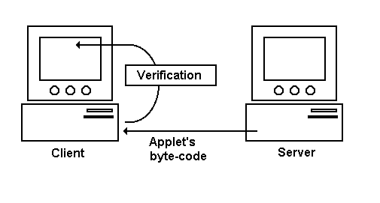
Remote Applets
Remote applets are applet types that are developed by someone else and stored on a remote system connected to the internet. Execution of remote applet requires internet connection.

Slide 6
Specifying a Remote Applet
<applet codebase="http://www.myconnect.com/applets/"
code="NewApplet.class"
width=120
height=120 >
</applet>

Slide 7
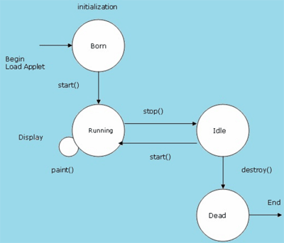
Life Cycle of an Applet

Slide 8
Lifecycle of Java Applet
Applet is initialized.
Applet is started.
Applet is painted.
Applet is stopped.
Applet is destroyed.

Slide 9
Initialization State
init: This method is intended for whatever initialization is needed for your applet. It is invoked only once.
public void init()
{
………..
………..
………..
}

Slide 10
Running State
start: This method is automatically called after the browser calls the init method. It is also called whenever the user returns to the page containing the applet after having gone off to other pages.
public void start()
{
………..
………..
………..
}

Slide 11
Idle or Stopped State
stop: This method is automatically called when the user moves off the page on which the applet sits. It can, therefore, be called repeatedly in the same applet.
public void stop()
{
………..
………..
………..
}

Slide 12
Dead State
destroy: This method is only called when the browser shuts down normally. Because applets are meant to live on an HTML page, you should not normally leave resources behind after a user leaves the page that contains the applet.
public void destroy()
{
………..
………..
………..
}

Slide 13
Display State
paint: Invoked immediately after the start() method, and also any time the applet needs to repaint itself in the browser.
public void paint(Graphics g)
{
………..
………..
………..
}

Slide 14
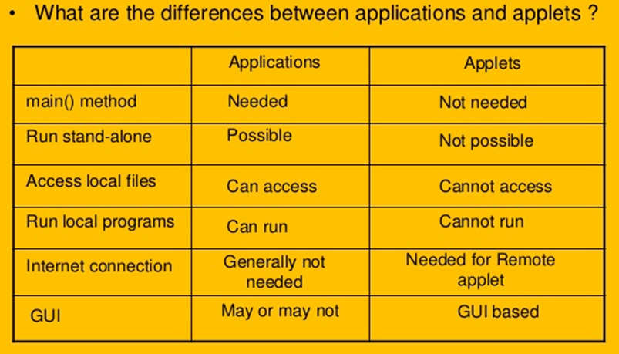

Slide 15
The <applet> Tag
< APPLET
[CODEBASE = codebaseURL]
CODE = appletFile
[ALT = alternateText]
[NAME = appletInstanceName]
WIDTH = pixels
HEIGHT = pixels
[ALIGN = alignment]
[VSPACE = pixels]
[HSPACE = pixels] >
[< PARAM NAME = appletParameter1 VALUE = value >]
[< PARAM NAME = appletParameter2 VALUE = value >]
</APPLET>

Slide 16
<applet> Tag
Required Attributes
Attribute | Value | Description
code | URL | Specifies the file name of a Java applet
width | pixels | Specifies the width of an applet
height | pixels | Specifies the height of an applet

Slide 17
Optional Attributes
Attribute | Value | Description
codebase | URL | Specifies a relative base URL for applets specified in the code attribute
alt | text | Specifies an alternate text for an applet
name | name | Defines the name for an applet (to use in scripts)
align | left right top bottom middle baseline | Specifies the alignment of an applet according to surrounding elements
hspace | pixels | Defines the horizontal spacing around an applet
vspace | pixels | Defines the vertical spacing around an applet

Slide 18
Creating applet
//First.java
import java.applet.Applet;
import java.awt.Graphics;
public class First extends Applet
{
public void paint(Graphics g)
{
g.drawString("welcome",150,150);
}
}

Slide 19
Adding Applet To HTML file
myapplet.html
<html>
<body>
<applet code="First.class" width="300" height="300">
</applet>
</body>
</html>

Slide 20
How to run an Applet?
There are two ways to run an applet
By html file.
By appletViewer tool (for testing purpose).

Slide 21
Embedding <applet>tags in java code
//First.java
import java.applet.Applet;
import java.awt.Graphics;
public class First extends Applet
{
public void paint(Graphics g)
{
g.drawString("welcome to applet",150,150);
}
}
/*
<applet code="First.class" width="300" height="300">
</applet>
*/

Slide 22
To execute the applet by appletviewer tool, write in command prompt:
c:\>javac First.java
c:\>appletviewer First.java

Slide 23
passing parameter to applet
<PARAM> tags are the only way to specify applet-specific parameters.
< PARAM NAME = appletParameter1 VALUE = value >
Attribute | Value | Description
name | name | Specifies the name of a parameter
value | value | Specifies the value of the parameter
We can get any information from the HTML file as a parameter. For this purpose, Applet class provides a method named getParameter().
public String getParameter(String parameterName)

Slide 24
Example of using parameter in Applet
//UseParam.java
import java.applet.Applet;
import java.awt.Graphics;
public class UseParam extends Applet
{
public void paint(Graphics g)
{
String str=getParameter("msg");
g.drawString(str,50, 50);
}
}

Slide 25
myapplet.html
<html>
<body>
<applet code="UseParam.class" width="300" height="300">
<param name="msg" value="Welcome to applet">
</applet>
</body>
</html>

Slide 26
Adding controls to applets
UserInput.java
import java.awt.*;
import java.applet.*;
public class UserInput extends Applet
{
TextField text1, text2;
public void init()
{
text1 = new TextField(8);
text2 = new TextField(8);
add(text1);
add(text2);
text1.setText("0");
text2.setText("0");
}

Slide 27
public void paint(Graphics g)
{
int x=0,y=0,z=0;
String s1,s2,s;
g.drawString("Input a number in each box ",10,50);
try
{
s1 = text1.getText();
x = Integer.parseInt(s1);
s2 = text2.getText();
y = Integer.parseInt(s2);
}
catch(Exception e) {}
z = x + y;
s = String.valueOf(z);
g.drawString("The Sum is : ",10,75);
g.drawString(s,100,75);
}

Slide 28
public boolean action(Event event, Object obj)
{
repaint();
return true;
}
}
UserInput.html
<HTML>
<HEAD>
<TITLE>Getting Input from the User</TITLE>
</HEAD>
<BODY>
<APPLET Code=“UserInput.class" Width=400 Height=300>
</APPLET>
</BODY>
</HTML>

Slide 29
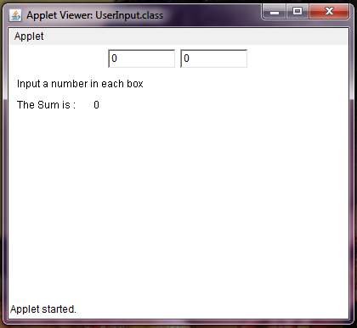

Slide 30
Handle Action Events for AWT Button Example
import java.applet.*;
import java.awt.*;
import java.awt.event.ActionEvent;
import java.awt.event.ActionListener;
/* <applet code="HAEEx.class" width=200 height=200>
</applet> */
public class HAEEx extends Applet implements ActionListener
{
String actionMessage="";

Slide 31
public void init()
{
Button B1 = new Button("Ok");
Button B2 = new Button("Cancel");
add(B1);
add(B2);
B1.addActionListener(this);
B2.addActionListener(this);
}
public void paint(Graphics g)
{
g.drawString(actionMessage,10,50);
}

Slide 32
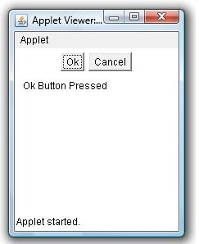
public void actionPerformed(ActionEvent ae)
{
String action = ae.getActionCommand();
if(action.equals("Ok"))
actionMessage = "Ok Button Pressed";
else if(action.equals("Cancel"))
actionMessage = "Cancel Button Pressed";
repaint();
}
}

Slide 33
Graphics Programming

Slide 34
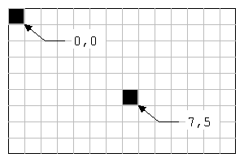
The coordinate plane
A coordinate system is a method for specifying the location of points in space. In the case of the AWT, this space is a two-dimensional surface called a plane. Each location in a plane can be specified by two integers, called the x and y coordinates. The values of the x and y coordinates are calculated in terms of the point's respective horizontal and vertical displacement from the origin. In the case of the AWT, the origin is always the point in the upper-left corner of the plane. It has the coordinate values 0 (for x) and 0 (for y).

Slide 35
Graphics class Methods
Drawing Lines
void drawLine(int x1, int y1, int x2, int y2)
It draws a straight line, a single pixel wide, between the specified beginning and ending points. The line will be drawn in the current foreground color.
Example:
g.drawLine(30,300,200,10);

Slide 36
Graphics class Methods
Drawing Rectangles
void drawRect(int x, int y, int width, int height)
It draws a rectangle. It require, as parameters, the x and y coordinates at which to begin the rectangle, and the width and the height of the rectangle. Both the width and the height must be positive integers.
Example:
g.drawRect(400,50,200,100);

Slide 37
Graphics class Methods
Drawing Rounded Rectangles
void drawRoundRect(int x, int y, int width, int height, int arcWidth, int arcHeight)
The rounded-rectangle graphics methods require two additional parameters, an arc width and an arc height, both of which control the rounding of the corners.
Example:
g.drawRoundRect(10,100,80,50,10,10);

Slide 38
Graphics class Methods
Drawing Filled/ Solid Rectangles
void fillRect(int x, int y, int w, int h)
It draws a solid rectangle. It also requires 4 parameters like drawRect() method.
Example:
g.fillRect(400,50,200,100);

Slide 39
Graphics class Methods
Drawing Rounded Rectangles
void fillRoundRect(int x, int y, int w, int h, int arcWidth, int arcHeight)
It draws solid rounded-rectangle. It also takes 6 parameters like drawRoundRect() method.
Example:
g.fillRoundRect(10,100,80,50,10,10);

Slide 40
Graphics class Methods
Drawing Ellipses & Circles
void drawOval(int x, int y, int w, int h)
It draws outline of an oval. It takes parameters, the x and y coordinates of the center of the oval and the width and height of the oval.
Example:
g.drawOval(10,10,100,120);

Slide 41
Graphics class Methods
Drawing Solid Ellipses & Circles
void fillOval(int x, int y, int w, int h)
It draws a solid oval. It also takes 4 parameters like drawOval() method.
Example:
g.fillOval(10,10,100,120);

Slide 42
Graphics class Methods
Drawing Arcs
void drawArc(int x, int y, int w, int h, int startAngle, int arcAngle)
It draws an arc. It requires 6 parameters. First 4 parameters are same as drawOval() method and two additional parameters, a start angle and an arc angle, to specify the beginning of the arc and the size of the arc in degrees.
Example:
g.drawArc(60,125,80,40,180,180);

Slide 43
Graphics class Methods
Drawing Solid Arcs
void fillArc(int x, int y, int w, int h, int startAngle, int arcAngle)
It draws solid arc. It also requires 6 parameters like drawArc() method.
Example:
g.fillArc(60,125,80,40,180,180);

Slide 44
Graphics class Methods
Drawing Polygons
void drawPolygon(int xPoints[], int yPoints[], int nPoints)
It draws outline of polygon. It requires 3 parameters. Two arrays of integers, one representing the successive x coordinates and the other representing the successive y coordinates. And an integer for the total number of points.
Example:
int xPoints[]={10,170,80,10};
int yPoints[]={20,40,140,20};
int nPoints= xPoints.length;
g.drawPolygon(xPoints, yPoints, nPoints);

Slide 45
Graphics class Methods
Drawing Solid Polygons
void fillPolygon(int xPoints[], int yPoints[], int nPoints)
It draws solid polygon. It requires 3 parameters like drawPolygon() method.
Example:
int xPoints[]={10,170,80,10};
int yPoints[]={20,40,140,20};
int nPoints= xPoints.length;
g.fillPolygon(xPoints, yPoints, nPoints);

Slide 46
import java.awt.*;
import java.applet.*;
public class Face extends Applet
{
public void paint(Graphics g)
{
g.drawOval(40,40,120,150); //Head
g.drawOval(57,75,30,20); //Left eye
g.drawOval(110,75,30,20); //Right eye
g.fillOval(68,81,10,10); //Pupil (left)
g.fillOval(121,81,10,10); //Pupil (right)
g.drawOval(85,100,30,30); //Nose
g.fillArc(60,125,80,40,180,180); //Mouth
g.drawOval(25,92,15,30); //Left ear
g.drawOval(160,92,15,30); //Right ear
}
}

Slide 47
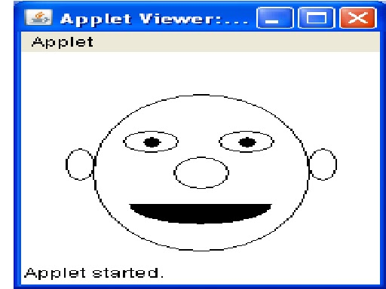

Slide 48
Color & Fonts
setColor()
public abstract void setColor(Color c)
Sets this graphics context's current color to the specified color. All subsequent graphics operations using this graphics context use this specified color.
getColor()
public abstract Color getColor()
Gets this graphics context's current color.

Slide 49
Color & Fonts
setBackGround()
void setBackground(mycolor)
Sets the color of the background of an applet window.
setForeGround()
void setForeground(mycolor)
Sets the foreground color to a specific color. mycolor is one of the color constants or the new color created by the user.

Slide 50
Color & Fonts
The list of color constants is given below:
• Color.red • Color.orange
• Color.gray • Color.darkGray
• Color.lightGray • Color.cyan
• Color.pink • Color.white
• Color.blue • Color.green
• Color.black • Color.yellow

Slide 51
font class
Constructors
public Font (String name, int style, int size)
There is a single constructor for Font. It requires a name, style, and size. name represents the name of the font to create, case insensitive.
setFont (new Font ("TimesRoman", Font.BOLD | Font.ITALIC, 20));
This can be also written as,
Font f=new Font("TimesRoman", Font.BOLD | Font.ITALIC, 20);
g.setFont(f);

Slide 52
font class
Variables defined by font class:
Three protected variables access the font setting. They are initially set through the Font constructor. To read these variables, use the Font class's "get" methods.
protected String name
The name of the font.
protected int size
The size of the font.
protected int style
The style of the font. The style is some logical combination of the constants listed previously.

Slide 53
font methods
getFamily()
public String getFamily ()
The getFamily() method returns the actual name of the font that is being used to display characters.

Slide 54
font methods
getFont()
public static Font getFont (String name)
The getFont() method gets the font specified by the system property name. If name is not a valid system property, null is returned.

Slide 55
font methods
getFontname()
String getFontName()
Returns the font face name of this Font.
getSize()
int getSize()
Returns the point size of this Font, rounded to an integer.
getStyle()
int getStyle()
Returns the style of this Font.

Slide 56
font methods
getAllFonts()
public abstract Font[] getAllFonts()
Returns an array containing an instance of all fonts available in this Graphics Environment.
getavailablefontfamilyname()
public abstract String[] getAvailableFontFamilyNames()
Returns an array containing the names of all font families in this Graphics Environment

