Slide 1
Object Oriented Programming using JAVA
Presented By Sudeshna Kundu (Mondal)

Slide 2
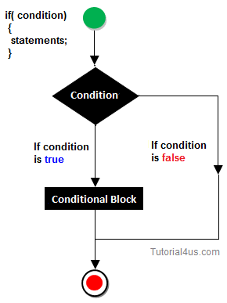
Decision Making Statement in Java
Decision making statement statements is also called selection statement.
That is depending on the condition block need to be executed or not which is decided by condition. If the condition is "true" statement block will be executed, if condition is "false" then statement block will not be executed.
if-then Statement

Slide 3
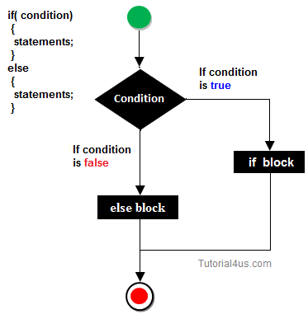
if-else Statement
//A Java Program to demonstrate the use of if-else statement.
//It is a program of odd and even number.
public class IfElseExample {
public static void main(String[] args) {
//defining a variable
int number=13;
//Check if the number is divisible by 2 or not
if(number%2==0){
System.out.println("even number");
}else{
System.out.println("odd number");
}
}
}

Slide 4
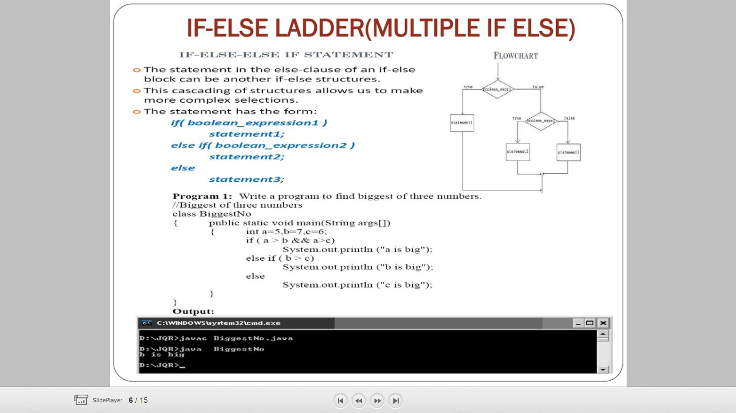
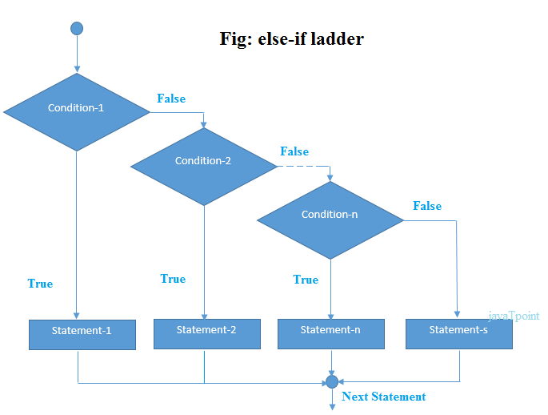
if-else Ladder

Slide 5
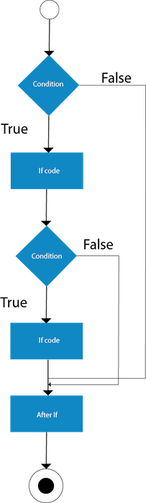
Java Nested if statement
The nested if statement represents the if block within another if block. Here, the inner if block condition executes only when outer if block condition is true.
Syntax:
if(condition){
//code to be executed
if(condition){
//code to be executed
}
}

Slide 6
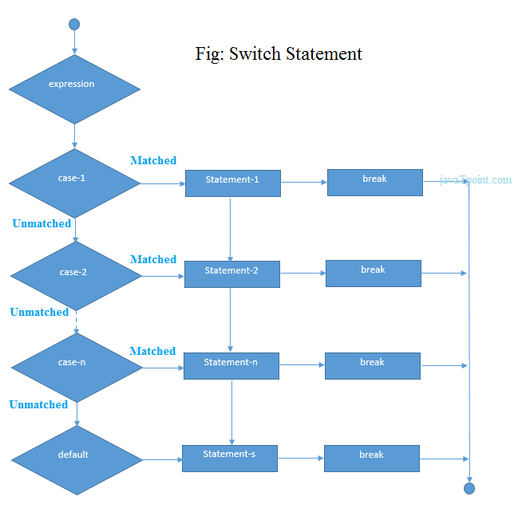
Switch Statement
switch(expression){
case value1:
//code to be executed;
break; //optional
case value2:
//code to be executed;
break; //optional
......
default:
code to be executed if all cases are not matched;
}

Slide 7
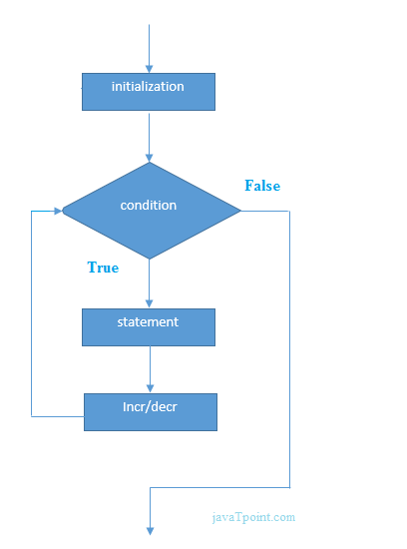
Loops in Java
In programming languages, loops are used to execute a set of instructions/functions repeatedly when some conditions become true. There are three types of loops in java.
for loop
while loop
do-while loop
public class ForExample {
public static void main(String[] args) {
for(int i=1;i<=10;i++){
System.out.println(i);
}
}
}
For Loop

Slide 8
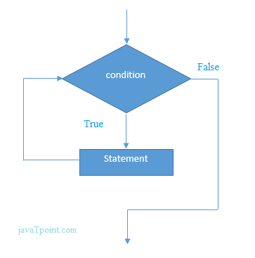
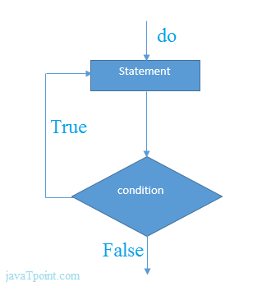
public class WhileExample {
public static void main(String[] args) {
int i=1;
while(i<=10){
System.out.println(i);
i++;
}
}
}
While Loop
Do While Loop
public class DoWhileExample {
public static void main(String[] args) {
int i=1;
do{
System.out.println(i);
i++;
}while(i<=10);
}
}

Slide 9
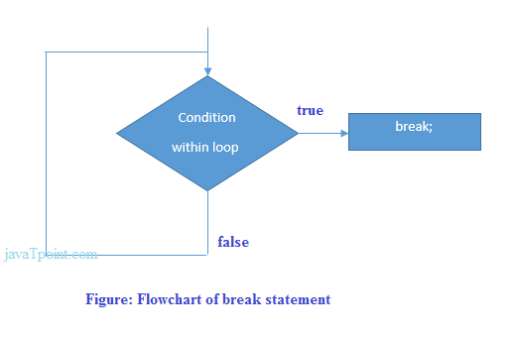
Break Statement
When a break statement is encountered inside a loop, the loop is immediately terminated and the program control resumes at the next statement following the loop.
The Java break statement is used to break loop or switch statement. It breaks the current flow of the program at specified condition. In case of inner loop, it breaks only inner loop.
We can use Java break statement in all types of loops such as for loop, while loop and do-while loop.
public class BreakExample2 {
public static void main(String[] args) {
//outer loop
for(int i=1;i<=3;i++){
//inner loop
for(int j=1;j<=3;j++){
if(i==2&&j==2){
//using break statement inside the inner loop
break;
}
System.out.println(i+" "+j);
}
}
}
}
Output:
1 1
1 2
1 3
2 1
3 1
3 2
3 3

Slide 10
Continue Statement
The continue statement is used in loop control structure when you need to jump to the next iteration of the loop immediately.
The Java continue statement is used to continue the loop. It continues the current flow of the program and skips the remaining code at the specified condition. In case of an inner loop, it continues the inner loop only.
We can use Java continue statement in all types of loops such as for loop, while loop and do-while loop.
public class ContinueExample {
public static void main(String[] args) {
//for loop
for(int i=1;i<=10;i++){
if(i==5){
//using continue statement
continue;//it will skip the rest statement
}
System.out.println(i);
}
}
}
Output:
1
2
3
4
6
7
8
9
10

Slide 11
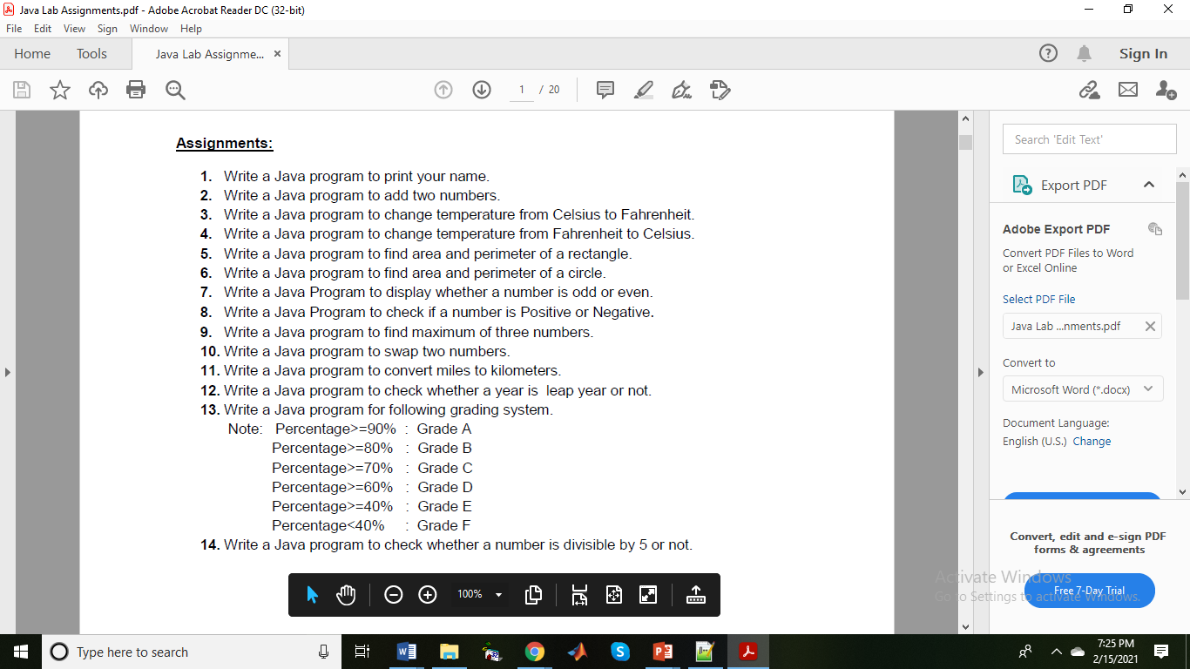

Slide 12
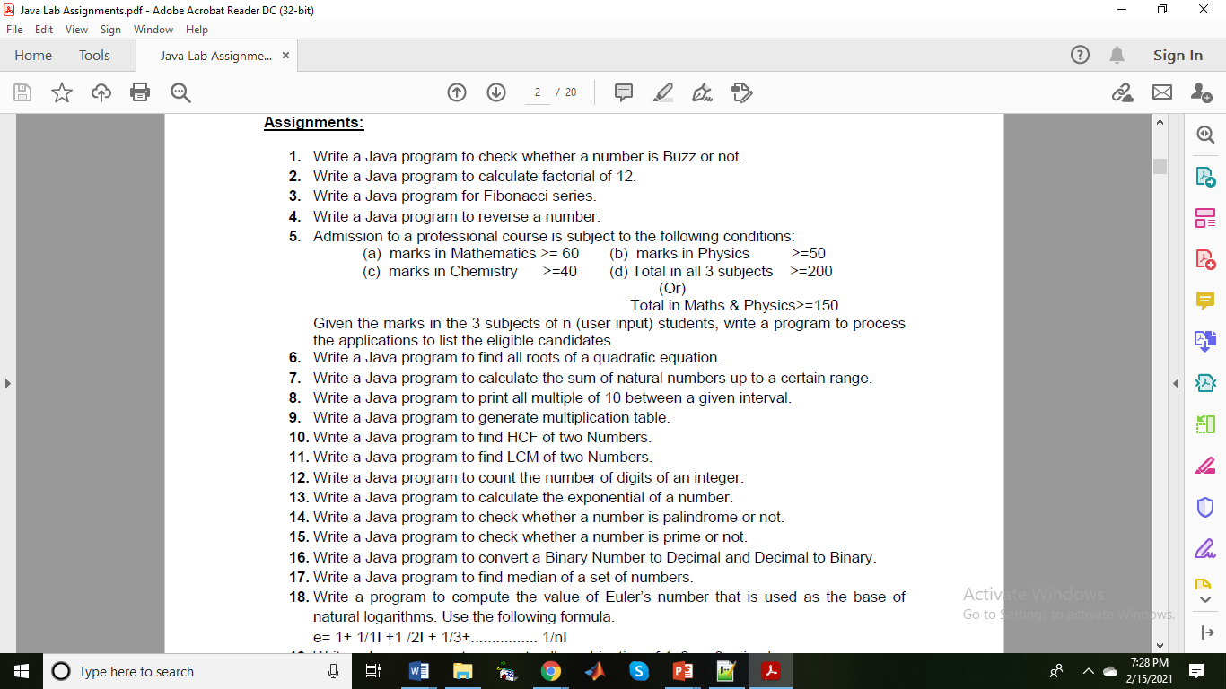

Slide 13
