Slide 1
Object Oriented Programming using JAVA
Presented By Sudeshna Kundu (Mondal)

Slide 2
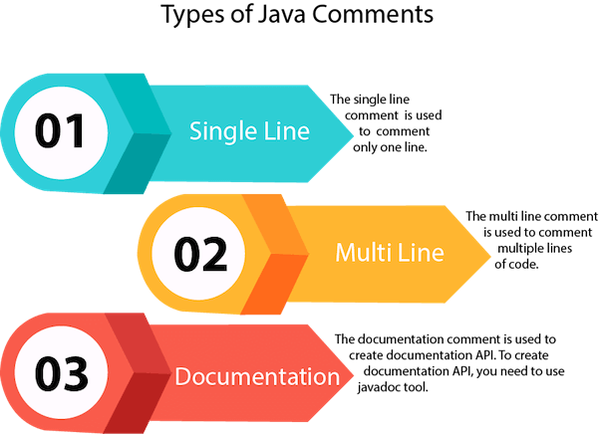
Java Comments
The Java comments are the statements that are not executed by the compiler and interpreter. The comments can be used to provide information or explanation about the variable, method, class or any statement. It can also be used to hide program code.
Types of Java Comments
There are three types of comments in Java.
Single Line Comment
Multi Line Comment
Documentation Comment

Slide 3
Java Comments
2) Java Multi Line Comment
The multi line comment is used to comment multiple lines of code.
Syntax:
/*
This
is
multi line
comment
*/
3) Java Documentation Comment
The documentation comment is used to create documentation API. To create documentation API, you need to use javadoc tool .
Syntax:
/**
This
is
documentation
comment
*/
1) Java Single Line Comment
The single line comment is used to comment only one line.
Syntax:
//This is single line comment

Slide 4
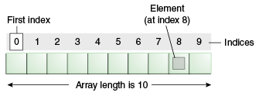
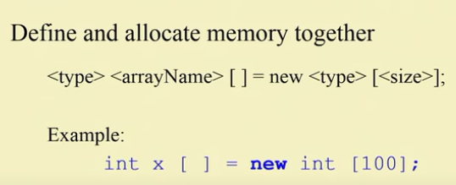
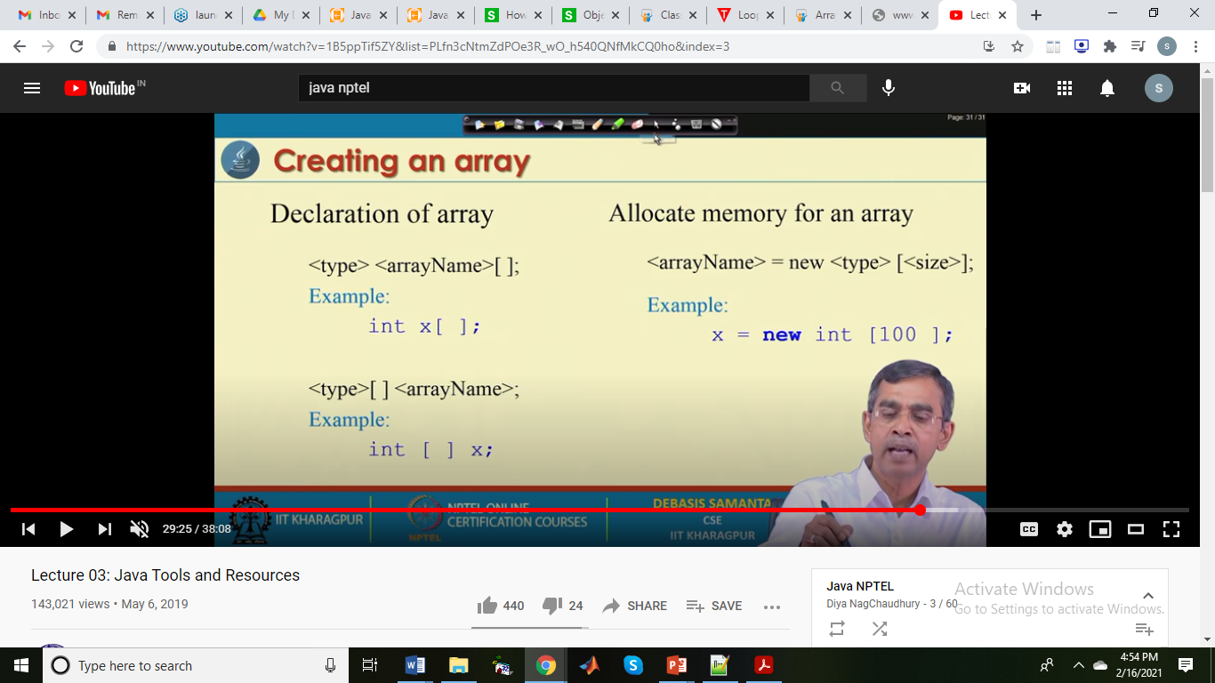
1-D Array

Slide 5
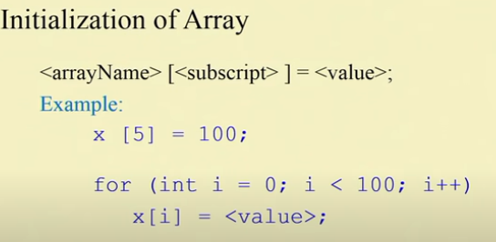
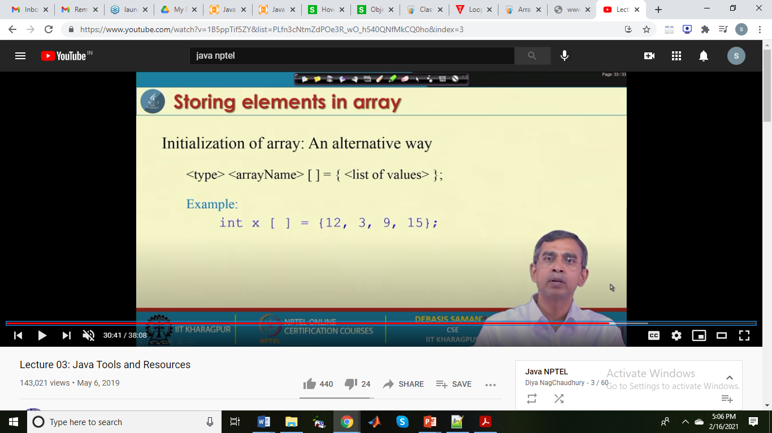
class Testarray{
public static void main(String args[]){
int a[]=new int[5];//declaration and instantiation
a[0]=10;//initialization
a[1]=20;
a[2]=70;
a[3]=40;
a[4]=50;
//printing array
for(int i=0;i<a.length;i++)//length is the property of array
System.out.println(a[i]);
}}

Slide 6
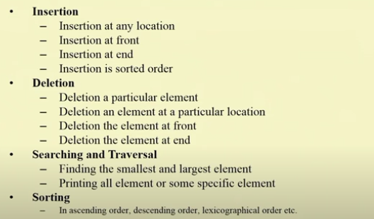
Processing elements in an array

Slide 7
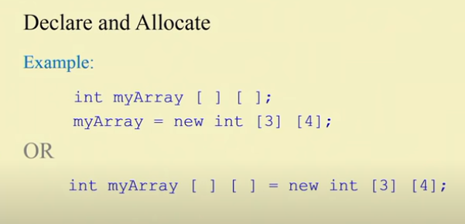
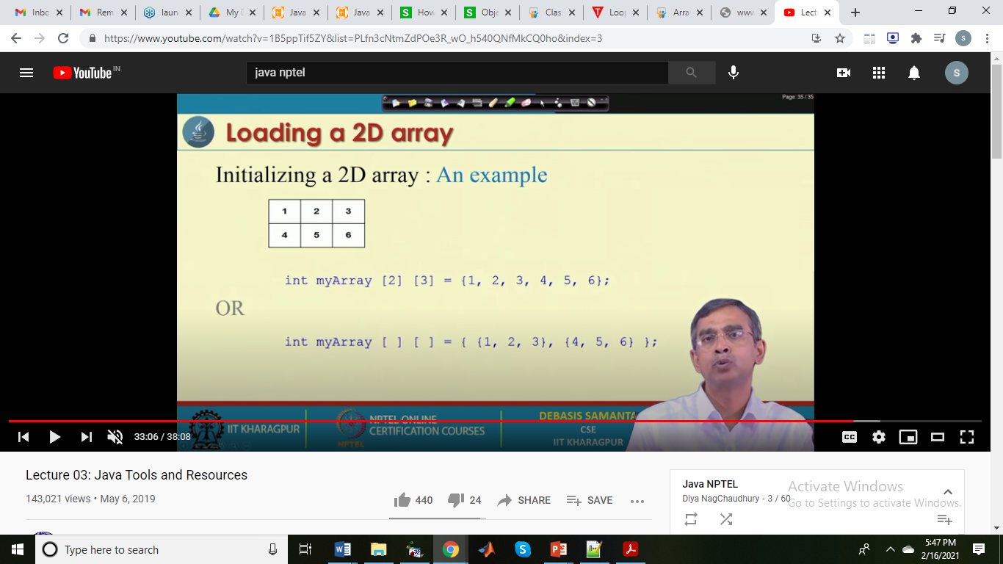
Creating and Loading a 2D array

Slide 8
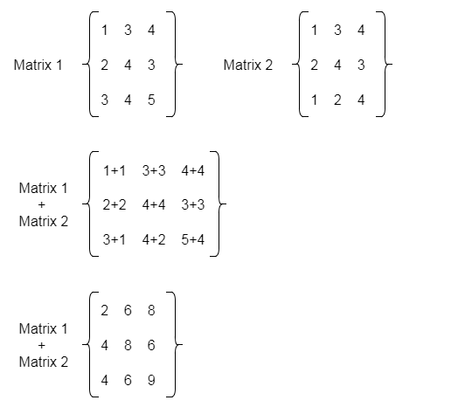
2D Array Implementation
public class MatrixAdditionExample{
public static void main(String args[]){
//creating two matrices
int a[][]={{1,3,4},{2,4,3},{3,4,5}};
int b[][]={{1,3,4},{2,4,3},{1,2,4}};
//creating another matrix to store the sum of two matrices
int c[][]=new int[3][3]; //3 rows and 3 columns
//adding and printing addition of 2 matrices
for(int i=0;i<3;i++){
for(int j=0;j<3;j++){
c[i][j]=a[i][j]+b[i][j];
System.out.print(c[i][j]+" ");
}
System.out.println();//new line
}
}}

Slide 9

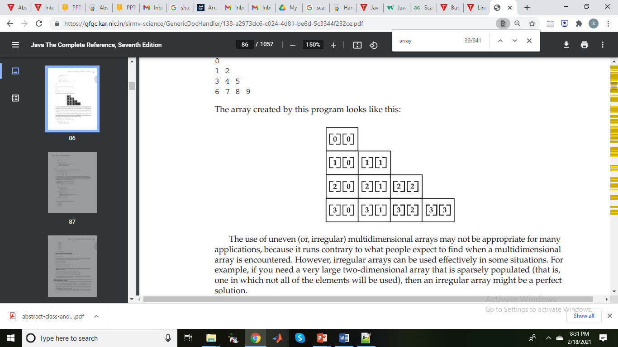
Variable sized 2D array
// Manually allocate differing size second dimensions.
class TwoDAgain {
public static void main(String args[]) {
int twoD[][] = new int[4][];
twoD[0] = new int[1];
twoD[1] = new int[2];
twoD[2] = new int[3];
twoD[3] = new int[4];
int i, j, k = 0;
for(i=0; i<4; i++)
for(j=0; j<i+1; j++) {
twoD[i][j] = k;
k++;
}
for(i=0; i<4; i++) {
for(j=0; j<i+1; j++)
System.out.print(twoD[i][j] + " ");
System.out.println();
}
}
}
This program generates the following output:
0
1 2
3 4 5
6 7 8 9
The array created by this program looks like this:

Slide 10
Java Naming conventions
Java naming convention is a rule to follow as you decide what to name your identifiers such as class, package, variable, constant, method, etc.
But, it is not forced to follow. So, it is known as convention not rule. These conventions are suggested by several Java communities such as Sun Microsystems and Netscape.
All the classes, interfaces, packages, methods and fields of Java programming language are given according to the Java naming convention. If you fail to follow these conventions, it may generate confusion or erroneous code.
Advantage of naming conventions in java
By using standard Java naming conventions, you make your code easier to read for yourself and other programmers. Readability of Java program is very important. It indicates that less time is spent to figure out what the code does.
The following are the key rules that must be followed by every identifier:
The name must not contain any white spaces.
The name should not start with special characters like & (ampersand), $ (dollar), _ (underscore).

Slide 11
Examples of naming conventions in java
Class
It should start with the uppercase letter.
It should be a noun such as Color, Button, System, Thread, etc.
Use appropriate words, instead of acronyms.
Example: -
public class Employee
{
//code snippet
}
Method
It should start with lowercase letter.
It should be a verb such as main(), print(), println().
If the name contains multiple words, start it with a lowercase letter followed by an uppercase letter such as actionPerformed().
Example:-
class Employee
{
//method
void draw()
{
//code snippet
}
}

Slide 12
Variable
It should start with a lowercase letter such as id, name.
It should not start with the special characters like & (ampersand), $ (dollar), _ (underscore).
If the name contains multiple words, start it with the lowercase letter followed by an uppercase letter such as firstName, lastName.
Avoid using one-character variables such as x, y, z.
Example :-
class Employee
{
//variable
int id;
//code snippet
}
Constant
It should be in uppercase letters such as RED, YELLOW.
If the name contains multiple words, it should be separated by an underscore(_) such as MAX_PRIORITY.
It may contain digits but not as the first letter.
Example :-
class Employee
{
//constant
static final int MIN_AGE = 18;
//code snippet
}

Slide 13
Package
It should be a lowercase letter such as java, lang.
If the name contains multiple words, it should be separated by dots (.) such as java.util, java.lang.
Example :-
package com.javatpoint; //package
class Employee
{
//code snippet
}
Interface
It should start with the uppercase letter.
It should be an adjective such as Runnable, Remote, ActionListener.
Use appropriate words, instead of acronyms.
Example: -
interface Printable
{
//code snippet
}

Slide 14
CamelCase in java naming conventions
Java follows camel-case syntax for naming the class, interface, method, and variable.
If the name is combined with two words, the second word will start with uppercase letter always such as actionPerformed(), firstName, ActionEvent, ActionListener, etc.

Slide 15
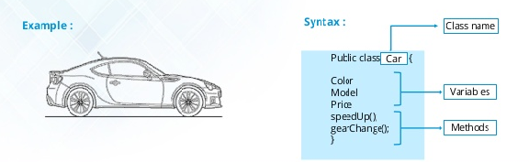
Classes & Objects
A class is a group of objects which have common properties. It is a template or blueprint from which objects are created. It is a logical entity. It can't be physical.
Syntax to declare a class:
class <class_name>{
field;
method;
}

Slide 16

Classes & Objects
Object is an instance of a class. Class is a template or blueprint from which objects are created. So object is the instance(result) of a class.
Object Definitions:
Object is a real world entity.
Object is a run time entity.
Object is an entity which has state and behavior.
Object is an instance of a class.

Slide 17
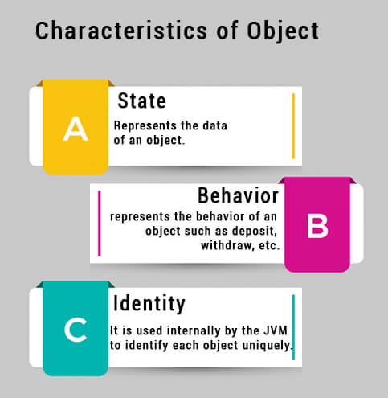
Characteristics of an object in Java
An object has three characteristics:
1. State: State represents properties of an object. It is represented by instance variable/attribute of an object. The properties of an object are important because the outcome of functions depend on the properties.
2. Behavior: Behavior represents functionality or actions. It is represented by methods in Java.
3. Identity: Identity represents the unique name of an object. It differentiates one object from the other. The unique name of an object is used to identify the object.
Let’s take a real-world example to understand all these points clearly.

Slide 18
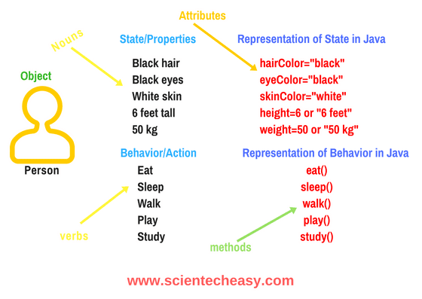
Real-time Examples of Objects in Java
We are taking the example “person”. A person has three characteristics: Identity (name), State (properties), and behavior (actions or functionality). Look at the below figure.
In the above figure, a person is an object. First state of the person (object) is black hair which can be represented in Java like this: hairColor = “black”.
In the same way, second property of the object is eye color which can be represented in Java like eyeColor = “black” and so on. These are called attributes that define the properties of a person.
Let’s consider the behaviors or actions of a person. The actions of a person may be “eat, sleep, walk, play, and study”. These actions are represented in Java like this: eat(), sleep(), walk(), play(), and study(). These are called methods.
Thus, when properties and actions are combined together of any real-world object make an object in Java.

Slide 19
Classes in Java
In Java programming, a class is basically user-defined data types that act as a template for creating objects of the identical type. It represents the common properties and actions (functions) of an object.
In other words, a class can also be defined as “a class is a group of objects which are common to all objects of one type”.
A class is the type of an object. Let’s understand it with realtime examples.
Realtime Examples of Class in Java
Let us consider two objects Samsung Galaxy S4 and iPhone. Suppose Samsung Galaxy S4 have some properties like width = “6.98 cms”, height = “13.6 cm”, OS = “Android”, brand = “Samsung”, price = “1000$” and actions are call(), sendMessage(), browser(), share().
Now, suppose iPhone has some properties such as width = “5.86 cm”, height = “12.3 cms”, OS = “iOS”, brand = “Apple”, price = “1200$” and actions are call(), sendMessage(), browse(), share().
Both objects have some different properties and actions but the type is the same “Phone”. This is the class. i.e the name of the class is “Phone”.

Slide 20
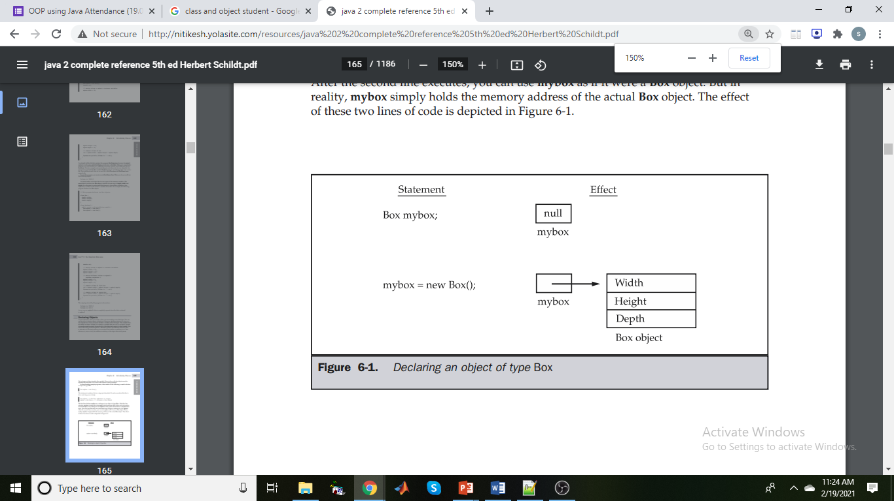
Object and Class Example: main within the class
In this example, we have created a Student class which has two data members id and name. We are creating the object of the Student class by new keyword and printing the object's value.
Here, we are creating a main() method inside the class.
//Java Program to illustrate how to define a class and fields
//Defining a Student class.
class Student{
//defining fields
int id;//field or data member or instance variable
String name;
//creating main method inside the Student class
public static void main(String args[]){
//Creating an object or instance
Student s1=new Student();
System.out.println(s1.id);//accessing member through reference variable
System.out.println(s1.name);
}
}
Output:
0
null

Slide 21
Classes & Objects
Creating Objects
Class name Dynamically create the object
Student s1= new Student();
Name of an object Automatically calls the constructor
A class provides the blueprints for objects. So basically, an object is created from a class. In Java, the new keyword is used to create new objects.
There are three steps when creating an object from a class −
Declaration − A variable declaration with a variable name with an object type.
Instantiation − The 'new' keyword is used to dynamically allocates memory for an object an returns a reference to it.
Initialization − The 'new' keyword is followed by a call to a constructor. This call initializes the new object.

Slide 22
Object and Class Example: main outside the class
In real time development, we create classes and use it from another class. It is a better approach than previous one. Let's see a simple example, where we are having main() method in another class.
We can have multiple classes in different Java files or single Java file. If you define multiple classes in a single Java source file, it is a good idea to save the file name with the class name which has main() method.
//Java Program to demonstrate having the main method in
//another class
//Creating Student class.
class Student{
int id;
String name;
}
//Creating another class TestStudent1 which contains the main method
class TestStudent1{
public static void main(String args[]){
Student s1=new Student();
System.out.println(s1.id);
System.out.println(s1.name);
}
}
Output:
0
null

