Slide 1
Object Oriented Programming using JAVA
Presented By Sudeshna Kundu (Mondal)

Slide 2
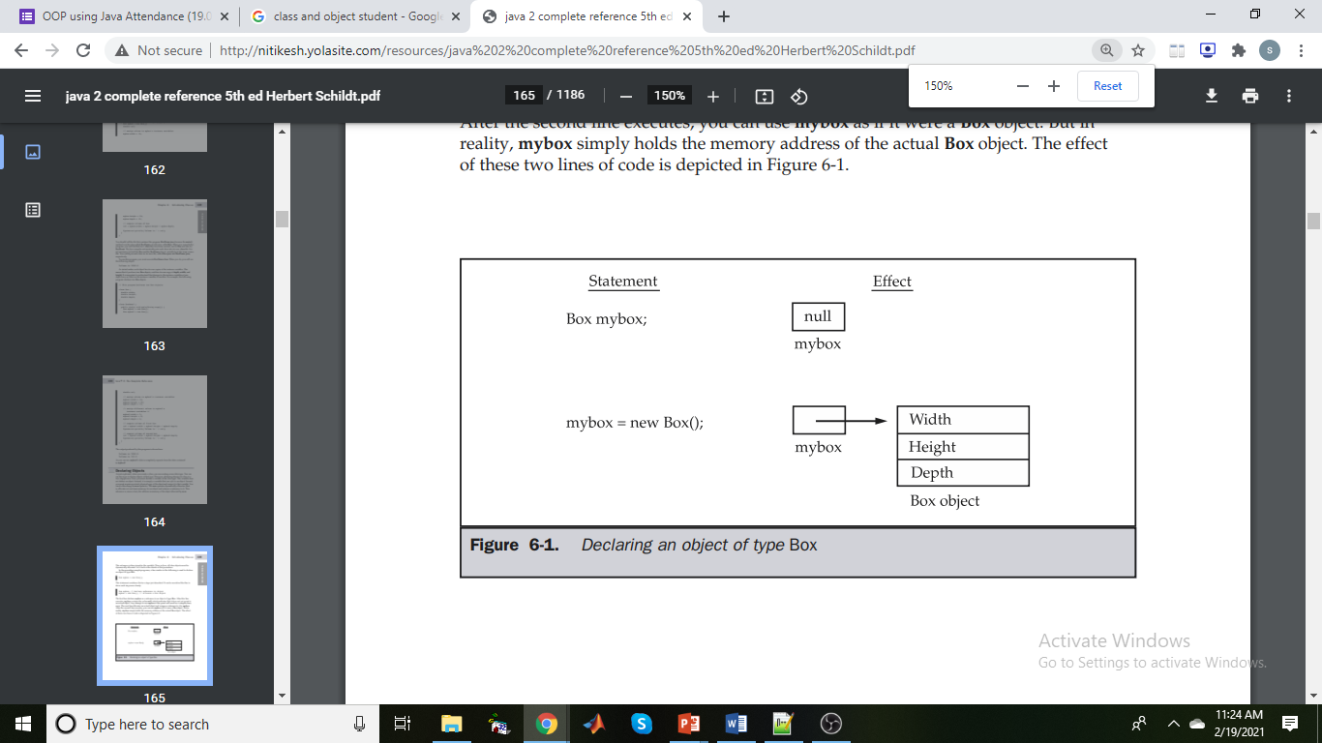
Object and Class Example:
when you create a class, you are creating a new data type. You can use this type to declare objects of that type.
However, obtaining objects of a class is a two-step process. First, you must declare a variable of the class type. This variable does not define an object. Instead, it is simply a variable that can refer to an object. Second, you must acquire an actual, physical copy of the object and assign it to that variable.
The new operator dynamically allocates (that is, allocates at run time) memory for an object and returns a reference to it. This reference is, more or less, the address in memory of the object allocated by new. This reference is then stored in the variable. Thus, in Java, all class objects must be dynamically allocated.
The class name followed by parentheses specifies the constructor for the class. However, if no explicit constructor is specified, then Java will automatically supply a default constructor.
class Box {
double width;
double height;
double depth;
}
Box mybox; // declare reference to object
mybox = new Box(); // allocate a Box object

Slide 3
Object and Class Example: main within the class
In this example, we have created a Student class which has two data members id and name. We are creating the object of the Student class by new keyword and printing the object's value.
Here, we are creating a main() method inside the class.
//Java Program to illustrate how to define a class and fields
//Defining a Student class.
class Student{
//defining fields
int id;//field or data member or instance variable
String name;
//creating main method inside the Student class
public static void main(String args[]){
//Creating an object or instance
Student s1=new Student();
System.out.println(s1.id);//accessing member through reference variable
System.out.println(s1.name);
}
}
Output:
0
null

Slide 4
Classes & Objects
Creating Objects
Class name Dynamically create the object
Student s1= new Student();
Name of an object Automatically calls the constructor
A class provides the blueprints for objects. So basically, an object is created from a class. In Java, the new keyword is used to create new objects.
There are three steps when creating an object from a class −
Declaration − A variable declaration with a variable name with an object type.
Instantiation − The 'new' keyword is used to dynamically allocates memory for an object an returns a reference to it.
Initialization − The 'new' keyword is followed by a call to a constructor. This call initializes the new object.

Slide 5
Object and Class Example: main outside the class
In real time development, we create classes and use it from another class. It is a better approach than previous one. Let's see a simple example, where we are having main() method in another class.
We can have multiple classes in different Java files or single Java file. If you define multiple classes in a single Java source file, it is a good idea to save the file name with the class name which has main() method.
//Java Program to demonstrate having the main method in
//another class
//Creating Student class.
class Student{
int id;
String name;
}
//Creating another class TestStudent1 which contains the main method
class TestStudent1{
public static void main(String args[]){
Student s1=new Student();
System.out.println(s1.id);
System.out.println(s1.name);
}
}
Output:
0
null

Slide 6
How to Initialize State of Object in Java?
There are three ways by which we can initialize state of an object. In other words, we can initialize value of variables in Java by using three ways. They are as follows:
1. By using a reference variable
2. By using a method.
3. By using constructor
Object Initialization by using Reference variable
We can also initialize the value of objects through the reference variable.

Slide 7
Object Initialization by using Reference variable
We can also initialize the value of objects through the reference variable.
class Student{
int id;
String name;
}
class TestStudent2{
public static void main(String args[]){
Student s1=new Student();
s1.id=101;
s1.name=“Kartik";
System.out.println(s1.id+" "+s1.name);//printing members with a white space
}
}
We can also create multiple objects and store information in it through reference variable.
Output:
101 Kartik

Slide 8

2. Initialization through method
class Student{
int rollno;
String name;
void insertRecord(int r, String n){
rollno=r;
name=n;
}
void displayInformation(){System.out.println(rollno+" "+name);}
}
class TestStudent4{
public static void main(String args[]){
Student s1=new Student();
Student s2=new Student();
s1.insertRecord(111,"Karan");
s2.insertRecord(222,"Aryan");
s1.displayInformation();
s2.displayInformation();
}
}
rollno=222
Name= Ayan
s2
rollno=111
Name= Karan
Stack Memory
Heap Memory

Slide 9
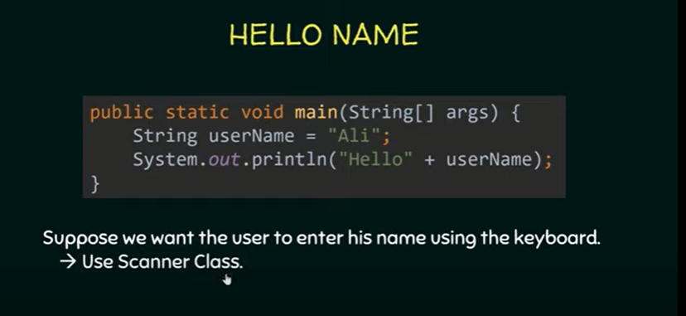
Input through Scanner class

Slide 10

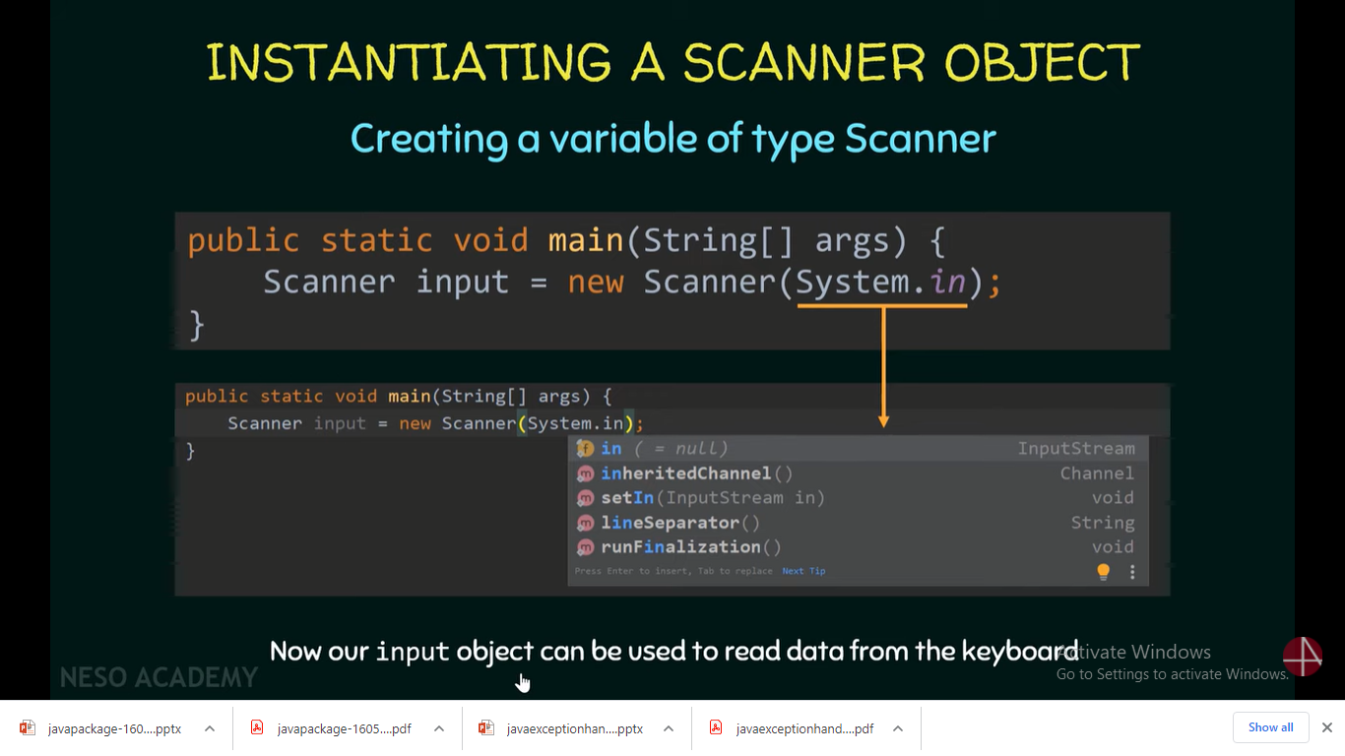
Scanner class in Java is found in the java.util package. Java provides various ways to read input from the keyboard, the java.util.Scanner class is one of them.

Slide 11
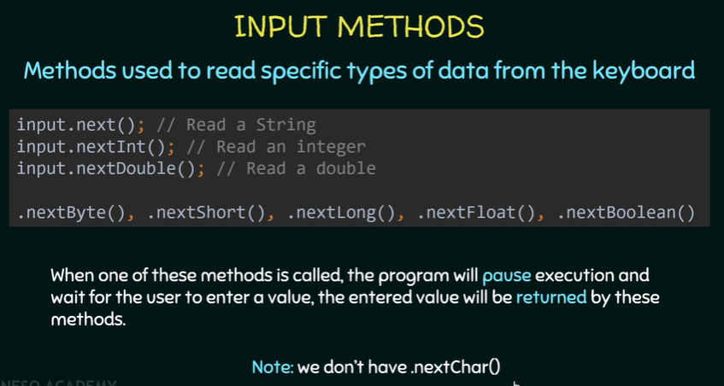
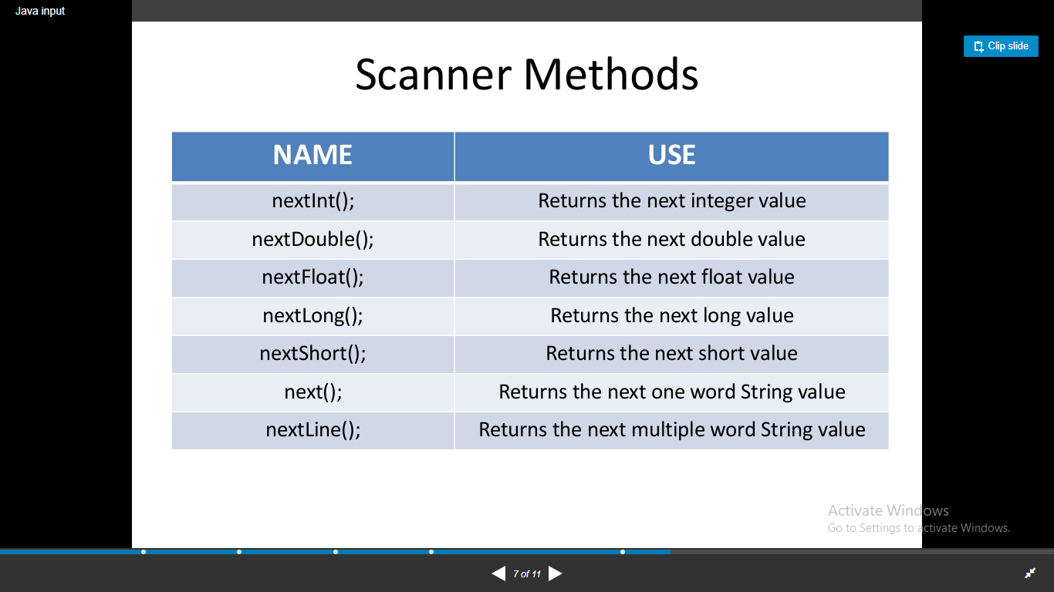
The Java Scanner class breaks the input into tokens using a delimiter which is whitespace by default. It provides many methods to read and parse various primitive values.

Slide 12
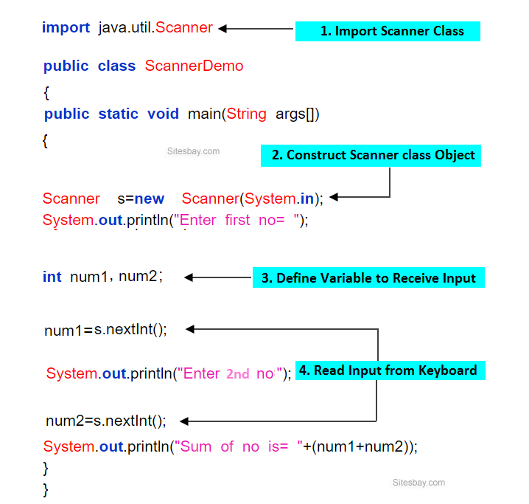
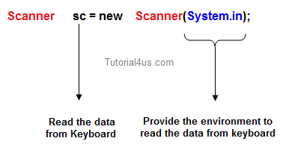
Input through Scanner class
Scanner is one of the predefined class which is used for reading the data dynamically from the keyboard.

