Slide 2
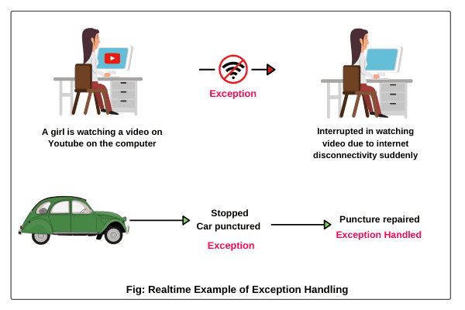
Exception Handling in Java
Realtime Example of Exception in Java
1. Suppose you are watching a video on Youtube, suddenly, internet connectivity is disconnected or not working. In this case, you are not able to continue watching the video on Youtube. This interruption is nothing but an exception.
2. Suppose a person is traveling by car from Mumbai to Pune. After traveling mid-distance, the tire of his car is punctured. This unexpected or unwanted event is nothing but an exception.
The car owner always keeps an extra tire as an alternative on a long-distance journey. He changes the punctured tire by a new tire. After changing the tire, he continues the rest of the journey. This alternative way is called exception handling.

Slide 3
Exception Handling in Java
Similarly, when we create a java program and it is compiled successfully, even exceptions might occur at runtime due to errors in the program logic. This exception must be handled to maintain the normal execution flow of the program.
If this exception is not handled suitably, the rest of code in the program will not be executed. To handle runtime exception, the exceptional handling technique is used in java programming.

Slide 4
Exception Handling in Java
Exception
Exception is an abnormal condition that arises at run time
Event that disrupts the normal flow of the program.
It is an object which is thrown at runtime.
Exception Handling
Exception Handling is a mechanism to handle runtime errors.
Normal flow of the application can be maintained.
It is an object which is thrown at runtime.
Exception handling done with the exception object.

Slide 5
Types of Errors
There are three categories of errors:
Syntax errors - arise because the rules of the language have not been followed. They are detected by the compiler.
Runtime errors - occur while the program is running if the
environment detects an operation that is impossible to carry out.
Logic errors - occur when a program doesn't perform the way it was
intended to.

Slide 6
Exception Classes
ClassNotFoundException
IOException
ArithmeticException
Exception
AWTException
NullPointerException
RuntimeException
IndexOutOfBoundsException
Object
Throwable
Several more classes
IllegalArgumentException
LinkageError
Several more classes
VirtualMachineError
Error
Several more classes

Slide 7
Types of Exception:
There are mainly two types of exceptions:
Checked
Unchecked – Eg. error
The sun microsystem says there are three types of exceptions:
Checked Exception - are checked at compile-time.
Unchecked Exception - are not checked at compile-time rather they are checked at runtime.
Error

Slide 8
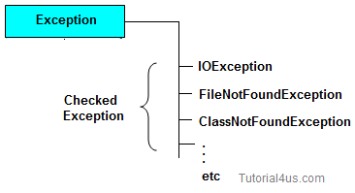
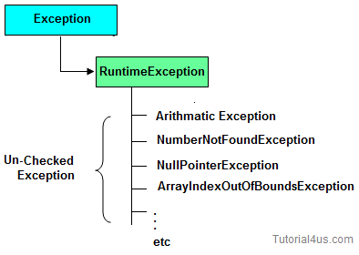
Checked Exception
Checked Exception are the exception which checked at compile-time. These exception are directly sub-class of java.lang.Exception class.
Only for remember: Checked means checked by compiler so checked exception are checked at compile-time.
Un-Checked Exception
Un-Checked Exception are the exception both identifies or raised at run time. These exception are directly sub-class of java.lang.RuntimeException class.
Note: In real time application mostly we can handle un-checked exception.
Only for remember: Un-checked means not checked by compiler so un-checked exception are checked at run-time not compile time.

Slide 9
Error is irrecoverable should not try to catch. e.g. OutOfMemoryError, VirtualMachineError, AssertionError etc.
 | Checked Exception | Un-Checked Exception
1 | checked Exception are checked at compile time | un-checked Exception are checked at run time
2 | e.g. FileNotFoundException, NumberNotFoundException etc. | e.g. ArithmeticException, NullPointerException, ArrayIndexOutOfBoundsException etc.
 | Error | Exception
1 | Can't be handle. | Can be handle.
2 | Example: OutOfMemoryError | Example: ClassNotFoundException NumberFormateException

Slide 10
System Errors
ClassNotFoundException
IOException
ArithmeticException
Exception
AWTException
NullPointerException
RuntimeException
IndexOutOfBoundsException
Object
Throwable
Several more classes
IllegalArgumentException
System errors are thrown by JVM and represented in the Error class.
The Error class describes internal system errors. Such errors rarely occur.
LinkageError
Several more classes
VirtualMachineError
Error
AWTError
Several more classes
6

Slide 11
Exceptions
Exception describes errors caused by your program and external circumstances. These errors can be caught and handled by your program.
ClassNotFoundException
IOException
ArithmeticException
Exception
AWTException
NullPointerException
RuntimeException
IndexOutOfBoundsException
Object
Throwable
Several more classes
IllegalArgumentException
LinkageError
Several more classes
VirtualMachineError
Error
AWTError
Several more classes
7

Slide 12
Runtime Exceptions
ClassNotFoundException
IOException
ArithmeticException
Exception
AWTException
NullPointerException
RuntimeException
IndexOutOfBoundsException
Object
Throwable
Several more classes
IllegalArgumentException
LinkageError
Several more classes
VirtualMachineError
RuntimeException is caused by programming errors, such as bad casting, accessing an out-of- bounds array, and numeric errors.
Error
AWTError
Several more classes
8

Slide 13
Exception Handling Terms
There are 5 keywords which are used in handling exceptions in Java
Keyword | Description
try | The "try" keyword is used to specify a block where we should place exception code. The try block must be followed by either catch or finally. It means, we can't use try block alone.
catch | The "catch" block is used to handle the exception. It must be preceded by try block which means we can't use catch block alone. It can be followed by finally block later.
finally | The "finally" block is used to execute the important code of the program. It is executed whether an exception is handled or not.
throw | The "throw" keyword is used to throw an exception.
throws | The "throws" keyword is used to declare exceptions. It doesn't throw an exception. It specifies that there may occur an exception in the method. It is always used with method signature.

Slide 14
Exceptions –Syntax
try
{
// Code which might throw an exception
}
catch(Exceptionclass object1)
{
// code to handle an exception
}
catch(Exceptionclass object2)
{
// code to handle an exception
}
finally
{
// ALWAYS executed whether an exception was thrown or not
}

Slide 15
class Simple
{
public static void main(String args[])
{
int data=50/0;
System.out.println("rest of the code...");
}
}
Output:
Exception in thread main java.lang.ArithmeticException:/ by zero
Rest of the code is not executed (rest of the code..)statement is not printed.

Slide 16
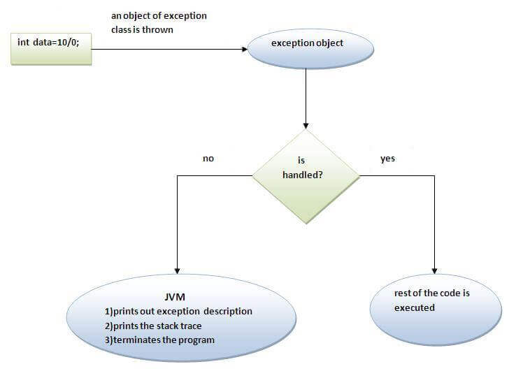
JVM first checks whether the exception is handled or not.
If exception is not handled, JVM provides a default exception handler that performs the following tasks:
Prints out exception description.
Prints the stack trace (Hierarchy of methods where the exception occurred).
Causes the program to terminate.
if exception is handled by the application programmer, normal flow of the application is maintained i.e. rest of the code is executed.

Slide 17
class Simple1
{
public static void main(String args[])
{
try
{
int data=50/0;
}
catch(ArithmeticException e)
{
System.out.println(e);
}
System.out.println("rest of the code...");
}}
Output:
Exception in thread main java.lang.ArithmeticException:/ by zero
rest of the code…

Slide 18
Multiple catch block:
If more than one exception can occur, then we use multiple catch
blocks
When an exception is thrown, each catch statement is inspected in order, and the first one whose type matches that of the exception is executed
After one catch statement executes, the others are bypassed
All catch blocks must be ordered from most specific to most general, i.e. catch for ArithmeticException must come before catch for Exception.

Slide 19
Multiple Catch Exceptions –Syntax
try
{
// Code which might throw an exception
}
catch(Exceptionclass object1)
{
// code to handle an exception
}
catch(Exceptionclass object2)
{
// code to handle an exception
}

Slide 20
Multiple Catch Exceptions
public class MultipleCatchBlock1 {
public static void main(String[] args) {
try{
int a[]=new int[5];
a[5]=30/0;
}
catch(ArithmeticException e)
{
System.out.println("Arithmetic Exception occurs");
}
catch(ArrayIndexOutOfBoundsException e)
{
System.out.println("ArrayIndexOutOfBounds Exception occurs");
}
catch(Exception e)
{
System.out.println("Parent Exception occurs");
}
System.out.println("rest of the code");
}
}
Output:
Arithmetic Exception occurs
rest of the code

Slide 21
Nested try Statements
A try statement can be inside the block of another try
Sometimes a situation may arise where a part of a block may cause one error and the entire block itself may cause another error. In such cases, exception handlers have to be nested.

Slide 22
Nested Try Block
try
{
statement 1;
statement 2;
try
{
statement 1;
statement 2;
}
catch(Exception e)
{
}
}
catch(Exception e)
{
}

Slide 23
class Excep6
{
public static void main(String args[])
{
try
{
try
{
System.out.println("going to divide");
int b =39/0;
}
catch(ArithmeticException e)
{
System.out.println(e);
}
try
{
int a[]=new int[5];
a[5]=4;
}
catch(ArrayIndexOutOfBoundsException e)
{
System.out.println(e);
}
System.out.println("other statement");
}
catch(Exception e)
{
System.out.println("handeled");
}
System.out.println("normal flow..");
}
}

Slide 24
Finally block
is a block that is always executed.
To perform some important tasks such as closing connection, stream etc.
Used to put "cleanup" code such as closing a file, closing connection etc.
Finally creates a block of code that will be executed after a try/catch block has completed
Finally block will be executed whether or not an exception is thrown.
Each try clause requires at least one catch or finally clause.
Note: Before terminating the program, JVM executes finally block(if any).
Note: finally must be followed by try or catch block.

Slide 25
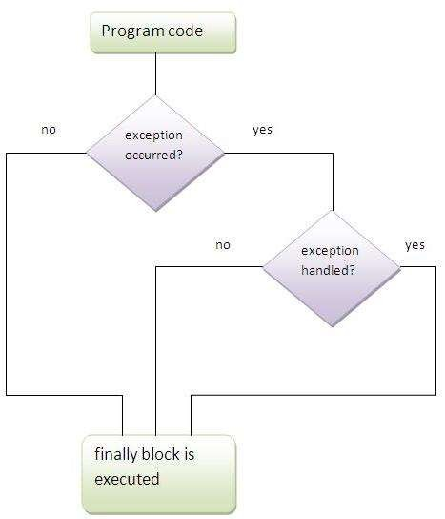

Slide 26
class Simple
{
public static void main(String args[])
{
try
{
int data=25/0;
System.out.println(data);
}
catch(ArithmeticException e)
{
System.out.println(e);
}
finally
{
System.out.println("finally block is always executed");
}
System.out.println("rest of the code...");
}
}

