Slide 1
Object Oriented Programming using JAVA Paper code: PCC – CS481
Presented By
Sudeshna Kundu (Mondal)

Slide 2
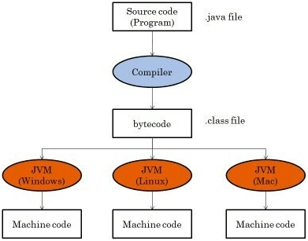
What is Java Bytecode?
Java bytecode is the instruction set for the Java Virtual Machine. As soon as a java program is compiled, java bytecode is generated. In more apt terms, java bytecode is the machine code in the form of a .class file. With the help of java bytecode we achieve platform independence in java.
Platform independence is one of the soul reasons for which James Gosling started the formation of java and it is this implementation of bytecode which helps us to achieve this. Hence bytecode is a very important component of any java program.The set of instructions for the JVM may differ from system to system but all can interpret the bytecode. A point to keep in mind is that bytecodes are non-runnable codes and rely on the availability of an interpreter to execute and thus the JVM comes into play.

Slide 3
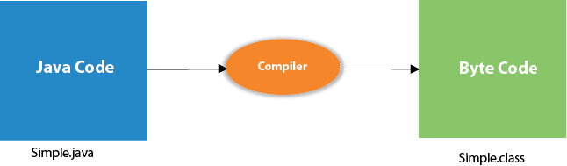
What happens at compile time?
At compile time, java file is compiled by Java Compiler (It does not interact with OS) and converts the java code into bytecode.

Slide 4
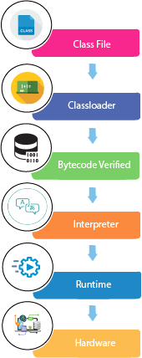
What happens at runtime?
Classloader: is the subsystem of JVM that is used to load class files.
Bytecode Verifier: checks the code fragments for illegal code that can violate access right to objects.
Interpreter: read bytecode stream then execute the instructions

Slide 5
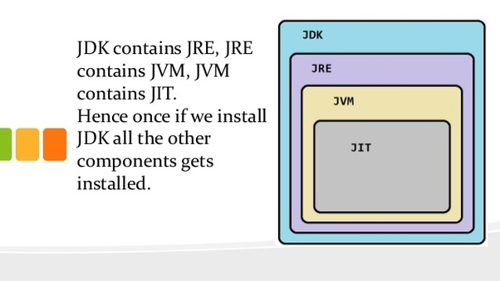
Just-In-Time(JIT) compiler:
It is used to improve the performance.
JIT compiles parts of the byte code that have similar functionality at the same time, and hence reduces the amount of time needed for compilation.
Here, the term "compiler" refers to a translator from the instruction set of a Java virtual machine (JVM) to the instruction set of a specific CPU.

Slide 6
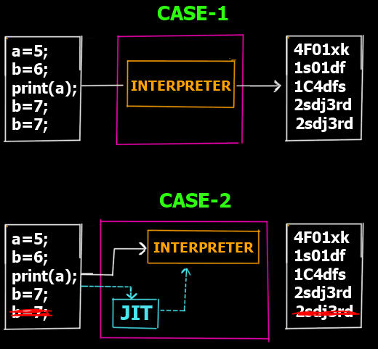
Just-In-Time(JIT) compiler:
Case 1:
In case 1 you can see that we are at the intepretation phase (Step 5 of the overall program execution). Lets assume we have 5 lines which are supposed to be interpretted to their corresponding machine code lines. So as you can see in the Case 1 there is no JIT involved. thus the interpreter converts each line into its corresponding machine code line. However if you notice the last 2 lines are the same (consider it a redundant line inserted by mistake). Clearly that line is redundant and does not have any effect on the actual output but yet since the interpreter works line by line it still creates 5 lines of machine code for 5 lines of the bytecode.
Now this is inefficient right? lets see case 2
Case 2:
In case 2 we have the JIT compiler. Now before the bytecode is passed onto the interpreter for conversion to machine code, the JIT compiler scans the full code to see if it can be optimized. As it finds the last line is redundant it removes it from the bytecode and passes only 4 lines to the interpreter thus making it more efficient and faster as the interpreter now has 1 line less to interpret.
So this is how JIT compiler speeds up the overall execution process.

Slide 7
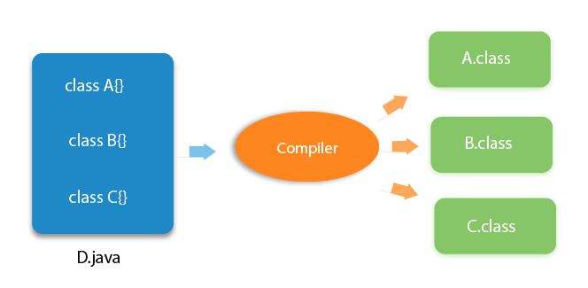
Can you have multiple classes in a java source file?
Yes, like the figure given below illustrates:

Slide 8
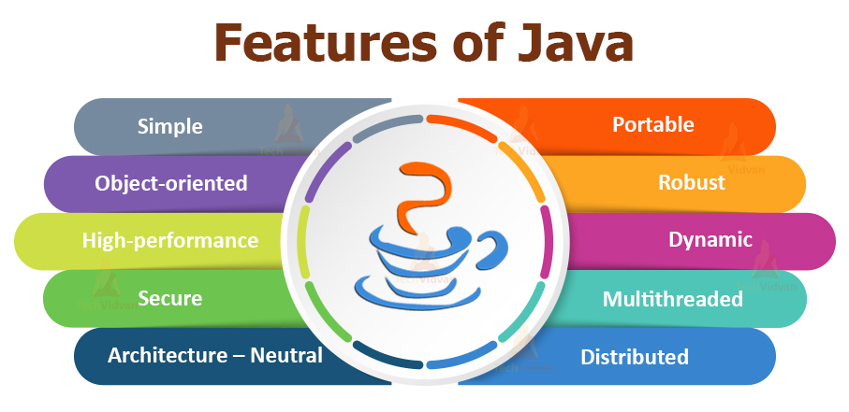
Features of Java
Simple
Object-Oriented
Portable
Platform independent
Secured
Robust
Architecture neutral
Multithreaded
Distributed

Slide 9
Features of Java
Simple
According to Sun, Java language is simple because:
syntax is based on C++ (so easier for programmers to learn it after C++).
removed many confusing and/or rarely-used features e.g., explicit pointers, operator overloading etc.
No need to remove unreferenced objects because there is Automatic Garbage Collection in java.
Object-oriented
Object-oriented means we organize our software as a combination of different types of objects that incorporates both data and behaviour.

Slide 10
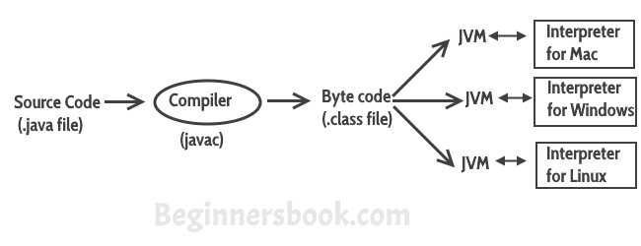
Features of Java
Platform Independent
Unlike other programming languages such as C, C++ etc which are compiled into platform specific machines. Java is guaranteed to be write-once, run-anywhere (WORA) language.
On compilation Java program is compiled into bytecode. This bytecode is platform independent and can be run on any machine, plus this bytecode format also provide security. Any machine with Java Runtime Environment can run Java Programs.

Slide 11
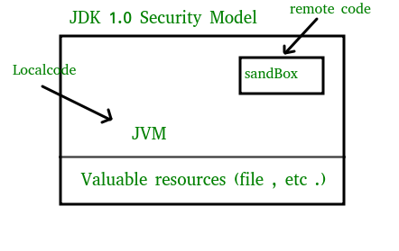
Features of Java
The essence of the sandbox model is that local code is trusted to have full access to vital system resources (such as the file system) while downloaded remote code (an applet) is not trusted and can access only the limited resources provided inside the sandbox
Secure
Java is secured because:
No explicit pointer
Java Programs run inside virtual machine sandbox

Slide 12
Features of Java
Robust
Robust simply means strong.
Java uses strong memory management.
There are lack of pointers that avoids security problem.
There is automatic garbage collection in java.
There is exception handling and type checking mechanism in java. All these points makes java robust.
Architecture-neutral
There is no implementation dependent features e.g. size of primitive types is fixed.
In C programming, int data type occupies 2 bytes of memory for 32-bit architecture and 4 bytes of memory for 64-bit architecture. But in java, it occupies 4 bytes of memory for both 32 and 64 bit architectures.

Slide 13
Features of Java
Portable
Compiler generates byte codes, which have nothing to do with a particular computer architecture, hence a Java program is easy to interpret on any machine. We may carry the java bytecode to any platform.
Multithreaded
Multithreading in java is a process of executing multiple threads simultaneously.
Thread is basically a lightweight sub-process, a smallest unit of processing.
It shares a common memory area. Threads are important for multi-media, Web applications etc.
Distributed
We can create distributed applications in java. We may access files by calling the methods from any machine on the internet.

Slide 14
Application
According to Sun, 3 billion devices run Java. There are many devices where Java is currently used. Some of them are as follows:
Desktop Applications such as acrobat reader, media player, antivirus, etc.
Web Applications such as irctc.co.in, javatpoint.com, etc.
Enterprise Applications such as banking applications.
Mobile
Embedded System
Smart Card
Robotics
Games, etc.

Slide 15
Types of Java Applications
There are mainly 4 types of applications that can be created using Java programming:
1) Standalone Application
Standalone applications are also known as desktop applications or window-based applications. These are traditional software that we need to install on every machine. Examples of standalone application are Media player, antivirus, etc. AWT and Swing are used in Java for creating standalone applications.
2) Web Application
An application that runs on the server side and creates a dynamic page is called a web application. Currently, Servlet, JSP, Struts, Spring, Hibernate etc. technologies are used for creating web applications in Java.
3) Enterprise Application
An application that is distributed in nature, such as banking applications, etc. is called enterprise application. It has advantages of the high-level security, load balancing, and clustering. In Java, EJB is used for creating enterprise applications.
4) Mobile Application
An application which is created for mobile devices is called a mobile application. Currently, Android and Java ME are used for creating mobile applications.

Slide 16
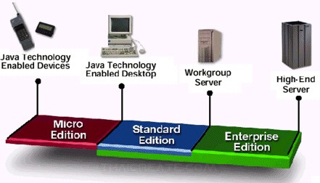
Java Platforms / Editions
There are 4 platforms or editions of Java:
1) Java SE (Java Standard Edition)
It is a Java programming platform. It includes Java programming APIs such as java.lang, java.io, java.net, java.util, java.sql, java.math etc. It includes core topics like OOPs, String, Regex, Exception, Inner classes, Multithreading, I/O Stream, Networking, AWT, Swing, Reflection, Collection, etc.
2) Java EE (Java Enterprise Edition)
It is an enterprise platform which is mainly used to develop web and enterprise applications. It is built on the top of the Java SE platform. It includes topics like Servlet, JSP, Web Services, EJB, JPA, etc.
3) Java ME (Java Micro Edition)
It is a micro platform which is mainly used to develop mobile applications.
4) JavaFX
It is used to develop rich internet applications. It uses a light-weight user interface API.

Slide 17
Java Version History
Many java versions have been released till now. The current stable release of Java is Java SE 10.
JDK Alpha and Beta (1995)
JDK 1.0 (23rd Jan 1996)
JDK 1.1 (19th Feb 1997)
J2SE 1.2 (8th Dec 1998)
J2SE 1.3 (8th May 2000)
J2SE 1.4 (6th Feb 2002)
J2SE 5.0 (30th Sep 2004)
Java SE 6 (11th Dec 2006)
Java SE 7 (28th July 2011)
Java SE 8 (18th Mar 2014)
Java SE 9 (21st Sep 2017)
Java SE 10 (20th Mar 2018)

Slide 18
THANK YOU

