Slide 1
Object Oriented Programming using JAVA
Presented By Sudeshna Kundu (Mondal)

Slide 2
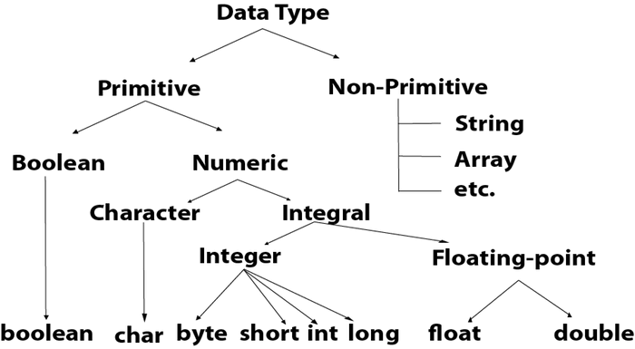
Datatypes in Java
Use float or double?
The precision of a floating point value indicates how many digits the value can have after the decimal point. The precision of float is only six or seven decimal digits, while double variables have a precision of about 15 digits. Therefore it is safer to use double for most calculations.

Slide 3
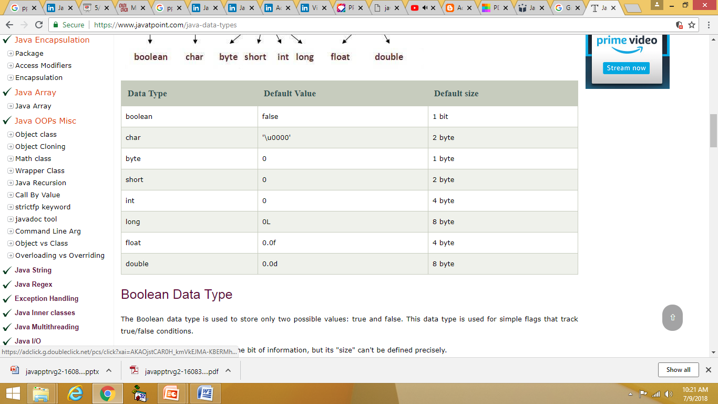
Data Type - Default Value and size

Slide 4
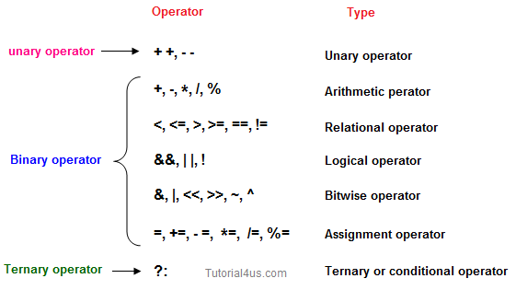
Operator in Java

Slide 5
Operator in Java
Java Unary Operator
Java Arithmetic Operator Example
class OperatorExample{
public static void main(String args[]){
int x=10;
System.out.println(x++);//10 (11)
System.out.println(++x);//12
System.out.println(x--);//12 (11)
System.out.println(--x);//10
}}
class OperatorExample{
public static void main(String args[]){
int a=10;
int b=5;
System.out.println(a+b);//15
System.out.println(a-b);//5
System.out.println(a*b);//50
System.out.println(a/b);//2
System.out.println(a%b);//0
}}

Slide 6
Operator in Java
Java AND Operator and OR Operator Example:
Java Left Shift AND Right Shift Operator
class OperatorExample{
public static void main(String args[]){
int a=10;
int b=5;
int c=20;
System.out.println(a<b&&a<c);//false && true = false
System.out.println(a<b&a<c);//false & true = false
System.out.println(a>b||a<c);//true || true = true
System.out.println(a>b|a<c);//true | true = true
}}
class OperatorExample{
public static void main(String args[]){
System.out.println(10<<2);//10*2^2=10*4=40
System.out.println(10<<3);//10*2^3=10*8=80
System.out.println(20>>2);//20/2^2=20/4=5
System.out.println(20>>3);//20/2^3=20/8=2
}}
The logical && operator doesn't check second condition if first condition is false. It checks second condition only if first one is true.
The bitwise & operator always checks both conditions whether first condition is true or false.
The logical || operator doesn't check second condition if first condition is true. It checks second condition only if first one is false.
The bitwise | operator always checks both conditions whether first condition is true or false.

Slide 7
Operator in Java
AND(&&) short circuit: In case of AND, the expression is evaluated until we get one false result because the result will always be false, independent of the further conditions. If there is an expression with &&(logical AND), and first operand itself is false, then short circuit occurs, the further expression is not evaluated and false is returned.
Short Circuiting in Java with Examples
class ShortCirAND {
public static void main(String arg[])
{
// Since first operand is false
// and operator is &&,
// Evaluation stops and
// false is returned.
if (false && true && true) {
System.out.println(
"This output will not be printed");
}
else {
System.out.println(
"This output got printed actually, due to short circuit");
}
}}
OR(||) short circuit: In case of OR, the expression is evaluated until we get one true result because the result will always be true, independent of the further conditions. If there is an expression with ||(logical OR), and first operand itself is true, then a short circuit occurs, evaluation stops and true is returned.
In Java logical operators, if the evaluation of a logical expression exit in between before complete evaluation, then it is known as Short-circuit. A short circuit happens because the result is clear even before the complete evaluation of the expression, and the result is returned. Short circuit evaluation avoids unnecessary work and leads to efficient processing.

Slide 8
Operator in Java
Java Assignment Operator Example:
Java Ternary Operator Example
class OperatorExample{
public static void main(String args[]){
int a=2;
int b=5;
int min=(a<b)?a:b;
System.out.println(min);
}}
class OperatorExample{
public static void main(String args[]){
int a=10;
int b=20;
a+=4;//a=a+4 (a=10+4)
b-=4;//b=b-4 (b=20-4)
System.out.println(a);
System.out.println(b);
}}

Slide 9
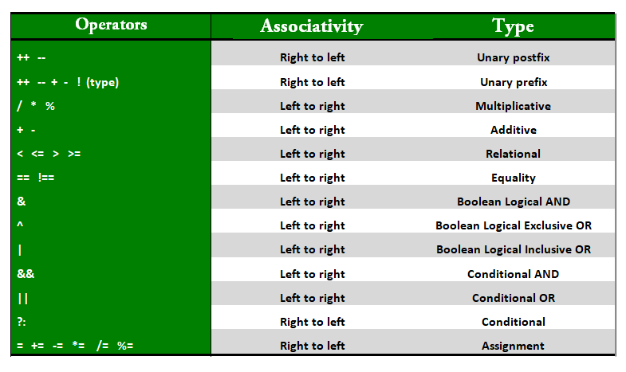
Operator in Java
Precedence and Associativity of Operators
Precedence and associative rules are used when dealing with hybrid equations involving more than one type of operator. In such cases, these rules determine which part of the equation to consider first as there can be many different valuations for the same equation. The table depicts the precedence of operators in decreasing order as magnitude with the top representing the highest precedence and bottom shows the lowest precedence.

Slide 10
Operator in Java
Precedence and Associativity of Operators
public class Operators {
public static void main(String[] args)
{
int a = 20, b = 10, c = 0, d = 20, e = 40, f = 30;
// precedence rules for arithmetic operators.
// (* = / = %) > (+ = -)
// prints a+(b/d)
System.out.println("a+b/d = " + (a + b / d));
// if same precendence then associative
// rules are followed.
// e/f -> b*d -> a+(b*d) -> a+(b*d)-(e/f)
System.out.println("a+b*d-e/f = "
+ (a + b * d - e / f));
}
}
Output:
a+b/d = 20
a+b*d-e/f = 219

Slide 11
What is dot operator in Java?
The (.) operator is also known as member operator it is used to access the member of a package or a class.
Example
public class Sample {
void display() {
double d = 20.3;
int i = (int)d;
System.out.println(i);
}
public static void main(String args[]) {
Sample s = new Sample();
s.display();
}
}
Output
20

Slide 12
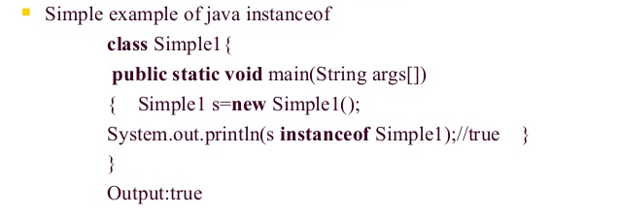
What is Java instanceof operator ?
instanceof operator is used only for object reference variables. The operator checks whether the object is of a particular type (class type or interface type). instanceof operator is written as −
( Object reference variable ) instanceof (class/interface type)
If the object referred by the variable on the left side of the operator passes the IS-A check for the class/interface type on the right side, then the result will be true. Following is an example

Slide 13
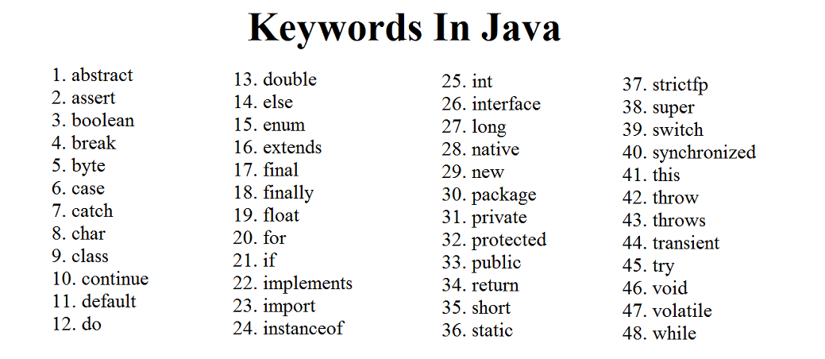

Slide 14
Unicode System
Unicode is a 16-bit character encoding standard and is capable to represent almost every character of well-known languages of the world.
Why java uses Unicode System?
Before Unicode, there were many language standards:
ASCII (American Standard Code for Information Interchange) for the United States.
ISO 8859-1 for Western European Language.
KOI-8 for Russian.
GB18030 and BIG-5 for chinese, and so on.
So to support multinational application codes, some character was using single byte, some two. An even same code may represent a different character in one language and may represent other characters in another language.
To overcome above shortcoming, the unicode system was developed where each character is represented by 2 bytes.

Slide 15
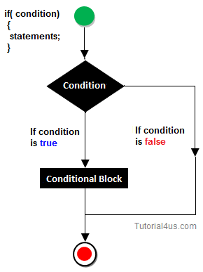
Decision Making Statement in Java
Decision making statement statements is also called selection statement.
That is depending on the condition block need to be executed or not which is decided by condition. If the condition is "true" statement block will be executed, if condition is "false" then statement block will not be executed.
if-then Statement

Slide 16
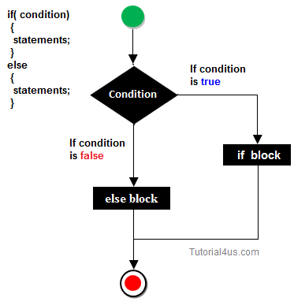
if-else Statement
//A Java Program to demonstrate the use of if-else statement.
//It is a program of odd and even number.
public class IfElseExample {
public static void main(String[] args) {
//defining a variable
int number=13;
//Check if the number is divisible by 2 or not
if(number%2==0){
System.out.println("even number");
}else{
System.out.println("odd number");
}
}
}

Slide 17
THANK YOU

