Slide 1
Object Oriented Programming using JAVA Paper code: PCC – CS481
Presented By
Sudeshna Kundu (Mondal)

Slide 2
Constructor in Java
A constructor in java is similar to a method that is used to initialize objects of a class through a new operator.
In other words, a constructor is basically a special method that is used to initialize instance variables in a program. The sole purpose of the constructor is to initialize the objects of the class.
Key points of Constructor:
1. Constructor name must be the same as its name of the class in which it is declared and defined.
2. The constructor should not have any return type even void also because if there is return type then JVM would consider as a method, not a constructor. Compiler and JVM differentiate constructor and method definitions on the basis of the return type. (Suppose you define the method and constructor with the same name as that of the class name then JVM would differentiate between them by using return type.)
3. Whenever you create an object/instance of a class, the constructor will be automatically called by the JVM. If you don’t define any constructor inside the class, the compiler automatically creates a default constructor at compile-time and assigns default values for all variables declared in the class.
The default values for variables are as follows:
a. Numeric variables are set to 0.
b. Strings are set to null.
c. Boolean variables are set to false.

Slide 3
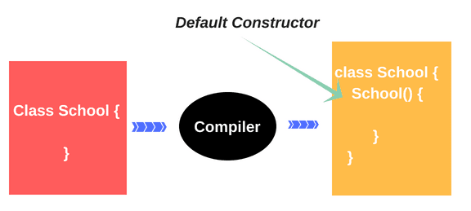
Types of Constructors in Java
Basically, there are two types of constructors in java. They are:
1. Default Constructor (No-argument constructor)
2. Parameterized Constructor (Argument constructor)
Default Constructor in Java with Example
A constructor which has no parameter is known as default constructor in Java. When a class does not declare a constructor, JVM automatically creates a constructor for that class. This constructor is called default constructor.
We cannot pass any argument to the default constructor. That’s why it is known as a no-argument constructor. It does not do anything but it allows to create the instance of the class.

Slide 4
Default Constructors in Java
// Static method or main method.
public static void main(String[] args)
{
// Create the object of the class using new keyword.
Person p = new Person(); // Calling default constructor.
// Call the method using object reference variable p.
p.display(); // Calling display method.
}
}
public class Person
{
// Declaration of Instance variables.
String name;
int age;
String address;
// Here, We are not creating any constructor. So Compiler will automatically insert a default constructor.
// Create one method to print the default values.
void display()
{
System.out.println(name+ " " +age+ " " +address );
}
Output:
null 0 null
In the preceding example program, we did not create any constructor. So, the java compiler provides a default constructor. null, 0, null is the default values of the instance variables provided by the default constructor.

Slide 5
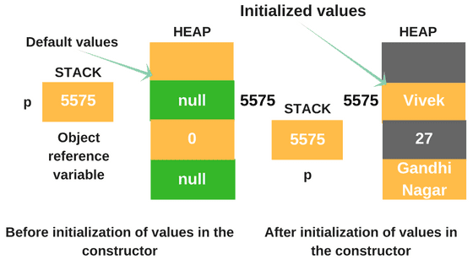
Default Constructors in Java
Person()
{
// Initialization of values of Instance variables.
name = "Vivek";
age = 25;
address = "Gandhi Nagar";
}
display(){
//Print the values on the console.
System.out.println(name+ " " +age+ " " +address);
}
Output:
Vivek 28 Gandhi Nagar.
We know that p is an object reference variable which contains the address of the memory location of the object. Here, 5575 is the address on the stack where we can find other detail of the class like name, age, and address on this address.
Key point:
👉 A reference variable never contains an object directly. It contains an address that points to data stored in the memory location.
In the above image, you can see that when we did not initialize the values of the instance variable in the constructor in program 1, default values for variables have been stored on the heap after calling constructor.
But, when we initialized the values of variables in the constructor in program 2, After calling the constructor, default values are eliminated from the memory location and initialized values are stored in the memory location of heap.

Slide 6
Parameterized Constructor in Java
A constructor that takes parameters is known as parameterized constructor in java or argument constructor. The parameterized constructor is used to provide different values to the distinct object.
To call the parameterized constructor, we pass arguments while creating the object. The argument can be of any type like integer, array, character or an object. It can take any number of arguments. Java does not provide a parameterized constructor by default.
public class Demo
{
// Declare parameterized constructor with zero argument.
Demo()
{
System.out.println("Zero argument constructor");
}
// Declare parameterized constructor with one argument.
Demo(int a)
{
System.out.println("One argument constructor");
}
// Declare parameterized constructor with two arguments.
Demo(int a, int b)
{
System.out.println("Two arguments constructor");
}
public static void main(String[] args)
{
// Create an object of the class.
Demo d = new Demo(); // Calling Default constructor.
d = new Demo(20); // Calling one argument constructor.
d = new Demo(10,15); // Calling two argument constructor.
}
}
Output:
Zero argument constructor
One argument constructor
Two arguments constructor

Slide 7
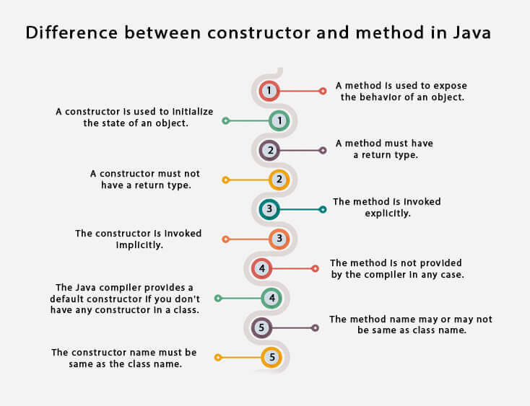

Slide 8
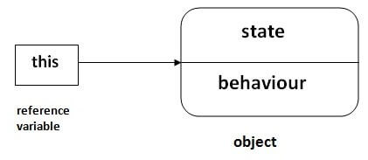
this Reference in Java
There can be a lot of usage of java this keyword. In java, this is a reference variable that refers to the current object.
Usage of java this keyword:
this can be used to refer current class instance variable.
this can be used to invoke current class method (implicitly)
this() can be used to invoke current class constructor.
1) this: to refer current class instance variable
The this keyword can be used to refer current class instance variable. If there is ambiguity between the instance variables and parameters, this keyword resolves the problem of ambiguity.

Slide 9
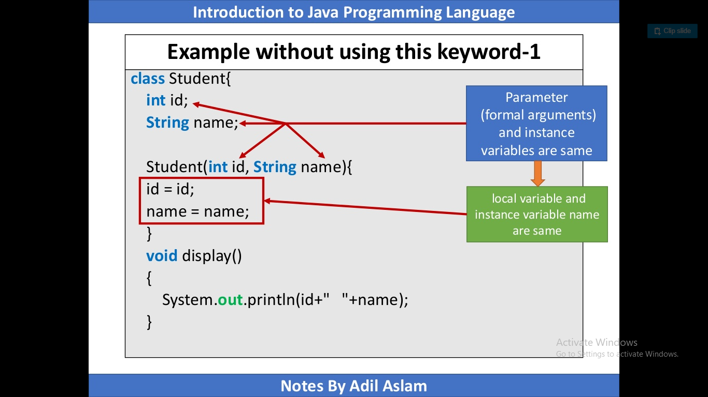
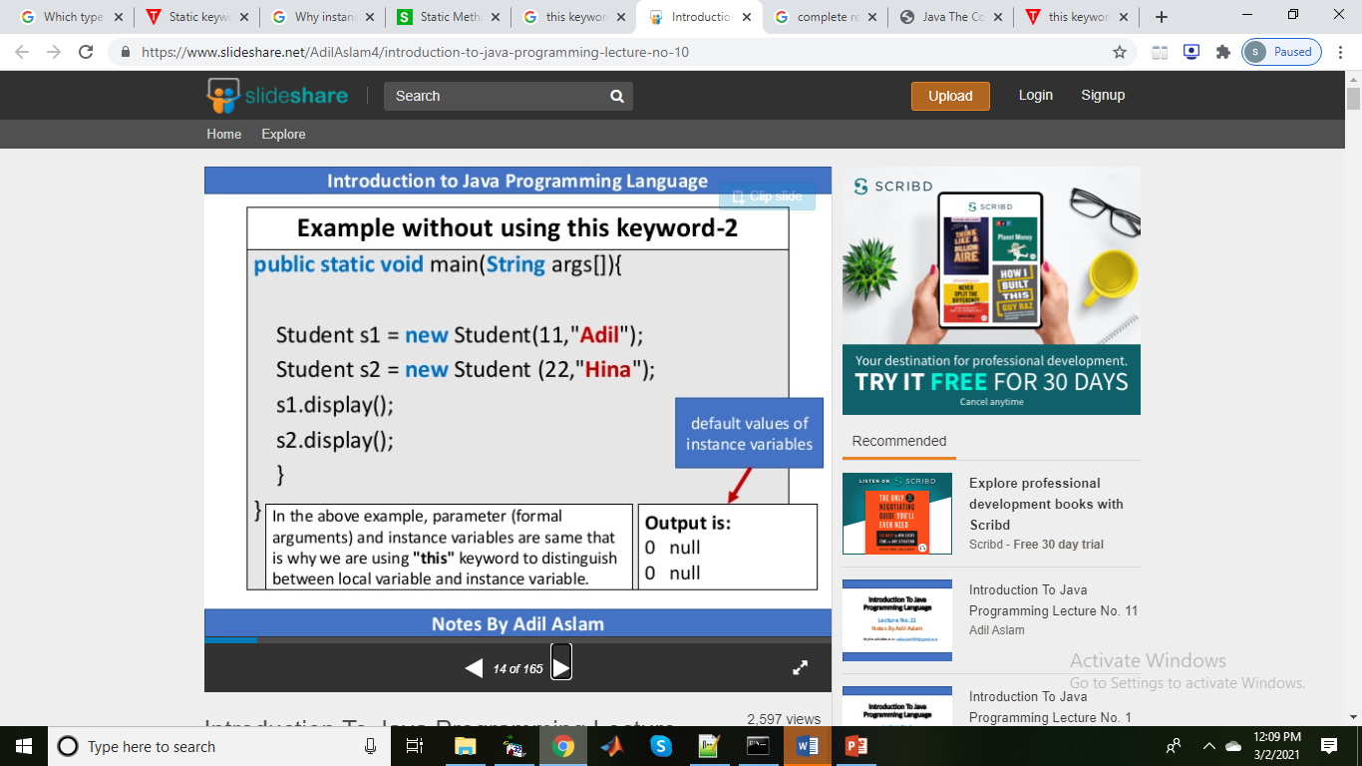
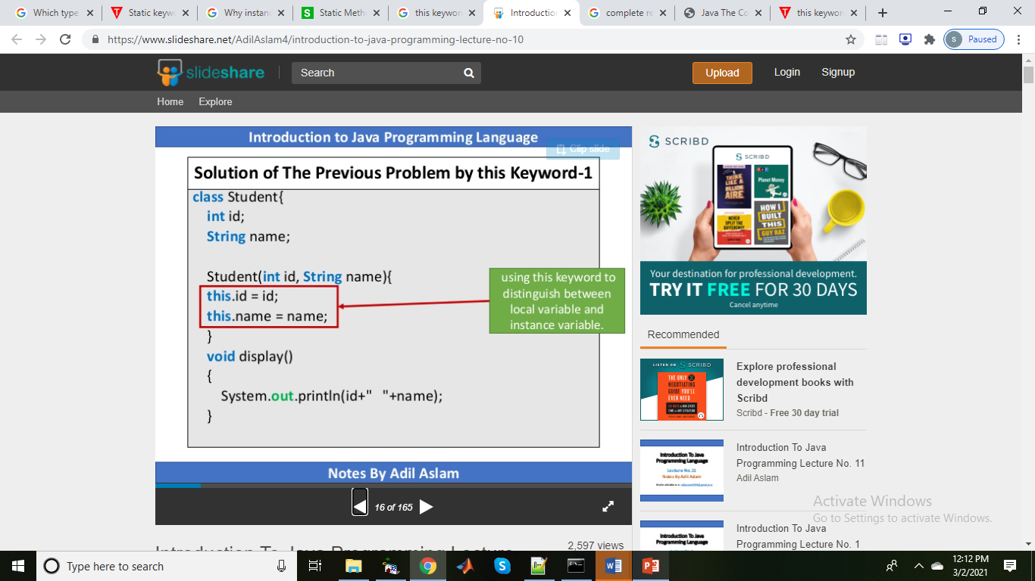
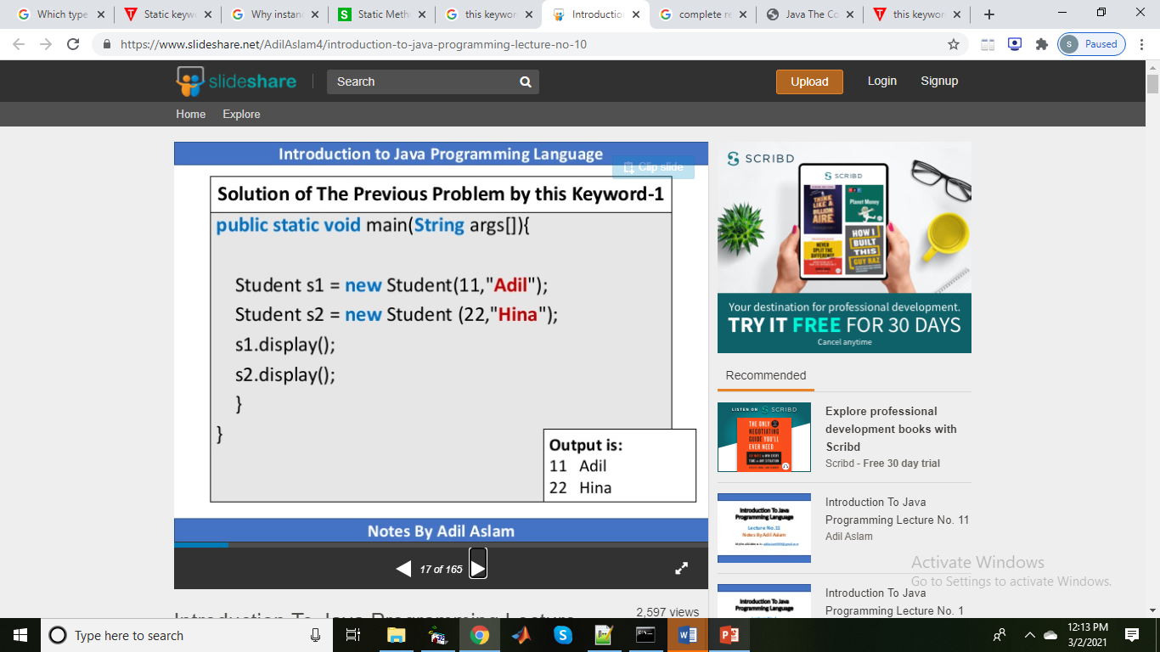

Slide 10
public class Student
{
// Declaration of instance variables.
String name;
String schoolName;
int rollNo;
Student(String name, String sName)
{
this.name = name; // Here, 'this' reference is used.
schoolName = sName;
}
Student(String name, String sName, int rollNo)
{
this.name = name; // this reference.
schoolName = sName;
this.rollNo = rollNo;
}
void details()
{
System.out.println(name+ " " +schoolName+ " " +rollNo);
}
public static void main(String[] args)
{
// Create an object of class and pass the arguments to its constructors.
Student st = new Student("Riddhi", "DPS");
Student st2 = new Student("Siddhi", "RSVM", 05);
st.details();
st2.details();
}
}

Slide 11
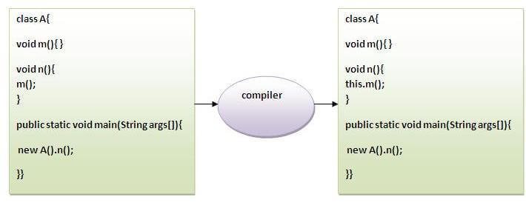
2) this: to invoke current class method
You may invoke the method of the current class by using the this keyword. If you don't use the this keyword, compiler automatically adds this keyword while invoking the method. Let's see the example
class A{
void m(){System.out.println("hello m");}
void n(){
System.out.println("hello n");
//m();//same as this.m()
this.m();
}
}
class TestThis4{
public static void main(String args[]){
A a=new A();
a.n();
}}
Output:
hello n
hello m

Slide 12
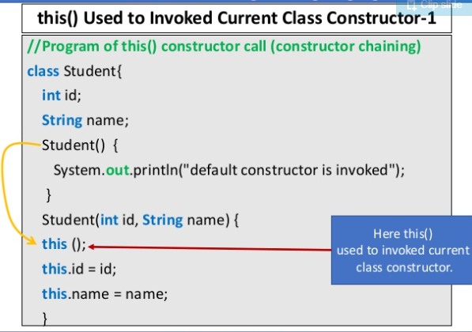
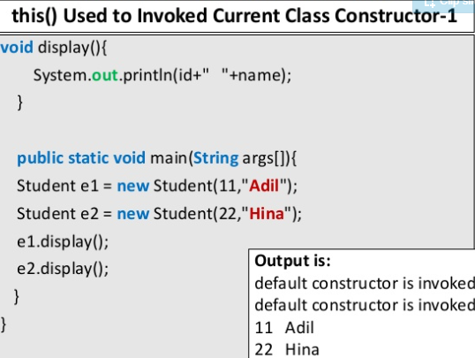
3) this() : to invoke current class constructor
The this() constructor call can be used to invoke the current class constructor. It is used to reuse the constructor. In other words, it is used for constructor chaining.

Slide 13
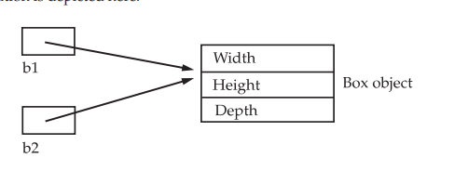
Assigning Object Reference Variables
Object reference variables act differently than you might expect when an assignment takes
place. For example, what do you think the following fragment does?
Box b1 = new Box();
Box b2 = b1;
You might think that b2 is being assigned a reference to a copy of the object referred to by
b1. That is, you might think that b1 and b2 refer to separate and distinct objects. However,
this would be wrong. Instead, after this fragment executes, b1 and b2 will both refer to the
same object.

Slide 14
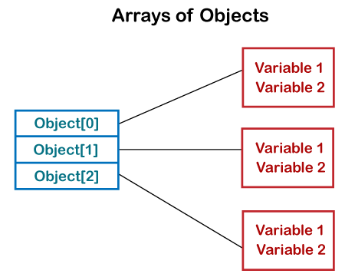
Array of Objects in Java Java is an object-oriented programming language. Most of the work done with the help of objects. We know that an array is a collection of the same data type that dynamically creates objects and can have elements of primitive types. Java allows us to store objects in an array. In Java, the class is also a user-defined data type. An array that contains class type elements are known as an array of objects. It stores the reference variable of the object.

Slide 15
Array of Objects in Java
public class ArrayOfObjects
{
public static void main(String args[])
{
//create an array of product object
Product[] obj = new Product[5] ;
//create & initialize actual product objects using constructor
obj[0] = new Product(23907,"Dell Laptop");
obj[1] = new Product(91240,"HP 630");
obj[2] = new Product(29823,"LG OLED TV");
obj[3] = new Product(11908,"MI Note Pro Max 9");
obj[4] = new Product(43590,"Kingston USB");
//display the product object data
System.out.println("Product Object 1:");
obj[0].display();
System.out.println("Product Object 2:");
obj[1].display();
System.out.println("Product Object 3:");
obj[2].display();
System.out.println("Product Object 4:");
obj[3].display();
System.out.println("Product Object 5:");
obj[4].display();
}
}
class Product
{
int pro_Id;
String pro_name;
//Product class constructor
Product(int pid, String n)
{
pro_Id = pid;
pro_name = n;
}
public void display()
{
System.out.print("Product Id = "+pro_Id + " " + " Product Name = "+pro_name);
System.out.println();
}
}

