Slide 1
DESIGN & ANALYSIS OF ALGORITHM
PCC-CS501

Slide 2
Design & analysis of ALGORITHM Schedule ----topic wise
 | Topic | Sub Topic
1 | INTRODUCTION | Design of algorithm , Analysis of algorithm, Algorithm properties
2 | FRAMEWORK FOR ALGORITHM ANALYSIS | HOW TO COUNT EXECUTION TIME OF ALGORITHM,INPUT INSTANCES
3 | ASYMPTOTIC NOTATION | BEST CASE,AVERAGE CASE, WORST CASE
4 | SOLVING RECURRENCE RELATION | SUBSTITUTION METHOD, MASTER THEOREM
5 | ALGORITHM DESIGN TECHNIQUES | DIVIDE & CONQUER, GREEDY,DYNAMIC PROGRAMMING, BACKTRACKING,
6 | DISJOINT SET MANIPULATION | UNION FIND
7 | NETWORK FLOW PROBLEM | FORD FULKERSON ALGORITHM
8 | NP COMPLETENESS | NP,NP HARD………ALGORITHM
9 | APPROXIMATION ALGORITHM | COMPLEXITY ANALYSIS OF NP COMPETE PROBLEM

Slide 3
Design strategy
Divide & Conquer Approach
Greedy Method
Dynamic Programming
Backtracking
Branch & Bound

Slide 4
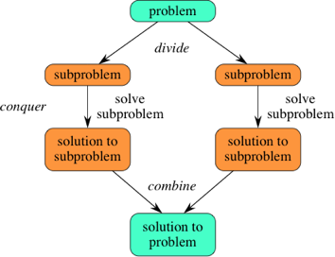
Divide & conquer
Sub problems must be similar in nature with the original one
Recursive in nature
Combination of all the sub problem solution must be there.

Slide 5
Divide & conquer
Algorithm : D&C(Problem P)
if subproblem(P) is small Then
solution(Subproblem(P))
else
Divide(P) into P1,P2,……Pn
D&C(P1) D&C(P2)…………
Combine(solution1,solution2……)
end if
Sub problems must be similar in nature with the original one
Recursive in nature
Combination of all the sub problem solution must be there.

Slide 6
Divide & conquer problem
Binary search
Finding maximum and minimum
Merge Sort
Quick Sort
Strassen’s Matrix Multiplication

Slide 7
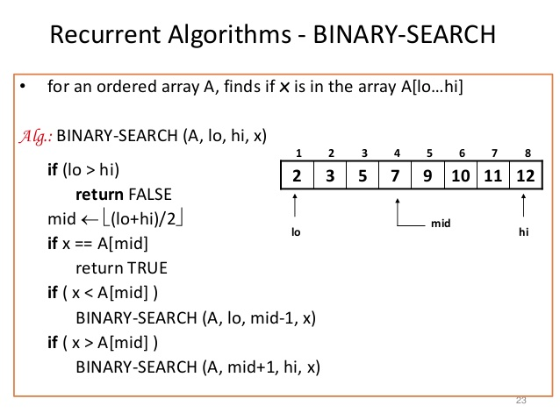
Divide & conquer problem Binary search
Sub problem of actual type? Ans:
Recursive in nature Ans:
Combination of all solution? Ans:

Slide 8
Divide & conquer problem Binary search
Framing Recurrence relation
T(n)=?

Slide 9
Divide & conquer problem Binary search
Framing Recurrence relation
T(n)=T(n/2)+1, n>1
=1 ,n=1

Slide 10
Divide & conquer problem Binary search
Solving Recurrence relation
T(n)=T(n/2)+1
=T(n/2^2)+1+1
=T(n/2^3)+1+1+1
…………..
=T(n/2^k)+1+…….+1
assume n/2^k =1
n=2^k
log n=k
=T(1)+k
=1+log n O(log n)
Framing Recurrence relation
T(n)=T(n-1)+1, n>1
=1 ,n=1

Slide 11
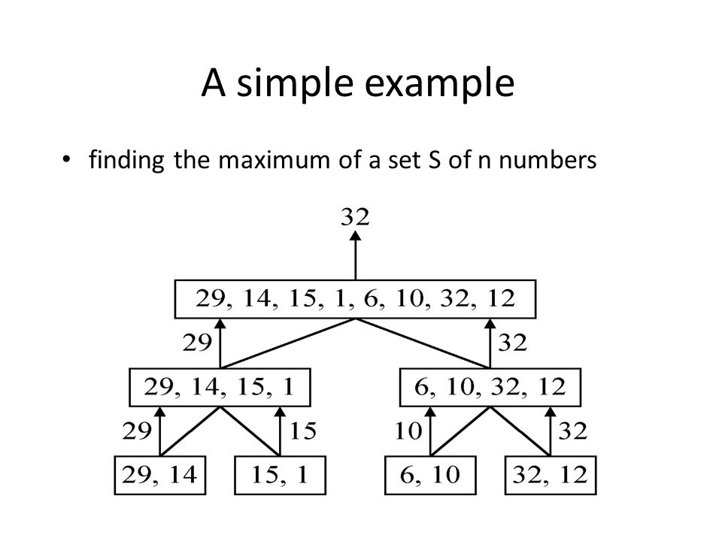
Divide & conquer problem find max & min
Sub problem of actual type? Ans: ?
Recursive in nature Ans: ?
Combination of all solution? Ans: ?

Slide 12
Divide & conquer problem find max & min
Sub problem of actual type? Ans: yes
Recursive in nature Ans: yes
Combination of all solution? Ans: yes

Slide 13
Divide & conquer question find max & min
Try to write the Algorithm by yours.
Try to find the recurrence relation.
Try to find the complexity.

Slide 14
Next class
DIVIDE & CONQUER

