Slide 1
DBMS

Slide 2
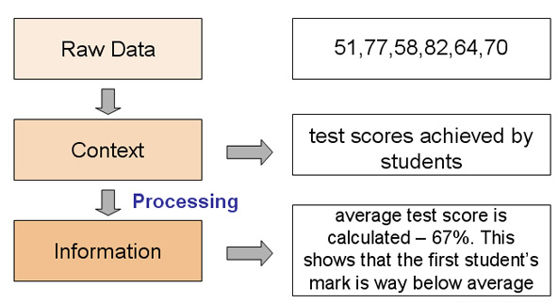
Data and Information
Data
Collection of facts and figures is called data
It is meaningless
Data can be of following forms
Information
Processed data is called information
It is meaningful
Information can be any type of data
Data
Number
Video
Audio
Image
Text

Slide 3
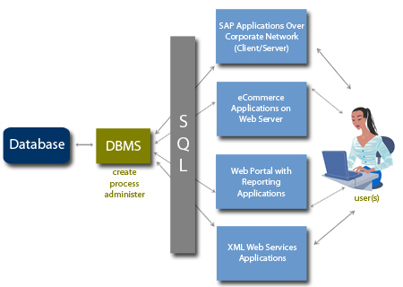
Database Management System (DBMS)
Database
Collection of logically related data stored in an efficient and compact manner
Efficient means stored data can be accessed very easily and quickly
Compact means that stored data takes up as little space as possible
Examples: Microsoft Access, SQL Server, MySQL, Oracle
DBMS
DBMS contains information about a particular enterprise
Collection of interrelated data
Set of programs to access the data
An environment that is both convenient and efficient to use

Slide 4
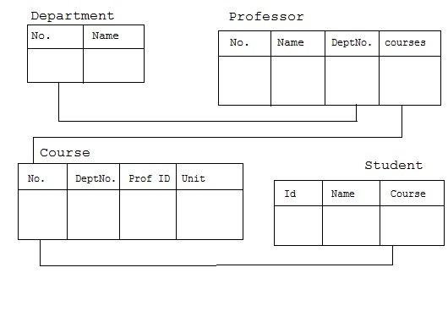
What is RDBMS?
Is a database with relational model
Developed by E.F. Codd
In this model, data is organized in two-dimensional tables called relations. The tables or relation are related to each other.
Most relational database (MS SQL Server, IBM DB2, Oracle, MySQL, and Microsoft Access) uses the SQL

Slide 5
What is SQL?
Stands for Structured Query Language
Designed by Donald Chamberlin and Raymond Boyce in 1974
Is a special-purpose language designed for managing data held in RDBMS
Is a fourth generation language
Can be classified in several types on the basis of task performed

Slide 6
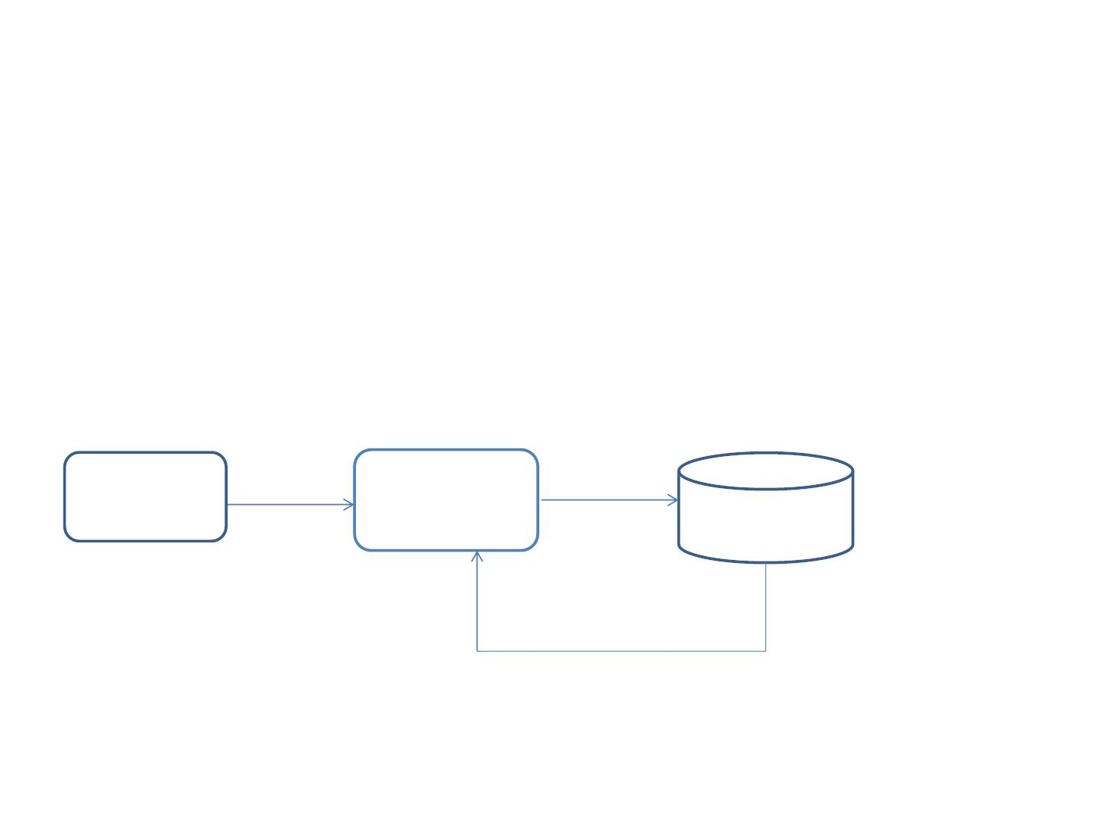
SQL
• SQL is an INTERFACE between client & Database
• SQL is a client tool to interact with ORACLE DB/any DB
• Client request should be submitted in the form of queries
• Queries are by SQL statement executor(ORACLE DB Engine)
Tech. User
connect
SQL
query
DB
result shown in sql window

Slide 7
DDL - Data Definition Language
Sr.No. | Command & Description
1 | CREATE Creates a new table, a view of a table, or other object in the database.
2 | ALTER Modifies an existing database object, such as a table.
3 | DROP Deletes an entire table, a view of a table or other objects in the database.

Slide 8
DML - Data Manipulation Language
Sr.No. | Command & Description
1 | SELECT Retrieves certain records from one or more tables.
2 | INSERT Creates a record.
3 | UPDATE Modifies records.
4 | DELETE Deletes records.

Slide 9
DCL - Data Control Language
Sr.No. | Command & Description
1 | GRANT Gives a privilege to user.
2 | REVOKE Takes back privileges granted from user.

Slide 10
Oracle Data types
Data
CHAR(size)
VARCHAR(size)/VARCHAR2(size)
DATE
NUMBER(P,S)
LONG
RAW/LONG RAW

Slide 11

Data Types
• Char(size): fixed length character strings. By default size is 1 character and
max is 2000 chars
• Varchar2(size): variable length character strings , Varchar2 maximum
length is 4000
• Number (precision, scale): Number type data with or without decimal
points
Precision represents total number of digits in the value( max is 38)
Ex-- number(7,2), 9999.99
Scale represents max number of digits after decimal point
• Date : DD-MMM-YY where DD-Date, MON-Initial three letters of
month, YY-year
• Integer

Slide 12
Naming conventions
Rules to be followed before specifying Oracle names(object names, column names, variable
names..)
•
Each name should begin with alphabets
• Valid character set a-z, A-Z, 0-9, @, $, # and _(underscore)
• Names are not case sensitive
• Already existed names are not allowed( for Tables)
• Pre-defined keywords are not allowed
• Blank spaces with a name are not allowed
Valid column names
emp_name
emp@sal
Invalid column names
emp name
emp.sal
emp001
001
emp_table
emp_info
table
emp-info

Slide 13
Oracle CREATE TABLE
Syntax:
CREATE TABLE table_name
(
column1 datatype [ NULL | NOT NULL ],
column2 datatype [ NULL | NOT NULL ],
...
column_n datatype [ NULL | NOT NULL ]
);
CREATE TABLE customers
( customer_id number(10) NOT NULL,
customer_name varchar2(50) NOT NULL,
city varchar2(50)
);

Slide 14
INSERT STATEMENT
Syntax:
INSERT INTO TABLE_NAME
[(col1, col2, col3,.... col N)]
VALUES (value1, value2, value 3, .... Value N);
Syntax:
INSERT INTO TABLE_NAME
[(col1, col2, col3,.... col N)]
VALUES (value1, value2, value 3, .... Value N);

Slide 15
Syntax of SELECT Query
The SELECT statement is used to select data from a database.
The data returned is stored in a result table, called the result-set
Syntax:
SELECT column1, column2, ... FROM table_name;
Syntax:
SELECT * FROM table_name;

Slide 16
Alias Column Syntax
Syntax:
SELECT column_name AS alias_name FROM table_name;

Slide 17
Deleting Tables
To delete a table use
DROP TABLE
[IF EXISTS]
<name>
Example:
DROP TABLE Module
BE CAREFUL with any SQL statement with DROP in it
You will delete any information in the table as well
You won’t normally be asked to confirm
There is no easy way to undo the changes

Slide 18
The TRUNCATE Command
The TRUNCATE TABLE command deletes the data inside a table, but not the table itself.
Syntax:
TRUNCATE TABLE <Table_name>
Example:
TRUNCATE TABLE Student;

Slide 19
Changing Tables
Sometimes you want to change the structure of an existing table
One way is to DROP it then rebuild it
This is dangerous, so there is the ALTER TABLE command instead
ALTER TABLE can
Add a new column
Remove an existing column
Add a new constraint
Remove an existing constraint

Slide 20
ALTERing Columns
To add or remove columns use
ALTER TABLE <table>
ADD COLUMN <col>
ALTER TABLE <table>
DROP COLUMN <name>
Examples
ALTER TABLE Student
ADD COLUMN
Degree VARCHAR(50)
ALTER TABLE Student
DROP COLUMN Degree

Slide 21
ALTERing Columns
To modify columns use
ALTER TABLE <table_name> MODIFY (<column_name> <NewDataType>(<NewSize>))
Examples
ALTER TABLE Student
MODIFY (Name Varchar2(40));

Slide 22
The RENAME Command
.
Syntax:
RENAME <OldTableName> TO <NewTableName>
Examples
RENAME <Student> TO <Stu>
The old name table was Student
now new name is the Stu

Slide 23
Restriction on the ALTER TABLE
Using the ALTER TABLE clause the following tasks cannot be performed.
Change the name of the table
Decrease the size of a column if table data exists

Slide 24
INSERT, UPDATE, DELETE
INSERT - add a row to a table
UPDATE - change row(s) in a table
DELETE - remove row(s) from a table
UPDATE and DELETE use ‘WHERE clauses’ to specify which rows to change or remove
BE CAREFUL with these - an incorrect WHERE clause can destroy lots of data

Slide 25
INSERT
INSERT INTO
<table>
(col1, col2, …)
VALUES
(val1, val2, …)
The number of columns and values must be the same
If you are adding a value to every column, you don’t have to list them
SQL doesn’t require that all rows are different (unless a constraint says so)

Slide 26
INSERT
Student
INSERT INTO Student
(ID, Name, Year)
VALUES (2, ‘Mary’, 3)
ID
1
2
Name
John
Mary
Year
1
3
Student
Student
ID
1
Name
John
Year
1
INSERT INTO Student
(Name, ID)
VALUES (‘Mary’, 2)
ID
1
2
Name
John
Mary
Year
1
Student
INSERT INTO Student
VALUES (2, ‘Mary’, 3)
ID
1
2
Name
John
Mary
Year
1
3

Slide 27
UPDATE
UPDATE <table>
SET col1 = val1
[,col2 = val2…]
[WHERE
<condition>]
All rows where the condition is true have the columns set to the given values
If no condition is given all rows are changed so BE CAREFUL
Values are constants or can be computed from columns

Slide 28
UPDATE
Student
ID
1
2
3
4
Name
John
Mark
Anne
Jane
Year
1
3
2
1
UPDATE Student
SET Year = 1,
Name = ‘Jane’
WHERE ID = 4
Student
ID
1
2
3
4
Name
John
Mark
Anne
Mary
Year
1
3
2
2
Student
ID
1
2
3
4
Name
John
Mark
Anne
Mary
Year
2
4
3
3
UPDATE Student
SET Year = Year + 1

Slide 29
DELETE
Removes all rows which satisfy the condition
DELETE FROM
<table>
[WHERE
<condition>]
If no condition is given then ALL rows are deleted - BE CAREFUL
Some versions of SQL also have TRUNCATE TABLE <T> which is like DELETE FROM <T> but it is quicker as it doesn’t record its actions

Slide 30
DELETE
Student
DELETE FROM
Student
WHERE Year = 2
ID
1
2
Name
John
Mark
Year
1
3
Student
ID
1
2
3
4
Name
John
Mark
Anne
Mary
Year
1
3
2
2
DELETE FROM Student
or
TRUNCATE TABLE Student
Student
ID
Name
Year

Slide 31
CREATE TABLE from OTHER TABLE
Example :-
CREATE TABLE Manager AS ( SELECT Emp_No, Emp_Name, Salary FROM Emp );
Column names are inherited.
The subquery returns a TABLE OF VALUES to ‘Manager’.
Columns which are NOT NULL in ‘Emp’ are also NOT NULL in ‘Manager’.

Slide 32
INSERT DATA FROM OTHER TABLE
The subquery returns a TABLE OF VALUES to ‘Manager’.
Example :-
INSERT INTO Manager ( SELECT Emp_No, Emp_Name, Salary FROM Emp);
The usual rules about data types apply.

Slide 33
The SQL LIKE Operator
The LIKE operator is used in a WHERE clause to search for a specified pattern in a column.
There are two wildcards used in conjunction with the LIKE operator:
% - The percent sign represents zero, one, or multiple characters
_ - The underscore represents a single character
LIKE Syntax
SELECT column1, column2, ... FROM table_name WHERE columnN LIKE pattern;
LIKE Operator | Description
WHERE CustomerName LIKE 'a%' | Finds any values that starts with "a"
WHERE CustomerName LIKE '%a' | Finds any values that ends with "a"
WHERE CustomerName LIKE '%or%' | Finds any values that have "or" in any position
WHERE CustomerName LIKE '_r%' | Finds any values that have "r" in the second position
WHERE CustomerName LIKE 'a_%_%' | Finds any values that starts with "a" and are at least 3 characters in length
WHERE ContactName LIKE 'a%o' | Finds any values that starts with "a" and ends with "o"

