Slide 1
Constraints
Sudeshna Kundu Mondal

Slide 2

SQL Constraints are rules used to limit the type of data that can go into a table, to maintain the accuracy and integrity of the data inside table.
Database integrity refers to the validity and consistency of stored data. Integrity is usually expressed in terms of constraints, which are consistency rules that the database is not permitted to violate. Constraints may apply to each attribute or they may apply to relationships between tables.
Integrity constraints ensure that changes (update deletion, insertion) made to the database by authorized users do not result in a loss of data consistency. Thus, integrity constraints guard against accidental damage to the database.
EXAMPLE- A brood group must be ‘A’ or ‘B’ or ‘AB’ or ‘O’ only (can not any other values else).

Slide 3
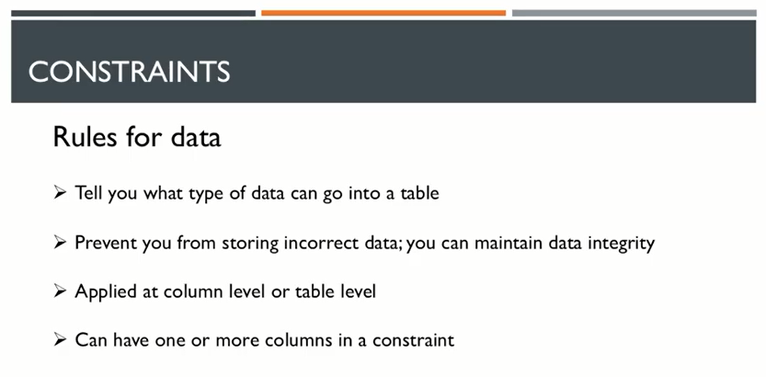

Slide 4
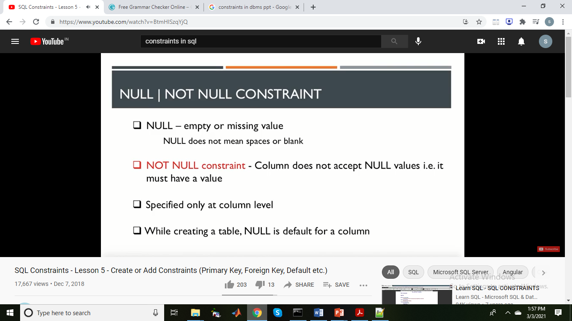

Slide 5
Oracle NOT NULL constraints
An Oracle NOT NULL constraint specifies that a column cannot contain NULL values. The Oracle NOT NULL constraints are inline constraints which are typically used in the column definition of the CREATE TABLE statement.
CREATE TABLE table_name (
...
column_name data_type NOT NULL
...
);
It is possible to add a NOT NULL constraint to an existing table by using the ALTER TABLE statement.
ALTER TABLE table_name MODIFY ( column_name NOT NULL);
In this case, the column_name must not contain any NULL value before applying the NOT NULL constraint.
CREATE TABLE Student
( s_id number NOT NULL,
name varchar(60),
age number
);

Slide 6
Drop NOT NULL constraints
Sometimes, you need to change a column with a NOT NULL constraint to accept NULL values.
To do this, you need to remove the NOT NULL constraint from the column by using the ALTER TABLE statement as below:
ALTER TABLE table_name MODIFY ( column_name NULL)
For example, to drop the NOT NULL constraint from the amount column of the surcharges table, you use the following statement:
ALTER TABLE surcharges
MODIFY (amount NULL);

Slide 7
The following statement displays all constraints of the surcharges table:
SELECT *
FROM
user_constraints
WHERE
table_name = 'SURCHARGES';

Slide 8
Oracle unique constraint syntax
A unique constraint is an integrity constraint that ensures the data stored in a column, or a group of columns, is unique among the rows in a table.
Typically, you apply the unique constraints to columns when you create the table using the inline constraint syntax as follows:
CREATE TABLE table_name (
...
column_name data_type UNIQUE
...
);
This unique constraint specifies that the values in the column_name is unique across the whole table.
You can also use the out-of-line constraint syntax to define a unique constraint:
CREATE TABLE table_name (
...,
UNIQUE(column_name)
);

Slide 9
Oracle unique constraint syntax
A unique constraint is an integrity constraint that ensures the data stored in a column, or a group of columns, is unique among the rows in a table.
Typically, you apply the unique constraints to columns when you create the table using the inline constraint syntax as follows:
CREATE TABLE table_name (
...
column_name data_type UNIQUE
...
);
This unique constraint specifies that the values in the column_name is unique across the whole table.
You can also use the out-of-line constraint syntax to define a unique constraint:
CREATE TABLE table_name (
...,
UNIQUE(column_name)
);

Slide 10
It’s possible to assign a unique constraint a name by using the CONSTRAINT clause followed by the constraint name:
CREATE TABLE table_name (
...
column_name data_type CONSTRAINT unique_constraint_name UNIQUE
...
);
or with out-of-line constraint syntax:
CREATE TABLE table_name (
...
column_name data_type,
...,
CONSTRAINT unique_constraint_name UNIQUE(column_name)
);

Slide 11
To define a unique constraint for a group of columns, you use the out-of-line constraint syntax:
CREATE TABLE table_name (
...
column_name1 data_type,
column_name2 data_type,
...,
CONSTRAINT unique_constraint_name UNIQUE(column_name1, column_name2)
);
If you want to add a unique constraint to an existing table, you use the ALTER TABLE statement:
ALTER TABLE table_name
ADD CONSTRAINT unique_constraint_name UNIQUE(column_name1, column_nam2);
Or even drop a unique constraint:
ALTER TABLE table_name
DROP CONSTRAINT unique_constraint_name;

Slide 12
Let’s create a table named clients for the demonstration:
CREATE TABLE clients (
client_id NUMBER NOT NULL UNIQUE,
first_name VARCHAR2(50) NOT NULL,
last_name VARCHAR2(50) NOT NULL,
company_name VARCHAR2(255) NOT NULL,
email VARCHAR2(255) NOT NULL UNIQUE,
phone VARCHAR(25)
);
The email column has a unique constraint that ensures there will be no duplicate email.

Slide 13
The following statement inserts a row into the clients table:
INSERT INTO clients(first_name,last_name, email, company_name, phone)
VALUES('Christene','Snider','christene.snider@abc.com', 'ABC Inc', '408-875-6075');
Now, we attempt to insert a new row whose email value already exists in the email column:
INSERT INTO clients(first_name,last_name, email, company_name, phone)
VALUES('Sherly','Snider','christene.snider@abc.com', 'ABC Inc', '408-875-6076');
Oracle issued the following error message indicated that the unique constraint has been violated:
SQL Error: ORA-00001: unique constraint (OT.SYS_C0010726) violated
If you want to add a unique constraint for the company_name and phone columns, you can use the following ALTER TABLE statement:
ALTER TABLE clients
ADD CONSTRAINT unique_company_phone UNIQUE(company_name, phone);
to drop it permanently:
ALTER TABLE clients DROP CONSTRAINT unique_company_phone;

Slide 14
Introduction to the primary key
Primary key is the term used to identify one or more columns in a table that make a row of data unique. Although the primary key typically consists of one column in a table, more than one column can comprise the primary key.
For example, either the employee's Social Security number or an assigned employee identification number is the logical primary key for an employee table.
The objective is for every record to have a unique primary key or value for the employee's identification number. Because there is probably no need to have more than one record for each employee in an employee table, the employee identification number makes a logical primary key.
The following are rules that make a column a primary key:
A primary key column cannot contain a NULL value or an empty string.
A primary key value must be unique within the entire table.
A primary key value should not be changed over time.

Slide 15
Oracle PRIMARY KEY constraint examples
Typically, you create a primary key for a table when you create that table. In addition, you can add a primary key to a table after the fact by using the ALTER TABLE statement.
Creating a primary key that consists of one column
The following CREATE TABLE statement creates the purchase_orderstable:
CREATE TABLE purchase_orders (
po_nr NUMBER PRIMARY KEY,
vendor_id NUMBER NOT NULL,
po_status NUMBER(1,0) NOT NULL);

Slide 16
Consider the following statement.
CREATE TABLE purchase_orders (
po_nr NUMBER,
vendor_id NUMBER NOT NULL,
po_status NUMBER(1,0) NOT NULL,
CONSTRAINT pk_purchase_orders PRIMARY KEY(po_nr)
);
This example used the PRIMARY KEY constraint as the table constraint. Notice the following clause:
CONSTRAINT pk_purchase_orders PRIMARY KEY(po_nr)
In addition, we explicitly assigned the PRIMARY KEY constraint a name pk_purchase_orders.

Slide 17
Creating a primary key that consists of multiple columns
The following statement creates the purchase order line items table:
CREATE TABLE purchase_order_items (
po_nr NUMBER,
item_nr NUMBER,
product_id NUMBER NOT NULL,
quantity NUMBER NOT NULL,
purchase_unit NUMBER NOT NULL,
buy_price NUMBER (9,2) NOT NULL,
delivery_date DATE,
PRIMARY KEY (po_nr, item_nr)
);
In this example, the primary key of the purchase_order_items table consists of two columns: po_nr and item_nr. It means that the combination of values of these columns uniquely identifies a purchase order line item.
This example did not use the CONSTRAINT clause to explicitly assign the PRIMARY KEY constraint a name. Therefore, Oracle implicitly assigned the primary key constraint a system-generated name such as SYS_C0010617.

Slide 18
Adding a primary key to a table
Sometimes, you may want to add a primary key constraint to an existing table. To do it, you use the ALTER TABLE statement as follows:
ALTER TABLE table_name
ADD CONSTRAINT constraint_name
PRIMARY KEY (column1, column2, ...);
The following example creates the vendors table first and then adds a primary key constraint to it:
CREATE TABLE vendors (
vendor_id NUMBER,
vendor_name VARCHAR2(255) NOT NULL,
address VARCHAR2(255) NOT NULL
);
ALTER TABLE vendors
ADD CONSTRAINT pk_vendors PRIMARY KEY (vendor_id);

Slide 19
Dropping an Oracle PRIMARY KEY constraint
You will rarely drop a PRIMARY KEY constraint from a table. If you have to do so, you use the following ALTER TABLE statement.
ALTER TABLE table_name
DROP CONSTRAINT primary_key_constraint_name;
For example, you can drop the primary key constraint of the vendors table as follows:
ALTER TABLE vendors
DROP CONSTRAINT pk_vendors;
It is possible to use the following statement to drop the primary key of a table:
ALTER TABLE table_name
DROP PRIMARY KEY;
For example:
ALTER TABLE vendors
DROP PRIMARY KEY;

Slide 20
Oracle Check constraint
An Oracle check constraint allows you to enforce domain integrity by limiting the values accepted by one or more columns.
To create a check constraint, you define a logical expression that returns true or false. Oracle uses this expression to validate the data that is being inserted or updated. If the expression evaluates to true, Oracle accepts the data and carry the insert or update. Otherwise, Oracle will reject the data and does not insert or update at all.
You can apply a check constraint to a column or a group of columns. A column may have one or more check constraints.
Creating Check constraint syntax
Typically, you create a check constraint on a column when you create the table:
CREATE TABLE table_name (
...
column_name data_type CHECK (expression),
...
);
CREATE table Student(
s_id int NOT NULL CHECK(s_id > 0),
Name varchar(60) NOT NULL,
Age int
);
The above query will restrict the s_id value to be greater than zero.

Slide 21
If you want to assign the check constraint an explicit name, you use the CONSTRAINT clause below:
CONSTRAINT check_constraint_name
CHECK (expression);
In addition, you can use the out-of-line constraint syntax as follows:
CREATE TABLE table_name (
...,
CONSTRAINT check_constraint_name CHECK (expresssion)
);
Suppose the cost must be positive and it is also greater or equal to the buy price. To enforce these rules, you add two check constraints to the parts table:
ALTER TABLE parts
ADD CONSTRAINT check_positive_cost CHECK (cost > 0);

Slide 22
Drop checking constraint
To drop a check constraint, you use the ALTER TABLE DROP CONSTRAINT statement as follows:
ALTER TABLE table_name
DROP CONSTRAINT check_constraint_name;
For example, to drop the check_valid_cost constraint, you use the following statement:
ALTER TABLE parts
DROP CONSTRAINT check_valid_cost;

Slide 23
SQL DEFAULT Constraint
The DEFAULT constraint is used to provide a default value for a column.
The default value will be added to all new records IF no other value is specified.
SQL DEFAULT on CREATE TABLE
The following SQL sets a DEFAULT value for the "City" column when the "Persons" table is created:
CREATE TABLE Persons (
ID number NOT NULL,
LastName varchar(255) NOT NULL,
FirstName varchar(255),
Age number,
City varchar(255) DEFAULT ‘Kolkata '
);

Slide 24
SQL DEFAULT on ALTER TABLE
To create a DEFAULT constraint on the "City" column when the table is already created, use the following SQL:
ALTER TABLE Persons
MODIFY City DEFAULT ‘Kolkata’;

Slide 25
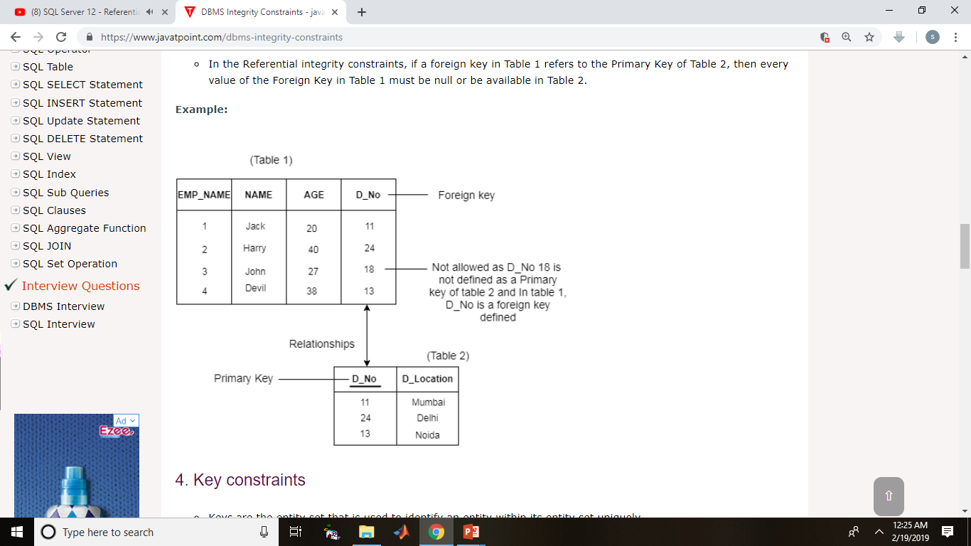
Introduction to Oracle foreign key constraint
A FOREIGN KEY is a key used to link two tables together.
A FOREIGN KEY is a field (or collection of fields) in one table that refers to the PRIMARY KEY in another table.
The table containing the foreign key is called the child table, and the table containing the candidate key is called the referenced or parent table.
Look at the following two tables:

Slide 26
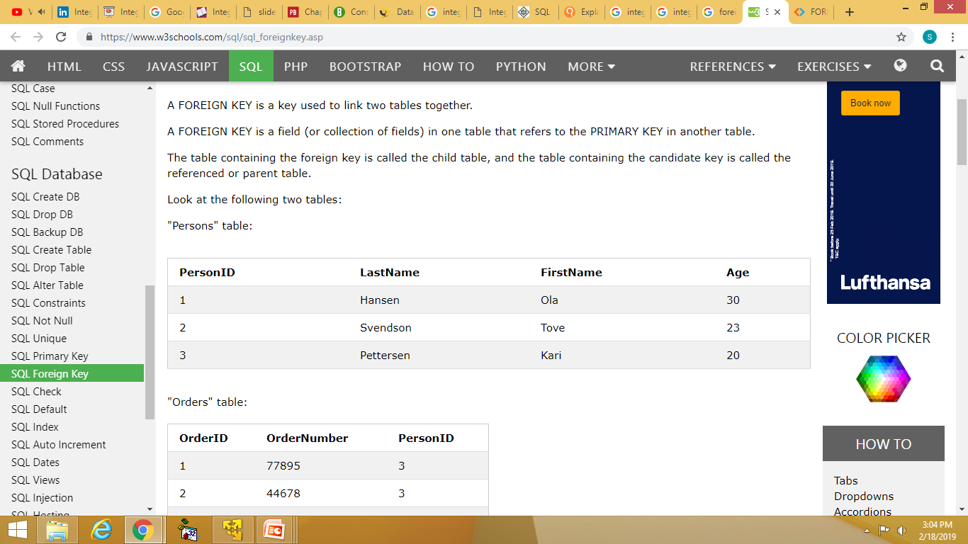
Foreign Key Constraints
The rules are:
You can't delete a record from a primary table if matching records exist in a related table.
You can't change a primary key value in the primary table if that record has related records.
You can't enter a value in the foreign key field of the related table that doesn't exist in the primary key of the primary table.
However, you can enter a Null value in the foreign key, specifying that the records are unrelated.
"Persons" table:
Notice that the "PersonID" column in the "Orders" table points to the "PersonID" column in the "Persons" table.
The "PersonID" column in the "Persons" table is the PRIMARY KEY in the "Persons" table.
The "PersonID" column in the "Orders" table is a FOREIGN KEY in the "Orders" table.

Slide 27
Suppose, we have two tables supplier_groups and suppliers:
CREATE TABLE supplier_groups(
group_id NUMBER,
group_name VARCHAR2(255) NOT NULL,
PRIMARY KEY (group_id)
);
CREATE TABLE suppliers (
supplier_id NUMBER,
supplier_name VARCHAR2(255) NOT NULL,
group_id NUMBER NOT NULL,
PRIMARY KEY(supplier_id)
);
Second, recreate the suppliers table with a foreign key constraint:
CREATE TABLE suppliers (
supplier_id NUMBER,
supplier_name VARCHAR2(255) NOT NULL,
group_id NUMBER NOT NULL,
PRIMARY KEY(supplier_id),
FOREIGN KEY(group_id) REFERENCES supplier_groups(group_id)
);
In this statement, the following clause was newly added:
FOREIGN KEY(group_id) REFERENCES supplier_groups(group_id)

Slide 28
Add a foreign key constraint to a table
If you want to add a foreign key constraint to an existing table, you use the ALTER TABLE statement as follows:
ALTER TABLE child_table
ADD CONSTRAINT fk_name
FOREIGN KEY (col1) REFERENCES parent_table(col1);
Drop a foreign key constraint
To drop a foreign key constraint, you use the ALTER TABLE statement below:
ALTER TABLE child_table
DROP CONSTRAINT fk_name;

Slide 29
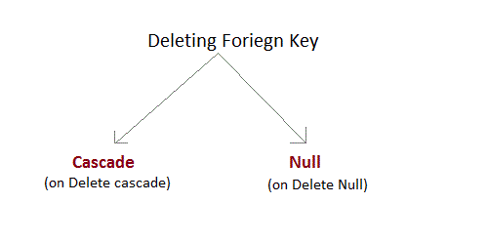
Behaviour of Foreign Key Column on Delete
There are two ways to maintain the integrity of data in Child table, when a particular record is deleted in the main table. When two tables are connected with Foriegn key, and certain data in the main table is deleted, for which a record exits in the child table, then we must have some mechanism to save the integrity of data in the child table.
foriegn key behaviour on delete - cascade and Null
On Delete Cascade : This will remove the record from child table, if that value of foriegn key is deleted from the main table.
On Delete Null : This will set all the values in that record of child table as NULL, for which the value of foreign key is deleted from the main table.
If we don't use any of the above, then we cannot delete data from the main table for which data in child table exists. We will get an error if we try to do so.
ERROR : Record in child table exist

Slide 30
For example:
CREATE TABLE supplier
( supplier_id number (10) not null,
supplier_name varchar2(50) not null,
contact_name varchar2(50),
CONSTRAINT supplier_pk PRIMARY KEY (supplier_id)
);
CREATE TABLE products
( product_id number(10) not null,
supplier_id number (10) not null,
CONSTRAINT fk_supplier
FOREIGN KEY (supplier_id)
REFERENCES supplier(supplier_id)
ON DELETE CASCADE
);
In this example, we've created a primary key on the supplier table called supplier_pk. It consists of only one field - the supplier_id field. Then we've created a foreign key called fk_supplier on the products table that references the supplier table based on the supplier_id field.
Because of the cascade delete, when a record in the supplier table is deleted, all records in the products table will also be deleted that have the same supplier_id value.

