Slide 1
Object Oriented Programming using JAVA
Presented By Sudeshna Kundu (Mondal)

Slide 2
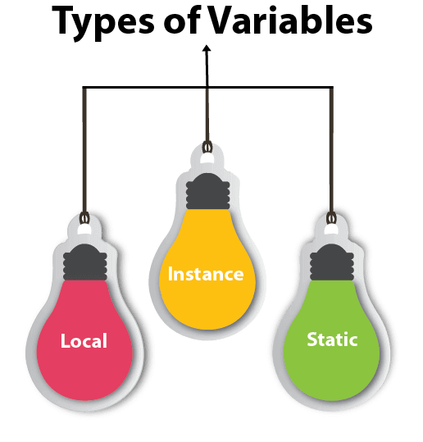
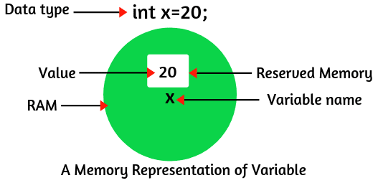
Java Variables
Types of Variables
There are three types of variables in Java:
local variable
instance variable
static variable
A variable in Java is a container that holds the value during the execution of Java program. In other words, Variable is the name of the memory location reserved for storing value.
Each variable in Java has a specific type that determines size of the memory. The size of the memory reserved depends on the data type

Slide 3
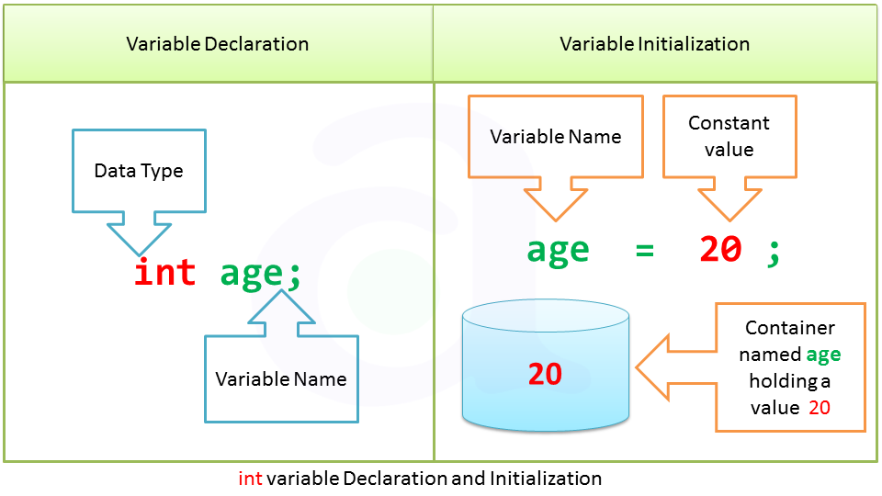
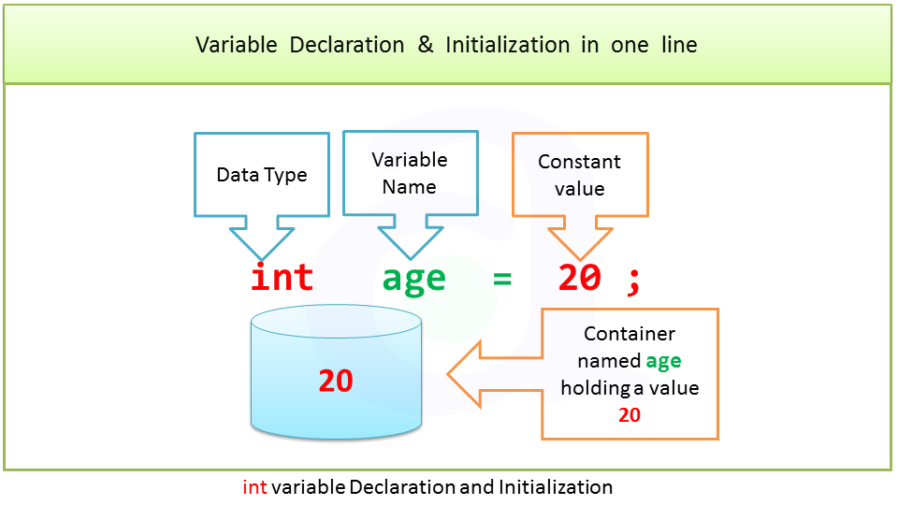
Java Variables

Slide 4
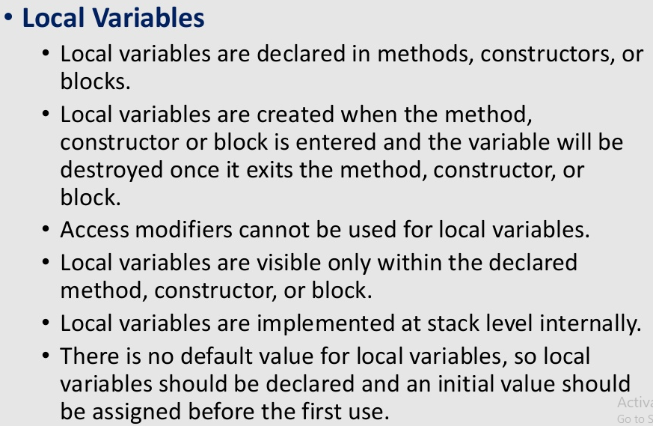
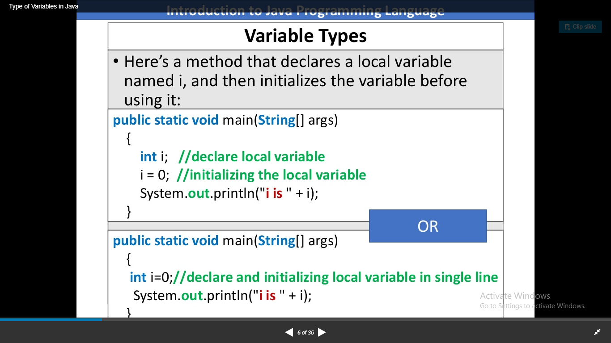

Slide 5
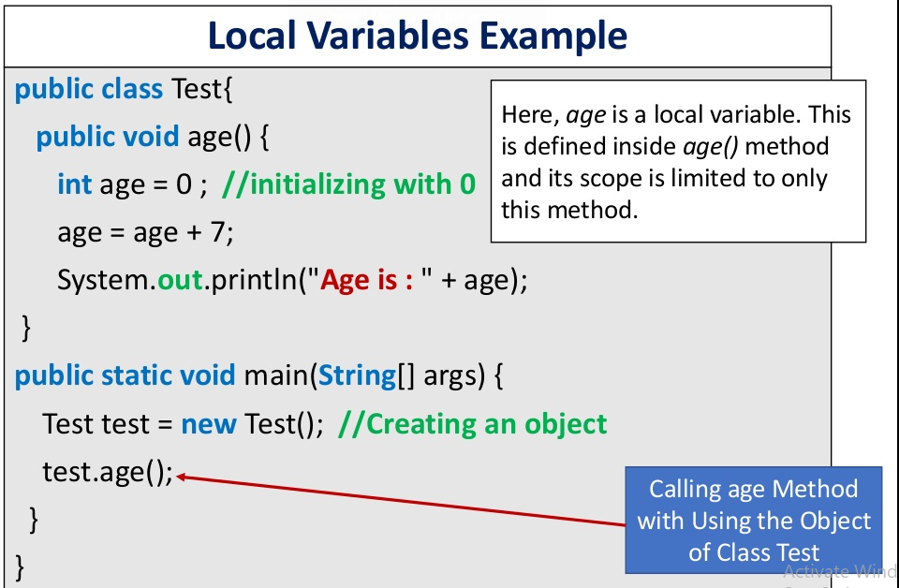
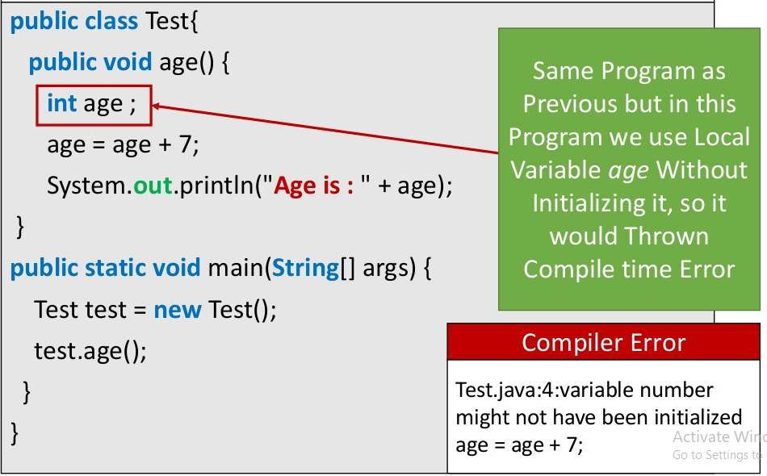
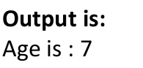

Slide 6
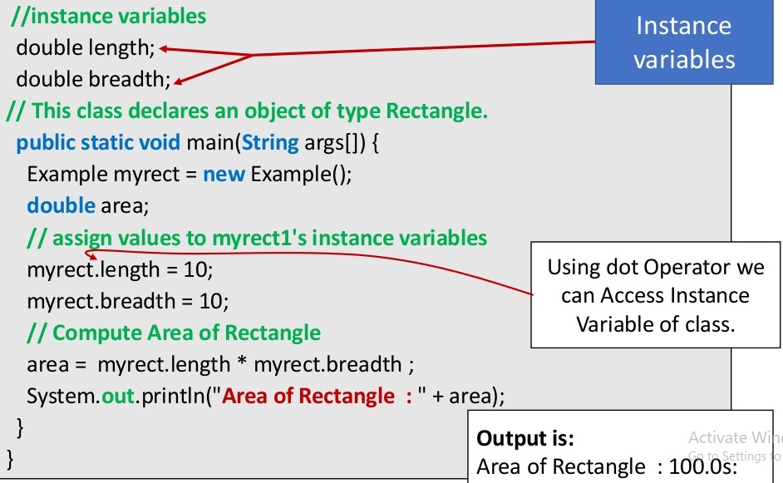
Instance Variables in Java
1. A variable that is declared inside the class but outside the body of the method, constructor, or any block is called instance variable in java.
It is called instance variable because its value is instance specific and is not shared among instances.
2. Instance variables are created when an object is created using the keyword ‘new’ and destroyed when the object is destroyed.
3. We can also use access modifiers with instance variables. If we do not specify any modifiers, the default access modifiers will be used which can be accessed in the same package only.
4. It is not necessary to initialize the instance variable.
5. Instance variables have default values. For numbers, the default value is 0, for Booleans it is false. Values can be assigned during the declaration or within the constructor.
Class Example{

Slide 7
import java.io.*;
class Marks {
// These variables are instance variables.
// These variables are in a class
// and are not inside any function
int engMarks;
}
class MarksDemo {
public static void main(String args[])
{
// first object
Marks obj1 = new Marks();
obj1.engMarks = 50;
// second object
Marks obj2 = new Marks();
obj2.engMarks = 80;
// displaying marks for first object
System.out.println("Marks for first object:");
System.out.println(obj1.engMarks);
// displaying marks for second object
System.out.println("Marks for second object:");
System.out.println(obj2.engMarks);
}
}
Output:
Marks for first object:
50
Marks for second object:
80

Slide 8
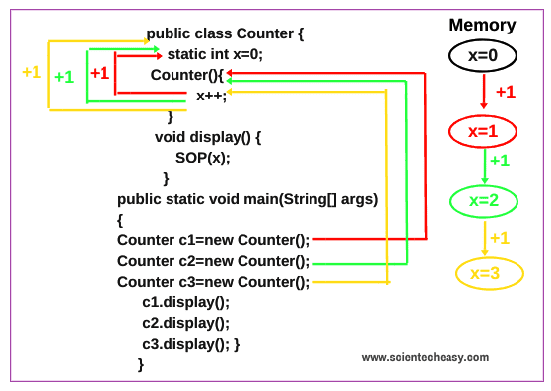
Static Variables
Static variables are also known as Class variables.
These variables are declared similarly as instance variables, the difference is that static variables are declared using the static keyword within a class outside any method constructor or block.
Unlike instance variables, we can only have one copy of a static variable per class irrespective of how many objects we create.
Static variables are created at the start of program execution and destroyed automatically when execution ends.
Initialization of Static Variable is not Mandatory. Its default value is 0
If we access the static variable like Instance variable (through an object), the compiler will show the warning message and it won’t halt the program. The compiler will replace the object name to class name automatically.
If we access the static variable without the class name, Compiler will automatically append the class name.
To access static variables, we need not create an object of that class, we can simply access the variable as
class_name.variable_name;

Slide 9
Difference between Instance Variables and Static variables in Java
Instance variables | Static (class) variables
Instance variables are declared in a class, but outside a method, constructor or any block. | Class variables also known as static variables are declared with the static keyword in a class, but outside a method, constructor or a block.
Instance variables are created when an object is created with the use of the keyword 'new' and destroyed when the object is destroyed. | Static variables are created when the program starts and destroyed when the program stops.
Instance variables can be accessed directly by calling the variable name inside the class. However, within static methods (when instance variables are given accessibility), they should be called using the fully qualified name. ObjectReference.VariableName. | Static variables can be accessed by calling with the class name ClassName.VariableName.
Instance variables hold values that must be referenced by more than one method, constructor or block, or essential parts of an object's state that must be present throughout the class. | There would only be one copy of each class variable per class, regardless of how many objects are created from it.

Slide 10
Method in Java
In general, a method is a way to perform some task. Similarly, the method in Java is a collection of instructions that performs a specific task.
It is used to achieve the reusability of code. We write a method once and use it many times. We do not require to write code again and again.
It also provides the easy modification and readability of code, just by adding or removing a chunk of code.

Slide 11
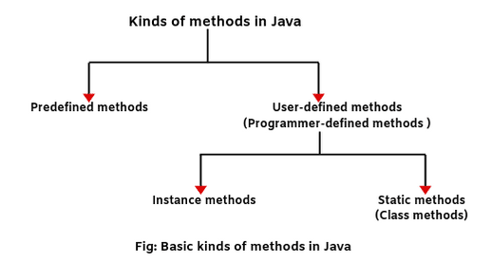
Types of methods in Java
Generally, there are two basic types of methods in Java but programmers can develop any kind of method depending on the scenario. 1. Predefined methods 2. User-defined methods (Programmer-defined methods)

Slide 12
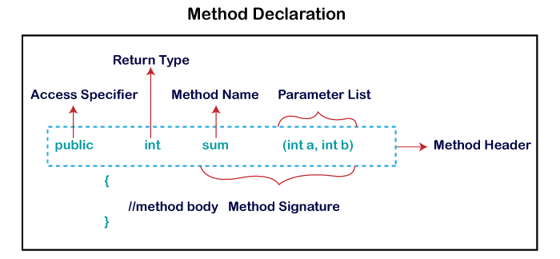
Method Declaration
The method declaration provides information about method attributes, such as visibility, return-type, name, and arguments. It has six components that are known as method header, as we have shown in the following figure.
Method in Java
Method Signature: Every method has a method signature. It is a part of the method declaration. It includes the method name and parameter list.
Access Specifier: Access specifier or modifier is the access type of the method. It specifies the visibility of the method. Java provides four types of access specifier:

Slide 13
Method Declaration
Public: The method is accessible by all classes when we use public specifier in our application.
Private: When we use a private access specifier, the method is accessible only in the classes in which it is defined.
Protected: When we use protected access specifier, the method is accessible within the same package or subclasses in a different package.
Default: When we do not use any access specifier in the method declaration, Java uses default access specifier by default. It is visible only from the same package only.
Return Type: Return type is a data type that the method returns. It may have a primitive data type, object, collection, void, etc. If the method does not return anything, we use void keyword.
Method Name: It is a unique name that is used to define the name of a method. It must be corresponding to the functionality of the method. Suppose, if we are creating a method for subtraction of two numbers, the method name must be subtraction(). A method is invoked by its name.
Parameter List: It is the list of parameters separated by a comma and enclosed in the pair of parentheses. It contains the data type and variable name. If the method has no parameter, left the parentheses blank.
Method Body: It is a part of the method declaration. It contains all the actions to be performed. It is enclosed within the pair of curly braces.

Slide 14
Predefined methods in Java with Example Program
Predefined methods are those methods that are already defined in the Java API (Application Programming Interface) to use in an application. Java Programming language contains predefined classes that are organized in different predefined packages.
Within these predefined classes, there are located predefined methods. In fact, Java has over 160 predefined packages that contain more than 3000 predefined classes.
These classes have many more thousands of individual predefined methods. All are available to the programmers via Java API.
For example:
1. print() is a predefined method present in the package java.io.PrintSteam. The print(“….”) prints the string inside the quotation marks.
2. sqrt() is a method of Math class which is present in package java.lang. It calculates the square root of a number. Let’ take an example program based on java predefined methods.

Slide 15
Predefined methods in Java with Example Program
public class Demo
{
public static void main(String[] args)
{
// using the max() method of Math class
System.out.print("The maximum number is: " + Math.max(9,7));
}
}

Slide 16
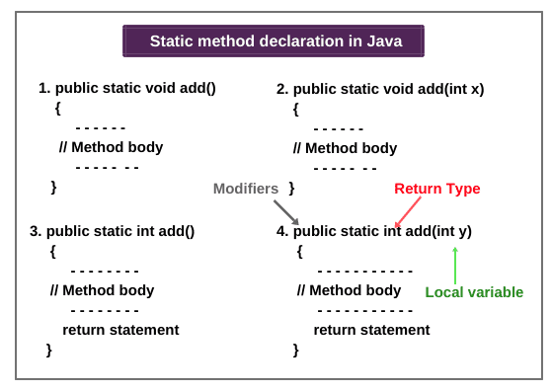
The different forms of declaration a static method can be seen at the below screenshot.

Slide 17
User-defined methods in Java with Example Program
Static Method
A method that has static keyword is known as static method. In other words, a method that belongs to a class rather than an instance of a class is known as a static method. We can also create a static method by using the keyword static before the method name.
The main advantage of a static method is that we can call it without creating an object. It can access static data members and also change the value of it. It is used to create an instance method. It is invoked by using the class name. The best example of a static method is the main() method.
public class Display
{
public static void main(String[] args)
{
show();
}
static void show()
{
System.out.println("It is an example of static method.");
}
}

Slide 18
User-defined methods in Java with Example Program
Instance Method
The method of the class is known as an instance method. It is a non-static method defined in the class. Before calling or invoking the instance method, it is necessary to create an object of its class. Let's see an example of an instance method.
public class InstanceMethodExample
{
int s;
//user-defined method because we have not used static keyword
public int add(int a, int b)
{
s = a+b;
//returning the sum
return s;
}
public static void main(String [] args)
{
//Creating an object of the class
InstanceMethodExample obj = new InstanceMethodExample();
//invoking instance method
System.out.println("The sum is: "+obj.add(12, 13));
}
}

Slide 19
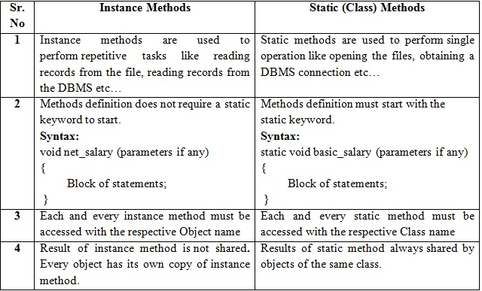
Difference between Instance Methods and Static Methods

Slide 20
Why instance variable is not available to static method?
When we declare a static method in Java, the JVM first executes the static method, and then it creates the objects of the class. Since the objects are not available at the time of calling the static method.
Therefore, the instance variables are also not available to a static method. Due to which a static method cannot access an instance variable in the class.

Slide 21
Objective: To understand the concepts of Array and Constructor.
Assignments 3:
1. Write a Java program to calculate Sum & Average of an integer array.
2. Write a Java program to implement stack using array.
3. Write a Java program to implement Queue using array.
4. Write a Java program to calculate Sum of two 2-dimensional arrays.
5. Write a Java program to find the range of a 1D array.
6. Write a Java program to search an element in an array.
7. Write a Java program to find the sum of even numbers in an integer array.
8. Write a Java program to find the sum of diagonal elements in a 2D array.
9. Reverse the elements in an array of integers without using a second array.
10. Write a Java program to enter n elements in an array and find smallest number among them.
11. Write Java program to find the sum of all odd numbers in a 2D array.
12. Write a Java program to print transpose of matrix.
13. Write a Java program to check whether a given matrix is sparse or not.
14. Write a Java program to count the prime numbers in an array.
15. Write a Java program to find second highest element of an array.
16. Write a Java program which counts the non-zero elements in an integer array.
17. Write a Java program to merge two float arrays.

Slide 22
18. Write a Java program where elements of two integer arrays get added index wise and get stored into a third array.
19. Write a Java program to multiply two matrices.
20. Write a Java program to subtract two matrices.
21. Write a Java program to find duplicate elements in a 1D array and find their frequency of occurrence.
22. Write a Java program to print every alternate number of a given array.
23. Given are two one-dimensional arrays A & B, which are sorted in ascending order. Write a Java program to merge them into single sorted array C that contains every item from arrays A & B, in ascending order.
24. Write a Java program to show 0-arguments constructor.
25. Write a Java program to show parameterized constructor.
26. Write a class, Grader, which has an instance variable, score, an appropriate constructor and appropriate methods. A method, letterGrade() that returns the letter grade as O/E/A/B/C/F.
Now write a demo class to test the Grader class by reading a score from the user, using it to create a Grader object after validating that the value is not negative and is not greater than 100. Finally, call the letterGrade() method to get and print the grade.
27. Write a class, Commission, which has an instance variable, sales; an appropriate constructor; and a method, commission() that returns the commission.
Now write a demo class to test the Commission class by reading a sale from the user, using it to create a Commission object after validating that the value is not negative. Finally, call the commission() method to get and print the commission. If the sales are negative, your demo should print the message “Invalid Input”.

