Slide 1
Object Oriented Programming using JAVA
Presented By Sudeshna Kundu (Mondal)

Slide 2
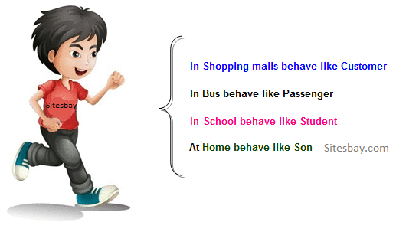
Polymorphism in Java
The process of representing one form in multiple forms is known as Polymorphism.
Polymorphism is derived from 2 greek words: poly and morphs. The word "poly" means many and "morphs" means forms. So polymorphism means many forms.
Real life example of polymorphism in Java
Suppose if you are in class room that time you behave like a student, when you are in market at that time you behave like a customer, when you at your home at that time you behave like a son or daughter, Here one person present in different-different behaviors.

Slide 3
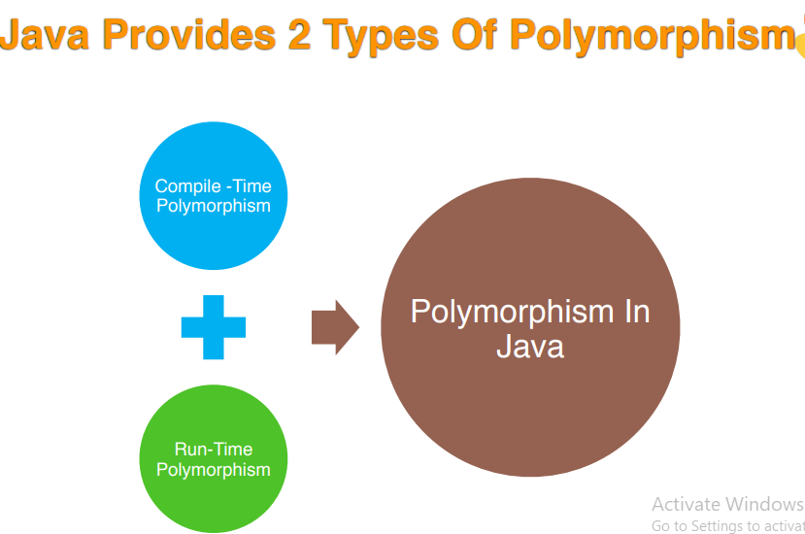

Slide 4
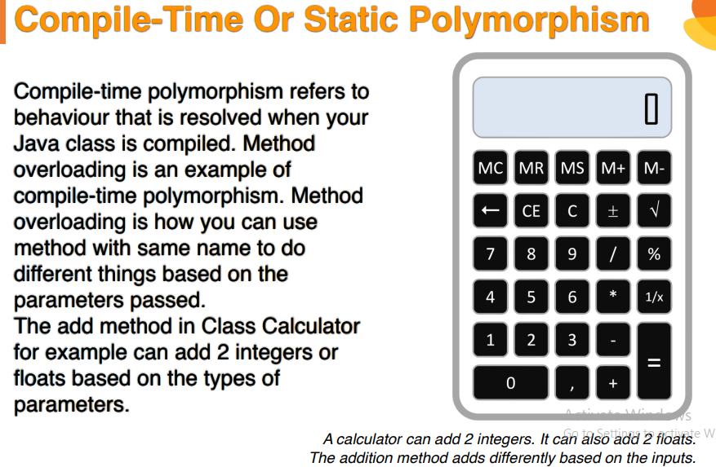

Slide 5
Method Overloading in Java
If a class has multiple methods having same name but different in parameters, it is known as Method Overloading.
If we have to perform only one operation, having same name of the methods increases the readability of the program.
Suppose you have to perform addition of the given numbers but there can be any number of arguments, if you write the method such as a(int,int) for two parameters, and b(int,int,int) for three parameters then it may be difficult for you as well as other programmers to understand the behavior of the method because its name differs.

Slide 6
Method Overloading in Java
Advantage of method overloading
Method overloading increases the readability of the program.
Different ways to overload the method
There are two ways to overload the method in java
By changing number of arguments
By changing the data type

Slide 7
Method Overloading in Java
1) Method Overloading: changing no. of arguments
In this example, we have created two methods, first add() method performs addition of two numbers and second add method performs addition of three numbers.
In this example, we are creating static methods so that we don't need to create instance for calling methods.
class Adder{
static int add(int a,int b){return a+b;}
static int add(int a,int b,int c){return a+b+c;}
}
class TestOverloading1{
public static void main(String[] args){
System.out.println(Adder.add(11,11));
System.out.println(Adder.add(11,11,11));
}}
Output:
22
33

Slide 8
Method Overloading in Java
2) Method Overloading: changing data type of arguments
In this example, we have created two methods that differs in data type. The first add method receives two integer arguments and second add method receives two double arguments.
class Adder{
static int add(int a, int b){return a+b;}
static double add(double a, double b){return a+b;}
}
class TestOverloading2{
public static void main(String[] args){
System.out.println(Adder.add(11,11));
System.out.println(Adder.add(12.3,12.6));
}}
Output:
22
24.9

Slide 9
Method Overloading in Java
Why Method Overloading is not possible by changing the return type of method only?
In java, method overloading is not possible by changing the return type of the method only because of ambiguity. Let's see how ambiguity may occur:
class Adder{
static int add(int a,int b){return a+b;}
static double add(int a,int b){return a+b;}
}
class TestOverloading3{
public static void main(String[] args){
System.out.println(Adder.add(11,11));//ambiguity
}}
Output:
Compile Time Error: method add(int,int) is already defined in class Adder

Slide 10
Method Overloading in Java
Can we overload java main() method?
Yes, by method overloading. You can have any number of main methods in a class by method overloading. But JVM calls main() method which receives string array as arguments only. Let's see the simple example:
class TestOverloading4{
public static void main(String[] args){System.out.println("main with String[]");}
public static void main(String args){System.out.println("main with String");}
public static void main(){System.out.println("main without args");}
}
Output:
main with String[]

Slide 11
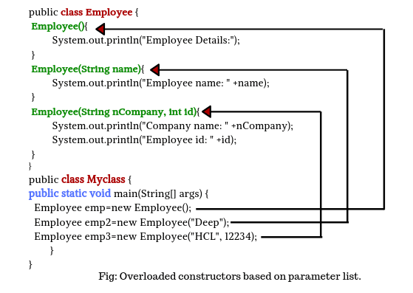
Constructor Overloading in Java
Constructor overloading in Java means to define multiple constructors but each one must have a different signature. It is a technique in Java in which a class can have more than one constructor that differ in the parameters list.
The Java compiler differentiates these constructors based on the number of the parameter list and their types. Therefore, the signature of each constructor must be different. The signature of a constructor consists of its name and sequence of parameter types.

Slide 12
Advantage of Constructor Overloading in Java
The advantages of using constructor overloading in java programming are as follows:
1. Java constructor overloading helps to achieve static polymorphism.
2. The main advantage of constructor overloading is to allow an instance of a class to be initialized in various ways.
3. It allows to define multiple constructors of a class with different signatures.

Slide 13
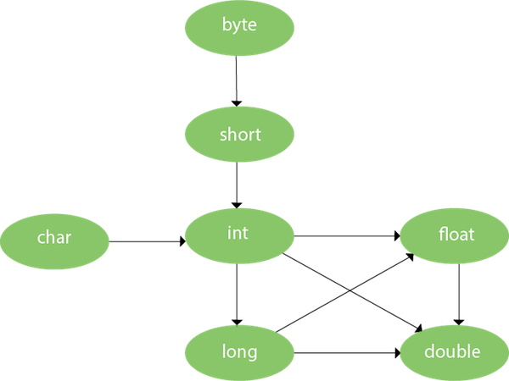
Method Overloading and Type Promotion
One type is promoted to another implicitly if no matching datatype is found. Let's understand the concept by the figure given below:
As displayed in the above diagram, byte can be promoted to short, int, long, float or double. The short datatype can be promoted to int, long, float or double. The char datatype can be promoted to int,long,float or double and so on.

Slide 14
Method Overloading and Type Promotion
Example of Method Overloading with TypePromotion
class OverloadingCalculation1{
void sum(int a,long b){System.out.println(a+b);}
void sum(int a,int b,int c){System.out.println(a+b+c);}
public static void main(String args[]){
OverloadingCalculation1 obj=new OverloadingCalculation1();
obj.sum(20,20);//now second int literal will be promoted to long
obj.sum(20,20,20);
}
}
Output:
40
60

Slide 15
Method Overloading and Type Promotion
Example of Method Overloading with Type Promotion if matching found
If there are matching type arguments in the method, type promotion is not performed.
class OverloadingCalculation2{
void sum(int a,int b){System.out.println("int arg method invoked");}
void sum(long a,long b){System.out.println("long arg method invoked");}
public static void main(String args[]){
OverloadingCalculation2 obj=new OverloadingCalculation2();
obj.sum(20,20);//now int arg sum() method gets invoked
}
}
Output:
int arg method invoked

Slide 16
Method Overloading and Type Promotion
Example of Method Overloading with Type Promotion in case of ambiguity
If there are no matching type arguments in the method, and each method promotes similar number of arguments, there will be ambiguity.
class OverloadingCalculation3{
void sum(int a,long b){System.out.println("a method invoked");}
void sum(long a,int b){System.out.println("b method invoked");}
public static void main(String args[]){
OverloadingCalculation3 obj=new OverloadingCalculation3();
obj.sum(20,20);//now ambiguity
}
}
Output:
Compile Time Error

Slide 17
Passing and Returning Objects in Java
Although Java is strictly pass by value, the precise effect differs between whether a primitive type or a reference type is passed.
When we pass a primitive type to a method, it is passed by value. But when we pass an object to a method, the situation changes dramatically, because objects are passed by what is effectively call-by-reference. Java does this interesting thing that’s sort of a hybrid between pass-by-value and pass-by-reference.
While creating a variable of a class type, we only create a reference to an object. Thus, when we pass this reference to a method, the parameter that receives it will refer to the same object as that referred to by the argument.
This effectively means that objects act as if they are passed to methods by use of call-by-reference.
Changes to the object inside the method do reflect in the object used as an argument.

Slide 18
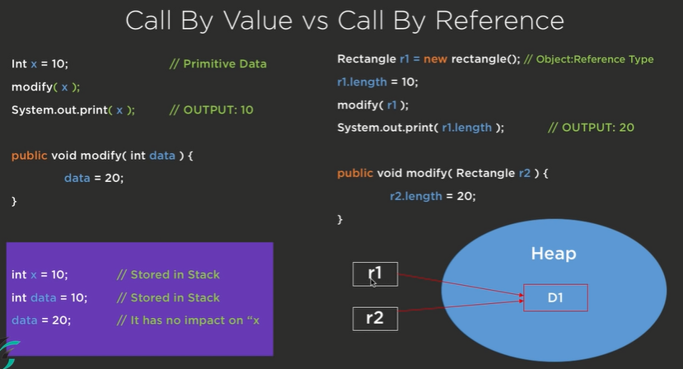
R

Slide 19
// Java program to demonstrate objects
// passing to methods.
class ObjectPassDemo
{
int a, b;
ObjectPassDemo(int i, int j)
{
a = i;
b = j;
}
// return true if o is equal to the invoking
// object notice an object is passed as an
// argument to method
boolean equalTo(ObjectPassDemo o)
{
return (o.a == a && o.b == b);
}
}
// Driver class
public class Test
{
public static void main(String args[])
{
ObjectPassDemo ob1 = new ObjectPassDemo(100, 22);
ObjectPassDemo ob2 = new ObjectPassDemo(100, 22);
ObjectPassDemo ob3 = new ObjectPassDemo(-1, -1);
System.out.println("ob1 == ob2: " + ob1.equalTo(ob2));
System.out.println("ob1 == ob3: " + ob1.equalTo(ob3));
}
}
Output:
ob1 == ob2: true
ob1 == ob3: false

Slide 20
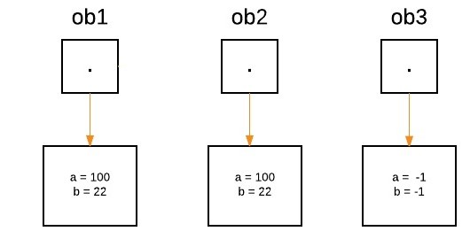
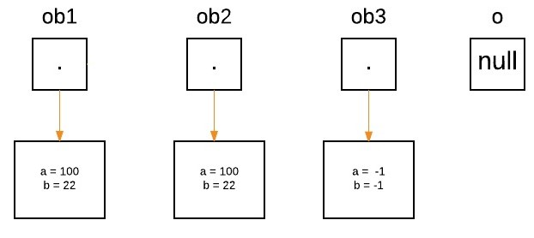
Illustrative images for the above program
Three objects ‘ob1’ , ‘ob2’ and ‘ob3’ are created:
ObjectPassDemo ob1 = new ObjectPassDemo(100, 22);
ObjectPassDemo ob2 = new ObjectPassDemo(100, 22);
ObjectPassDemo ob3 = new ObjectPassDemo(-1, -1);
boolean equalTo(ObjectPassDemo o);

Slide 21
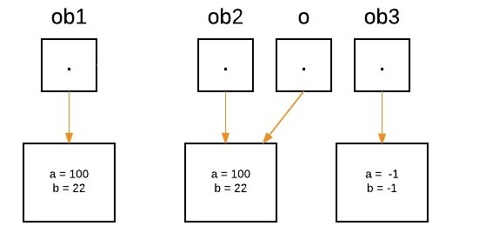
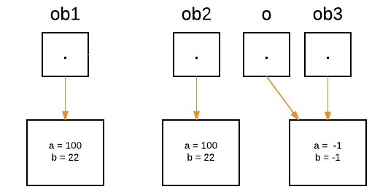
System.out.println("ob1 == ob2: " + ob1.equalTo(ob2));
As we call the method equalTo, the reference ‘o’ will be assigned to the object which is passed as an argument, i.e. ‘o’ will refer to ‘ob2’ as following statement execute.
Now as we can see, equalTo method is called on ‘ob1’ , and ‘o’ is referring to ‘ob2’. Since values of ‘a’ and ‘b’ are same for both the references, so if(condition) is true, so boolean true will be return.
if(o.a == a && o.b == b)
Again ‘o’ will reassign to ‘ob3’ as the following statement execute.
System.out.println("ob1 == ob3: " + ob1.equalTo(ob3));

Slide 22
Assignments:
1. Create a “circle” class & a “point” class. The coordinates of the circle are given and used within the “circle” class as object of the “point” class. Display the area of circle.
2. Create a class called Time, which has three private instance variables – hour, min and sec. It contains a method called add( ) which takes one Time object as parameter and print the added value of the calling Time object and passes Time object. In the main method, declare two Time objects and assign values using constructor and call the add() method.
3. Create a class called Complex, which has three private instance variables –real and imaginary. It contains a method called add( ) which takes one Complex object as parameter and print the added value of the calling Complex object and passes Complex object. In the main method, declare two Complex objects and assign values using constructor and call the add() method.
4. Write a program to define a class having one 3-digit number, num as data member. Initialize and display reverse of that number.
5. Write a program to define a class Student with four data members such as name, roll no., sub1, and sub2. Define appropriate methods to initialize and display the values of data members. Also calculate total marks and percentage scored by student.
6. Write a program to define a class Employee to accept emp_id, emp _name, basic_salary from the user and display the gross_salary.

Slide 23
7. Write a program to define a class Fraction having data members numerator and denominator. Initialize three objects using different constructors and display its fractional value.
8. Write a program to define a class Item containing code and price. Accept this data for five objects using array of objects. Display code, price in tabular form and also, display total price of all items.
9. Write a program to define a class Tender containing data members cost and company name. Accept data for five objects and display company name for which cost is minimum.
10. Write a program to define a class 'employee' with data members as empid, name and salary. Accept data for 5 objects using Array of objects and print it.
11. Define a class called circle that contains:
• Two private instance variables: radius (of type double) and color (of type String),
• Initialize the variables radius and color with default value of 1.0 and "red", respectively using default constructor.
• Include a second constructor that will use the default value for color and sets the
radius to the value passed as parameter.
• Two public methods: getRadius() and getArea() for returning the radius and area of
the circle
• Invoke the above methods and constructors in the main.

Slide 24
12. Write a program which will accept an integer from the user and pass the value to a method called PrintNumberInWord that will print "ONE", "TWO",... , "NINE", "ZERO" if the integer variable "number" is 1, 2,... , 9, or 0, respectively.
13. Design a class named Account that contains:
I. A private int data field named id for the account (default 0).
II. A private double data field named balance for the account (default 0).
III. A private double data field named annualInterestRate that stores the cur-rent interest rate (default 0). Assume all accounts have the same interest rate.
IV. A private Date data field named dateCreated that stores the date when the account was created.
V. A no-arg constructor that creates a default account.
VI. A constructor that creates an account with the specified id and initial balance.
VII. The accessor and mutator methods for id,balance, and annualInterestRate.
VIII. The accessor method for dateCreated.
IX. A method named getMonthlyInterestRate() that returns the monthly interest rate.
X. A method named getMonthlyInterest() that returns the monthly interest.
XI. A method named withdraw that withdraws a specified amount from the account.
XII. A method named deposit that deposits a specified amount to the account.

Slide 25
14. Write a test program that prompts the user to enter the investment amount (e.g., 1000) and the interest rate (e.g., 9%), and print a table that displays future value for the years from 1 to 30, as shown below:
The amount invested: 1000
Annual interest rate: 9%
Years Future Value
1 1093.8
2 1196.41
...
29 13467.25
30 14730.57

Slide 26
15. Write method headers for the following methods:
a. Computing a sales commission, given the sales amount and the commission rate.
b. Printing the calendar for a month, given the month and year.
c. Computing a square root.
d. Testing whether a number is even, and returning true if it is.
e. Printing a message a specified number of times.
f. Computing the monthly payment, given the loan amount, number of years, and annual interest rate.
16. Write a program that reads ten numbers, computes their average, and finds out how many numbers are above the average. [Use this keyword]
17. Write a program that reads ten integers and displays them in the reverse of the order in which they were read.
18. Write a program to demonstrate use of 'this' keyword.
19. Write a program to demonstrate use of 'static' keyword.
20. Write a program to accept value of apple sales for each day of the week (using array of type float) and then, calculate the average sale of the week.
21. Write program, which finds the sum of numbers formed by consecutive digits. Input : 2415 output : 24+41+15=80.

