Slide 1
Object Oriented Programming using JAVA
Presented By Sudeshna Kundu (Mondal)

Slide 2
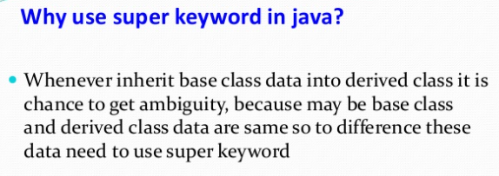
Super Keyword in Java
The super keyword in Java is a reference variable which is used to refer immediate parent class object.
Whenever you create the instance of subclass, an instance of parent class is created implicitly which is referred by super reference variable.

Slide 3
Super Keyword in Java
Base Class | Derived class
Variables Methods | Variables with same name Methods with same name
super keyword
super.variable (Base class)
super.method (Base class)
Example:
a=20;
void display()
{
}
Example:
a=10;
void display()
{
super.a
super.display()
}

Slide 4
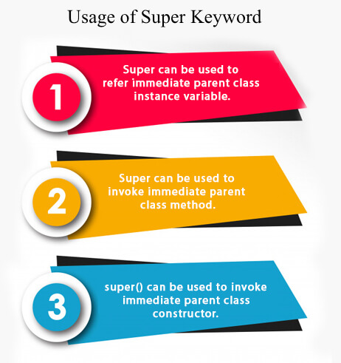
Super Keyword in Java
The super keyword in Java is a reference variable which is used to refer immediate parent class object.
Whenever you create the instance of subclass, an instance of parent class is created implicitly which is referred by super reference variable.
Usage of Java super Keyword
super can be used to refer immediate parent class instance variable.
super can be used to invoke immediate parent class method.
super() can be used to invoke immediate parent class constructor.

Slide 5
super to refer immediate parent class instance variable
We can use super keyword to access the data member or field of parent class. It is used if parent class and child class have same fields.
class Animal{
String color="white";
}
class Dog extends Animal{
String color="black";
void printColor(){
System.out.println(color);//prints color of Dog class
System.out.println(super.color);//prints color of Animal class
}
}
class TestSuper1{
public static void main(String args[]){
Dog d=new Dog();
d.printColor();
}}

Slide 6
super can be used to invoke parent class method
class Animal{
void eat(){System.out.println("eating...");}
}
class Dog extends Animal{
void eat(){System.out.println("eating bread...");}
void bark(){System.out.println("barking...");}
void work(){
super.eat();
bark();
}
}
class TestSuper2{
public static void main(String args[]){
Dog d=new Dog();
d.work();
}}
The super keyword can also be used to invoke parent class method. It should be used if subclass contains the same method as parent class. In other words, it is used if method is overridden.

Slide 7
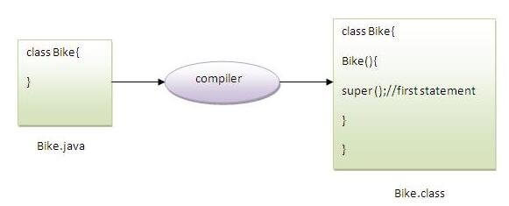
super invoke parent class constructor.
class Animal{
Animal(){System.out.println("animal is created");}
}
class Dog extends Animal{
Dog(){
super();
System.out.println("dog is created");
}
}
class TestSuper3{
public static void main(String args[]){
Dog d=new Dog();
}}
The super keyword can also be used to invoke the parent class constructor. Let's see a simple example:

Slide 8
Difference between method overloading and method overriding in java
There are many differences between method overloading and method overriding in java. A list of differences between method overloading and method overriding are given below:
No. | Method Overloading | Method Overriding
1) | Method overloading is used to increase the readability of the program. | Method overriding is used to provide the specific implementation of the method that is already provided by its super class.
2) | Method overloading is performed within class. | Method overriding occurs in two classes that have IS-A (inheritance) relationship.
3) | In case of method overloading, parameter must be different. | In case of method overriding, parameter must be same.
4) | Method overloading is the example of compile time polymorphism. | Method overriding is the example of run time polymorphism.
5) | In java, method overloading can't be performed by changing return type of the method only. Return type can be same or different in method overloading. But you must have to change the parameter. | Return type must be same or covariant in method overriding.

Slide 9
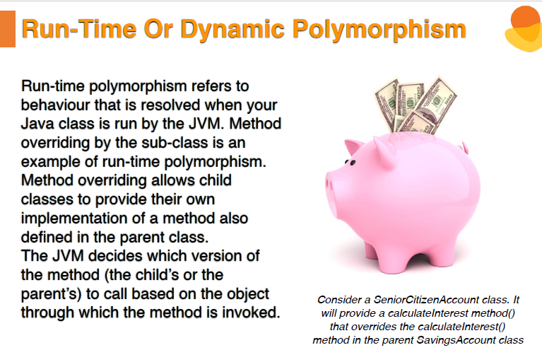

Slide 10
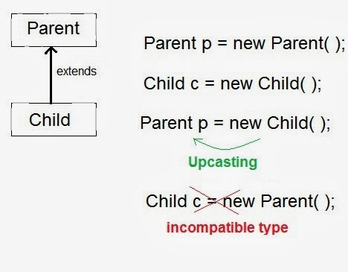
Runtime Polymorphism in Java
Runtime polymorphism or Dynamic Method Dispatch is a process in which a call to an overridden method is resolved at runtime rather than compile-time.
Dynamic Method Dispatch is related to a principle that states that a super class reference can store the reference of subclass object. However, it can't call any of the newly added methods by the subclass but a call to an overridden methods results in calling a method of that object whose reference is stored in the super class reference. It simply means that which method would be executed, simply depends on the object reference stored in super class object.
In this process, an overridden method is called through the reference variable of a superclass. The determination of the method to be called is based on the object being referred to by the reference variable.
class A
{
void m1( ) { }
}
class B extends A
{
void m1( ) { }
}
class A{}
class B extends A{}
A a=new B();//upcasting
Upcasting
If the reference variable of Parent class refers to the object of Child class, it is known as upcasting. For example:

Slide 11
class A
{
void display(){ System.out.println("class A"); }
}
class B extends A
{
void display( ) { System.out.println("class B"); }
}
class BasicPolymorphism
{
public static void main(String args[])
{
A a1 = new A();
A a2 = new B();
a1.display();
a2.display();
}
}

Slide 12
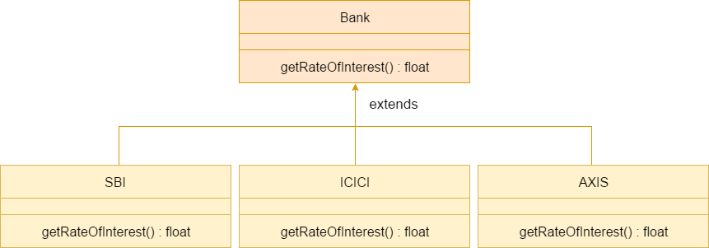
Java Runtime Polymorphism Example: Bank
Consider a scenario where Bank is a class that provides a method to get the rate of interest. However, the rate of interest may differ according to banks. For example, SBI, ICICI, and AXIS banks are providing 8.4%, 7.3%, and 9.7% rate of interest.

Slide 13
class Bank{
float getRateOfInterest(){return 0;}
}
class SBI extends Bank{
float getRateOfInterest(){return 8.4f;}
}
class ICICI extends Bank{
float getRateOfInterest(){return 7.3f;}
}
class AXIS extends Bank{
float getRateOfInterest(){return 9.7f;}
}
class TestPolymorphism{
public static void main(String args[]){
Bank b;
b=new SBI();
System.out.println("SBI Rate of Interest: "+b.getRateOfInterest());
b=new ICICI();
System.out.println("ICICI Rate of Interest: "+b.getRateOfInterest());
b=new AXIS();
System.out.println("AXIS Rate of Interest: "+b.getRateOfInterest());
}
}
Output:
SBI Rate of Interest: 8.4
ICICI Rate of Interest: 7.3
AXIS Rate of Interest: 9.7

Slide 14
Can we override a static method?
No, we cannot override static methods because method overriding is based on dynamic binding at runtime and the static methods are bonded using static binding at compile time. So, we cannot override static methods.
The calling of method depends upon the type of object that calls the static method. It means:
If we call a static method by using the parent class object, the original static method will be called from the parent class.
If we call a static method by using the child class object, the static method of the child class will be called.
In the following example, the ParentClass has a static method named display() and the ChildClass also has the same method signature. The method in the derived class (ChildClass) hides the method in the base class. let's see an example.
//parent class
class ParentClass
{
//we cannot override the display() method
public static void display()
{
System.out.printf("display() method of the parent class.");
}
}

Slide 15
//child class
class ChildClass extends ParentClass
{
//the same method also exists in the ParentClass
//it does not override, actually it is method hiding
public static void display()
{
System.out.println("Overridden static method in Child Class in Java");
}
}
public class OverloadStaticMethodExample3
{
public static void main(String args[])
{
ParentClass pc = new ChildClass();
//calling display() method by parent class object
pc.display();
}
}
Output:
display() method of the parent class.

Slide 16
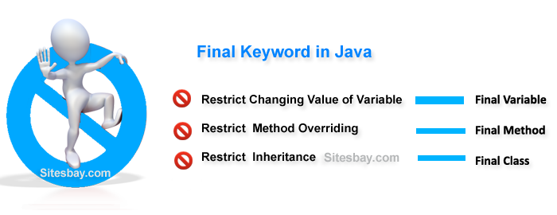
Final keyword in java
It is used to make a variable as a constant, Restrict method overriding, Restrict inheritance. It is used at variable level, method level and class level. In java language final keyword can be used in following way.
Final Keyword at Variable Level
Final Keyword at Method Level
Final Keyword at Class Level

Slide 17
Final at variable level
Final keyword is used to make a variable as a constant. This is similar to const in other language. A variable declared with the final keyword cannot be modified by the program after initialization. This is useful to universal constants, such as "PI".
Final Keyword in java Example
public class Circle
{
public static final double PI=3.14159;
public static void main(String[] args)
{
System.out.println(PI);
}
}

Slide 18
Final Keyword at method level
It makes a method final, meaning that sub classes can not override this method. The compiler checks and gives an error if you try to override the method.
When we want to restrict overriding, then make a method as a final.
Example of final keyword at method level
class Employee
{
final void disp()
{
System.out.println("Hello Good Morning");
}
}
class Developer extends Employee
{
void disp()
{
System.out.println("How are you ?");
}
}
class FinalDemo
{
public static void main(String args[])
{
Developer obj=new Developer();
obj.disp();
}
}
Output
It gives an error

Slide 19
Final Keyword at Class Level
It makes a class final, meaning that the class can not be inheriting by other classes. When we want to restrict inheritance then make class as a final.
Example of final keyword at class level
final class Employee
{
int salary=10000;
}
class Developer extends Employee
{
void show()
{
System.out.println("Hello Good Morning");
}
}
class FinalDemo
{
public static void main(String args[])
{
Developer obj=new Developer();
Developer obj=new Developer();
obj.show();
}
}
Output:
It gives an error

Slide 20
Objective: To understand the concepts of OOPs Properties (Inheritance and Dynamic Polymorphism).
Assignments:
1. Write a Java program to implement the concept of inheritance.
2. Write a Java program to show method overloading.
3. Write a Java program to show method overriding.
4. Create a general class ThreeDObject and derive the classes Box, Cube, Cylinder and Cone from it. The class ThreeDObject has methods wholeSurfaceArea ( ) and volume ( ). Override these two methods in each of the derived classes to calculate the volume and whole surface area of each type of three-dimensional objects. The dimensions of the objects are to be taken from the users and passed through the respective constructors of each derived class. Write a main method to test these classes.
5. Write a program to create a class named Vehicle having protected instance variables regnNumber, speed, color, ownerName and a method showData ( ) to show “This is a vehicle class”. Inherit the Vehicle class into subclasses named Bus and Car having
individual private instance variables routeNumber in Bus and manufacturerName in Car and both of them having showData ( ) method showing all details of Bus and Car respectively with content of the super class’s showData ( ) method.

Slide 21
6. An educational institution maintains a database of its employees. The database is divided into a number of classes whose hierarchical relationships are shown below. Write all the classes and define the methods to create the database and retrieve individual information as and when needed.
Write a driver program to test the classes.
Staff (code, name) Teacher (subject, publication) is a Staff
Officer (grade) is a Staff Typist (speed) is a Staff
RegularTypist (remuneration) is a Typist CasualTypist (daily wages) is a Typist.
7. Create a base class Building that stores the number of floors of a building, number of rooms and it’s total footage. Create a derived class House that inherits Building and also stores the number of bedrooms and bathrooms. Demonstrate the working of the classes.
8. In the earlier program, create a second derived class Office that inherits Building and stores the number of telephones and tables. Now demonstrate the working of all three classes.
9. Write a Java program which creates a base class Num and contains an integer number along with a method shownum() which displays the number. Now create a derived class HexNum which inherits Num and overrides shownum() which displays the hexadecimal value of the number. Demonstrate the working of the classes.
10. Write a Java program which creates a base class Num and contains an integer number along with a method shownum() which displays the number. Now create a derived class OctNum which inherits Num and overrides shownum() which displays the octal value of the number. Demonstrate the working of the classes.

Slide 22
11. Combine Question number 10 and 11 and have all the three classes together. Now describe the working of all classes.
12. Create a base class Distance which stores the distance between two locations in miles and a method travelTime(). The method prints the time taken to cover the distance when the speed is 60 miles per hour. Now in a derived class DistanceMKS, override travelTime() so that it prints the time assuming the distance is in kilometers and the speed is 100 km per second. Demonstrate the working of the classes.
13. Create a base class called “vehicle” that stores number of wheels and speed.
Create the following derived classes –
“car” that inherits “vehicle” and also stores number of passengers.
“truck” that inherits “vehicle” and also stores the load limit.
Write a main function to create objects of these two derived classes and display all
the information about “car” and “truck”. Also compare the speed of these two
vehicles - car and truck and display which one is faster.
14. Write a Java program to explain “multilevel inheritance.”

