Slide 1
Object Oriented Programming using JAVA
Presented By Sudeshna Kundu (Mondal)

Slide 2


Abstraction in Java
Abstraction is the concept of exposing only the required essential characteristics and behavior with respect to a context.
Real Life Example of Abstraction in Java
Abstraction shows only important things to the user and hides the internal details, for example, when we ride a bike, we only know about how to ride bikes but can not know about how it work? And also we do not know the internal functionality of a bike.
Another real life example of Abstraction is ATM Machine; All are performing operations on the ATM machine like cash withdrawal, money transfer, retrieve mini-statement…etc. but we can't know internal details about ATM.
Note: Data abstraction can be used to provide security for the data

Slide 3
Another way, it shows only essential things to the user and hides the internal details, for example, sending SMS where you type the text and send the message. You don't know the internal processing about the message delivery.
Abstraction lets you focus on what the object does instead of how it does it.
Ways to achieve Abstraction
There are two ways to achieve abstraction in java
Abstract class (0 to 100%)
Interface (100%)

Slide 4
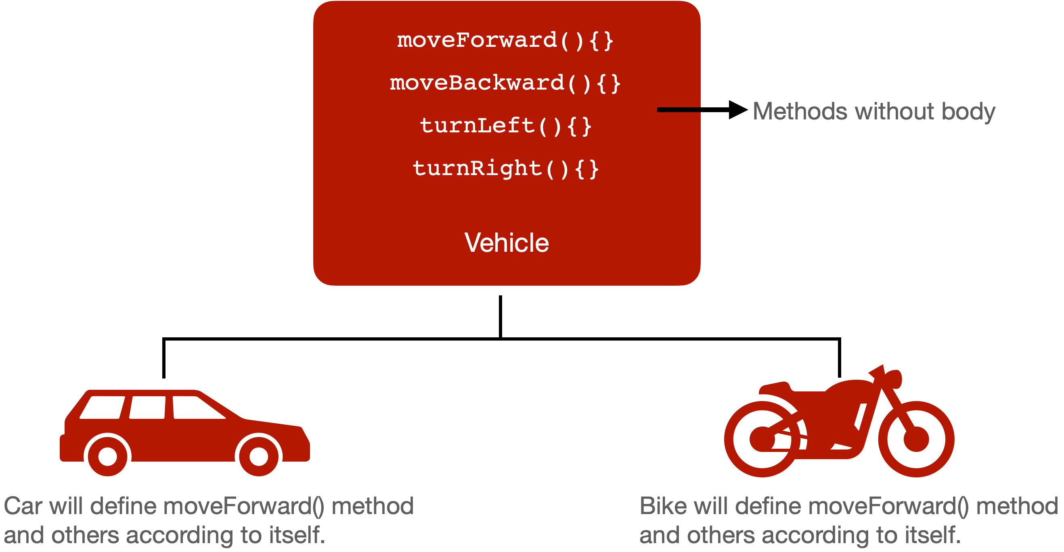
class Vehicle
{
int no_of_tyres;
void start();
}
class Vehicle
{
int no_of_tyres;
abstract void start();
}
class Car
{int no_of_tyres=4;
void start()
{
S.o.p (“Car Started”);
}}
Class MotorCycle
{int no_of_tyres=2;
void start()
{
S.o.p ("MotorCycle Started”);
}}
A method without body (no implementation) is known as abstract method.

Slide 5
abstract class Vehicle
{
int no_of_tyres;
abstract void start();
}
class Car
{int no_of_tyres=4;
void start()
{
S.o.p (“Car Started”);
}}
Class MotorCycle
{int no_of_tyres=2;
void start()
{
S.o.p ("MotorCycle Started”);
}}
A method without body (no implementation) is known as abstract method.
A method must always be declared in an abstract class, or in other words you can say that if a class has an abstract method, it should be declared abstract as well.

Slide 6
abstract class Vehicle
{
int no_of_tyres;
abstract void start();
}
class MotorCycle extends Vehicle
{
int no_of_tyres=2;
void start()
{
System.out.println("MotorCycle Started and tyres="+no_of_tyres);
}
}
class Car extends Vehicle
{
int no_of_tyres=4;
void start()
{
System.out.println("Car Started and tyres="+no_of_tyres);
}
}
If a regular class extends an abstract class, then the class must have to implement all the abstract methods of abstract parent class or it has to be declared abstract as well.

Slide 7
abstract class Vehicle
{
int no_of_tyres;
abstract void start();
}
class MotorCycle extends Vehicle
{
int no_of_tyres=2;
void start()
{
System.out.println("MotorCycle Started and tyres="+no_of_tyres);
}
}
class Car extends Vehicle
{
int no_of_tyres=4;
void start()
{
System.out.println("Car Started and tyres="+no_of_tyres);
}
}
class AbstractMain
{
public static void main(String arg[])
{
Car c = new Car();
c.start();
MotorCycle m = new MotorCycle();
m.start();
}
}
We can't create an object of an abstract class. But we can create a reference variable of an abstract class. The reference variable is used to refer to the objects of derived classes (subclasses of abstract class).

Slide 8
Abstract Method in Java
A method which is declared as abstract and does not have implementation is known as an abstract method.
Example of abstract method
abstract void printStatus();//no method body and abstract
Example of Abstract class that has an abstract method
In this example, Bike is an abstract class that contains only one abstract method run. Its implementation is provided by the Honda class.
Rules of Abstract Method
1. Abstract methods don’t have body, they just have method signature as shown above.
2. If a class has an abstract method it should be declared abstract, the vice versa is not true, which means an abstract class doesn’t need to have an abstract method compulsory.
3. If a regular class extends an abstract class, then the class must have to implement all the abstract methods of abstract parent class or it has to be declared abstract as well.
abstract class Bike{
abstract void run();
}
class Honda4 extends Bike{
void run(){System.out.println("running safely");}
public static void main(String args[]){
Honda4 obj = new Honda4();
obj.run();
}
}
Output:
running safely

Slide 9
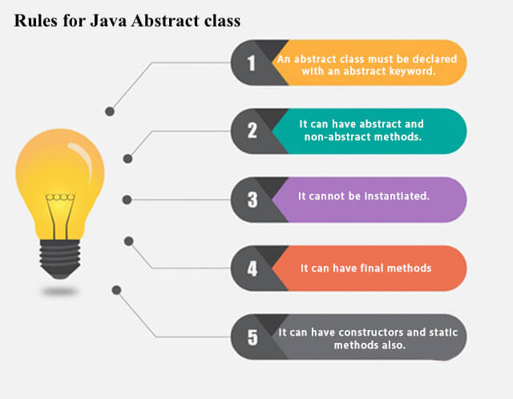
Abstract class in Java
A class which is declared as abstract is known as an abstract class. It can have abstract and non-abstract methods. It needs to be extended and its method implemented. It cannot be instantiated.
Points to Remember
An abstract class must be declared with an abstract keyword.
It can have abstract and non-abstract methods.
It cannot be instantiated.
It can have constructors and static methods also.
It can have final methods which will force the subclass not to change the body of the method.

Slide 10
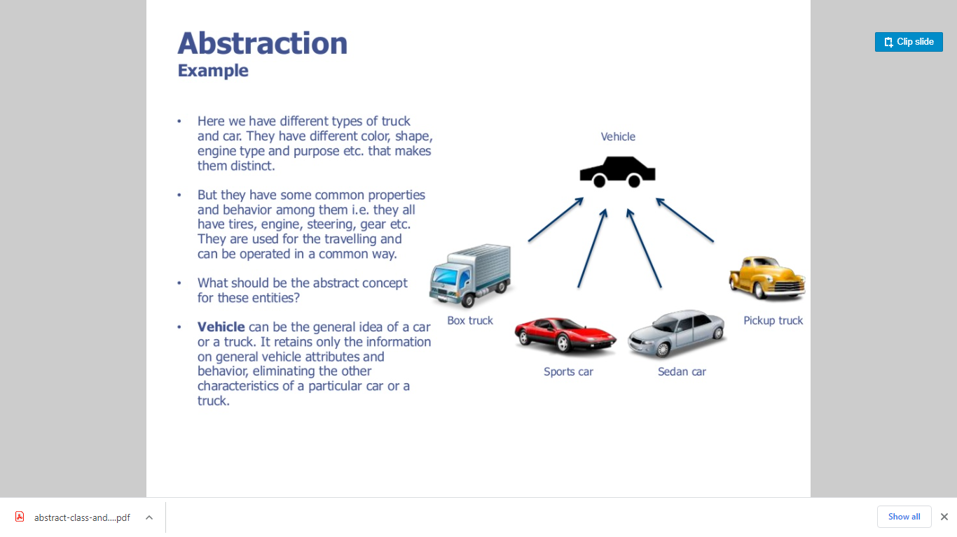

Slide 11
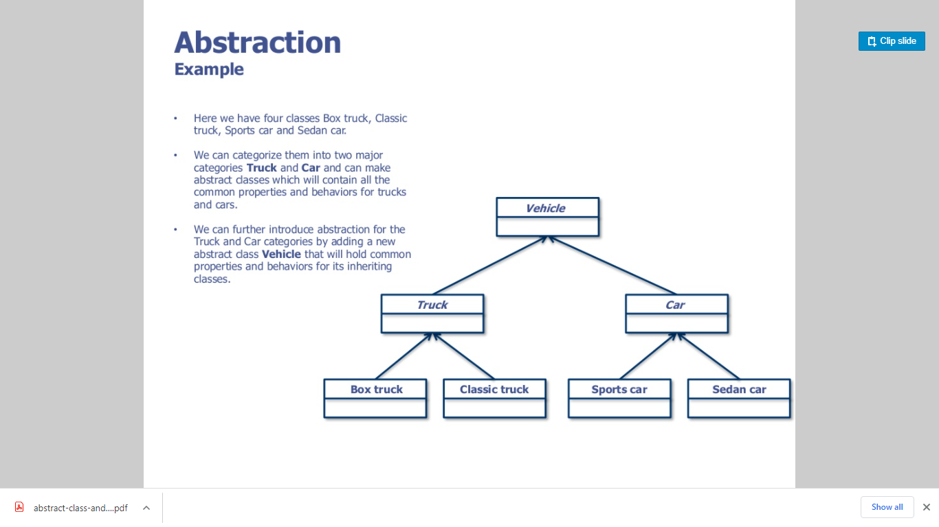

Slide 12
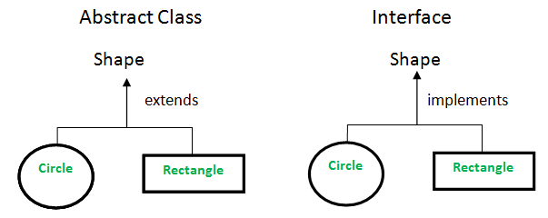
Understanding the real scenario of Abstract class
abstract class Shape{
abstract void draw();
}
//In real scenario, implementation is provided by others i.e. unknown by end user
class Rectangle extends Shape{
void draw(){System.out.println("drawing rectangle");}
}
class Circle1 extends Shape{
void draw(){System.out.println("drawing circle");}
}
//In real scenario, method is called by programmer or user
class TestAbstraction1{
public static void main(String args[]){
Shape s=new Circle1();
s.draw();
}
}
In this example, Shape is the abstract class, and its implementation is provided by the Rectangle and Circle classes.
In this example, if you create the instance of Rectangle class, draw() method of Rectangle class will be invoked.
Output:
drawing circle

Slide 13
Abstract class having constructor, data member and methods
//Example of an abstract class that has abstract and non-abstract methods
abstract class Bike{
Bike(){System.out.println("bike is created");}
abstract void run();
void changeGear(){System.out.println("gear changed");}
}
//Creating a Child class which inherits Abstract class
class Honda extends Bike{
void run(){System.out.println("running safely..");}
}
//Creating a Test class which calls abstract and non-abstract methods
class TestAbstraction2{
public static void main(String args[]){
Bike obj = new Honda();
obj.run();
obj.changeGear();
}
}
An abstract class can have a data member, abstract method, method body (non-abstract method), constructor, and even main() method.
Output:
bike is created
running safely..
gear changed

