Slide 1
Java String

Slide 2
Java String
In Java, string is basically an object that represents sequence of char values. An array of characters works same as Java string. For example:
char[] ch={'j','a','v','a','t','p','o','i','n','t'};
String s=new String(ch);
is same as:
String s="javatpoint";
Java String class provides a lot of methods to perform operations on strings such as compare(), concat(), equals(), split(), length(), replace(), compareTo(), intern(), substring() etc.

Slide 3
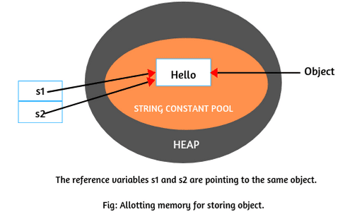
How to create a string object?
There are two ways to create String object:
By string literal
By new keyword
By converting Character Arrays into String
1) String Literal
Java String literal is created by using double quotes. For Example:
String s=“Hello";
Each time you create a string literal, the JVM checks the "string constant pool" first. If the string already exists in the pool, a reference to the pooled instance is returned. If the string doesn't exist in the pool, a new string instance is created and placed in the pool. For example:
String s1="Hello";
String s2="Hello";//It doesn't create a new instance

Slide 4
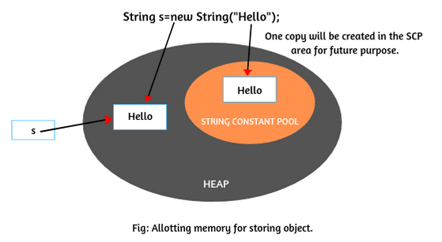
2) By new Keyword
The second way of creating an object to string class is by using new operator. It is just like creating an object of any class. It can be declared as follows:
String s = new String("Hello");
String s1 = new String("Hello");
Whenever we will create an object of string class using the new operator, JVM will create two objects. First, it will create an object in the heap area and store string “Hello” into the object.
After storing data into memory, JVM will point a reference variable s to that object in the heap.
Hello
s1
Now JVM will create the second object as a copy for literal “Hello” in string constant pool for the future purpose. There is no explicit reference variable pointing to the copy object in the pool but internally, JVM maintains the reference variable implicitly.

Slide 5
3) By converting Character Arrays into String
The third way to create strings is by converting the character arrays into string. Let’s take a character type array: arr[ ] with some characters as given below.
char arr[ ] = {'j','a','v','a'};
Now create a string object by passing array name to string constructor like this:
String s = new String(arr);
Now string object ‘s’ contains string “java”. It means that all the characters of the array are copied into string. If you do not want all the characters of the array into string then you can also mention which character you need, like this:
String s = new String(arr, 1,3);
From the above statement, total three characters will be copied into string s. Since the original characters are j-a-v-a. So, the counting will start from 0 i.e 0th character in the array is ‘j’ and the first character is ‘a’. Starting from ‘a’, total of three characters ‘ava’ will copy into string s

Slide 6
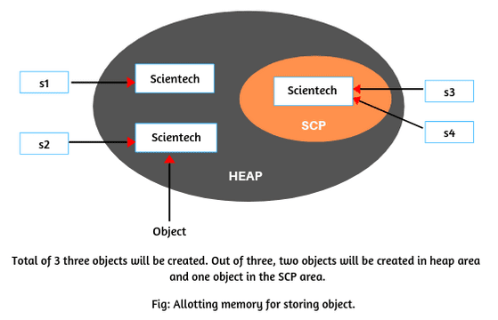
How many total objects will be created in memory for following string objects?
String s1 = new String("Scientech");
String s2 = new String("Scientech");
String s3 = "Scientech";
String s4 = "Scientech";
In the preceding code, we are creating four string objects using two new operators and 2 string literal. How many objects will be created in the heap and SCP area?
1. During the execution of first statement using new operator, JVM will create two objects, one with content in heap area and another as a copy for literal “Scientech” in the SCP area for future purposes as shown in the figure. The reference variable s1 is pointing to the first object in the heap area.

Slide 7

2. When the second statement will be executed, for every new operation, JVM will create again one new object with content “Scientech” in the heap area.
But in the SCP area, no new object for literal will be created by JVM because it is already available in the SCP area. The s2 is pointing to the object in the heap area as shown in the figure.
3. During the execution of third and fourth statements, JVM will not create a new object with content “Scientech” in the SCP area because it is already available in string constant pool. It simply points the reference variables s3 and s4 to the same object in the SCP. They are shown in the above figure.

Slide 8
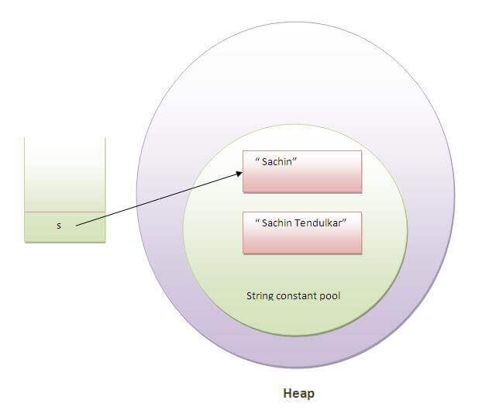
Why String is Immutable in Java?
String class in Java is immutable. The meaning of immutable is unchangeable or unmodifiable. i.e. Once we create a string object with value, you are not allowed to perform any changes in that object.
In other words, you cannot modify the value of the string. But if you try to change with a new value, a new string object will be created by storing a new value.
So, we cannot perform any changes with the existing string object. This non-changeable behavior is nothing but an immutability concept in Java.
Java implements this immutability concept to minimize the duplication of string values that tend to exist many times in any application program.
class Testimmutablestring{
public static void main(String args[]){
String s="Sachin";
s.concat(" Tendulkar");//concat() method appends the string at the end
System.out.println(s);//will print Sachin because strings are immutable objects
}
}
Output:Sachin

Slide 9
Now it can be understood by the diagram given below. Here Sachin is not changed but a new object is created with sachintendulkar. That is why string is known as immutable.
class Testimmutablestring1{
public static void main(String args[]){
String s="Sachin";
s=s.concat(" Tendulkar");
System.out.println(s);
}
}
Output:Sachin Tendulkar
As you can see in the above figure that two objects are created but s reference variable still refers to "Sachin" not to "Sachin Tendulkar".
But if we explicitly assign it to the reference variable, it will refer to "Sachin Tendulkar" object.For example:

Slide 10
Java String compare
We can compare string in java on the basis of content and reference.
It is used in authentication (by equals() method), sorting (by compareTo() method), reference matching (by == operator) etc.
There are three ways to compare string in java:
class Teststringcomparison1{
public static void main(String args[]){
String s1="Sachin";
String s2="Sachin";
String s3=new String("Sachin");
String s4="Saurav";
System.out.println(s1.equals(s2));
System.out.println(s1.equals(s3));
System.out.println(s1.equals(s4));
}
}
Output:
true
true
false
By equals() method
By = = operator
By compareTo() method
1) String compare by equals() method
The String equals() method compares the original content of the string. It compares values of string for equality. String class provides two methods:
public boolean equals(Object another) compares this string to the specified object.
public boolean equalsIgnoreCase(String another) compares this String to another string, ignoring case

Slide 11
Java String compare
class Teststringcomparison2{
public static void main(String args[]){
String s1="Sachin";
String s2="SACHIN";
System.out.println(s1.equals(s2));
System.out.println(s1.equalsIgnoreCase(s2));
}
}
Output:
false
true

Slide 12
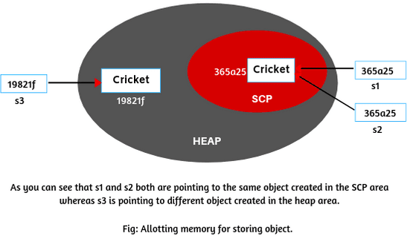
2) String Compare by = = Operator in Java
The = = operator (double equal operator) compares two object references, not characters. i.e, it compares the memory address of object references. If both references are pointing to the same object then it will return true. But if they are pointing to the different objects, it will automatically return false.
public class DoubleEqualOperatorTest
{
public static void main(String args[])
{
String s1 = "Cricket";
String s2 = "Cricket";
String s3 = new String("Cricket");
System.out.println(s1==s2); System.out.println(s1==s3); }
}
Output:
true
false

Slide 13
Explanation of allotting memory for storing objects:
1. Let us take the first statement: String s1 = “Cricket”;
When JVM executes the first statement, it will create an object in the string constant pool and store “Cricket” in it. The reference variable s1 which contains the address of object says 365a25 is allocated to this object in the memory.
2. When the second statement String s2 = “Cricket”; will be executed by JVM, it will search in the SCP area to know whether the object with the same content is already available there or not.
Since the same object is already present in the pool, it will simply create another reference variable s2 and copies the address of reference variable s1 into s2. That’s why s2 will also point to the same object.
3. During the execution of the third statement String s3 = new String(“Cricket”); JVM will create another object in the heap area and allocate another address of the reference variable s3 says 19821f.
Since we know that for every string literal, JVM also creates one copy of the object in the string constant pool. But the object “Cricket” is already available in the pool. Therefore, it will not create another copy of the object.

Slide 14
3) String compare by compareTo() method
The String compareTo() method compares values lexicographically and returns an integer value that describes if first string is less than, equal to or greater than second string.
Suppose s1 and s2 are two string variables. If:
➲ If s1 = = s2, this method returns zero. It means that two strings are equal.
➲ If s1 > s2, +ve value. It means that first string is lexicographically greater than second string.
➲ If s1 < s2, -ve value. It means that first string is lexicographically less than second string.
class Teststringcomparison4{
public static void main(String args[]){
String s1="Sachin";
String s2="Sachin";
String s3="Ratan";
System.out.println(s1.compareTo(s2));//0
System.out.println(s1.compareTo(s3));//1(because s1>s3)
System.out.println(s3.compareTo(s1));//-1(because s3 < s1 )
}
} Output:0
1
-1

Slide 15
String Concatenation in Java
In java, string concatenation forms a new string that is the combination of multiple strings. There are two ways to concat string in java:
By + (string concatenation) operator
By concat() method
1) String Concatenation by + (string concatenation) operator
Java string concatenation operator (+) is used to add strings. For Example:
class TestStringConcatenation1{
public static void main(String args[]){
String s="Sachin"+" Tendulkar";
System.out.println(s);//Sachin Tendulkar
}
}
Output:Sachin Tendulkar

Slide 16
The string concatenation operator can concat not only string but primitive values also. For Example:
class TestStringConcatenation2{
public static void main(String args[]){
String s=50+30+"Sachin"+40+40;
System.out.println(s);//80Sachin4040
}
}
Note: After a string literal, all the + will be treated as string concatenation operator.
2) String Concatenation by concat() method
The String concat() method concatenates the specified string to the end of current string. Syntax:
public String concat(String another)
Let's see the example of String concat() method.
class TestStringConcatenation3{
public static void main(String args[]){
String s1="Sachin ";
String s2="Tendulkar";
String s3=s1.concat(s2);
System.out.println(s3);//Sachin Tendulkar
}
}

Slide 17
Substring in Java
A part of string is called substring. In other words, substring is a subset of another string. In case of substring startIndex is inclusive and endIndex is exclusive.
Note: Index starts from 0.
You can get substring from the given string object by one of the two methods:
public String substring(int startIndex): This method returns new String object containing the substring of the given string from specified startIndex (inclusive).
public String substring(int startIndex, int endIndex): This method returns new String object containing the substring of the given string from specified startIndex to endIndex.
In case of string:
startIndex: inclusive
endIndex: exclusive
public class TestSubstring{
public static void main(String args[]){
String s="SachinTendulkar";
System.out.println(s.substring(6));//Tendulkar
System.out.println(s.substring(0,6));//Sachin
}
}

Slide 18
Java String class methods
Java String toUpperCase() and toLowerCase() method
The java string toUpperCase() method converts this string into uppercase letter and string toLowerCase() method into lowercase letter.
String s="Sachin";
System.out.println(s.toUpperCase());//SACHIN
System.out.println(s.toLowerCase());//sachin
System.out.println(s);//Sachin(no change in original)
Java String charAt() method
The string charAt() method returns a character at specified index.
String s="Sachin";
System.out.println(s.charAt(0));//S
System.out.println(s.charAt(3));//h
Java String trim() method
The string trim() method eliminates white spaces before and after string.
String s=" Sachin ";
System.out.println(s);// Sachin
System.out.println(s.trim());//Sachin
Java String length() method
The string length() method returns length of the string.
String s="Sachin";
System.out.println(s.length());//6

Slide 19
Java String class methods
Java String valueOf() method
The string valueOf() method coverts given type such as int, long, float, double, boolean, char and char array into string.
int a=10;
String s=String.valueOf(a);
System.out.println(s+10); //1010
Java String replace() method
The string replace() method replaces all occurrence of first sequence of character with second sequence of character.
String s1="Java is a programming language. Java is a platform. Java is an Island.";
String replaceString=s1.replace("Java","Kava");//replaces all occurrences of "Java" to "Kava"
System.out.println(replaceString); // Kava is a programming language. Kava is a platform. Kava is an Island.

Slide 20
Java String toCharArray()
The java string toCharArray() method converts this string into character array. It returns a newly created character array, its length is similar to this string and its contents are initialized with the characters of this string.
public class StringToCharArrayExample{
public static void main(String args[]){
String s1="hello";
char[] ch=s1.toCharArray();
for(int i=0;i<ch.length;i++){
System.out.print(ch[i]);
}
}}

Slide 21
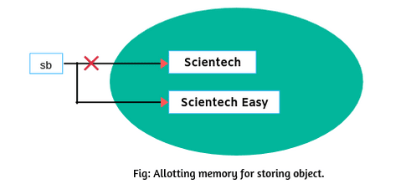
StringBuffer class in Java
class MutableStringEx
{
public static void main(String[] args)
{
StringBuffer sb=new StringBuffer("Scientech");
sb.append(" Easy");
System.out.println(sb);
}
}
Java StringBuffer class is used to create mutable (modifiable) string. The StringBuffer class in java is same as String class except it is mutable i.e. it can be changed.
1) StringBuffer append() method
The append() method concatenates the given argument with this string.
As you can see that in the above figure no new object is created to add “Easy”. It is appended in the existing object because we can perform any required changes in the object when you create a StringBuffer object. This changeable behavior is nothing but mutability. The old object by default will be removed by garbage collector.

Slide 22
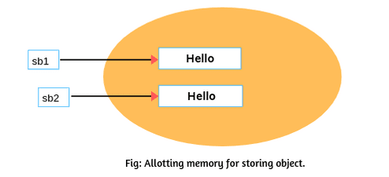
class MutableStringEx
{
public static void main(String[] args)
{ StringBuffer sb1=new StringBuffer("Scientech");
StringBuffer sb2=new StringBuffer("Scientech");
System.out.println(sb1.equals(sb2));
System.out.println(sb1==sb2); }
}
Whenever we create a string buffer object using the new operator, compulsory a new object will be created in the heap area with content “Hello”. Therefore, JVM will create two objects with content “Hello” and the reference variable sb1 and sb2 are pointing to both objects respectively. Output Explanation: 1. (sb1==sb2); will return false because both references are pointing to the different objects as shown in the above figure. 2. sb1.equals(sb2); will return false because in the case of StringBuffer, equals() method compare the content based on reference (i.e. address). Both references are pointing to different objects.

Slide 23
2) StringBuffer insert() method
The insert() method inserts the given string with this string at the given position.
class StringBufferExample2{
public static void main(String args[]){
StringBuffer sb=new StringBuffer("Hello ");
sb.insert(1,"Java");//now original string is changed
System.out.println(sb);//prints HJavaello
}
}
4) StringBuffer delete() method
The delete() method of StringBuffer class deletes the string from the specified beginIndex to endIndex.
class StringBufferExample4{
public static void main(String args[]){
StringBuffer sb=new StringBuffer("Hello");
sb.delete(1,3);
System.out.println(sb);//prints Hlo
}
}
5) StringBuffer reverse() method
The reverse() method of StringBuilder class reverses the current string.
class StringBufferExample5{
public static void main(String args[]){
StringBuffer sb=new StringBuffer("Hello");
sb.reverse();
System.out.println(sb);//prints olleH
}
}
3) StringBuffer replace() method
The replace() method replaces the given string from the specified beginIndex and endIndex.
class StringBufferExample3{
public static void main(String args[]){
StringBuffer sb=new StringBuffer("Hello");
sb.replace(1,3,"Java");
System.out.println(sb);//prints HJavalo
}
}

Slide 24
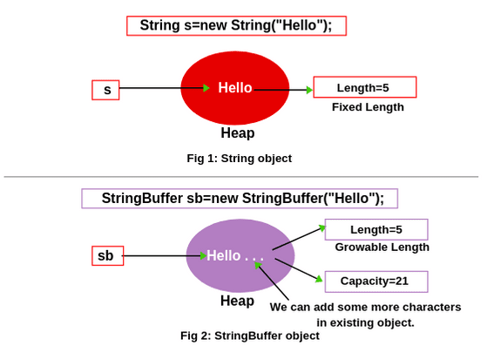
StringBuffer class in Java
In the above fig 1, we have created a string object with content “Hello”. We have already learned that once we create a string object with content, there is no chance to change its content because the string object is immutable. That means if we cannot change its content, the length of content “Hello” is fixed i.e. 5 and its capacity is also 5 because we cannot add new characters. Therefore, in the string, the terminology length and capacity both are the same. So, string never uses the terminology “capacity”.
But in the case of StringBuffer, there is a small difference between length and capacity.
Capacity: The total number of characters hold in the StringBuffer object is called capacity.
Length: The number of characters already present in the StringBuffer object is called length.

Slide 25
In fig 2, we have created a StringBuffer object with the same content. So, in the case of StringBuffer, the length of the content “Hello” is also 5. But is it possible to add some more characters in the existing object or not? Yes, we can add characters in the existing object only because the capacity of StringBuffer is not full. So, here capacity is not 5. Let’s understand them with a real-time example.
Real-time Example:
Assume that there is a classroom. In the classroom, the capacity of classroom is 100. i.e. the total number of students can sit in the classroom is 100. But currently, only 20 students are there. So, many seats are vacant. If the classroom is considered as StringBuffer, length is 20 and capacity is 100. We can add 80 more students in the classroom. That means we can add 80 characters more in the existing object. Hope you will have understood these terminologies clearly in the case of StringBuffer. Now let’s move to the main topic StringBuffer constructors.
Java StringBuffer class is used to create mutable (modifiable) string. The StringBuffer class in java is same as String class except it is mutable i.e. it can be changed.
class StringBufferExample{
public static void main(String args[]){
StringBuffer sb=new StringBuffer("Hello ");
sb.append("Java");//now original string is changed
System.out.println(sb);//prints Hello Java
}
}
1) StringBuffer append() method
The append() method concatenates the given argument with this string.

Slide 26
6) StringBuffer capacity() method
The capacity() method of StringBuffer class returns the current capacity of the buffer. The default capacity of the buffer is 16. If the number of character increases from its current capacity, it increases the capacity by (oldcapacity*2)+2. For example if your current capacity is 16, it will be (16*2)+2=34.
class StringBufferExample6{
public static void main(String args[]){
StringBuffer sb=new StringBuffer();
System.out.println(sb.capacity());//default 16
sb.append("Hello");
System.out.println(sb.capacity());//now 16
sb.append("java is my favourite language");
System.out.println(sb.capacity());//now (16*2)+2=34 i.e (oldcapacity*2)+2
}
}
7) StringBuffer ensureCapacity() method
The ensureCapacity() method of StringBuffer class ensures that the given capacity is the minimum to the current capacity. If it is greater than the current capacity, it increases the capacity by (oldcapacity*2)+2. For example if your current capacity is 16, it will be (16*2)+2=34.
class StringBufferExample7{
public static void main(String args[]){
StringBuffer sb=new StringBuffer();
System.out.println(sb.capacity());//default 16
sb.append("Hello");
System.out.println(sb.capacity());//now 16
sb.append("java is my favourite language");
System.out.println(sb.capacity());//now (16*2)+2=34 i.e (oldcapacity*2)+2
sb.ensureCapacity(10);//now no change
System.out.println(sb.capacity());//now 34
sb.ensureCapacity(50);//now (34*2)+2
System.out.println(sb.capacity());//now 70
}
}

Slide 27
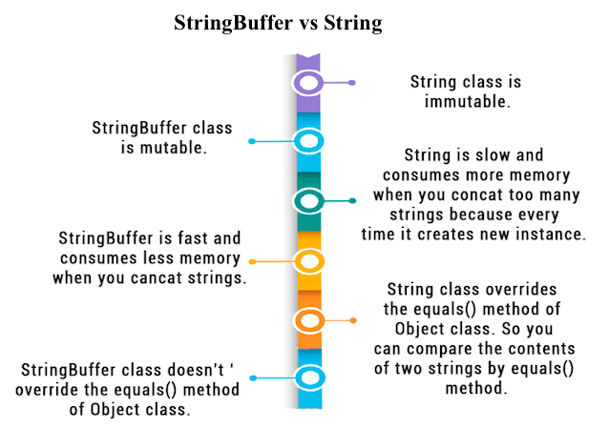

Slide 28
Assignments:
Write a Java program for calculating Factorial. Number should be taken through user input (Using Scanner
Design a palindrome class that will input a string from console and check whether the string is palindrome or not.
3. Write a Java program to merge two strings.
4. Write a Java program for reverse a string. (String will be taken as user input through console).
5. Write a Java Program to Concatenate Two Strings.
6. Write a Java Program to check if a Given String is getChar from Specific Index.
7. Write a Java Program to Find the Length of the String.
8. Write a Java Program to Find All Possible Subsets of given Length in String.
9. Write a Java Program to Remove the White Spaces from a String.
10. Write a Java Program to Compare two Strings.
11. Write a Java Program to Compare Performance of Two Strings.
12. Write a Java Program to Use Equals Method In a String Class.
13. Write a Java Program to Use EqualsIgnoreCase Method In a String Class.
14. Write a Java Program to Use compareTo Method In a String Class.
15. With a Java Program to Use compareToIgnoreCase Method In a String Class.
16. Write a Java Program to Replace Character or String.
17. Write a Java Program to Search Last Occurance of a Substring Inside a Substring.
18. Write a Java Program to Remove a Particular Character from a String.
19. Write a Java Program to Replace a Substring Inside a String by Another One.
20. Write a Java Program to Reverse a String.
21. Write a Java Program to Search a Word Inside a String.
22. Write a Java Program to Split a String into a Number of Substrings.
23. Write a Java Program to Search a Particular Word in a String.
24. Write a Java Program to Replace All Occurings of a String.

Slide 29
25. Write a Java Program to Make First Character of Each Word in Uppercase.
26. Write a Java Program to Delete All Repeated Words in String.
27. Write a Java Program to Reverse the String Using Both Recursion and Iteration.
28. Write a Java Program to Convert a String Totally into Upper Case.
29. Write a Java Program to Remove all Characters in Second String which are Present in First String.
30. Write a Java Program to Find the Consecutive Occurrence of any Vowel in a String.
31. Write a Java Program to Find the Largest & Smallest Word in a String.
32. Write a Java Program to Find First and Last Occurrence of Given Character in a String.
33. Write a Java Program to Display the Characters in Prime Position a Given String.
34. Write a Java Program to Sort String Ignoring Whitespaces and Repeating Characters Only Once.
35. Write a Java Program to Count Replace First Occurrence of a String.
36. Write a Java Program to Know the Last Index of a Particular Word in a String.
37. Write a Java Program to Access the Index of the Character or String.
38. Write a Java Program to Access the Characters or the ASCII of the Character Available in the String.
39. Write a Java Program to Display the Character and the Corresponding ASCII Present in the String.
40. Write a Java Program to Accept 2 String & Check Whether all Characters in First String is Present in Second String & Print.
41. Write a Java Program to Check whether a Given Character is Present in a String, Find Frequency & Position of Occurrence.
42. Write a Java Program to Count the Number of Occurrence of Each Character Ignoring the Case of Alphabets & Display them.
43. Write a Java Program to Give Shortest Sequence of Character Insertions and Deletions that Turn One String Into the Other.
44. Write a Java Program to Check Whether Date is in Proper Format or Not.
45. Write a Java Program to Validate an Email Address Format.
46. Write a Java Program to Store String Literals Using String Buffer.
47. Write a Java Program to Verify a Class is StringBuffer Class Method.
48. Write a Java Program to Ask the User His Name and Greets Him With His Name.
49. Write a Java Program to Count a Group of Words in a String.
50. Write a Java Program to Count Number of Words in a given Text or Sentence.

