Slide 1
INTRODUCTION
In java, programmers can create several classes & Interface. After creating these classes and interface, it is better if they are divided into some groups depending on their relationship. Thus, the classes and interface which handle similar or same task are put into the same directory or folder, which is also known as package.
Packages act as “containers” for classes. A package represents a directory that contain related group of classes & interface.

Slide 2
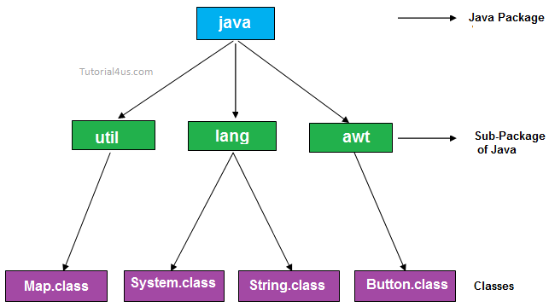
Purpose of package
The purpose of package concept is to provide common classes and interfaces for any program separately. In other words if we want to develop any class or interface which is common for most of the java programs than such common classes and interfaces must be place in a package.

Slide 3
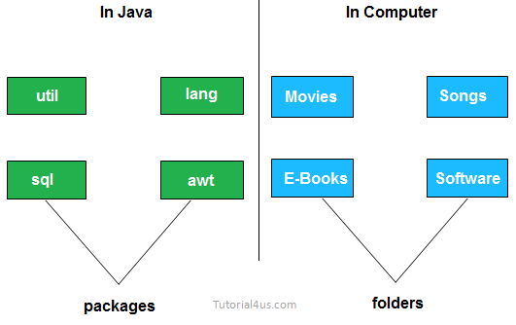
Packages in Java are the way to organize files when a project has many modules. Same like we organized our files in Computer. For example we store all movies in one folder and songs in other folder, here also we store same type of files in a particular package for example in awt package have all classes and interfaces for design GUI components.

Slide 4
Advantage of package
Package is used to categorize the classes and interfaces so that they can be easily maintained
Application development time is less, because reuse the code
Application memory space is less (main memory)
Application execution time is less
Application performance is enhance (improve)
Redundancy (repetition) of code is minimized
Package provides access protection.
Package removes naming collision.

Slide 5
TYPES OF PACKAGES
There are basically only 2 types of java packages. They are as follow :
System Packages or Java API
User Defined Packages.

Slide 6
SYSTEM PACKAGES OR JAVA API
As there are built in methods , java also provides inbuilt packages which contain lots of classes & interfaces. These classes inside the packages are already defined & we can use them by importing relevant package in our program.
Java has an extensive library of packages, a programmer need not think about logic for doing any task. For everything, there are the methods available in java and that method can be used by the programmer without developing the logic on his own. This makes the programming easy.

Slide 7
JAVA SYSTEM PACKAGES & THEIR CLASSES
java.lang
Language Support classes. These are classes that java compiler itself uses & therefore they are automatically imported. They include classes for primitive types, strings, maths function, threads &exception.
java .util
Language Utility classes such as vector, hash tables random numbers, date etc.
java.io
Input /Output support classes. They provide facilities for the input & output of data
java.awt
Set of classes for implementing graphical user interface. They include
classes for windows, buttons, list, menus & so on.
java.net
Classes for networking. They include classes for communicating with local computers as well as with internet servers.
java.applet
Classes for creating & implementing applets.

Slide 8

2. USER DEFINED PACKAGES :
The users of the Java language can also create their own packages. They are called user-defined packages. User defined packages can also be imported into other classes & used exactly in the same way as the Built in packages.
i) Creating User Defined Packages
Syntax :
package packageName;
public class className
{
- - - - - - - - - - - - -
// Body of className
- - - - - - - - - - - -
}
We must first declare the name of the package using the package keyword followed by the package name. This must be the first statement in a Java source file. Then define a classes as normally as define a class.

Slide 9
Example :
package myPackage;
public class class1
{
- - - - - - - - - - - - -
// Body of class1
}
In the above example, myPackage is the name of the package. The class class1 is now considered as a part of this package.
This listing would be saved as a file called class1.java & located in a directory named mypackage. When the source file is compiled, java will create a .class file & store it in the same directory.
The .class files must be located in a directory that has the same name as the package & this directory should be a subdirectory of the directory where classes that will import the package are located.

Slide 10

STEPS FOR CREATING PACKAGE :
To create a user defined package the following steps
should be involved :-
1: Declare the package at the beginning of a file using the syntax :-
package packageName;
2: Define the class that is to be put in the package & declare it public.
3: Create a subdirectory under the directory where the main source files are stored.
4: Store the listing as the classname.java file in the subdirectory created.
5: Compile the file. This create .class file in the subdirectory.

Slide 11
Java also supports the concept of package hierarchy. This is done by specifying multiple names in a package statement, seprated by dots (.).
Ex :- package firstPackage.secondPackage;
This approach allows us to group related classes into a package and their group related package into a larger package. Store this package in a subdirectory named firstpackage/secondPackage.
A java package file can have more than one class definition. In such cases, only one of the classes may be declared public & that class name with .java extension is the source file name. When a source file with more than one class definition is compiled, java creates independent
.class files for those classes.

Slide 12
ACCESSING A PACKAGE
Java package can be accessed either using a fully qualified class name or using a shortcut approach through the import statement.
Syntax :
import package1[.package2][.package3].classname;
Here, package1 is the name of the top level package, package2 is the name of the package that is inside the package & so on. We can have any number of packages in a package hierarchy. Finally the explicit classname is specified. The import statement must end with a semicolon (;). The import startment should appear before any class definitions in a source file. Multiple import statements are allowed.
Ex :
import firstpackage.secondPackage.Myclass;
or
import firstpackage.*;

Slide 13

ADVANTAGES OF PACKAGES
There are several advantages of package some of them are as follow :-
1: Packages are useful to arrange related classes and interface into a group.This makes all the classes & interface performing the same task to put together in the same package.
2: Packages hide the classes & interfaces in a seprate subdirectory, so that accidental deletion of classes & interfaces will not take place.
3: The classes & interfaces of a packages are isolated form the classes & interfaces of another packages. This means that we can use same names for classes of two different classes.
4: A group of packages is called a library. The classes & interface of a package are like books in a library & can be reused several times. This reusability nature of packages makes programming easy.

Slide 14




