Slide 1
Object Oriented Programming using JAVA Paper code: PCC – CS481
Presented By
Sudeshna Kundu (Mondal)
Mobile No. : 9564842816

Slide 2
Difference between JDK, JRE and JVM
JVM
JVM (Java Virtual Machine) is an abstract machine. It is a specification that provides runtime environment in which java bytecode can be executed.
JVMs are available for many hardware and software platforms. JVM, JRE and JDK are platform dependent because configuration of each OS differs. But, Java is platform independent.
The JVM performs following main tasks:
Loads code
Verifies code
Executes code
Provides runtime environment

Slide 3
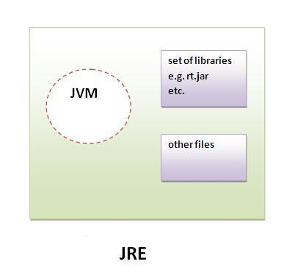
Difference between JDK, JRE and JVM
JRE
JRE is an acronym for Java Runtime Environment.
It is used to provide runtime environment. It is the implementation of JVM.
It physically exists. It contains set of libraries + other files that JVM uses at runtime.

Slide 4
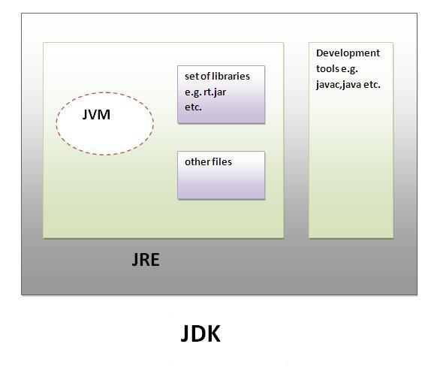
Difference between JDK, JRE and JVM
JDK
JDK is an acronym for Java Development Kit. It physically exists. It contains JRE + development tools.

Slide 5
First JAVA Program
class Hello {
public static void main(String[] args) {
System.out.println(“Hello World !!!”);
}
}
To write the simple program, open notepad by start menu -> All Programs -> Accessories -> notepad and write simple program and save it as Hello.java.
To compile and run this program, you need to open command prompt by start menu -> All Programs -> Accessories -> command prompt.

Slide 6
First JAVA Program
Hello.java
class Hello {
public static void main(String[] args) {
System.out.println(“Hello World !!!”); }
}
C:\javac Hello.java
C:\java Hello
( compilation creates Hello.class )
(Execution on the local JVM)

Slide 7
First JAVA Program
class Hello {
public static void main(String[] args) {
System.out.println(“Hello World !!!”);
}
}
class keyword is used to declare a class in java.
public keyword is an access modifier which represents visibility, it means it is visible to all.
static is a keyword, if we declare any method as static, it is known as static method. The core advantage of static method is that there is no need to create object to invoke the static method. The main method is executed by the JVM, so it doesn't require to create object to invoke the main method. So it saves memory.
void is the return type of the method, it means it doesn't return any value.
main represents startup of the program.
String[] args is used for command line argument.
System.out.println() is used print statement.

Slide 8
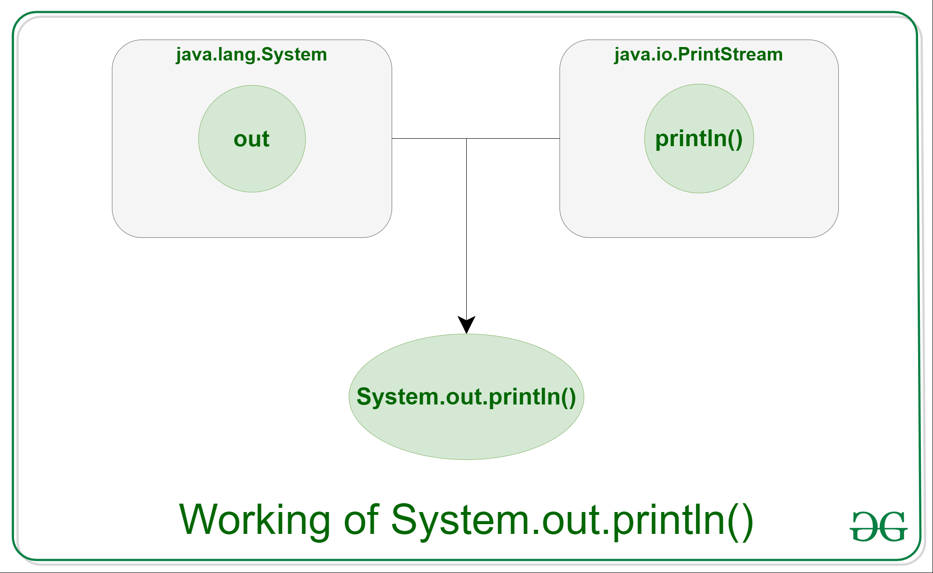
System.out.println in Java
Java System.out.println() is used to print an argument that is passed to it. The statement can be broken into 3 parts which can be understood separately as:
System: It is a final class defined in the java.lang package.
out: This is an instance of PrintStream type, which is a public and static member field of the System class.
println(): As all instances of PrintStream class have a public method println(), hence we can invoke the same on out as well. This is an upgraded version of print(). It prints any argument passed to it and adds a new line to the output. We can assume that System.out represents the Standard Output Stream.

Slide 9
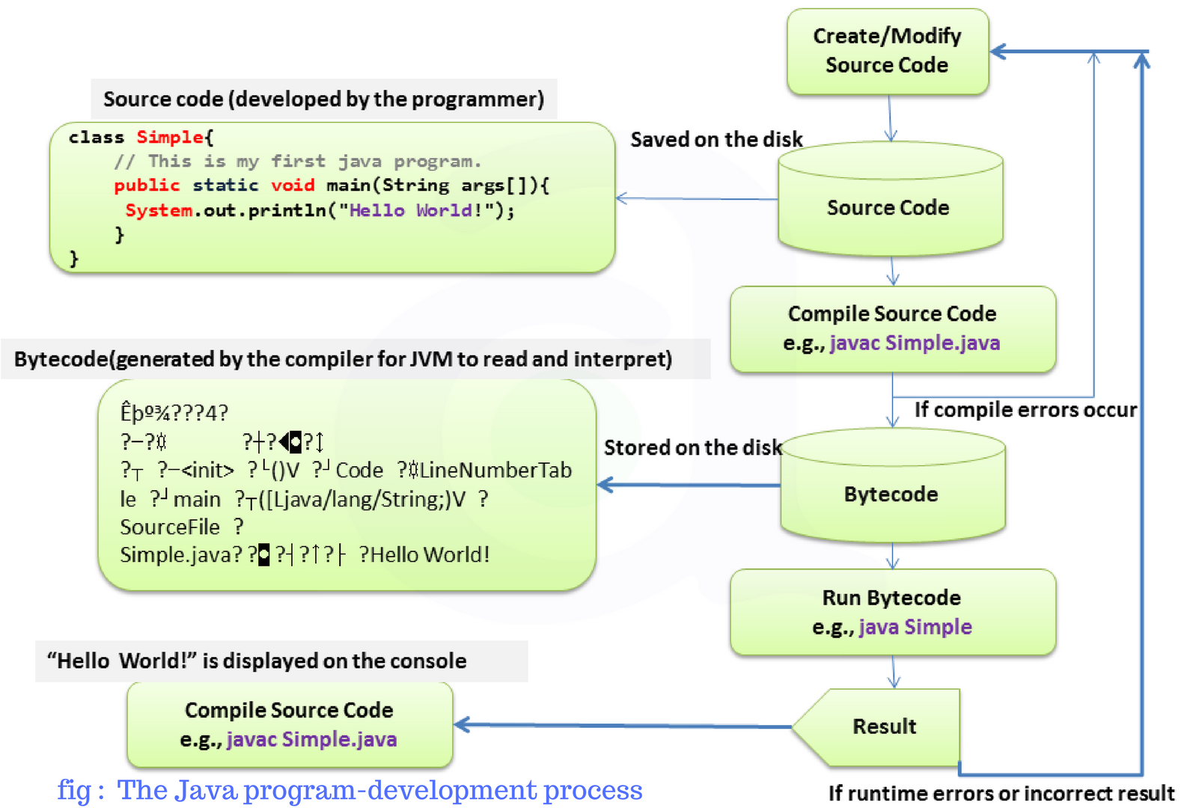

Slide 10
THANK YOU

