Slide 1
“Voice Assistant”
Group – 4
04- Aniket Bichare 12- Ajinkya Deshmukh 18- Sachin Gajalwad 21- Kiran Gunjal
24- Shubham Hingade
Guided By -
Prof. Salapurkar Deepali
Department of IT and MCA Vishwakarma Institute of technology Bibwewadi, Pune-411037.

Slide 2
OBJECTIVE
Creating a system that can be control by using voice commands
Using the technology, the device synthesises the user's message, breaks it down, evaluates it, and offers a meaningful response in return.
In this system we can perform various type of task by using voice commands. Creating a system that can be control by using voice commands

Slide 3
EXISTING SYSTEM
In the Existing System we can perform various tasks by using input devices as like mouse, keyboard, etc.
We need to interact physically with the system.
Some time it is difficult to interact physically with the system as well as a person with physical disability it is difficult to physically interact with the system

Slide 4
PROPOSED SYSTEM
Provide the voice input to the system throw microphone analyze that voice & perform the task as per the command
We can give voice to perform specific task & the result will be displayed on the screen.
The physical interaction is less required as compared to the existing system

Slide 5
Opening Application
Searching for web site
Playing music
Telling News
Modules

Slide 6
Modules
Audio Visualization
Reading/Writing
Chat Bot
Search in Website

Slide 7
Module Specification
Audio Visualization
Using this module, we can Show getting audio by the system in the bar/graphical view.
Reading/Writing
Using this module, we can read any file with our system, we can read the copied clipboard text. We can write the word file or the text file using our audio/ voice command
Chat Bot
Using this module, answer the user’s question with the machine learning

Slide 8
Working in Website
This is updated version of previous program module; in previous program module we can search only for website not on the website using this module we can search any specific page of the web site
E. g. Open YouTube Subscription

Slide 9
Hardware & Software
Hardware Software Technology Used
• 4 GB Ram • Windows 10 • Python
• 256 GB hard disk • Python • PyQt5
• Microphone • Visual Studio • pygame
Module Specification
➢ Audio Visualization
➢ Reading and Writing
➢ Chat-bot
➢ Search in the Website

Slide 10
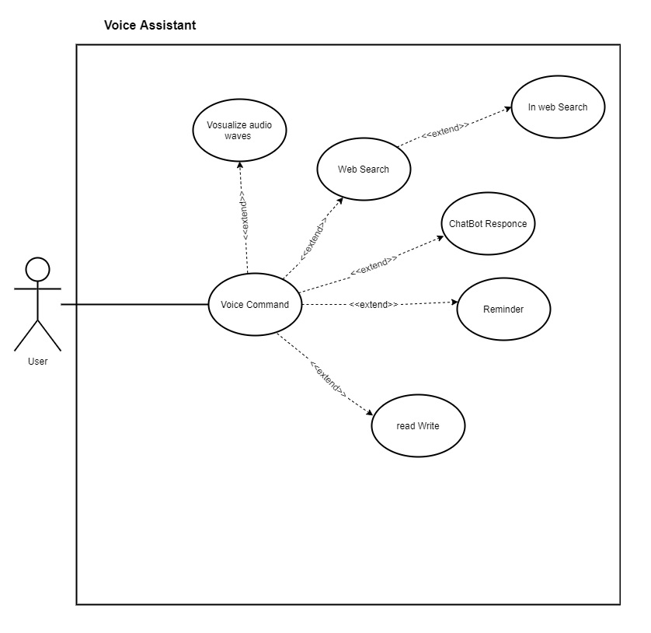
Use Case Diagram

Slide 11
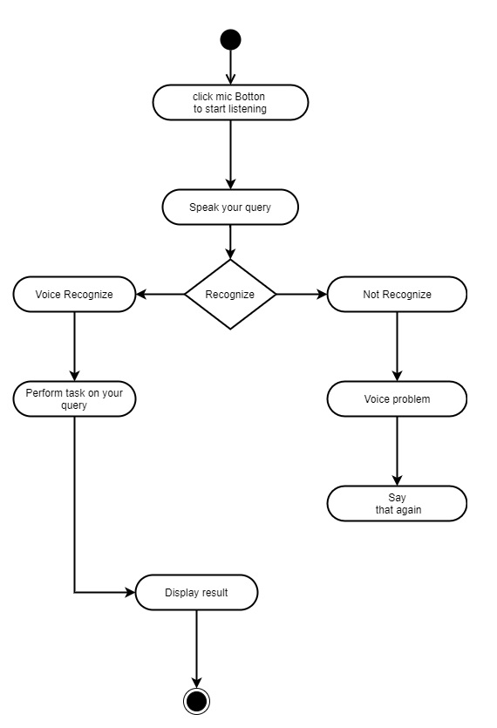
Activity Diagram

Slide 12
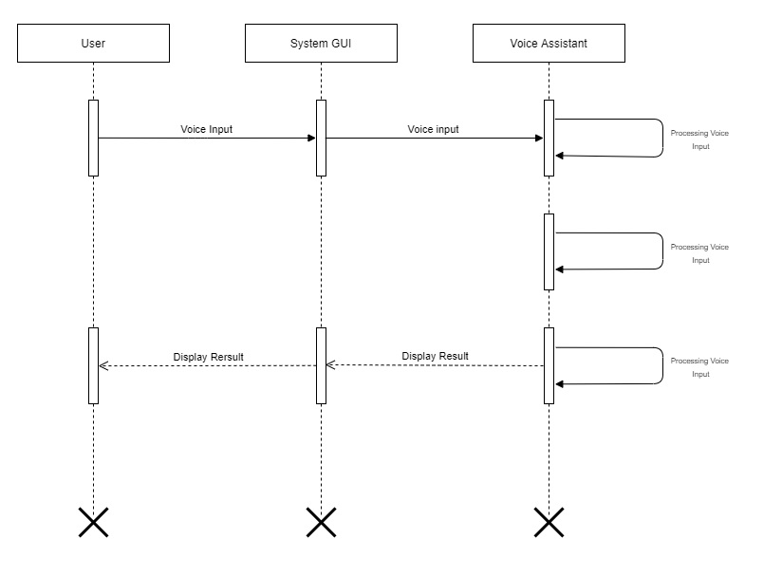
Sequence Diagram

Slide 13
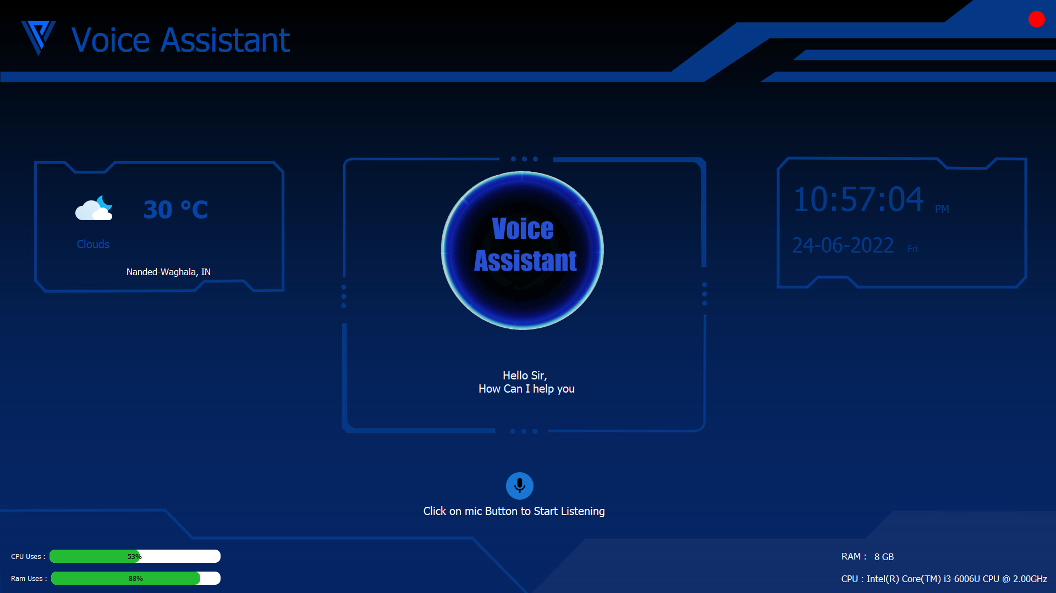
ScreenShots

Slide 14
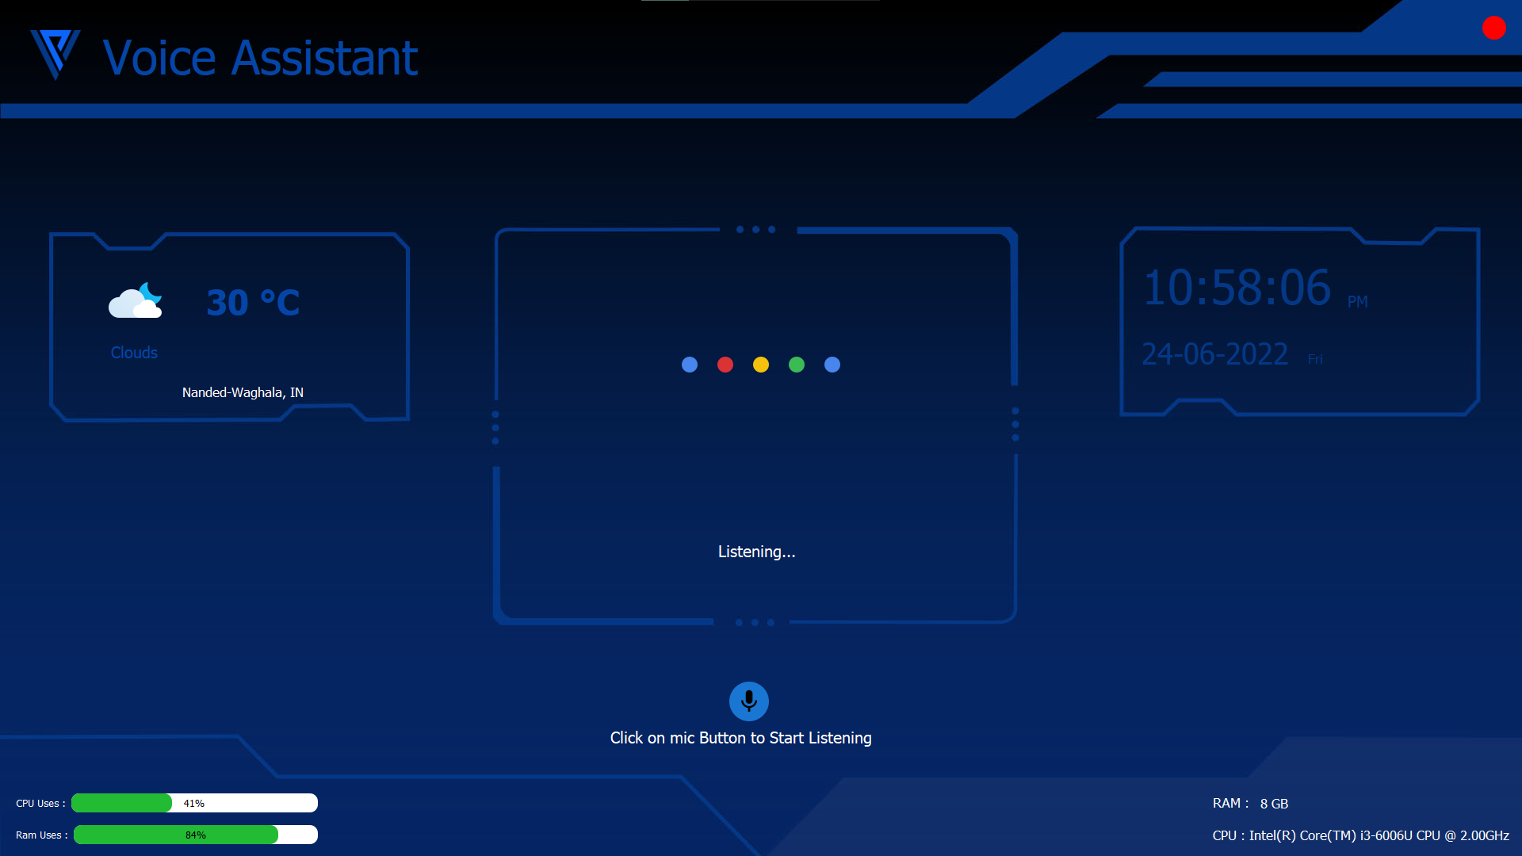

Slide 15
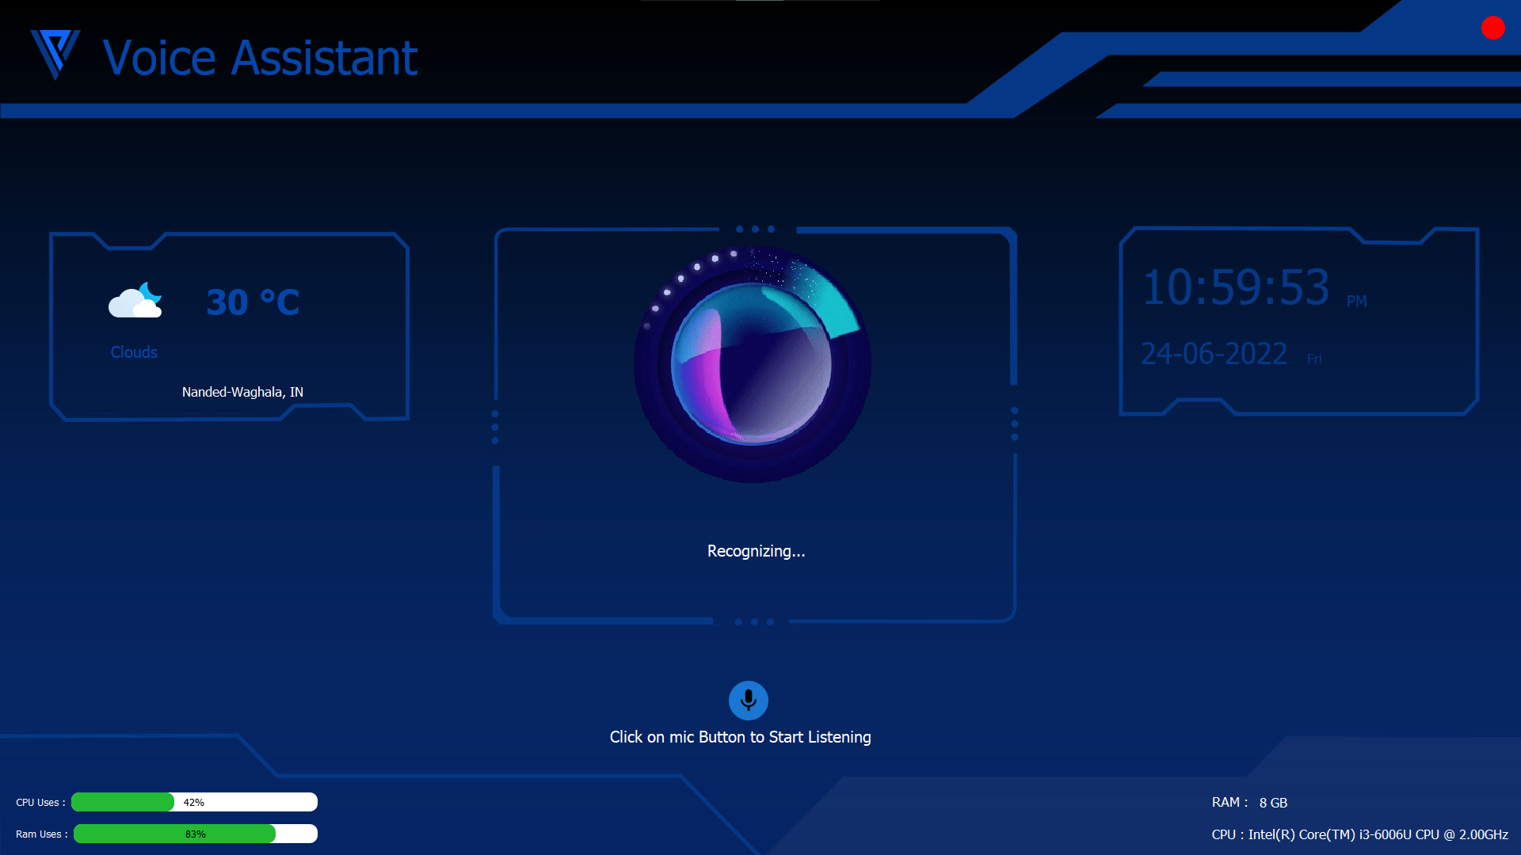

Slide 16
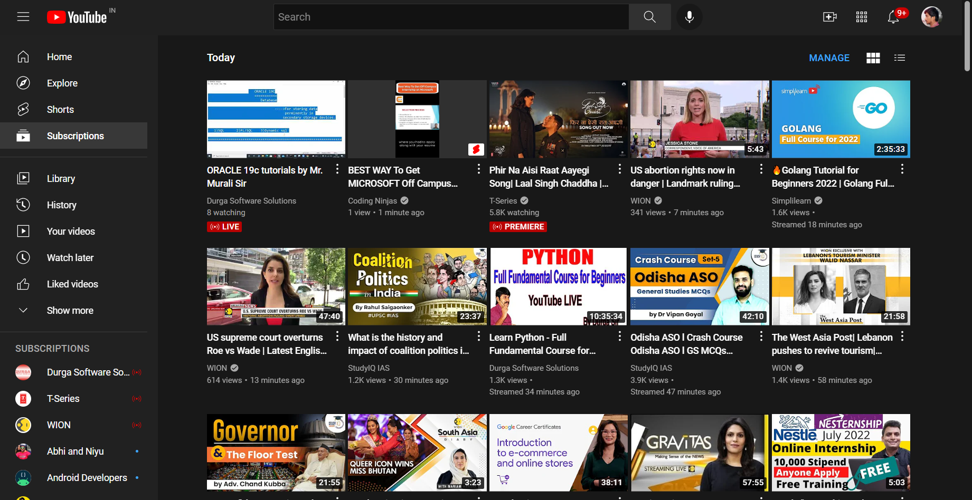

Slide 17
Conclusion
This system is designed in such a way that can understood by any of the user it is easy to understand we can perform any type of task by using voice commands. To perform a task, we need to give the voice commands.
Following are the conclusions can be deducted from the development of the project
Open Applications
Open Websites
Send Emails
et news
Play music

Slide 18
THANK YOU !

