Slide 1

Introduction
The word geospatial is composed of two distinct terms. Geo means Earth, and Spatial means relating to or occupying space.
GeoPandas is a popular library used to analyze and work with geospatial data in Python.

Slide 2
GeoPandas is a widely used open-source library for working and manipulating geospatial data in Python.
It extends the functionalities of a pandas’ DataFrame, thereby making it possible to handle spatial data within pandas .
GeoPandas combines the power of pandas with Shapley.
Shapley is a Python package for manipulation and analyzing geometric objects in the Cartesian plane.

Slide 3
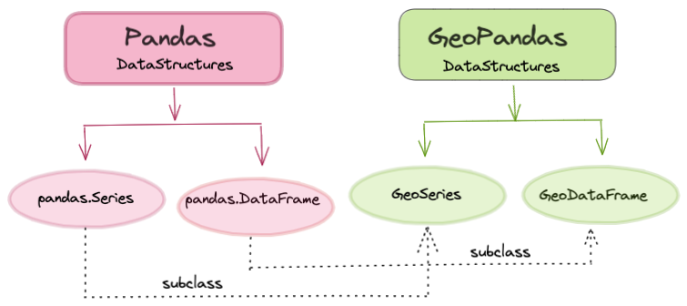
GeoPandas builds up on Pandas library

Slide 4
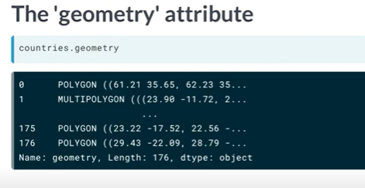
Attribute

Slide 5
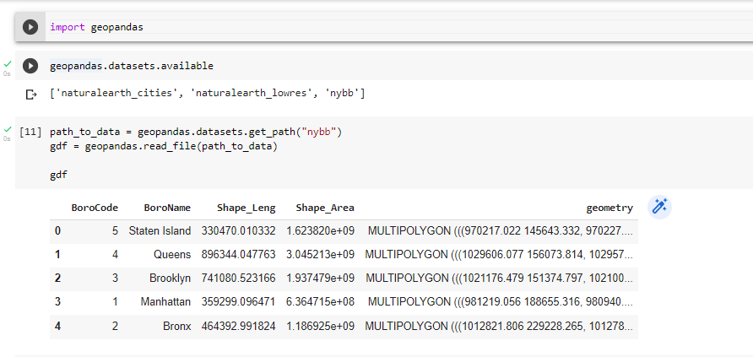
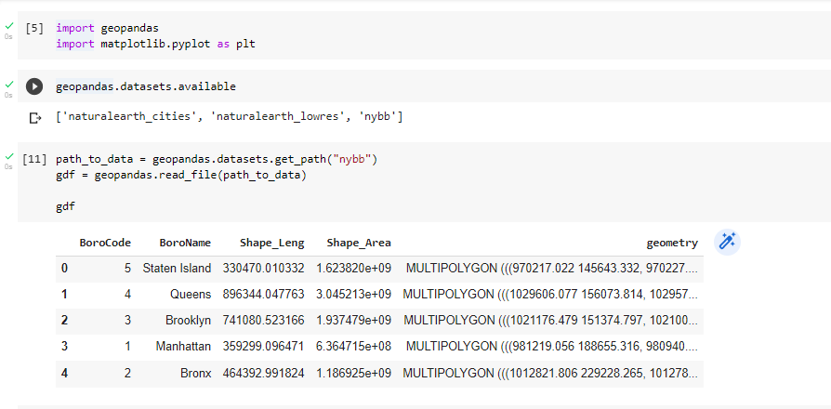
Reading files

Slide 6
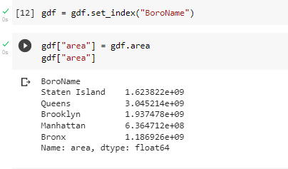
Measuring area

Slide 7
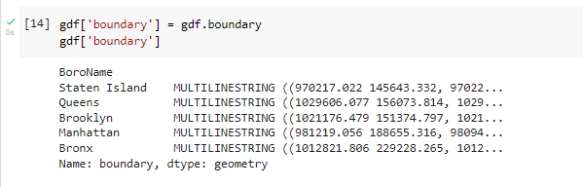
Getting polygon boundary

Slide 8
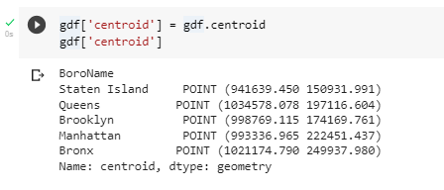
Getting polygon centroid

Slide 9
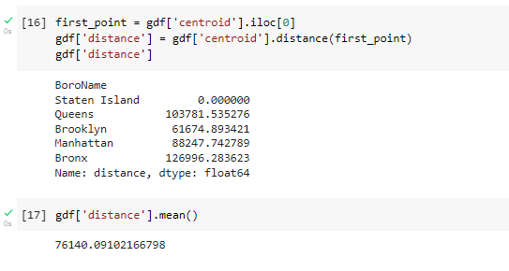
Measuring distance

Slide 10
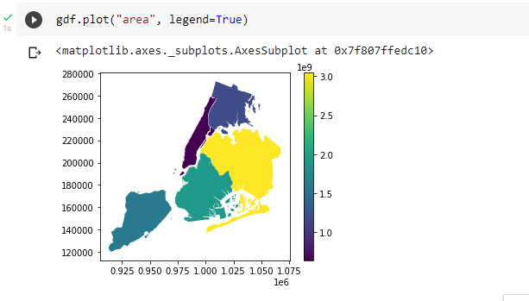
Making maps

Slide 11
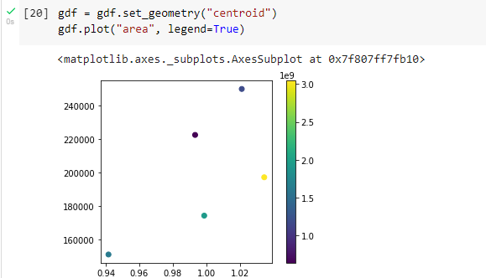
Switching the active geometry (GeoDataFrame.set_geometry) to centroids

Slide 12
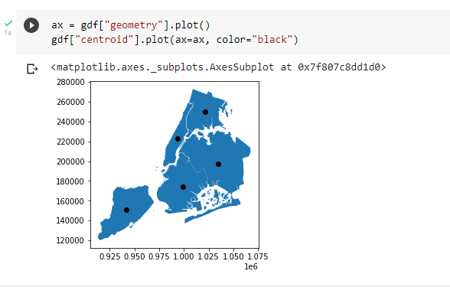
layer both GeoSeries on top of each other

Slide 13
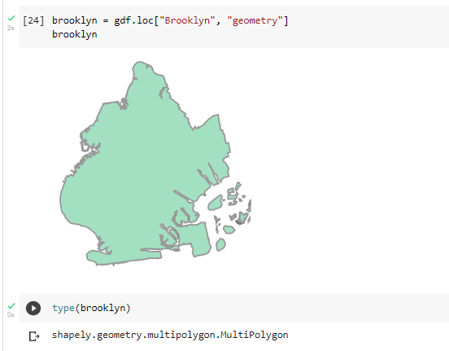
Geometry relations

Slide 14
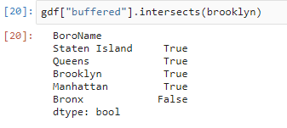
Intersect

Slide 15
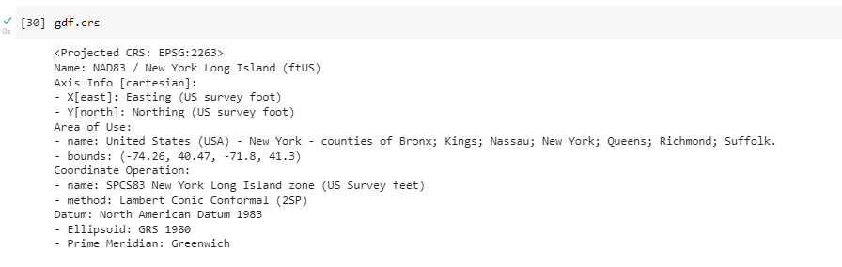
Projections
Each GeoSeries has its Coordinate Reference System (CRS) accessible at GeoSeries.crs. The CRS tells GeoPandas where the coordinates of the geometries are located on the earth’s surface.

Slide 16
Reference
https://geopandas.org/en/v0.10.2/getting_started/introduction.html#Concepts
https://towardsdatascience.com/interactive-geographical-maps-with-geopandas-4586a9d7cc10

