Slide 1

SMART INDIA HACKATHON 2026
TITLE PAGE
Problem Statement ID – SIH26178
Problem Statement Title- PS : A resilient, AI-powered environmental monitoring network that provides early detection, localized intelligence, and actionable alerts for floods, forest fires, pollution events, and other environmental hazards common in India, enabling authorities and communities to shift from reactive disaster response to proactive risk prevention.
Theme- Disaster Management
PS Category- Hardware
Team ID-
Team Name - Avengers

Slide 2
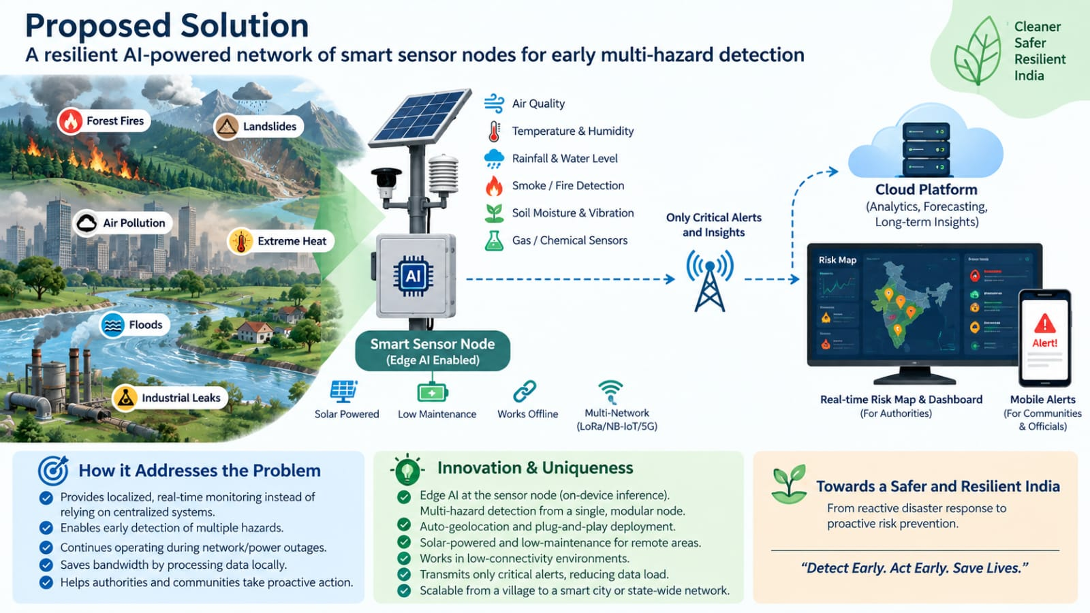
Resilient AI-Powered Environmental Monitoring Network For Early Multi-Hazard Detection
Avengers
PROPOSED SOLUTION
Smart environmental telemetry nodes combining
ESP32-S3 hardware, multi-parameter sensors
(DHT11, MQ-2), and local TinyML neural networks
paired with a real-time command dashboard for live
mapping and sensor visualization.
​Delivers zero-latency hazard detection, saves
Bandwidth by filtering noise locally, and ensures
continuous risk monitoring even during network
or power outages.
​Runs AI inference locally on low-cost
microcontrollers, features auto-geolocation without
manual setup, and provides offline resilience for
remote forest and disaster-prone zones.

Slide 3
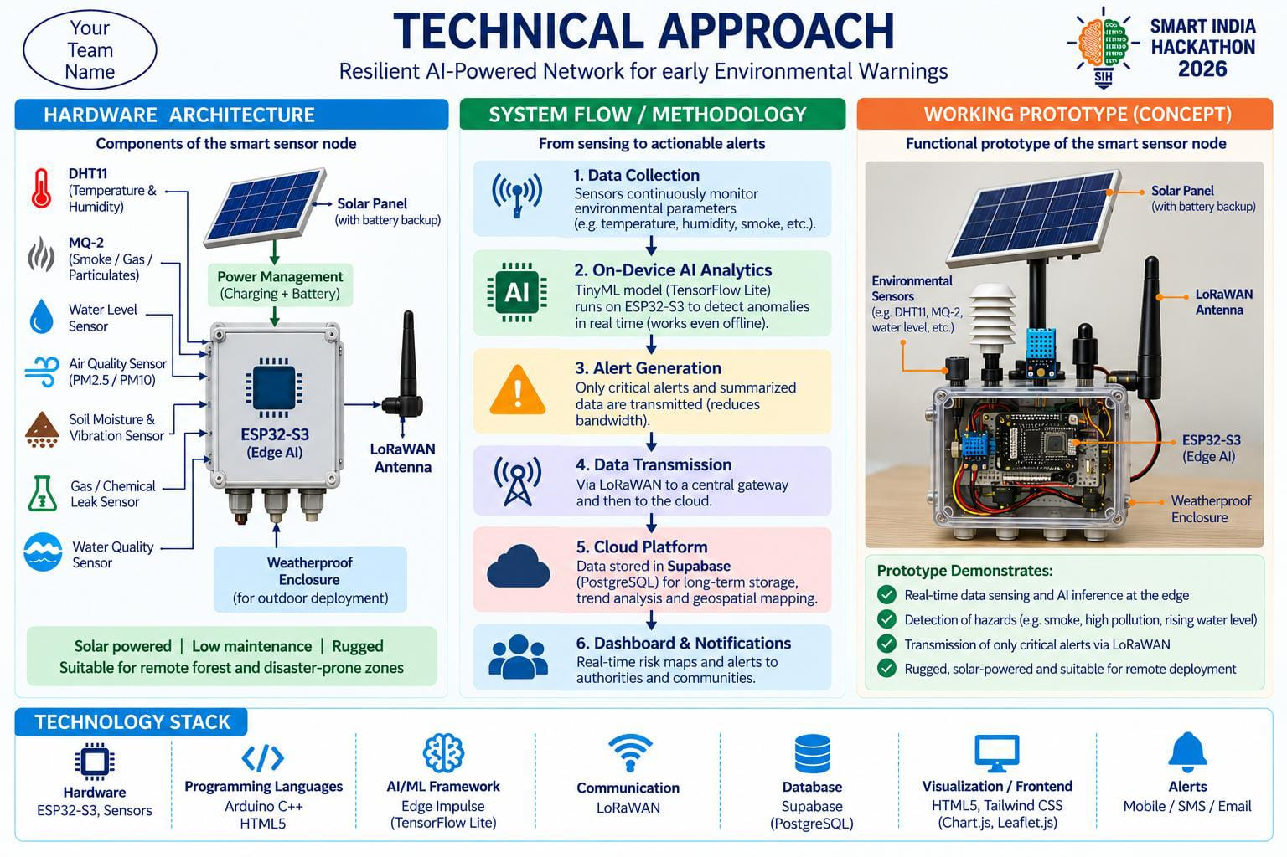
TECHNICAL APPROACH
Avengers
Prototype visual shown for representational purposes only; final implementation may vary.

Slide 4
FEASIBILITY AND VIABILITY
Avengers
Highly viable due to sub-$5 low-cost microcontrollers (ESP32-S3) and lightweight TinyML deployment, enabling affordable wide-scale network deployment.
Wi-Fi dependency and power grid limitations in deep remote forests, alongside harsh weather causing false triggers or hardware damage.
Integrating LoRaWAN for 10–15 km long-range offline mesh connectivity, adding solar charging with deep-sleep power cycles, and using multi-sensor fusion for 99.9% detection accuracy.
Technical: ESP32-S3 + TinyML enables real-time edge inference.
Cost: Low-cost hardware + solar power enables affordable deployment.
Connectivity: LoRaWAN enables long-range communication in remote areas.
Scalability: Supabase-based architecture supports large-scale deployment.
Reliability: Edge processing reduces bandwidth dependency and enables offline operation.

Slide 5
IMPACT AND BENEFITS
Avengers
​Empowers disaster authorities (NDMA, forest departments, local municipal councils) with localized early intelligence to shift from reactive disaster management to proactive risk prevention.
​Environmental & Social: Rapid real-time detection of forest fires, hazardous pollution, and flash floods reduces ecosystem destruction, saves human lives, and protects vulnerable local communities.
Substantially lowers cloud server bandwidth costs through on-chip Edge AI filtering, while low-cost hardware enables economical mass deployment across large states.
Faster Response: Real-time edge detection enables early, actionable hazard alerts.
Scalable Deployment: Modular architecture supports expansion from a few nodes to large-scale networks.
Planned future updates include developing online simulations for soil moisture, rainfall, and ground vibration to train TinyML models for flood and landslide prediction. This will be paired with ultrasonic water-level and vibration sensors to expand our current prototype into a full multi-hazard warning system.

Slide 6
RESEARCH AND REFERENCES
Avengers
Hardware & Edge AI Frameworks:
​Edge Impulse & TensorFlow Lite: Used for training and flashing neural networks locally on ESP32-S3 microcontrollers for real-time anomaly detection (https://studio.edgeimpulse.com/).
​Arduino C++ Runtime: Embedded execution engine for low-latency processing and local sensor
feature extraction (https://www.arduino.cc/en/software).
​Command Center & Data Pipeline Sources:
​Leaflet.js & Carto Dark Maps: Open-source JavaScript libraries used for real-time interactive GIS mapping and node tracking (https://leafletjs.com/).
​Chart.js Telemetry Engine: Dual-axis visualization library for plotting real-time sensor streams (Surface Temp & Smoke Index) (https://www.chartjs.org/).
​Supabase REST API & PostgreSQL:
Cloud backend infrastructure for lightweight JSON data transmission and live polling (https://supabase.com/).
​Disaster Management Standards:
​NDMA SACHET Portal Alignment: Integrates standard emergency warning protocols and risk assessment parameters for authorities (https://sachet.ndma.gov.in/).

