Slide 1
Seqeuntial Control and Loops
By Shirish

Slide 2
GOTO statements
A GOTO statement in PL/SQL programming language provides an unconditional jump from the GOTO to a labeled statement in the same subprogram.

Slide 3
Syntax
GOTO label;
.. ..
<< label >>
statement;

Slide 4
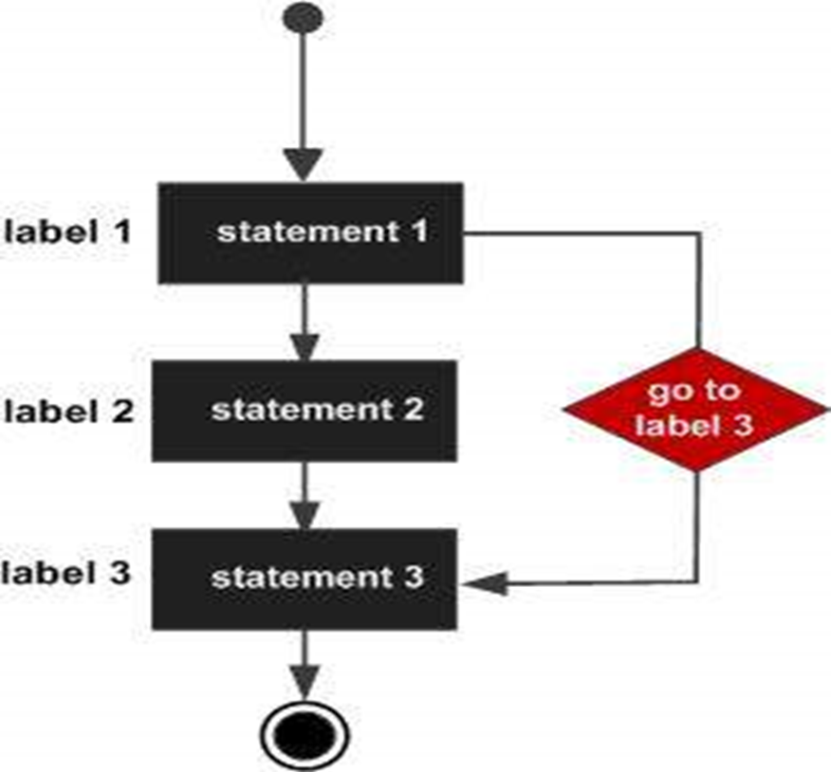
Flow Diagram

Slide 5
Example
DECLARE
a number(2) := 10;
BEGIN <<loopstart>>
-- while loop execution
WHILE a < 20 LOOP
dbms_output.put_line ('value of a: ' || a);
a := a + 1;
IF a = 15 THEN a := a + 1;
GOTO loopstart;
END IF;
END LOOP;
END;
/
OUTPUT:
value of a: 10
value of a: 11
value of a: 12
value of a: 13
value of a: 14
value of a: 16
value of a: 17
value of a: 18
value of a: 19

Slide 6
FOR Loop
A FOR LOOP is a repetition control structure that allows you to efficiently write a loop that needs to execute a specific number of times.

Slide 7
Example
DECLARE
a number(2);
BEGIN
FOR a in 10 .. 20 LOOP
dbms_output.put_line('value of a: ' || a);
END LOOP;
END;
/
value of a: 10
value of a: 11
value of a: 12
value of a: 13
value of a: 14
value of a: 15
value of a: 16
value of a: 17
value of a: 18
value of a: 19
value of a: 20

Slide 8
While Loop
A WHILE LOOP statement in PL/SQL programming language repeatedly executes a target statement as long as a given condition is true.

Slide 9
Example
DECLARE
a number(2) := 10;
BEGIN
WHILE a < 20 LOOP
dbms_output.put_line('value of a: ' || a);
a := a + 1;
END LOOP;
END;
/
Output
value of a: 10
value of a: 11
value of a: 12
value of a: 13
value of a: 14
value of a: 15
value of a: 16
value of a: 17
value of a: 18
value of a: 19

Slide 10
The End !!!!

