Slide 1
DRAW
Drug Review Analysis Work

Slide 2
Motivation
DRAW
Motivation
Progress Report
Future Work
Adverse side effects may not be detected before the product launches due to various limitations in clinical trials.
We can get easily overwhelmed by numerous reviews listed for symptoms and medicines available for any conditions.
There is no tool available in the market which provides such consolidated information at a single place.

Slide 3
Why this project is challenging?
DRAW
Motivation
Progress Report
Future Work
Analysis of patient review data on their drug experience is a challenging problem, as it requires good understanding of medicine market, and critical brainstorming on feature engineering and data analysis.
Reviews and opinion about drugs, treatments or side effects expressed in online media (Web 2.0 platforms like WebMD, Drugs.com, Druglib etc.) provides new opportunities for analyst to conduct aspect-based opinion mining and sentiment analysis.

Slide 4







Data Sources and Collection
Final Dataset

Slide 5
Current Status
DRAW
Motivation
Progress Report
Future Work
Data Collection
Data Filtering
Data Cleaning
Data Manipulation
Data Transformation
Initial EDA
Sentiment Analysis
Statistical Analysis
Prediction of Drug Rating
Future Work
WebMD
(n=362K)
Drugs.com
(n=215K)
Druglib
(n=4.2K)
Pending
Ongoing
Completed

Slide 6
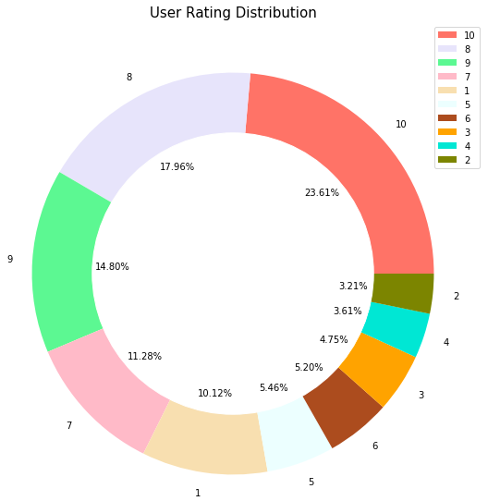
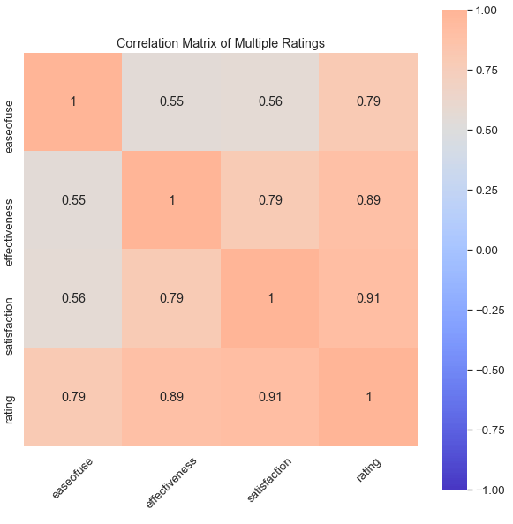
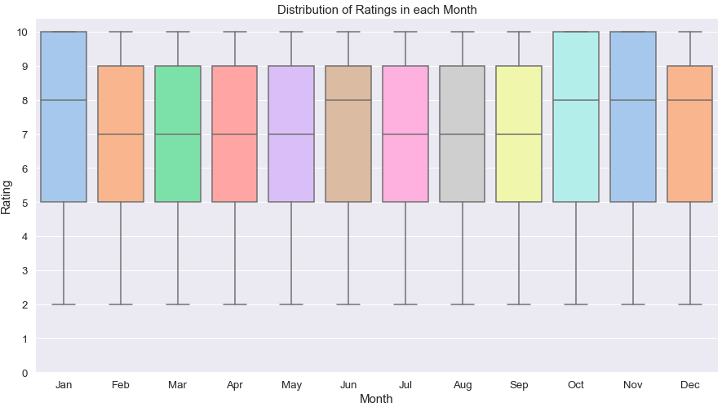
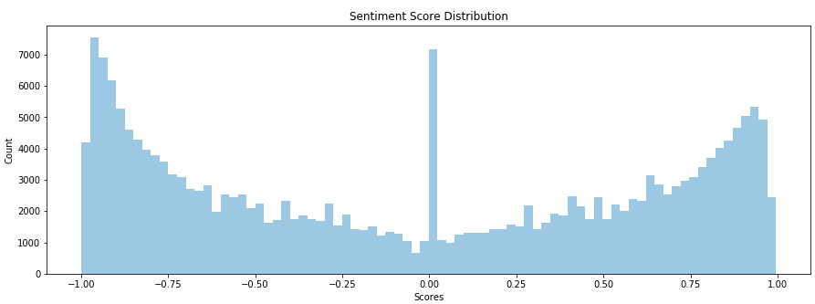
EDA Findings
User Rating Distribution
Distribution of Monthly Ratings
Correlation Matrix
Review Sentiment Score Distribution

Slide 7







Progress Report Timeline
DRAW
Motivation
Progress Report
Future Work
We Are Here
Feb 14
Feb 28
Mar 13
Project Proposal
Data Pre-Processing
EDA and Milestone
Finalizing project topic
Identfying Analyses
Decided Tech Stack
Data Filtering
Data Cleaning
Data Manipulation
EDA on individual data sources
Database completion (merging dataset)
Statistical and Sentiment Analysis
Presentation/Video Creation
Data Collection
Data Transformation
Future Work
Finding Data Sources
WebScrapping Data (WebMD, Drugs.com, Druglib websites)
Conditional Grouping
Jaccard Similarity
Fuzzy Matching
Feb 21
Mar 6
Till April 19

Slide 8




Future Work
DRAW
Motivation
Progress Report
Future Work
Mar 20
Apr 3
Apr 19
Machine Learning Techniques
Data Analysis
Report & Video
Drug Rating Prediction
Classification of Sentiments using NLP
Model Evaluation
Final Data Analysis
Data VIsualizations
Video submission
Report/Medium post
Recommendations
Product Creation
Developing Drug Recommendation System
Structuring Web App
Web App Creation
Finalizing Poster
Mar 27
Apr 10

Slide 9

Risk Mitigation
DRAW
Motivation
Progress Report
Future Work
Potential Risks
IMBALANCED DATASET
Unstructured and imbalanced data increases analysis complexity
CONDITION MISMATCH
Drugs and conditions mismatch due to diverse data sources hinders data uniformity
ACCURACY & CORRECTNESS
Building a drug recommendation system with higher accuracy and evaluating its correctness
LATENCY
Monitoring the latency of visualizations and results on the interactive web app

Slide 10
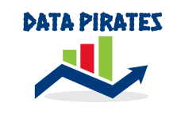
Data Pirates
Akash Singh Kunwar
Rohan Harode
Shubham Malik
Link to our repository -- https://csil-git1.cs.surrey.sfu.ca/akunwar/drug-review-analysis-work
YouTube presentation -- https://www.youtube.com/watch?v=azuqEHub7qE

Slide 11


