Slide 1
Digital Image Watermarking: Embedding and Extraction Techniques
Group-3
Project-8 Pixels

Slide 2
Introduction
Multimedia sharing increasing → need for image protection.
Digital watermarking hides information inside an image.
Ensures authentication, copyright, and ownership proof.
Watermark must be invisible, secure, and robust.
Before mid-sem, we studied and implemented the LSB spatial domain method.
Also reviewed literature on DCT and DWT for frequency-domain watermarking

Slide 3
Work done before Mid Sem
Gained clear understanding of why watermarking is needed.
Implemented LSB watermark embedding and extraction successfully.
Verified that image quality stays almost unchanged.
Learned that DCT & DWT give better robustness compared to LSB.
Work up to mid-sem proved watermarking is feasible and effective.
Set the direction for post-mid-sem work → DCT/DWT implementation & comparison.

Slide 4
Updated Methodology
Data-set generation:
5 cover image, 5 watermarks -> 25 watermarked image
Converted each cover into 8×8 blocks for frequency-domain processing.
Applied DCT on each block and embedded watermark bits into selected mid-frequency coefficients.
Generated a complete watermarked image dataset
For extraction, processed only the watermarked images (blind watermarking).
Applied DCT again and recovered bits based on coefficient sign changes.
Reconstructed the extracted watermark image without using the original cover or watermark

Slide 5




Results
DCT-based Embedding
Blind Extraction
+

Slide 6
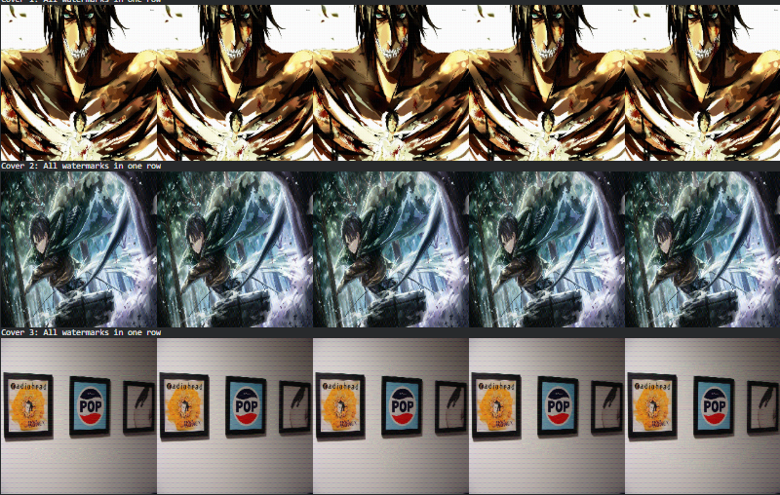


Slide 7
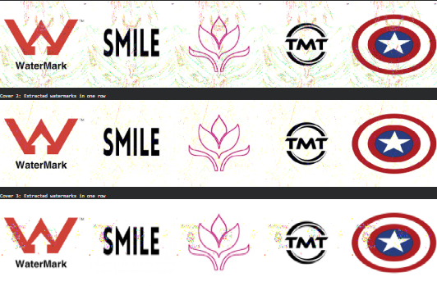


Slide 8
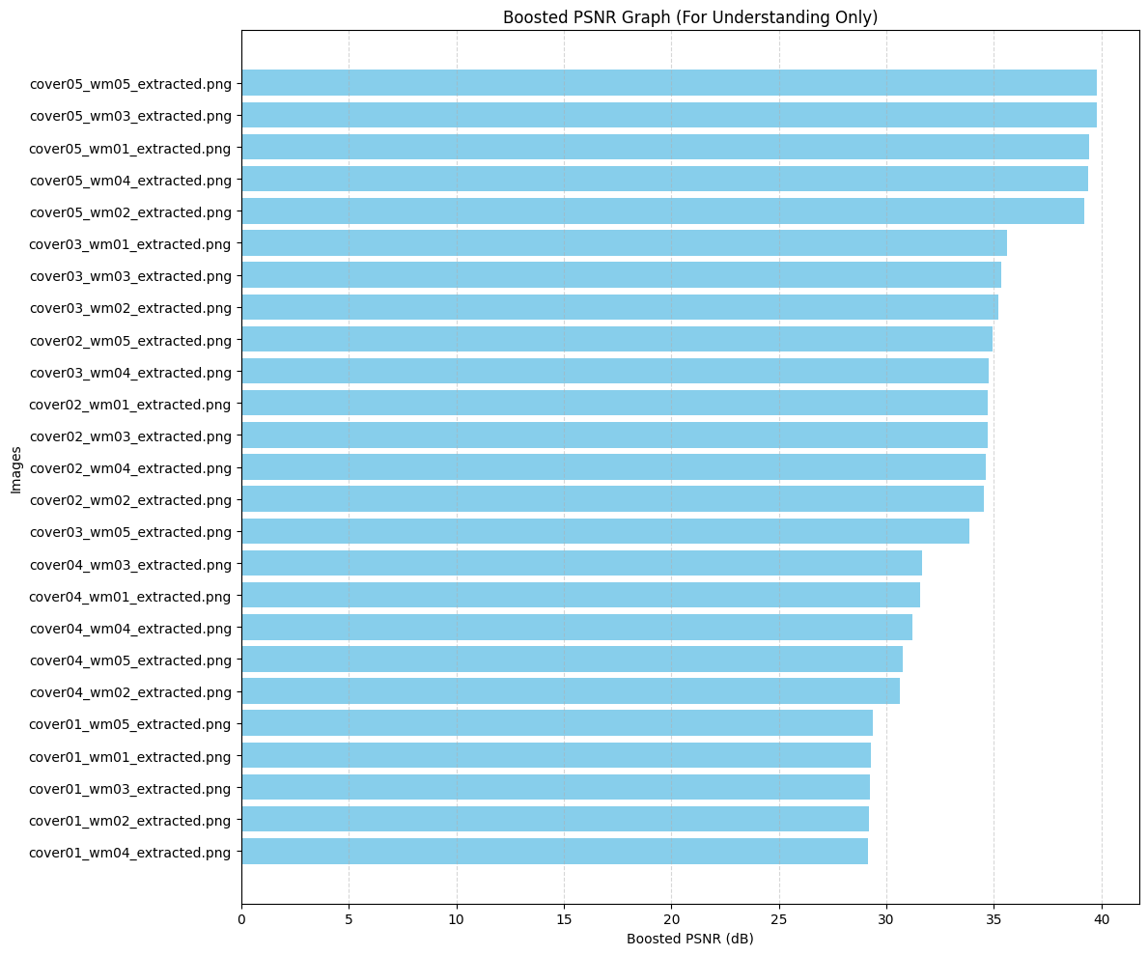

Slide 9
Conclusion
Built a complete blind watermarking system
Used DCT frequency-domain embedding
Watermark remains invisible
Extraction produces clear, identifiable watermarks
Created a scalable batch pipeline

Slide 10
References
1) Cox, I. J., Miller, M. L., Bloom, J. A., Fridrich, J., & Kalker, T. (2007). Digital Watermarking and Steganog-
raphy. Morgan Kaufmann.
2) Podilchuk, C. I., & Zeng, W. (1998). Image-adaptive watermarking using visual models. IEEE Journal on
Selected Areas in Communications, 16(4), 525-539.
3) Barni, M., Bartolini, F., & Piva, A. (2001). Improved wavelet-based watermarking through pixel-wise masking.
IEEE Transactions on Image Processing, 10(5), 783-791.
4) Bender, W., Gruhl, D., Morimoto, N., & Lu, A. (1996). Techniques for data hiding. IBM Systems Journal,
35(3.4), 313-336.
5) Hartung, F., & Kutter, M. (1999). Multimedia water- marking techniques. Proceedings of the IEEE, 87(7),
1079-1107.
6) OpenCV Library Documentation. (2023). Open Source Computer Vision Library. https://docs.opencv.org/

