Slide 1

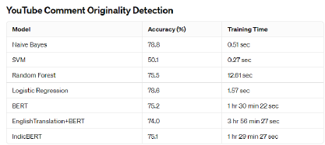
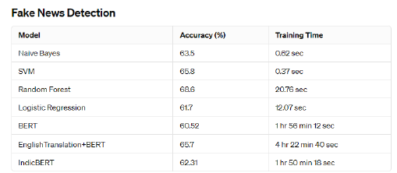
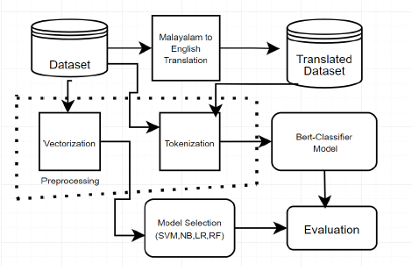
Multilingual Sentiment Analysis
Shubham Ojha – 20BCE1205
Dr. Rajalakshmi R
School of Computer Science and Engineering
INTRODUCTION
Multilingual sentiment analysis is crucial in understanding emotions across diverse linguistic landscapes.
This research focuses on leveraging multilingual sentiment analysis within Malayalam, a significant South Indian language.
Two Malayalam datasets are analyzed: one for discerning between original and fabricated YouTube comments, and another for classifying news content into five veracity levels.
Traditional classifiers like SVM, RF, Logistic Regression, and Naive Bayes are compared with state-of-the-art techniques such as BERT classifiers and the Indic BERT tokenizer.
The study aims to enhance sentiment analysis accuracy in Malayalam by integrating traditional and cutting-edge methodologies, contributing to the discourse on multilingual sentiment analysis.
OBJECTIVES
Evaluation of traditional machine learning algorithms (SVM, RF, Logistic Regression, Naive Bayes) for sentiment classification on Malayalam datasets, focusing on discerning between original and fake sentiments in YouTube comments and categorizing news articles into five veracity levels.
Adaptation and fine-tuning of BERT-based deep learning models for sentiment analysis of Malayalam text, exploring methodologies like direct BERT classification, translation via Helsinki-NLP pipeline, and Indic BERT tokenizer for language-specific tokenization.
Comprehensive comparison of approaches' effectiveness in sentiment analysis through metrics such as accuracy, precision, recall, and F1-score, aiming to identify the most reliable method for Malayalam sentiment analysis and delving into the efficacy of machine learning vs. deep learning in detecting fake comments and classifying news articles.
SCOPE OF THE PROJECT
The scope of this project is to applying traditional and deep learning methods for sentiment analysis in Malayalam.
METHODOLOGY
Preprocessing
Clean and preprocess the Malayalam text data, including tokenization, stemming, and removal of stop words and special characters.
Traditional Machine Learning Models
Implement SVM, Random Forest, Logistic Regression, and Naive Bayes classifiers for sentiment analysis on the preprocessed data.
Deep Learning Models
Utilize BERT classifiers directly on the Malayalam text, translate Malayalam to English using the Helsinki-NLP pipeline before employing BERT, and apply an Indic BERT tokenizer for enhanced tokenization.
Model Evaluation
Evaluate the performance of each model using accuracy metrics and confusion matrices, comparing their effectiveness in detecting fake news and classifying YouTube comments.
ARCHITECTURE
RESULTS
CONCLUSION
This project concludes that traditional machine learning achieves the highest accuracy of 78.8% for YouTube comment classification (Naive Bayes) and 68.6% for fake news detection (Random Forest), surpassing the performance of deep learning methods such as BERT (75.2%) and English translation + BERT (65.7%) in Malayalam sentiment analysis.
CONTACT DETAILS
MAIL ID – shubham.ojha2020@vitstudent.ac.in
MOBILE NO - 8709647209
REFERENCES
Helsinki-NLP. (n.d.). opus-mt-ru-en. Hugging Face. Retrieved from https://huggingface.co/Helsinki-NLP/opus-mt-ru-en
AI4Bharat. (n.d.). indic-bert. Hugging Face. Retrieved from https://huggingface.co/ai4bharat/indic-bert
AI4Bharat. (n.d.). Indic-BERT-v1. GitHub. Retrieved from https://github.com/AI4Bharat/Indic-BERT-v1

