Slide 1



Olympic Insight Using Data Analytics
By :- Shubham Paitwar
Tools Used :- PowerBI
BUILT FOR THE COURT

Slide 2
Project Overview
Problem Statement
The Olympic Games generate a large amount of data related to athletes, countries, sports, events, medals, and participation. Analyzing this historical data manually can make it difficult to identify performance trends and meaningful patterns. This project uses Power BI and data analytics to transform Olympic data into interactive insights for better understanding and decision-making.
Project Objectives
Analyze medal trends across Olympic Games and countries.
Identify top-performing countries, athletes, and sports.
Evaluate athlete participation and performance by gender and age.
Analyze the impact of hosting the Olympic Games on medal performance.
Track the growth of sports and events over the years.
Expected Outcomes
Identify countries and athletes with the strongest Olympic performance.
Understand medal and participation trends over time.
Discover sport-specific and country-specific dominance.
Compare host vs. non-host medal performance.
Generate data-driven insights that can support strategic planning and athlete development

Slide 3
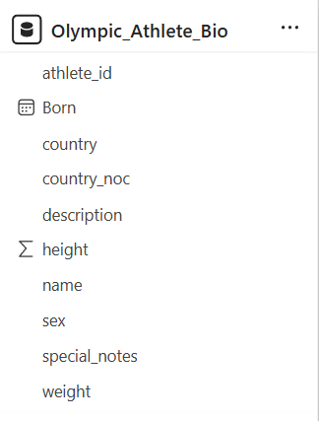
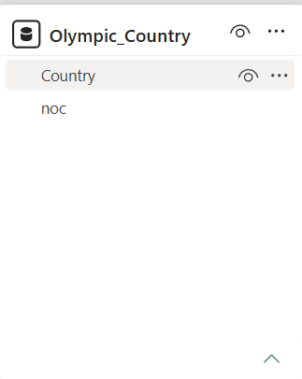
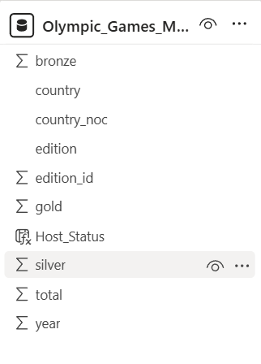
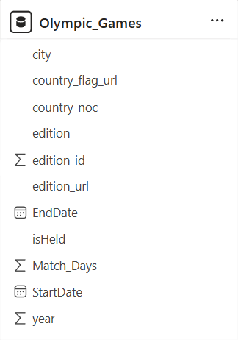
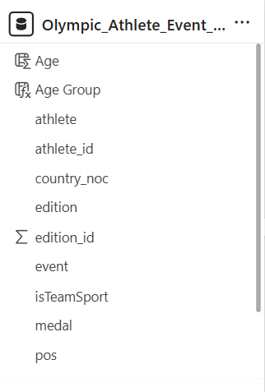
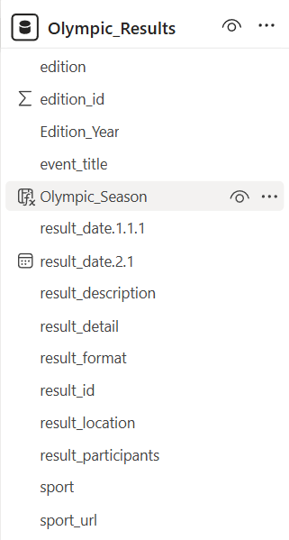
Dataset Overview
Source: Historical Olympic Games Dataset
Coverage: Multiple Olympic Games & Events
Includes: Athletes, Countries, Sports, Events & Medals
Key Attributes: Year, Athlete, Gender, Age, Country, Sport, Event & Medal
Tool Used: Power BI & Power Query
Purpose: Analyze Olympic performance and participation trends

Slide 4
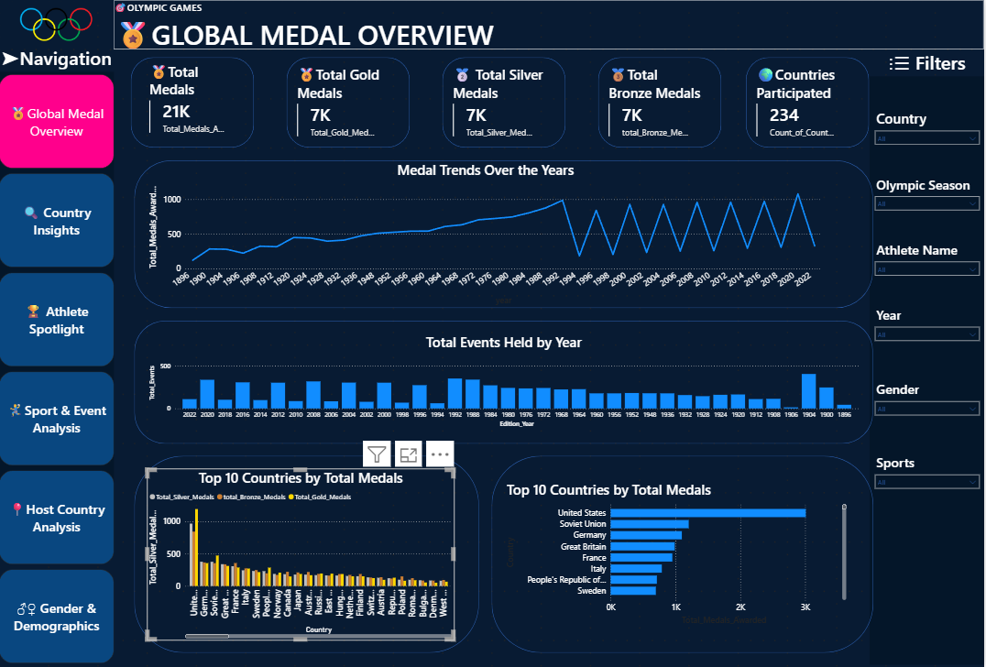
Dashboard Overview
Page 1: Global Medal Overview

Slide 5
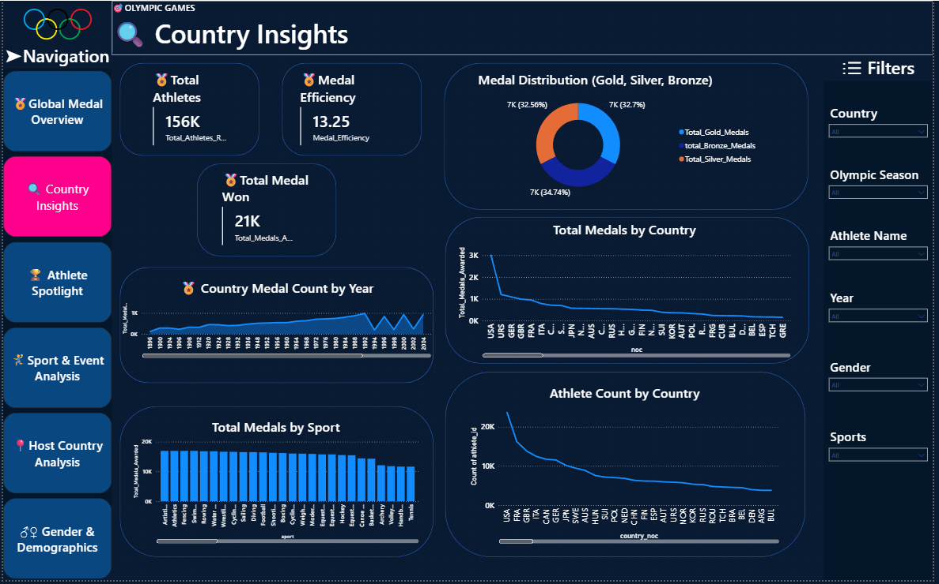
Page 2: Country Insights

Slide 6
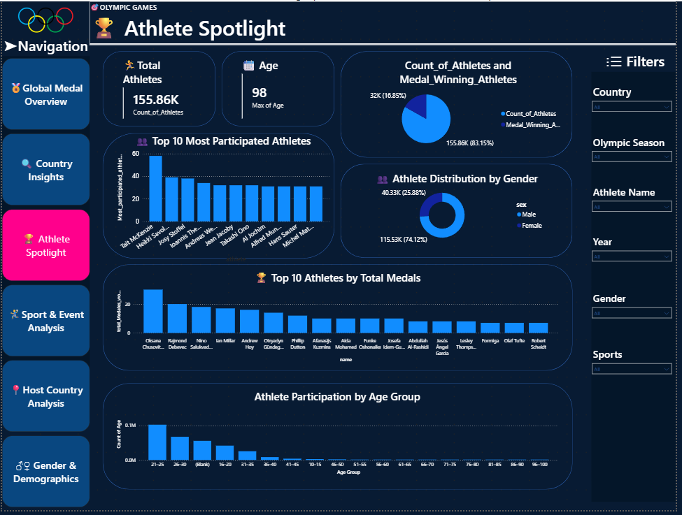
Page 3: Athlete Spotlight

Slide 7
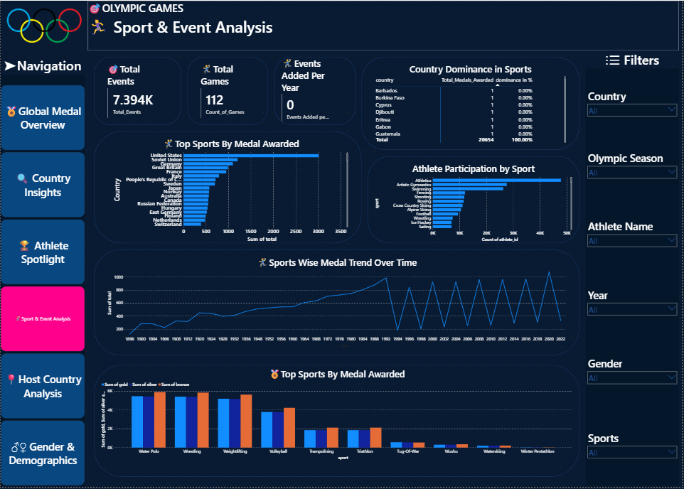
Page 4: Sports & Event Analysis

Slide 8
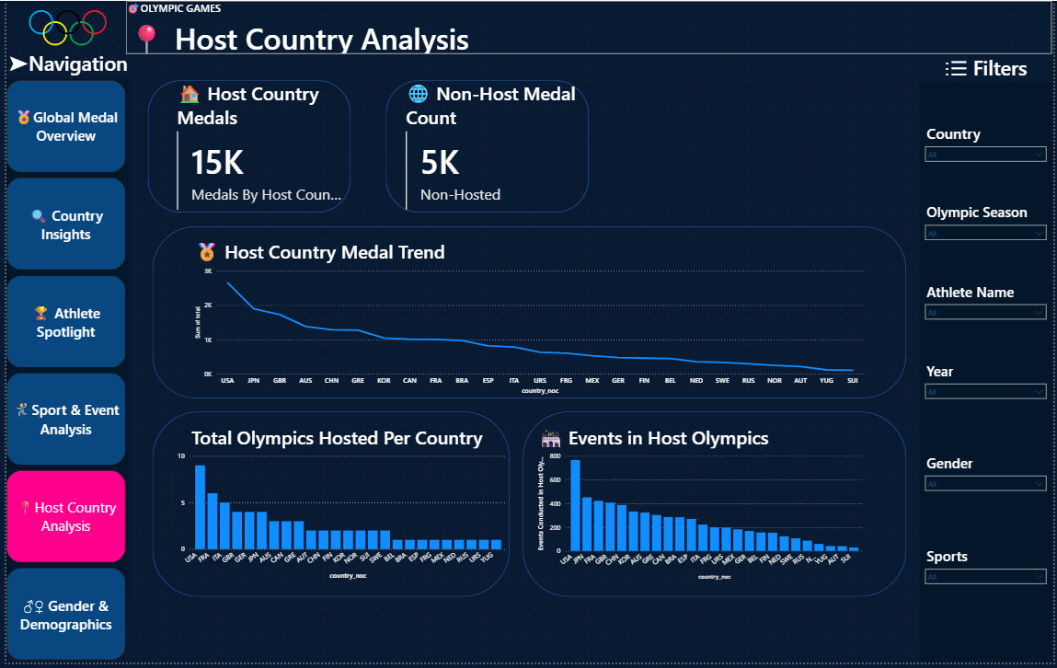
Page 5: Host Country Analysis

Slide 9
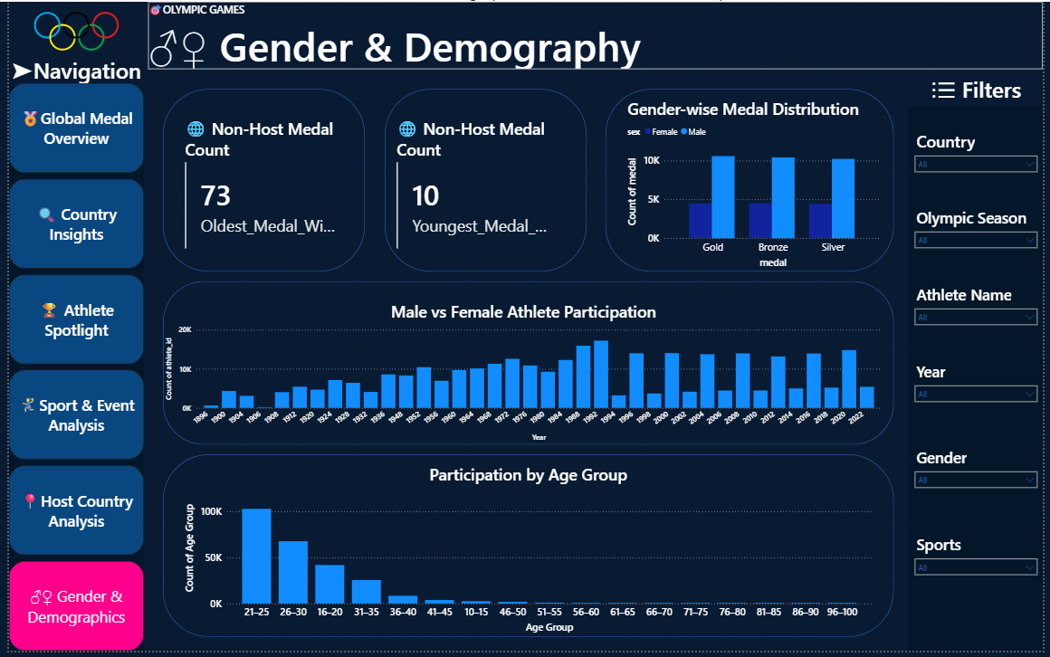
Page 6: Gender & Demography

Slide 10
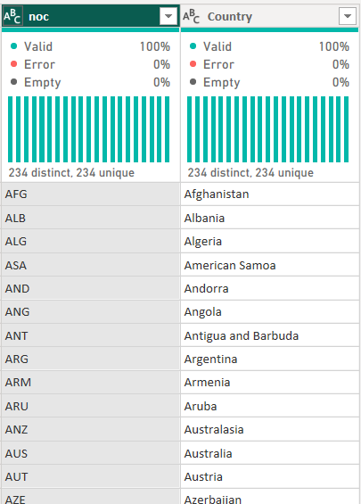
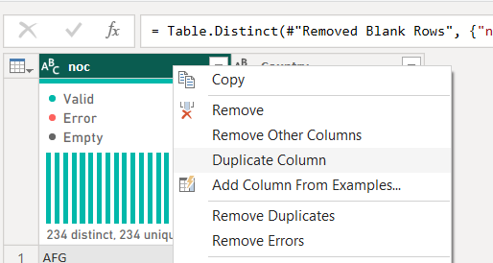
Data Cleaning and Preparation
Cleaning
Cleaned duplicate data by using “Power Query Editor” to clean duplicate value we selected primary key column

Slide 11
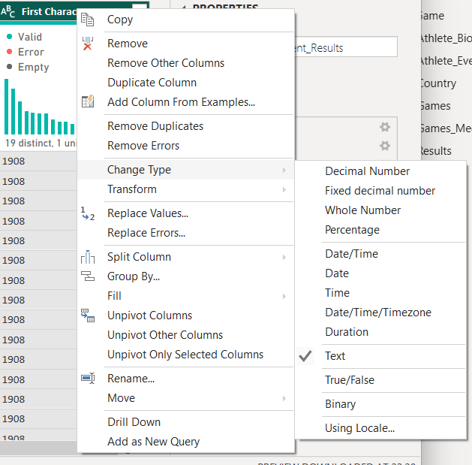
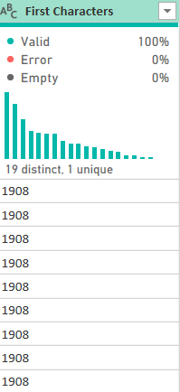
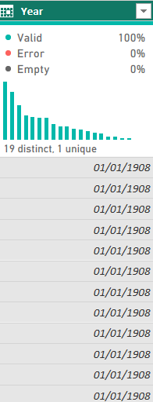
Standardizing Data Format
By using “Power Query Editor” we Standardized data format
In our case date was in text format therefore we changed its data type as date

Slide 12
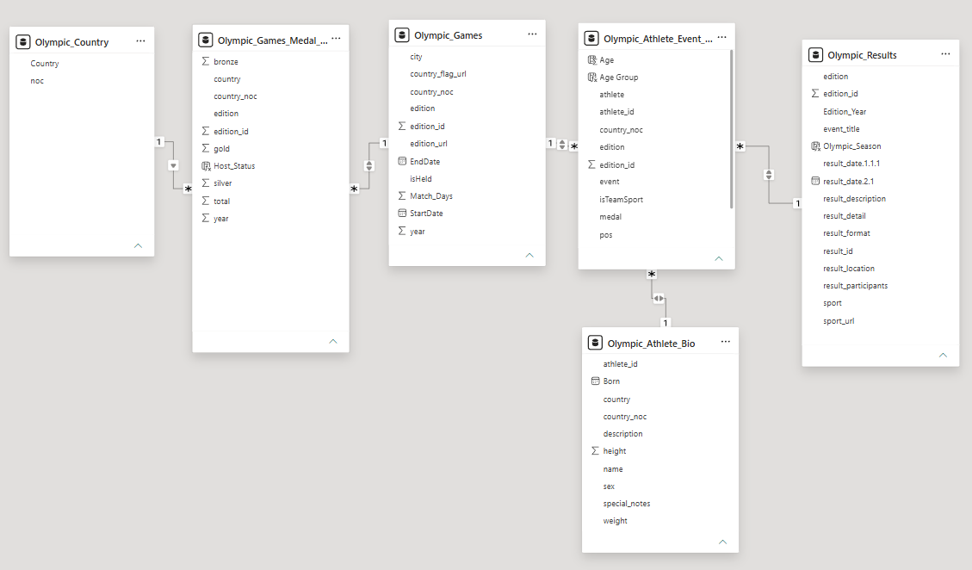
Data Model

Slide 13




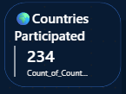
Page 1: Global Medal Overview
KPI’S
🏅Total Medals Distributed
21K medals were distributed among athletes across all Olympic Games.
🏅Total Gold Medals
7K Medals were distributed among athletes across all Olympic Games
🥈 Total Silver Medals Distributed
7K silver medals were awarded to athletes.
🥉 Total Bronze Medals Distributed
7K bronze medals were awarded to athletes.
🌍 Countries Participated
- 234 countries participated in the Olympic Games.

Slide 14
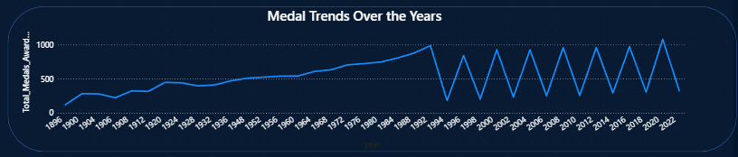
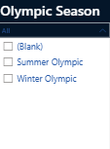
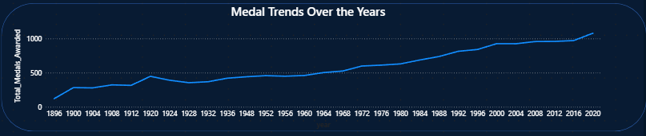
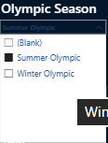
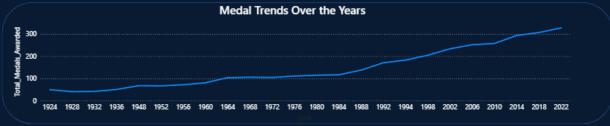

Medals Trends Over the Years
🏅 Medal Trend Analysis
When the Olympic Season filter is not selected, we can observe a significant difference between the Summer and Winter Olympic medal trends.
The overall trend shows noticeable fluctuations because the Summer and Winter Olympic Games are held in different years.
Summer Olympics distributed significantly more medals compared to the Winter Olympics.
This higher number of medals may indicate that more athletes and sporting events participate in the Summer Olympics compared to the Winter Olympics.

Slide 15
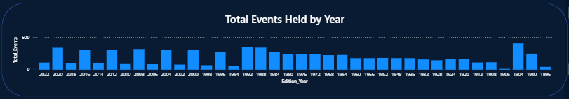
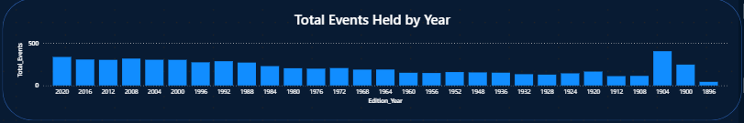
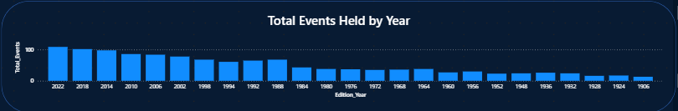
📅 Total Events Held by Years
When the Olympic Season filter is not selected, we can observe a significant difference between the Summer and Winter Olympic Events trends by years.
Summer Olympics distributed significantly more Events Held compared to the Winter Olympics.
☀️ Summer Olympics
1904 recorded the highest number of events, but it appears to be an outlier and does not represent the regular trend.
Excluding this outlier, 2020 recorded the highest number of events, with 336 events held.
The lowest number of events was recorded in 1896, with only 43 events.
Overall, the trend shows that the number of events has increased significantly over the years.
❄️ Winter Olympics
The lowest number of events was recorded in 1906, with only 13 events.
The highest number of events was recorded in 2022, with 109 events held.
The overall trend indicates a steady growth in the number of Winter Olympic events.
📅 Total Events Held by Years

Slide 16
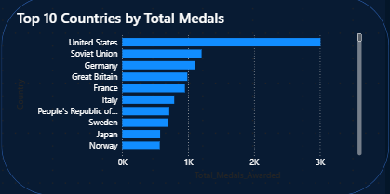
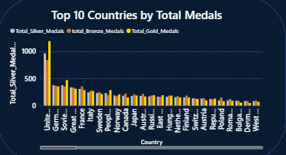
Top 10 Countries by medals
The United States dominates the Olympic medal standings with 3,009 medals, significantly ahead of the Soviet Union in second place with 1,204 medals. Germany ranks third with 1,098 medals.

Slide 17
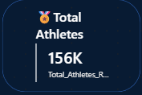
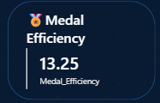
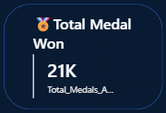
Page 2: Country Insights
KPI’S
🏅Total Athletes Participated
156K Total Athletes were participated among all Events and Olympic Games.
🏅Medal Efficiency
On average, 13.25 medals were won per participating country.
🏅Total Medals Distributed
21K Total medals were awarded to athletes.

Slide 18
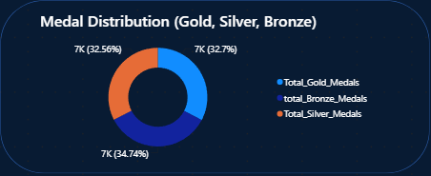
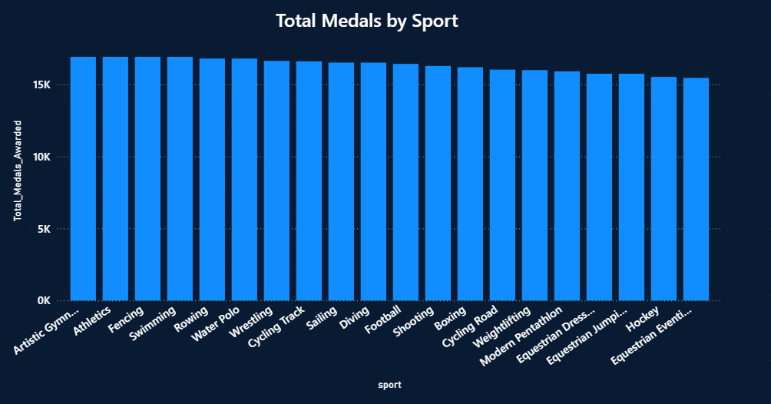
🏅 Medal Distribution: Gold, Silver & Bronze
-🥇 Gold Medals: 6,753 medals, contributing 32.70% of the total medals.
-🥈 Silver Medals: 6,725 medals, contributing 32.56% of the total medals.
-🥉 Bronze Medals: 7,176 medals, contributing 34.74% of the total medals.
🏆 Total Medals by Sports
Artistic Gymnastics, Athletics, Fencing, and Swimming jointly hold the 1st position, each with 16,912 medals.
Rowing and Water Polo share the 2nd position, with 16,790 medals each.
Wrestling ranks 3rd, with 16,628 medals.
- Among the sports with the lowest medal counts:
Skijoring: 41 medals
Dogsled Racing: 42 medals
Bandy: 67 medals

Slide 19
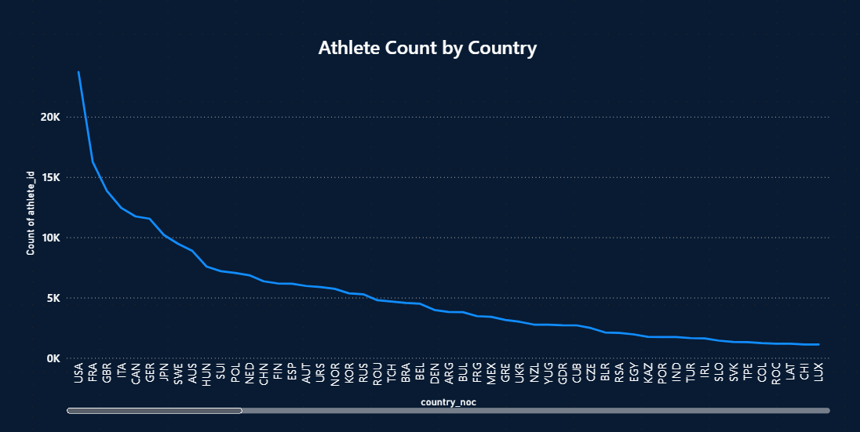
🌍Athlete Count by Country
👥 Athlete Participation by Country
The United States (USA) has the highest athlete participation, with 23,700 athletes.
France (FRA) ranks second, with 16,240 athletes.
Great Britain (GBR) ranks third, with 13,831 athletes.
Participation Lowest Athlete
NBO: 3 athletes
YMD: 5 athletes
SSD: 5 athletes
📊 Key Insight
- The United States has the highest athlete participation among all countries, followed by France and Great Britain, while NBO, YMD, and SSD recorded the lowest participation.

Slide 20
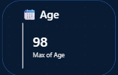
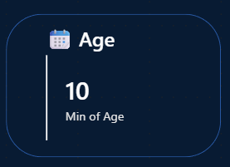
Page 3: Athlete Spotlight
KPI’S
🏅Total Athletes Participated
156K Total Athletes were participated among all Events and Olympic Games.
🏅Maximum Age
98Y is the maximum age of athlete who’s participated in event
🏅Minimum Age
10Y is the minimum age of athlete who’s participated in event

Slide 21
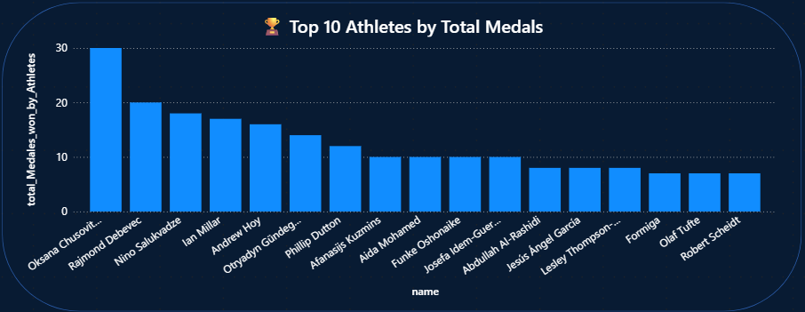
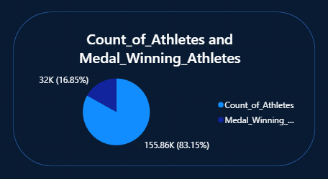
Top 10 Athletes by Total Medals
👥 Top 10 Athlete by total medals
Oksana Chusovitina ranks first in total medals, with an impressive 30 medals.
Rajmond Debevec ranks second with a total of 20 medals.
Nino Salukvadze ranks third with a total of 18 medals.
Medal-Winning Athletes vs Total Athletes
👥 Medal-Winning Athletes vs Total Athletes
A total of 32K athletes won medals, representing 16.85% of all participating athletes.
A total 155.86K athletes didn’t won medals, representing 83.15% of all participating athletes.

Slide 22
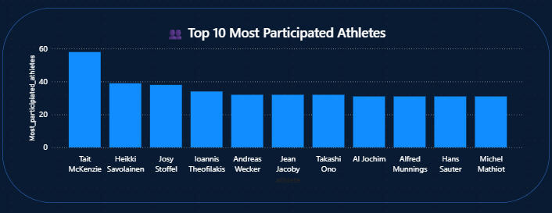
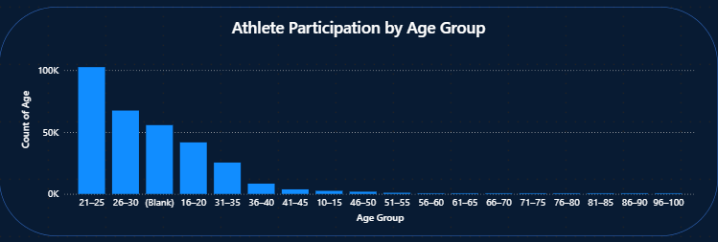
Most Participated Athletes (Olympic Appearances)
👥 Most Participated Athletes (Olympic Appearance)
Tait McKenzie hold the first rank as a most participated Athletes with an 58 time Participated
Heikki Savolainen holds 2nd rank as most participated athlete with an 39 times Participated
Josy Stoffel holds 3rd rank as most participated athlete with an 38 times participated
Athlete Age Distribution at Medal Wins
👥 Athlete Age Distribution at Medal Wins
The 21–25 age group holds the top rank in terms of participation
The 26–30 age group ranks second
followed by the 16–20 age group in third place
The 96–100 age group has the lowest participation, ranking last.

Slide 23
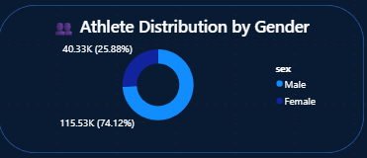
Gender Distribution of Medal Winners
Male athletes accounted for the majority of participation, with 115.53K athletes, representing 74.12% of the total participants.
Female athletes accounted for 40.33K participants, representing 25.88% of the total participation, highlighting a significant participation gap between male and female athletes.

Slide 24

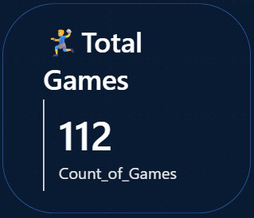


Page 4: Sport & Event Analysis
KPI’S
🎯Total Events
A total of 7.394K events were held across all Olympic Games and sporting categories.
🤾Total Games
A total of 7.394K events were held across 112 Olympic Games.
🤾Events Added per Year
In 1900, a total of 226 new events were added, based on the selected year in the slicer.

Slide 25
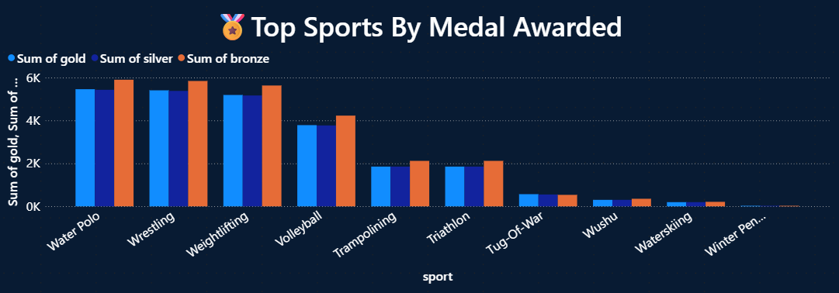
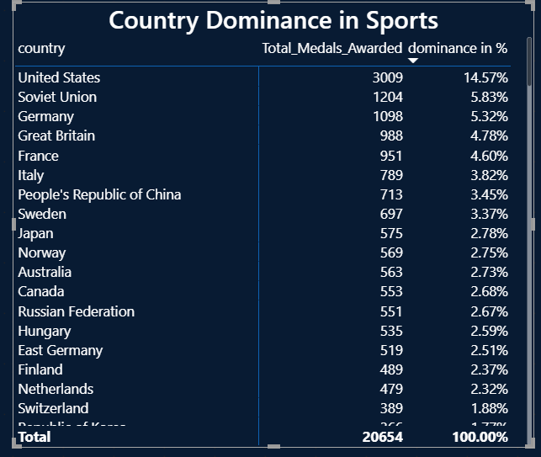
Top Sports by Medals Awarded
Water Polo ranks first in overall medal count, with 5,459 Gold medals, 5,431 Silver medals, and 5,900 Bronze medals.
Wrestling ranks second in the overall medal count, with 5,406 Gold medals, 5,380 Silver medals, and 5,842 Bronze medals.
Weightlifting follows closely, with 5,190 Gold medals, 5,166 Silver medals, and 5,631 Bronze medals.
The United States demonstrates the highest medal dominance, accounting for 14.57% of the total medals with 3,009 medals won. The Soviet Union follows with a 5.83% share and 1,204 medals, while Germany ranks third with a 5.32% share, winning 1,098 medals.
A total of 26 countries hold a medal dominance of 1% or more, collectively accounting for 82.14% of the total medals.
Among 234 participating countries, only 26 countries hold a medal dominance of 1% or more, collectively accounting for 82.14% of the total medals.
**The remaining 208 countries account for only 17.86% of the total medals, highlighting a significant concentration of medal dominance among a relatively small number of countries.**
Country Dominance in Sports

Slide 26
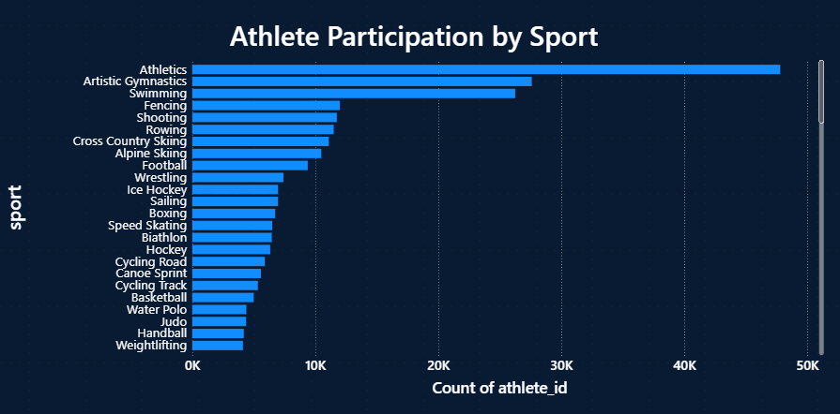
Sport-wise Athlete Participation
Athletics recorded the highest athlete participation, with 47,792 athletes, securing the first rank among all sports.
Artistic Gymnastics ranks second in athlete participation, with a total of 27,592 athletes.
Swimming ranks third in athlete participation, with a total of 26,246 athletes.
A total of 46 countries recorded athlete participation of 1,000 or more, highlighting their significant contribution to overall Olympic participation.
A total of 66 countries recorded fewer than 1,000 athlete participants, indicating comparatively lower levels of Olympic participation.
Out of 112 countries, 66 recorded fewer than 1,000 athlete participants, indicating comparatively lower levels of Olympic participation.

Slide 27
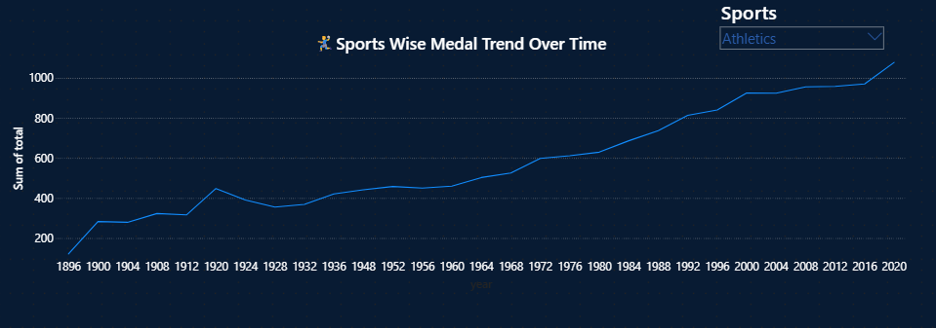
Sport-wise Medal Trends Over Time
Athletics shows a strong long-term upward trend in medal counts, increasing from approximately 120 medals in 1896 to nearly 1,100 medals by 2020. Despite some fluctuations across individual Olympic editions, the overall trend indicates significant growth in the number of medals awarded in Athletics over time.

Slide 28


Page 5: Host Country Analysis
KPI’S
🏠Host Country Medals
15k Total Medal count from host countries, which shows higher count as compare to non-host medal count
🌍Non – Host Medal Count
Approximately 5K medals were won by countries that did not host the Olympic Games.

Slide 29
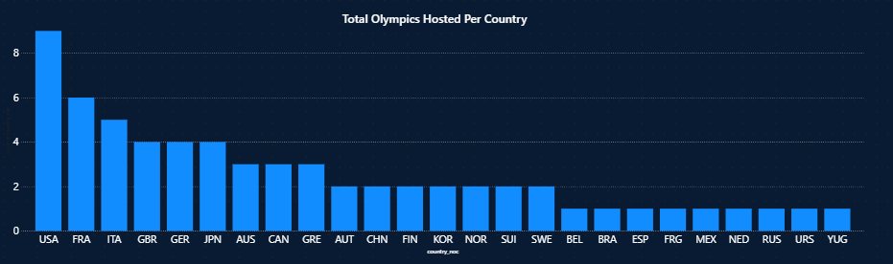
Total Olympics Hosted per Country
With 9 Olympic editions hosted, the USA stands as the most frequent host nation, while France and Italy follow with 6 and 5 editions, respectively.
The USA leads Olympic hosting with 9 editions, followed by France (6) and Italy (5), while most countries in the dataset have hosted the Games only once or twice, highlighting the concentration of Olympic hosting among a few nations.

Slide 30
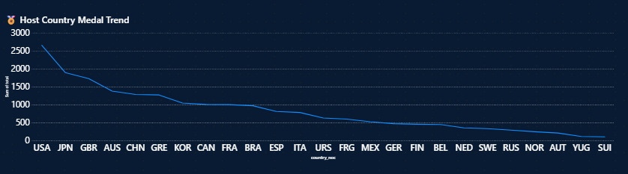
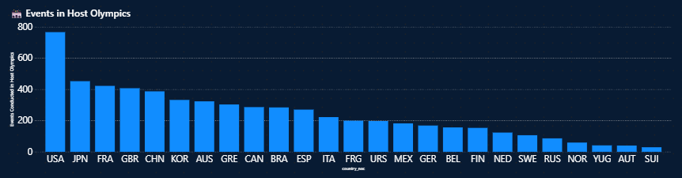
Host Country Medal Trend
The USA leads in medals won as a host country with 2,652 medals, followed by Japan with 1,894 and Great Britain with 1,727.
Events Conducted in Host Olympics
USA leads with 766 events conducted, followed by Japan (452) and France (422), while Switzerland recorded the lowest count at 29.

Slide 31


Page 6: Gender & Demographics
KPI’S
🏅Age of Youngest Medal Winner
The age of youngest medal winner is10Y only accounted
🏅Age of Oldest Medal Winner
The age of oldest medal winner is 73Y Accounted

Slide 32

Gender-wise Medal Distribution
Male athletes dominate the medal distribution across all categories, winning more than 10K medals each in Gold, Silver, and Bronze.
Female athletes have consistently lower medal counts, with approximately 4.5K medals in each category, highlighting a significant gender gap.
Gold medals show the largest gender difference, with 10,592 won by males compared to 4,480 by females.
Female medal distribution is highly balanced across Gold (4,480), Silver (4,446), and Bronze (4,513), with only minor variation.
A significant gender gap exists across all medal categories, with male athletes winning more than twice as many medals as female athletes, while female medal counts remain relatively balanced across Gold, Silver, and Bronze.

Slide 33

Participation by Age Group
Athlete participation is strongly concentrated in the younger age groups, with ages 21–25 ranking first (105,272), followed by 26–30 (67,449) and 16–20 (14,684). Participation declines significantly among older age groups, with the 61–65, 66–70, 71–75, 76–80, 81–85, and 86–90 age groups recording relatively low participation, while the 96–100 age group has the lowest count overall.
Participation peaks between ages 21–25 and gradually declines across older age groups, with athletes aged above 60 representing the lowest participation levels.

Slide 34
Conclusion
This project analysed old historical data to track previous records and forecast future outcomes for strategic planning and athlete development..
Key Findings:
The analysis of 234 countries, 112 Olympic Games, and approximately 156,000 athlete records provides valuable insights into Olympic participation and performance. Around 21,000 medals were awarded, while only 16.85% of athletes won a medal, highlighting the highly competitive nature of the Olympic Games.
The USA remains the leading country in total medals, while Athletics records the highest number of medals among sports. Athlete participation is highest in the 21–25 age group and gradually declines after age 30. Female participation has also increased significantly over time, moving closer to gender parity.
The analysis further highlights a strong host-country advantage, with host nations winning significantly more medals when competing at home. For smaller countries, improving medal efficiency rather than simply increasing team size may be a more effective strategy.
Overall, the dashboard demonstrates how data analytics can support athlete development, gender equality, strategic planning, and performance improvement. Future analysis can include forecasting models to predict participation, medal trends, and athlete performance, helping sports organizations make more informed decisions.

Slide 35
Final Recommendation
Based on the analysis and forecasting results, Olympic organizations and national committees should focus on improving medal efficiency, athlete development, and long-term participation.
Invest in early talent identification and athlete development, particularly before the age of 21.
Provide better training, financial support, and sports science resources to retain athletes in the 26–30 age group.
Encourage greater female participation to support the continued progress toward gender equality.
Smaller countries should focus on improving medal efficiency by investing in high-potential athletes and sports rather than simply increasing team size.
Host nations should use the identified home advantage to strategically plan athlete preparation and maximize performance during hosted Olympic Games.
Host nations should use the identified home advantage to strategically plan athlete preparation and maximize performance during hosted Olympic Games.
These recommendations demonstrate how historical Olympic data and future forecasting can support more effective, data-driven strategic decisions for athletes, national committees, and Olympic organizations.

Slide 36




THANK YOU
+91 7972585147
shubhampaitwar1@gmail.com

